Slide 1
Hardening OS
Secure Compilation Options Usage and Hands-on….
Bharath M
(@bharath1940)

Slide 2
Agenda
Why Hardening?
What Options
Some Examples
Other Platforms Support

Slide 3
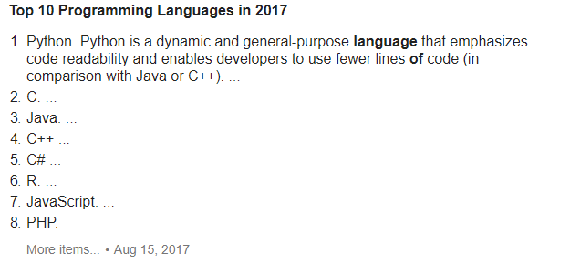
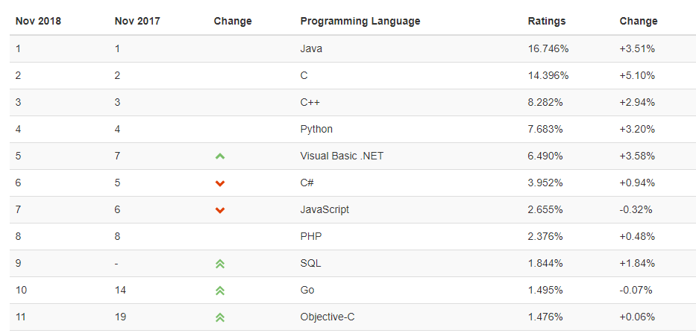
https://www.tiobe.com/tiobe-index//

Slide 4
Why Hardening?
Linux kernel – Vulnerability Stats
Source (CVE details) (1999 to 2017)

Slide 6
Source: Security Vulnerabilities in Modern Operating Systems,

Slide 7
Basic Requirements
Dev lan : C/C++
Compiler : GCC 3.4.3 and later , VS 2002 Later
OS : Linux Kernel 2.6 and later , xp sp2 and later , WindRiver , VxWorks 6.4 and later
Layer : Application, OS Modules, Platforms, Stacks , Shared Libraries, Any C /C++ Programs
BinUtils and GCC

Slide 8
Linux Platform
1.1 ASLR
How to Enable : System Configuration
Scope : heaps, stacks, memory mapping area (mmap base address, shared libraries, vdso pages)
Usage: echo 1 >/proc/sys/kernel/randomize_va_space
Note:
ASLR is a security against buffer overflow protection technology, through the heap, stack, and shared library mapping linear layout randomization, more difficult to forecast destination address by the attacker, attackers cannot directly locate the attack code, to prevent overflow attacks.
randomize_va_space is equal to 1, stack, data segment, and VDSO can randomize, randomize_va_space is equal to 2 block of addresses will be randomized.
The system enables the randomization protection flag is randomize_va_space is greater than or equal to 1
Suggestion: This parameter is mandatory. The value is a string.
Weight: 5

Slide 9
NX (or DEP) protects a system by not allowing arbitrary code execution on non-text pages
(stack/heap/data/BSS/etc, generically, on W^X pages)
But it cannot protect against attacks that invoke legal code – like [g]libc functions, system calls(as they’re in a valid text segment and are thus marked as r-x in their respective PTE entries)
● In fact, this is the attack vector for what is commonly called Ret2Libc and ROP-style
(ROP = Return Oriented Programming) attacks
● How can these attacks be prevented (or at least mitigated)?
– ASLR : by randomizing the layout of the process VAS (virtual address space), an attacker
cannot know (or guess) in advance the location (virtual address) of glibc code, system call
code, etc– Hence, attempting to launch this attack usually causes the process to just crash and the attack fails
– ASLR in Linux from early on (2005; CONFIG_RANDOMIZE_BASE), and KASLR from
3.14 (2014); KASLR is only enabled by default in recent 4.12 Linux kernels.

Slide 10
Note though:
– (K)ASLR is a statistical protection not an absolute one; it just adds an additional layer of
difficulty (depending on the # of random bits available; curr 9 bits used) for an attacker, but
does not inherently prevent attacks in any way
– Also, even with full ASLR support, a particular process may not have it’s VAS randomized
– Why? Because this requires compile-time support (within the binary executable too): the
binary must be built as a Position Independent Executable (PIE) [-no-pie -mforce-nopic
-fno-stack-protector etc]
● Process ASLR – turned On by compiling source with the -fPIE and -pie gcc flags
● Information leakage (for eg. a known kernel pointer value) can completely compromise the ASLR schema (example)
● Recent: a Perl script to detect ‘leaking’ kernel addresses added in 4.14 (commit; TC Harding)
– leaking_addresses: add 32-bit support : commit 4.17-rc1 29 Jan 2018
Suggested-by: Kaiwan N Billimoria <kaiwan.billimoria@gmail.com>

Slide 11
Linux Platform
1.2 Stack protection
Phase : Compilation Option
Scope : static or dynamic databases (Lib/DLL, ELF format executable program)
Usage : -fstack-protector
Note: Avoids Stack Overflow , How ? When Buffer and control info
(1) This parameter can be controlled by additional control protection code: --param ssp-buffer-size=4.
(2)windriver linux 4.3 + MIPS environment does not support this feature.
W : 3

Slide 12
#include <cstring>
void exploitable(char* bar)
{
char buffer[16];
strcpy(buffer, bar); // String 'bar' is directly copied into the buffer.
// This will overwrite adjacent data on the stack when
// 'bar' is longer than 16 bytes (including null terminator).
}
int main(int argc, char** argv)
{
exploitable(argv[1]); // User can pass a string of arbitrary length here.
return 0;
}

Slide 13
$ g++ -fstack-protector example.cpp -o example
$ ./example 0123456789 # Ok, string does not exceed buffer
$ echo $?
0
$ ./example 0123456789012345678901234 # String too long for buffer!
*** stack smashing detected ***: ./example terminated
======= Backtrace: =========
/lib64/libc.so.6(+0x7275f)[0x2b381cbd375f]
/lib64/libc.so.6(__fortify_fail+0x37)[0x2b381cc56467]
/lib64/libc.so.6(__fortify_fail+0x0)[0x2b381cc56430]
./example[0x4006a9]
./example[0x4006cd]
/lib64/libc.so.6(__libc_start_main+0xf5)[0x2b381cb82b05]
./example[0x400599]
======= Memory map: ========
...
Aborted

Slide 14
Linux Platform
1.3 GOT Table global Offset table
Phase : Link Option
Scope : dynamic library, ELF format executable program
Usage : (1) Some redirection read-only:-Wl,-z,relro
(2) redirect read-only:-Wl,-z,relro,-z,now
Dynamically linked ELF binary program calls the global offset table (GOT) lookup table to function in the dynamic resolution that resides in a shared library. The attacker using buffer overflow can modify GOT entry address of the function value to achieve the attack purpose. By RELRO option is added, you can prevent malicious GOT table is rewritten.
w:3

Slide 15
Linux Platform
1.4 Attack against Dynamic Library Search path
Phase : Link Option
Scope : dynamic library, ELF format executable program
Usage : -Wl,--disable-new-dtags,--rpath,/libpath1:/libpath2
protect LD_LIBRARY_PATH to overwrite the original attack of the dynamic library, the search takes precedence over the LD_LIBRARY_PATH path specified Executable files in the running stage of the dynamic database search first searches the --rpath path specified by the dynamic library, and then to the path specified by the LD_LIBRARY_PATH search .In this case, you can effectively defend against LD_LIBRARY_PATH =[attackpath] to overwrite the original dynamic library of the attacks

Slide 16
Linux Platform
1.5 Protect Stack from getting executed
Phase : Link Option
Scope : dynamic library, ELF format executable program
Usage : Wl,-z,noexecstack
After the buffer overflows are executed, attacker through shellcode will try to achieve the purpose of attack, and shellcode generally is in the buffer, as long as allowed by the operating system data only in the stack can be read and written,and cannot be executed. Once data is executed in the stack immediately reports an error and exits, the overflow is successful cannot be executed shellcode, And for application security protection purposes.
(1)windriver linux 4.3 common version does not support this feature.
(2)windriver linux 6 + MIPS does not support this feature
w : 5

Slide 17
Linux Platform
https://gcc.gnu.org/onlinedocs/gcc/Code-Gen-Options.html#Code-Gen-Options
1.6 Position Independent Code
Phase : Compilation Option
Scope : dynamic library (dll)
Usage : – fPIC(-fpic)
Generate position-independent code (PIC) suitable for use in a shared library, if supported for the target machine. Such code accesses all constant addresses through a global offset table (GOT). The dynamic loader resolves the GOT entries when the program starts (the dynamic loader is not part of GCC; it is part of the operating system). If the GOT size for the linked executable exceeds a machine-specific maximum size, you get an error message from the linker indicating that -fpic does not work; in that case, recompile with -fPIC instead.
(These maximums are 8k on the SPARC, 28k on AArch64 and 32k on the m68k and RS/6000. The x86 has no such limit.)
Position-independent code requires special support, and therefore works only on certain machines.
For the x86, GCC supports PIC for System V but not for the Sun 386i.
Code generated for the IBM RS/6000 is always position-independent.
-fPIC has nothing to do with -fpic all indicate GCC generates an address code.
The only difference is -fPIC generate code larger,-fpic generate code is relatively small.

Slide 18
Linux Platform
1.7 Position Independent Executable
Phase : Compilation Option
Scope : ELF executable
Usage : -pie-fPIE (-fpie)
The generated position-independent code can be only linked into executable.loading and executing can be loaded as random as a shared library
Research has shown that:PIE can effectively reduce fixed address attacks, buffer overflow attack success rate.
(1) conflicts with the hot patch function. Therefore, you are advised not to use hot patches products use this option.
(2)-fPIE compilation options,-pie link options.
(3)-fPIE generating code slightly larger,-fpie code is relatively small.

Slide 19
Linux Platform
1.8 Stack Protect:
Phase : Compilation Option
Scope : Static or dynamic library and ELF format executable program
Usage : -D_FORTIFY_SOURCE=2 -O2
Stack Protection and Buffer overflow protection by adding a canary

Slide 20
https://idea.popcount.org/2013-08-15-fortify_source/
https://access.redhat.com/blogs/766093/posts/1976213
https://access.redhat.com/blogs/766093/posts/1976213
https://gcc.gnu.org/ml/gcc-patches/2004-09/msg02055.html
Reading symbols from /usr1/Sem/a.out...done.
(gdb) disassemble fun
Dump of assembler code for function fun:
0x00000000004004ec <fun+0>: push %rbp
0x00000000004004ed <fun+1>: mov %rsp,%rbp
0x00000000004004f0 <fun+4>: sub $0x20,%rsp
0x00000000004004f4 <fun+8>: sub $0x110,%rsp
0x00000000004004fb <fun+15>: mov %rsp,-0x18(%rbp)
0x00000000004004ff <fun+19>: mov -0x18(%rbp),%rax
0x0000000000400503 <fun+23>: add $0xf,%rax rax = rsp + 0xf
0x0000000000400507 <fun+27>: shr $0x4,%rax
0x000000000040050b <fun+31>: shl $0x4,%rax
0x000000000040050f <fun+35>: mov %rax,-0x18(%rbp)
0x0000000000400513 <fun+39>: mov -0x18(%rbp),%rax
0x0000000000400517 <fun+43>: mov %rax,-0x8(%rbp) save rax in the stack frame
0x000000000040051b <fun+47>: leaveq
0x000000000040051c <fun+48>: retq
End of assembler dump.

Slide 21
usr1/Sem # gcc -fstack-protector fort.c
fort.c: In function ‘fun’:
fort.c:4: warning: incompatible implicit declaration of built-in function ‘alloca’
/usr1/Sem # gdb a.out

Slide 22
GNU gdb (GDB) SUSE (7.0-0.4.16)
Reading symbols from /usr1/Sem/a.out...done.
(gdb) disassemble fun
Dump of assembler code for function fun:
0x000000000040056c <fun+0>: push %rbp
0x000000000040056d <fun+1>: mov %rsp,%rbp
0x0000000000400570 <fun+4>: sub $0x20,%rsp
0x0000000000400574 <fun+8>: mov %fs:0x28,%rax Store Canary using fs
0x000000000040057d <fun+17>: mov %rax,-0x8(%rbp) Save it in Stack Canary
0x0000000000400581 <fun+21>: xor %eax,%eax Clear Registers
0x0000000000400583 <fun+23>: sub $0x110,%rsp
0x000000000040058a <fun+30>: mov %rsp,-0x18(%rbp)
0x000000000040058e <fun+34>: mov -0x18(%rbp),%rax
0x0000000000400592 <fun+38>: add $0xf,%rax rax = rsp + 0xf
0x0000000000400596 <fun+42>: shr $0x4,%rax
0x000000000040059a <fun+46>: shl $0x4,%rax
0x000000000040059e <fun+50>: mov %rax,-0x18(%rbp)
0x00000000004005a2 <fun+54>: mov -0x18(%rbp),%rax Load Canary Back
0x00000000004005a6 <fun+58>: mov %rax,-0x10(%rbp)
0x00000000004005aa <fun+62>: mov -0x8(%rbp),%rax
0x00000000004005ae <fun+66>: xor %fs:0x28,%rax Compare Canary
0x00000000004005b7 <fun+75>: je 0x4005be <fun+82>
0x00000000004005b9 <fun+77>: callq 0x400468 <__stack_chk_fail@plt>
0x00000000004005be <fun+82>: leaveq
0x00000000004005bf <fun+83>: retq
End of assembler dump.

Slide 23
Linux Platform
1.9 non-exec memory segmentation (ExecShield)
Phase : Link
Scope : dynamic library
Usage : -z now
Stops execution of code in heap/stack. i386 specific (nx already does this for amd64),
and introduces some small level of performance loss (5% for CPU-bound). Some people have worked on getting it pushed into the mainline kernel. Current state unknown -- would be very handy to have due to the popularity of i386.
Some applications appear to break when run in the protected memory layout.
Most of these issues should be fixed due to RH (and SUSE?) already running with these protections.
Additional work for user-space is identifying programs that build assembly but fail to e
xplicitly mark their stack as non-exec (gnupg, for example).

Slide 24
Linux Platform
https://gcc.gnu.org/onlinedocs/gcc/Code-Gen-Options.html
https://stackoverflow.com/questions/435352/limiting-visibility-of-symbols-when-linking-shared-libraries
1.10 Dynamic Library Symbol Hiding
Phase : Link
Scope : dynamic library
Usage : -fvisibility=hidden ([default|internal|hidden|protected])

Slide 25
Linux Platform
1.11 Integer OverFlow Checks (Not there in Owasp)
Phase : Compilation
Scope : Static or dynamic library and ELF format executable program
Usage : -ftrapv
This option generates traps for signed overflow on addition, subtraction, multiplication operations. The options -ftrapv and -fwrapv override each other, so using -ftrapv -fwrapv on the command-line results in -fwrapv being effective.
Note that only active options override, so using -ftrapv -fwrapv -fno-wrapv on the command-line results in -ftrapv being effective.

Slide 26
#include<iostream>
#include<signal.h>
#include<limits.h>
/** g++'s -ftrapv flag provides some protection against integer overflows. It
* is a little awkward to use, though. All it will do is "trap" -- you must
* provide a signal handler to deal with it.
* (You must compile with -ftrapv for this to work)
*/
// a simple signal handler. it must take the signal as an argument, per
// signal.h, whether we use it or not.
void handler(int /*signal*/)
{
std::cout << "Overflow'd!" << std::endl;
}
int main()
{
// when we get a SIGABRT, call handler
signal(SIGABRT, &handler);
// LONG_MAX is the largest long integer on this system, from limits.h
long a = LONG_MAX;
int b = 1;
long c = a + b;
return 0;
}

Slide 27
Linux Platform
1.12 Delete the symbol table
Phase : Link
Scope : dynamic library and ELF format executable program
Usage : -s (strip)
During symbol link, play a vital role in linking process essentially multiple different target
files “ stick ” together at the same time, with the symbol can be regarded as link adhesives,
the linking process is based on symbols became correct and complete.
After the link is complete, the symbol table for executable file to run have no function,
instead will become an attacker constructs attack tools. Therefore, delete the symbol table can defend against hacker attacks.
In fact, delete the symbol table except attack defense, you can lose weight, reduce the file size of the file.
Will affect the locating of problems on the Field network.

Slide 28
Linux Platform
1.13 Warning Alarm
Phase : Compilation
Scope : Static or dynamic library and ELF format executable program
Usage : -Wformat=2
-Wfloat-equal
-Wshasow

Slide 29
Linux Platform
1.14 Stack protection
Phase : Compilation
Scope : Static or dynamic library and ELF format executable program
Usage : -fstack-check
Prevents the stack-pointer from moving into another memory region without accessing the stack guard-page.
The "-fstack-check" remediation has some expense.
It touches each page using a 4K stride to ensure the guard page is touched.

Slide 30
Linux Platform
https://stackoverflow.com/questions/26370839/what-exception-is-raised-in-c-by-gcc-fstack-check-option
https://insecure.org/stf/smashstack.html
https://gcc.gnu.org/onlinedocs/gccint/Stack-Checking.html
https://github.com/BharathMeduri/AdvancedMemoryChallenges

Slide 31
Other Platform
Android --------→ All Same
Windows
=======
GS(Buffer security Zone) , visual studio config
Data execution prevention (DEP) /NXCOMPAT : NO
VS2012 is used as an example. The procedure is as follows:
project-> attribute-> configuration attribute-> Linker-> command line and additional options, enter /NXCOMPAT can control whether to use the option.
Address Space Randamization (DYNAMICBASE)
:/DYNAMICBASE:NO
Choose Project-> attributes-> attribute-> linker-> Advanced-> Random.
SDL security dev lifecycle /SDL
ASLR

