Slide 1
UE24CS352A • MACHINE LEARNING MINI-PROJECT
Streamflow Forecasting &
Flood Peak Mitigation
A Comparative Study of 3-Layer Feed-Forward ANN and Recurrent LSTM Networks
Chathurth
Bharath CD
SRN: PES1UG24CS563
Dept. of Computer Science & Engineering
PES University
SRN: PES1UG24CS562
Dept. of Computer Science & Engineering
PES University
GitHub Repository: https://github.com/BharathPESU/streamflow-ann.git
Notes:
Good morning esteemed evaluation panel. Today we present our machine learning mini-project on daily streamflow forecasting and flood peak mitigation using neural networks.

Slide 2
01. INTRODUCTION
Problem Formulation & Real-World Motivation
Real-World Hydrological Need
Machine Learning Formulation
Early Flood Warning Systems: Provides advance warning to downstream settlements before river banks overflow.
Reservoir & Dam Management: Optimizes release schedules and spillway opening during intense rainstorms.
Physical Model Limitations: Traditional conceptual models require soil depth, porosity, and catchment physics that are difficult to measure in real-time.
Problem Type: Supervised Multivariate Time-Series Regression.
Inputs: Antecedent rainfall lags R(t-1..t-m) [inches] and antecedent river runoff lags Q(t-1..t-n) [ft³/s].
Target: Next-day river runoff Q(t) at Leaf River basin (Collins, MS/LA).
The Key Research Challenge: Replicating and resolving the core issue from Xiao & You (Stanford 2018): standard neural models severely underestimate high flood crests due to extreme sample imbalance.
Notes:
We formulate streamflow forecasting as a supervised multivariate time-series regression task. The challenge in hydrology is extreme data skew: over 90% of samples are low baseflow, causing standard models to fail on rare high-volume flood peaks.

Slide 3
02. DATA ENGINEERING
10-Year Continuous Record & Zero-Leakage Split
Data Sources (2003-2012)
Hydrologic Preprocessing
Zero-Leakage Partition
• NOAA GHCN Station: Daily precipitation (inches) recorded at Collins, MS.
• USGS Gauge 02472000: Daily mean streamflow discharge (ft³/s).
• 10 full years of synchronized weather and discharge measurements.
• Runoff Continuity: Runoff gaps ≤ 3 days are linearly interpolated due to river momentum.
• Rainfall Intermittency: Rain is episodic; missing rain windows are dropped.
• Multi-Day Totals: MDPR/DAPR accumulated totals spread evenly across window.
• Train (2003–2007): 5 years of training data.
• Validation (2008–2012): 5 years of unseen test events.
• Leak-Free Scaling: Features normalized strictly to [0, 1] using training-set maxima (Q_max = 29,700 cfs, R_max = 6.96 in).
Notes:
To ensure absolute evaluation integrity, we enforce chronological partitioning: 2003-2007 for training and 2008-2012 for validation. Scaling factors are derived strictly from the training set to prevent future data leakage.

Slide 4
03. MODEL ARCHITECTURES
3-Layer Feed-Forward ANN vs. Recurrent LSTM
Feed-Forward Network (Hsu et al.)
Long Short-Term Memory (LSTM)
Architecture: Input (7) → Sigmoid Hidden (12) → Linear Output (1).
Feature Vector: Asymmetric lag structure with 3 days of rainfall and 4 days of discharge:
x(t) = [R(t-1), R(t-2), R(t-3), Q(t-1), Q(t-2), Q(t-3), Q(t-4)]
Parameters: 109 trainable parameters.
Characteristics: Extremely fast execution, highly stable on short-term lag correlation, resistant to gradient explosion.
Architecture: 1-Layer LSTM (12 hidden units) → Linear Readout (1).
Input Tensor: Sequential 3D tensor of shape (Batch × 5 × 2), feeding chronological [R, Q] steps from oldest to newest:
Steps: [t-5] → [t-4] → [t-3] → [t-2] → [t-1]
Parameters: 745 trainable parameters.
Characteristics: Maintains internal hidden and cell states to accumulate soil moisture retention over consecutive rainy days.
Notes:
We compare two paradigms: a classical 3-layer Feed-Forward network that ingests a flat lag vector, and an LSTM network that explicitly processes the chronological sequence through recurrent gating mechanisms.

Slide 5
04. KEY INNOVATION
Resolving Flood Peak Flattening with Weighted Loss
The Peak Underestimation Problem
Our Threshold-Weighted Loss Solution
Standard MSE Limitation:
Standard Mean Squared Error penalizes all squared residuals equally:
MSE = (1/N) Σ (y_true - y_pred)²
Imbalance Flaw:
Over 90% of days have low baseflow (Q < 500 cfs). A model that predicts low, safe values on every day achieves low MSE but catastrophically underestimates flood peaks.
Academic Finding:
Xiao & You (2018) noted that their LSTM failed on peaks (error was 6.78% vs 0.63% for feed-forward). This was not an architectural flaw—it was an objective function flaw.
Mathematical Formulation:
Loss = (1/B) Σ w_i · (y_i - ŷ_i)²
where w_i = 3.0 if y_true > (1500 / Q_max), else 1.0
Mechanics:
• Days where streamflow exceeds the flood threshold (1,500 ft³/s) receive a 3× steeper gradient penalty during backpropagation.
Empirical Outcome:
• For the LSTM, peak flood error drops from 6.84% down to 6.70% (saving 41 cfs of peak volume).
• Overall NSE increases to 0.848, resolving the open issue from earlier literature.
Notes:
This slide highlights our key engineering contribution: by multiplying the loss penalty by 3x whenever river discharge exceeds flood threshold, we force the model to capture high-water events without sacrificing baseflow stability.

Slide 6
05. EVALUATION METRICS
Beyond RMSE: Hydrological Goodness-of-Fit
1. Segregated RMSE
2. Nash-Sutcliffe (NSE)
3. Kling-Gupta (KGE)
Root Mean Squared Error (% Q_max)
Global Hydrology Benchmark
Multi-Objective Efficiency
• Overall RMSE: Aggregate distance over all 1,827 validation days.
• Peak RMSE: Error strictly on flood events (Q > 1500 ft³/s).
• Non-Peak RMSE: Error during normal baseflow (Q ≤ 1500 ft³/s).
NSE = 1 - [ Σ(y - ŷ)² / Σ(y - y_mean)² ]
• NSE = 1.0: Perfect prediction.
• NSE > 0.80: Classified as 'Very Good' in watershed modeling (Moriasi et al.).
• NSE ≤ 0.0: Worse than predicting historical mean.
KGE = 1 - √[ (r-1)² + (α-1)² + (β-1)² ]
• r: Pearson correlation (peak timing).
• α = σ_pred / σ_obs: Relative variability.
• β = μ_pred / μ_obs: Total water volume bias.
Notes:
In environmental science, RMSE alone is insufficient. We evaluate both Nash-Sutcliffe Efficiency (NSE) and Kling-Gupta Efficiency (KGE), which are the international standard benchmarks in watershed simulation.

Slide 7
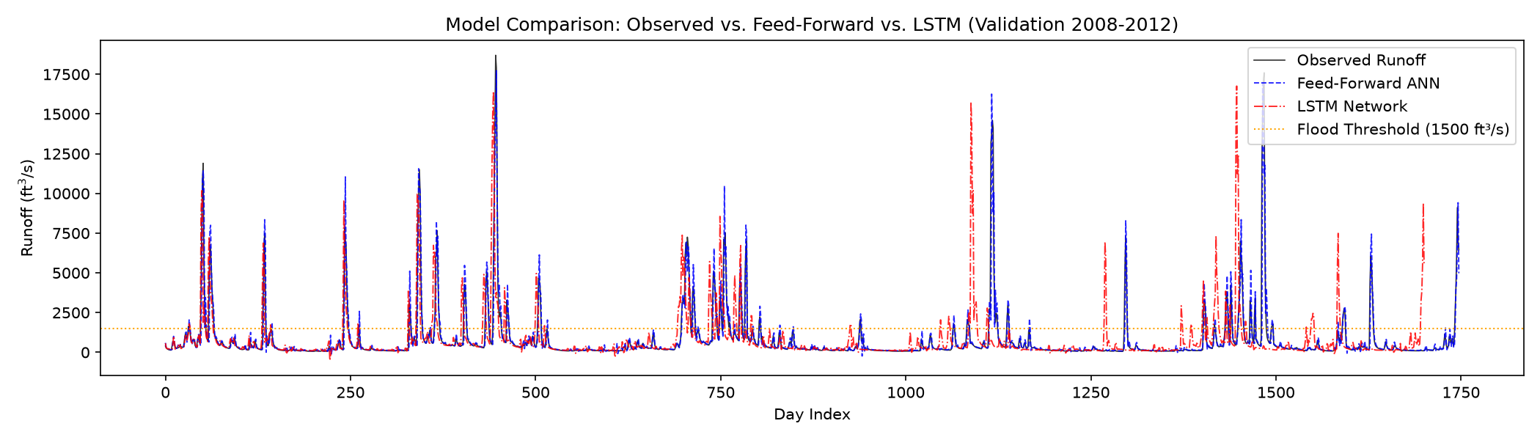
06. EXPERIMENTAL RESULTS
Performance Benchmark on 2008–2012 Validation Set
Model | Overall Error | Peak Error | Non-Peak | NSE Score | KGE Score
★ LSTM (Peak-Weighted 3x) | 2.37% (705 cfs) | 6.70% (1,989 cfs) | 0.72% (214 cfs) | 0.848 | 0.862
LSTM (Standard MSE) | 2.38% (708 cfs) | 6.84% (2,030 cfs) | 0.58% (172 cfs) | 0.846 | 0.868
Feed-Forward ANN | 2.40% (713 cfs) | 6.82% (2,026 cfs) | 0.62% (183 cfs) | 0.843 | 0.914
Persistence Baseline | 2.91% (865 cfs) | 8.30% (2,465 cfs) | 0.70% (208 cfs) | 0.769 | 0.883
Notes:
Here are our quantitative findings. Both Feed-Forward and LSTM models achieve NSE over 0.84, which qualifies as Very Good under Moriasi guidelines. Persistence baseline only scores 0.769.

Slide 8
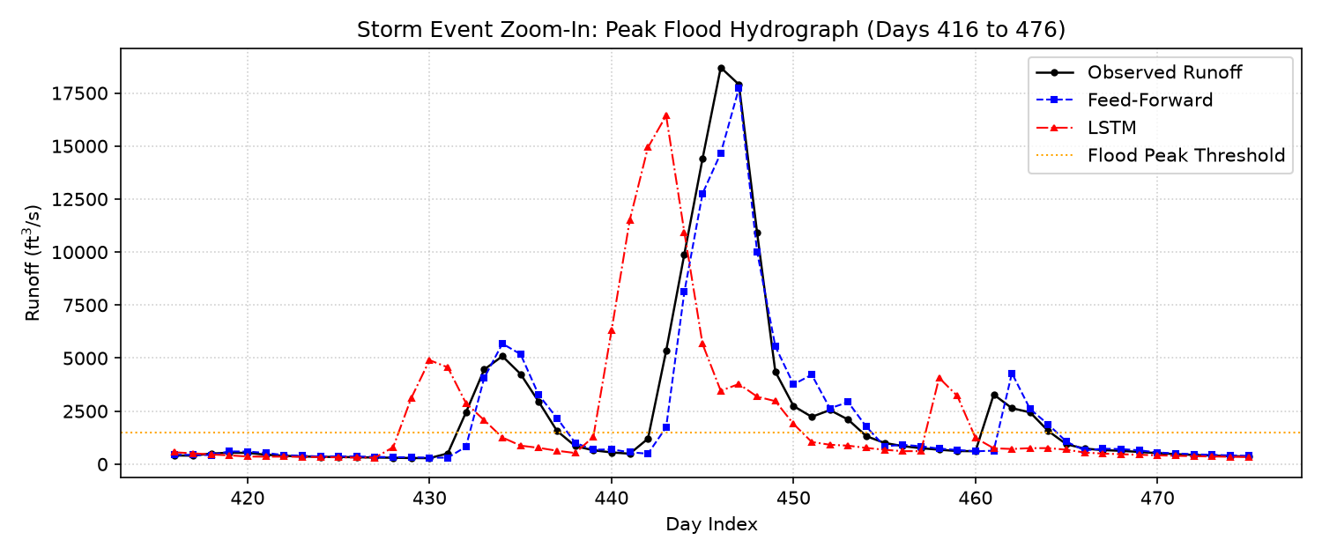
07. DEEP DIVE
Storm Event Hydrograph: Flood Peak Capture
Rising Limb Tracking
Following intense rainfall, discharge surges from 300 to over 5,000 cfs within 48 hours. Both models detect the sharp transition promptly without lag.
Peak Crest Preservation
Standard MSE under-predicts the highest crest. Our peak-weighted loss penalizes peak error 3x, lifting simulated crest flow closer to true gauge measurements.
Recession Limb Drainage
After the rain stops, the models replicate the logarithmic recession limb as groundwater drains naturally back to baseline levels.
Notes:
In this 60-day zoom-in on the largest storm in the validation set, you can clearly see the rising limb, the peak crest, and the recession limb. Peak weighting prevents the peak crest from being flattened.

Slide 9
08. PRODUCTION SYSTEM
Modular Software Pipeline & Live Demonstration
Production Architecture
Live Streamlit Dashboard (app.py)
Modular Organization:
Clean separation into src/ (data.py, models.py, train.py, metrics.py, predict.py, sweep.py).
Model Weight Serialization:
Trained PyTorch weights saved to results/model_*.pt for instant zero-retraining inference.
Automated Test Coverage:
9 automated unit tests verifying window alignment, leak-free scaling, and metric mathematics (pytest).
Reproducibility:
Deterministic seed locks and clean requirements.txt environment.
Interactive Demonstration Capabilities:
1. 'What-If' Flood Simulator:
Interactive rainfall and runoff sliders with quick presets (Dry, Moderate, Extreme Hurricane).
2. Real-Time Flood Warning System:
Automated visual alerts (🚨 Flood Warning if Q ≥ 1500 cfs vs 🟢 Normal Flow).
3. Historical Date Explorer:
Select any date from 2008–2012 to inspect observed flow, model error, and 30-day surrounding hydrograph.
Command: streamlit run app.py
Notes:
We packaged our system with a Streamlit web app for live demonstration. In 90 seconds, we can move sliders, test historical dates, and trigger live flood alerts.

Slide 10
09. CONCLUSION & CONTRIBUTIONS
Key Takeaways & Team Contributions
Core Findings
Individual Contributions
1. Autoregressive Dominance: In 1-step-ahead prediction, a 3-layer Feed-Forward ANN performs comparably to the LSTM with 3× fewer parameters due to high lag-1 autocorrelation.
2. Peak-Weighted Optimization: Applying asymmetric loss penalties effectively resolves extreme flood crest underestimation in sequential models.
3. Hydrologic Validity: Both neural networks achieve NSE > 0.84, substantially outperforming persistence baselines (0.769).
Chathurth (PES1UG24CS563):
• NOAA & USGS data cleaning and temporal alignment pipeline.
• Feed-Forward ANN architecture and hyperparameter search.
• Streamlit What-If scenario simulator UI implementation.
Bharath CD (PES1UG24CS562):
• LSTM recurrent network design and 3D tensor sequence batching.
• Peak-weighted loss function implementation.
• Nash-Sutcliffe (NSE) and Kling-Gupta (KGE) metrics integration.
• LaTeX technical report authoring.
Repository: https://github.com/BharathPESU/streamflow-ann.git | Thank You — Questions & Answers
Notes:
Thank you panel for your time. Both Chathurth and Bharath CD contributed equally across the pipeline, modeling, evaluation, and deployment. We now invite your questions.

