Slide 1

Building Application with serverless architecture
Done By:
Bharath Parthasarathy N01609484

Slide 2
Executive Summary
Overview of the application and its objectives
Architecture overview highlighting AWS services used
Implementation details including frontend, backend, and database
Achieved project objectives

Slide 3
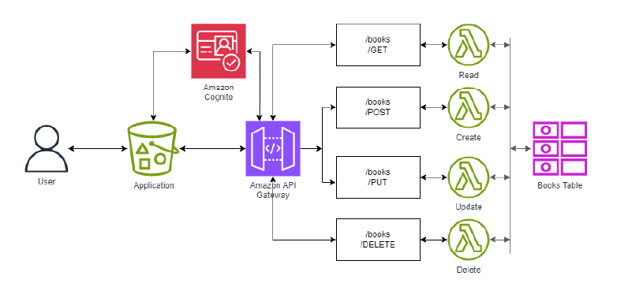
Introduction & Architecture
Introduction to ABCBooks and the need for a web-based application
Objectives of the new application

Slide 4


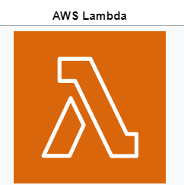




AWS Services

Slide 5

Languages used
HTML, CSS – UI Front end
JAVA SCRIPT – UI Front end
PYTHON – Lambda Backend

Slide 6
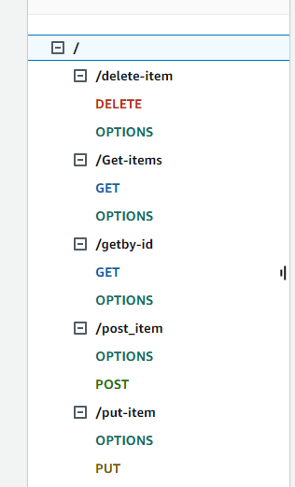
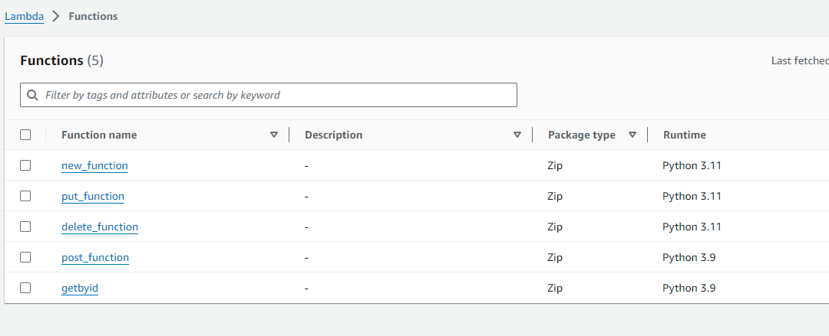
API Gateway & Lambda
API Gateway Methods
Lambda function

Slide 7
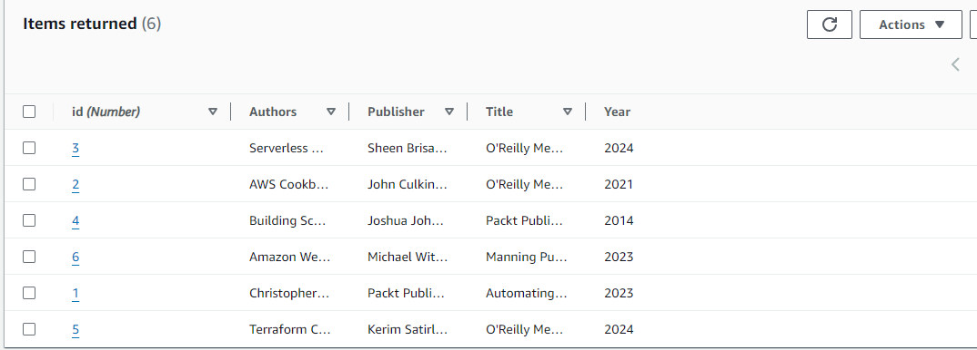
Dynamo DB

Slide 8
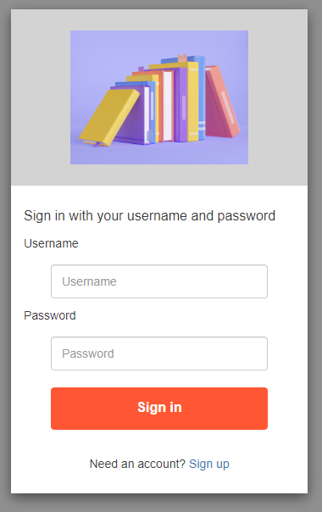
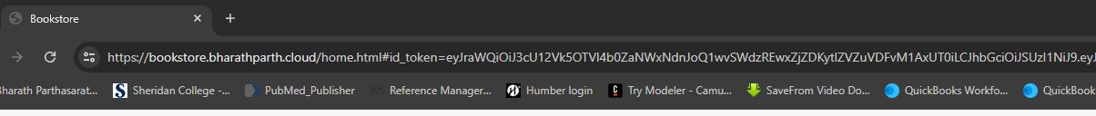
Cognito
User Authorization with Id token
Authentication

Slide 9
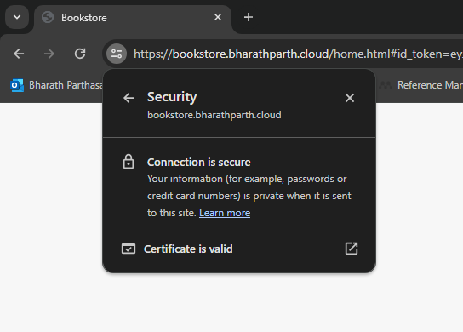
Route 53 & Cloud Front
Routing the DNS traffic from public domain – Route 53
Amazon Certificate Manager – Secure the website URL
Distributing the web content – CloudFront

Slide 10

Thank You

