Slide 1
AI Genie Capstone Project
Dataset – movie_metadata.csv
Columns :
Color,director_name,num_critic_for_reviews,duration,
director_facebook_likes,actor_3_facebook_likes,actor_2_name,actor_1_facebook_likes,
Gross,genres,actor_1_name,movie_title,num_voted_users,cast_total_facebook_likes,
actor_3_name,facenumber_in_poster,
plot_keywords,movie_imdb_link,num_user_for_reviews,language,country,content_rating,
Budget,title_year,actor_2_facebook_likes,imdb_score,aspect_ratio,movie_facebook_likes

Slide 2
Project Approach
I had built both the Regression and Classificaiton Model based on the requirement based on the previous slide.
Implemented Regression and predicted imdb_score the using given data set.
Splitted the data-set into Train and Test and predict the imdb_score for the test set and made a prediction of the Regression.
Built a Classification model on the column "imdb_score" as target and categorized this column into 3 classes based on its score like
if imdb_score is between 1 and 3 then class1 - Flop Movie
if imdb_score is between 3 and 6 then class2 - Average Movie
if imdb_score is between 6 and 10 then class3 - Hit Movie
Built, predicted and evaluated the model. Using different Classification algorithms and compare the result and chose the model based on high accuracy for this data-set.
Applied Data Wrangling where-ever it is necessary like removing duplicates, handling missing and NULL values etc.

Slide 3
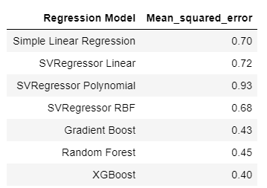
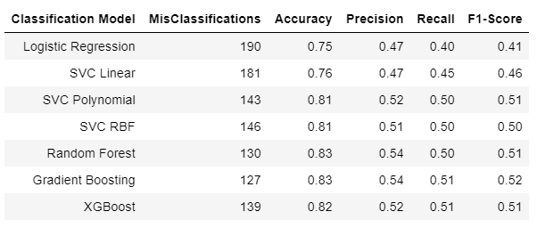
Results
All the details and the work flow of the models are clear in the jupyter notebook. Highly recommend to go through it.

