Slide 1
Group Presentation
PROGRAMME: MSC IN DATA ANALYTICS
LECTURER NAME: DR. SHAZIA A AFZAL
MODULE/SUBJECT TITLE: B9DA111/DATA STORAGE SOLUTIONS FOR DATA ANALYTICS
Group Members:
IHENACHO DANIEL CHIEBUKA – 20067317
MRUNAL SUNIL FULZELE - 20029230
BHARATH SHAKTHIVEL BALAIH RAVEENDRAN – 20057027

Slide 2
Introduction: The dataset
The dataset contains transaction of a global electronic retailer company from 2016 – 2021.
The source of the dataset is gotten from Maven Analytics

Slide 3
Introduction: VISION & GOALS
Vision: Create a suitable warehouse for OLAP operations which aids decision making for the Sales Manager.
Goals:
Develop a data warehouse
Generate insightful reports and visuals
Implement a Graph database
Compare the differences between SQL and CQL.

Slide 4
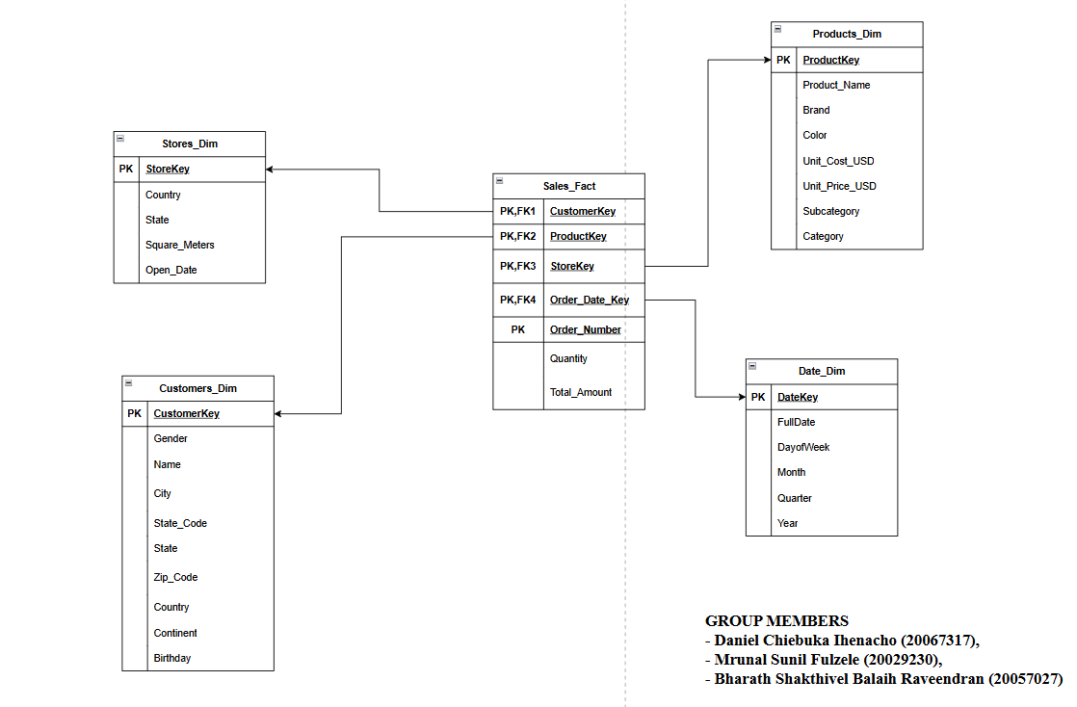
Introduction: SCHEMA

Slide 5
Database creation, relation & warehouse
Import Excel dataset to SSMS
Create Relation between Table
Create Data Base Diagram
Create Where house according to Schema

Slide 6
SQL Server Integration Services (SSIS)
Creating the DataFlow for all Dimension and Fact Table
Creating the migration flow from Database to warehouse
Mapping the column also applying data conversion and shorting whenever necessary

Slide 7
Neo4j – Graph Database Design
Designed a graph model with Customer, Product, Store, Date, and Order nodes linked by meaningful relationships.
Implemented key sales queries like customer orders, high-value transactions, store analysis and compared it with SQL Queries.
Observed faster performance in multi-hop queries compared to SQL join-heavy queries.
Can conclude that Neo4j is more intuitive and efficient for connected sales data and relationship-driven insights.

Slide 8
Tableau Visualization
Global sales map highlights key markets.
Top products chart ranks best sellers.
Sales trends line chart shows patterns from 2016–2020.
Customer charts display distribution and regional sales.
Brand box plot compares sales across brands.

Slide 9
SSRS Reports
Analyse average spending and total orders by gender
Identify the continent with highest sales
Compare yearly sales to find peak and lowest years
Determine the top and low selling brand
Which country has the highest average profit over time
Generate transaction list for manger's view

Slide 10
Conclusion
Successfully built a data warehouse for global electronics retailer using a star schema approach for data-driven decisions.
Implemented an ETL pipeline
Generated insights using SSRS and Tableau
Implemented a Graph database using Neo4j

