Slide 1


Slide 2
LTE protocol stack
RRC
PDCP
RLC
App interface
openLteMac
UL/DL MAC
PDCCH
UL/DL scheduler
App interface
Common timer/clk to L1 & MAC to be in sync
App interface
App interface
L1
App interface is one module used to exchange messages or signals between other process or other layers
App interface

Slide 3
openLteMac specification
Particulars | App support
Platform | X86 & ARM
OS | Any linux flavor
Kernel | Any version
Interface | Open MP
Reference | 3gpp
Hardware | SOCs, PC, Laptop, Servers (based on x86/ARM)
Number of Cores | Assuming 4 cores for reserved
Design pattern | openLteMac is one application with threads equivalent to number of cores.

Slide 4
openLteMac Functions
Real time | Non-real time
Process keeping TTI indication as reference | Sending UL data to RLC
DL scheduler | Updating BSR to UL scheduler
UL scheduler | Updating DL CQI to DL scheduler
PDCCH allocator | BO update to DL scheduler
RB allocator | M-plane processing using open MP (RLC, RRC,CLI)
TB creation
Send SF data to L1(all DL physical info)

Slide 5
PDSCH
DL MAC
PDCCH
PCFICH
PHICH
PBCH
Data from RLC
Alloc Info
RLC
Scheduled Mac CE’s
Request RLC for data
UL RB allocator
DL RB allocator
DCI allocated (FORMAT_0, 3,3A,4)
DCI allocated (FORMAT_1,1A/B/C/D, 2,2A,B/C)
1 mili second
PDCCH allocator
Time
Time bound operations
List of UE’s to be scheduled
LC’s to be scheduled
UL scheduler
DL scheduler
PUCCH /PUSCHTPC
SR
TA
PHR
CRNTI-CE
UL-CQI
RACH-Info
TA
RACH-info
UL MAC
HARQ-fbk
PRACH-info
PUCCH-info
PUSCH-info
UL
DL

Slide 6
1. Cell configuration
2. UE configuration 3. Mac Configuration
4. CLI (Measurement & debug)
MAC
M-plane
UL RLC
UL Scheduler
DL Scheduler
DL RLC
BSR
DL-Data to be sched
QCI-1(LCG-2)
SRB(LCG-1)
Time
DL-CSI
DL MAC
Non Real time operations
QCI-2-9(LCG-3)
S-BSR
L-BSR
UL MAC
QCI-2-9(LCG-3)
QCI-2-9(LCG-3)
QCI-2-9(LCG-3)
QCI-2-9(LCG-3)
QCI-2-9(LCG-3)
QCI-2-9(LCG-3)
QCI-2-9(LCG-3)
QCI-2-9(LCG-3)
QCI-2-9(LCG-3)
QCI-2-9(LCG-3)
RS
PRACH-info
PUCCH-info
PUSCH-info

Slide 7
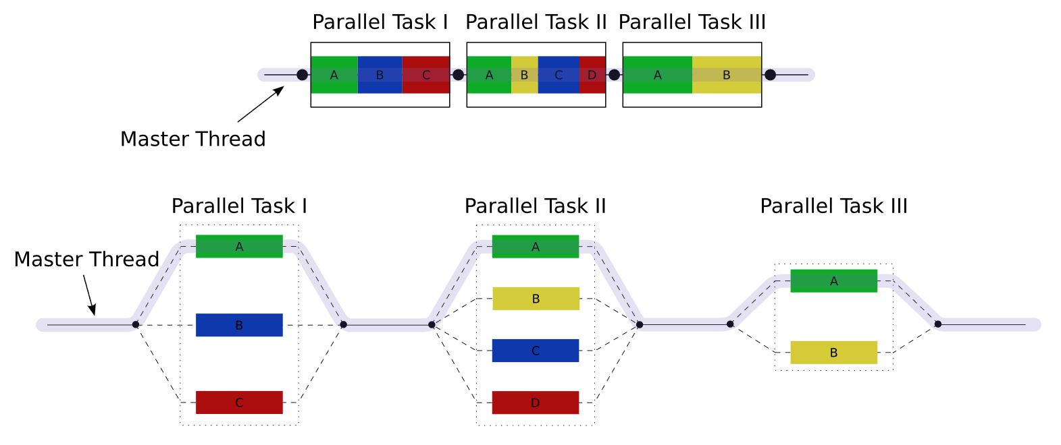
openLteMac ThreadPool
Parallel execution of sub-modules
Faster completion of processing
Parallel execution of real time & non-real time funtions
Set of tasks are grouped & started parallely

Slide 8
openLteMac DL scheduler/UE prioritization
UE_1 LC-1
UE_2 LC-1
UE_3 LC-1
UE_1 LC-2
UE_* LC-1
UE_* LC-2
UE_* LC-*
UE_5 LC-2
UE_2 LC-2
UE_* LC-*
UE_* LC-*
List of logical channel nodes of a cell sorted based on PFS priority.
PFS priority = PDB for LC + LC priority + remaining data + CSI(CQI + RI)
Priority calculation are only for GBR/NGBR while mac CE & SRB will be considered separately
Based on PFS priority UE prioritization will be done,UE priority = MAX_PRIO(active_logical_channels)
Another list based on UE priority will be maitained, top nodes will be considered for resource allocation every TTI
Based on max_UEs/TTI & min_priority of selected UE will be used to decide multi bearere scheduling.

Slide 9
openLteMac DL scheduler/UE prioritization (continue…)
UE-1 | UE-2 | UE-3 | UE-4 | UE-5 | UE-6 | UE-7 | UE-8 | UE-* | UE-*
LC-1 | LC-2 | LC-3 | LC_1 | LC-1 | LC-2 | LC-1 | LC-1 | LC-* | LC-1
LC-2 | LC-1 | LC-1 |  | LC-2 | LC-1 | LC-2 | LC-2 | LC-* | LC-2
 |  | Lc-2 |  |  | LC-3 |  |  | *
 |  | LC-4 |  |  |  |  |  | *
 |  |  |  |  |  |  |  | LC-*
List of UE nodes of a cell sorted based on MAX_PRIO(active_logical_channels)
Every TTI few UE’s in top of list to get PDSCH resources.
Based on max_UEs/TTI & min_priority of selected UE will be used to decide multi bearere scheduling.

Slide 10
openLteMac DL scheduler/UE prioritization (continue…)
Re-Tx list
List of harq process for re-Tx.
Mac CE list
List of Mac CE’s to be scheduled.
SRB list
List of RAR/SRB nodes.
New-Tx list
List of UE nodes based on MAX_priority(active LC channel).
Irresepective of harq process content.
List also to have entry of Contention Resolution nodes.
GBR/NGBR nodes priority deceided from PFS priority.

