Slide 1



CSA0915 -Programming In Java HOSPITAL MANAGEMENT SYSTEM
Project By:
G.Bharathchandra
192111649
Computer Science
And Engineering
SSE,SIMATS
Guided By:
T.Vincent Gnanaraj
(Course Faculty)
Programming In Java
SSE,SIMATS

Slide 2

ABSTRACT
A typical Hospital requires a management system to control its various operations such as maintaining an account of all people in its domain of services, attending to various needs of patients, and also achieving increased efficiency in the overall working of the Hospital itself. In the present time, there is a great rush in hospitals, as these have become necessities for the middle and upper class of society. Nowadays people are visiting the hospital because of this indecisive situation, even for a small issue, we need to consult a doctor. The booking is manually done using paperwork and direct human language communication by mouth to the hospital management. This delays the information in the hospital. Booking is done through phone calls or through visits to the hospital or online. The Hospital Management System aims to make simpler interactions between staff and patients. The system can be accessed by the admin and patients but the highest priority given to the admin is that they are allocated a login id and password. Hospital Management System provides various Appointments Booking Services, Managing the information of patients, Description regarding the Appointment booking.
Keywords: Hospital Management System , Patient Management , Online Booking , Appointment Description , Appointment Booking , Patient Records.

Slide 3

INTRODUCTION
Hospital management system is a computer system that helps to manage the information related to healthcare.
It manages the data related to all departments of healthcare such as clinical, financial, laboratory etc.
The hospital management system simplifies the work of healthcare professional and their interaction with their patients.
Moreover all the activities in the hospital can be recorded systematically in the digital form.
The hospital management system automates the management and reduces the paper work.

Slide 4

SOFTWARE AND HARDWARE REQUIREMENTS
HARDWARE REQUIREMENTS :
Processor : 11th Gen Intel(R) Core(TM) i5-11400F @ 2.60GHz
RAM : 8.0 GB or 16.0 GB
Storage Space : 100-150GB
Monitor : LCD
Internet : 4g/5g Internet or wifi
Mouse : wired or wireless
SOFTWARE REQUIREMENTS :
JDK 21 and JRE 8
Packages- Mysql , java server pages
Windows 11 64-Bit OS
Operating system : 64-bit operating system and X64-based processor

Slide 5
EXISTING SYSTEM
In today’s world if someone wants to book a Doctor’s Appointment we need to call in clinic or personally go to that place and book the appointment.
This consumes precious time of the patient. Also if the doctor cancels his / her schedule, the patient does not come to know about it unless he/she goes to the clinic.

Slide 6
DISADVANTAGES OF EXISTING SYSTEM
Lack of privacy​
Risk in the management of the data.​
Less Security​
Low co-ordination between ​
Less User-friendly​
Accuracy not guaranteed​
Not in reach of distant users.
There is no storage and automation if users have some enquiry.

Slide 7
PROPOSED SYSTEM
The patient will have to register into the application for the first time. On registering, the patient will receive a username and password.
The filtration is done on two bases: Gender wise and Specialty wise. After selecting the filtration type, the doctors list will be displayed. The patient can select any particular doctor and view his profile. And patient give reviews on doctor profile. Also the patient can view the doctor’s profile and look for an appointment.
The patient will then send a request for appointment. The doctor can either accept the appointment or reject it. The database will get updated accordingly and the patient will get a confirmation message.
The add-on to this system is that the patient will receive a notification 2 hours before the actual appointment. As well as if doctor cancels the appointment patient received a message for appointment cancelation.
This will be very useful in case the patient tends to forget the appointment. Also doctor can search patient history by using a unique ID.

Slide 8
MODULE LIST
ADMIN
Create Id & Password
DOCTOR
Login
View Complaint
Post Solution
Clinic Register

Slide 9

MODULE LIST
PATIENT
Register
Login
Find Doctor
View Details
View Profile
CLINIC
Login
Update Patient Details
CASHIER
Login
Payment Entry

Slide 10
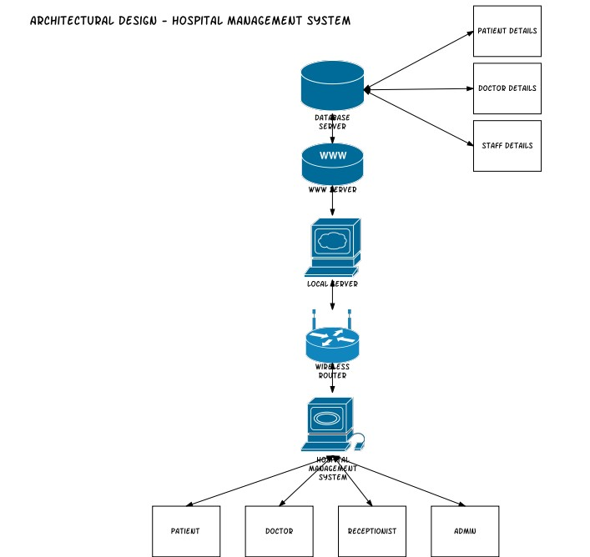
ARCHITECTURE OF HOSPITAL MANAGEMENT SYSTEM

Slide 11

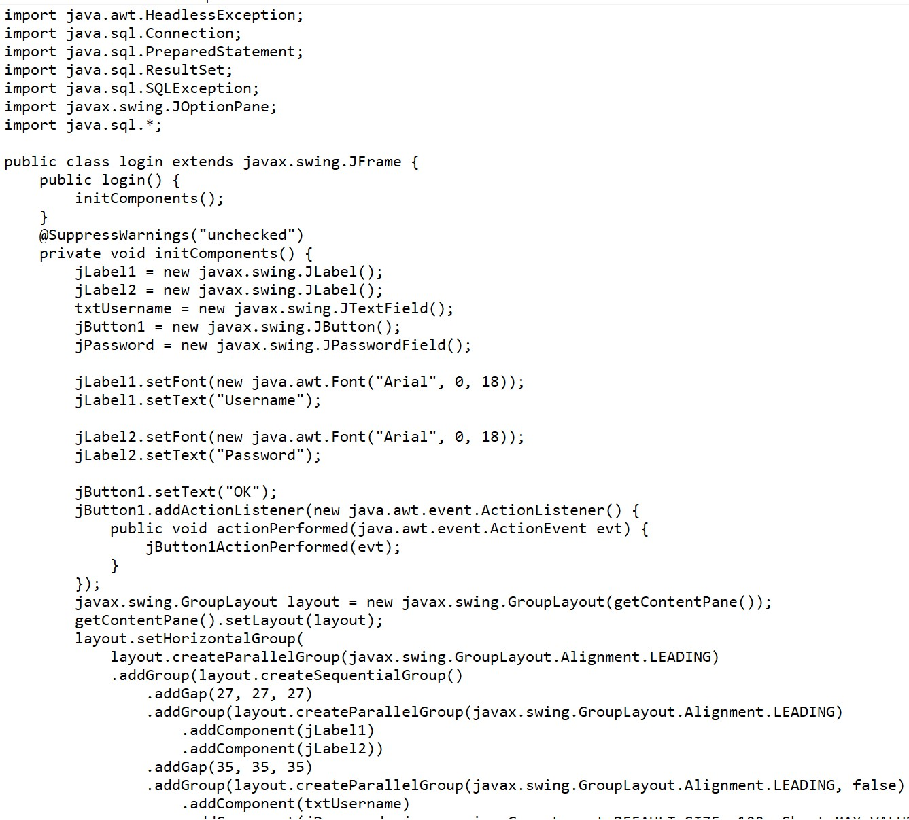
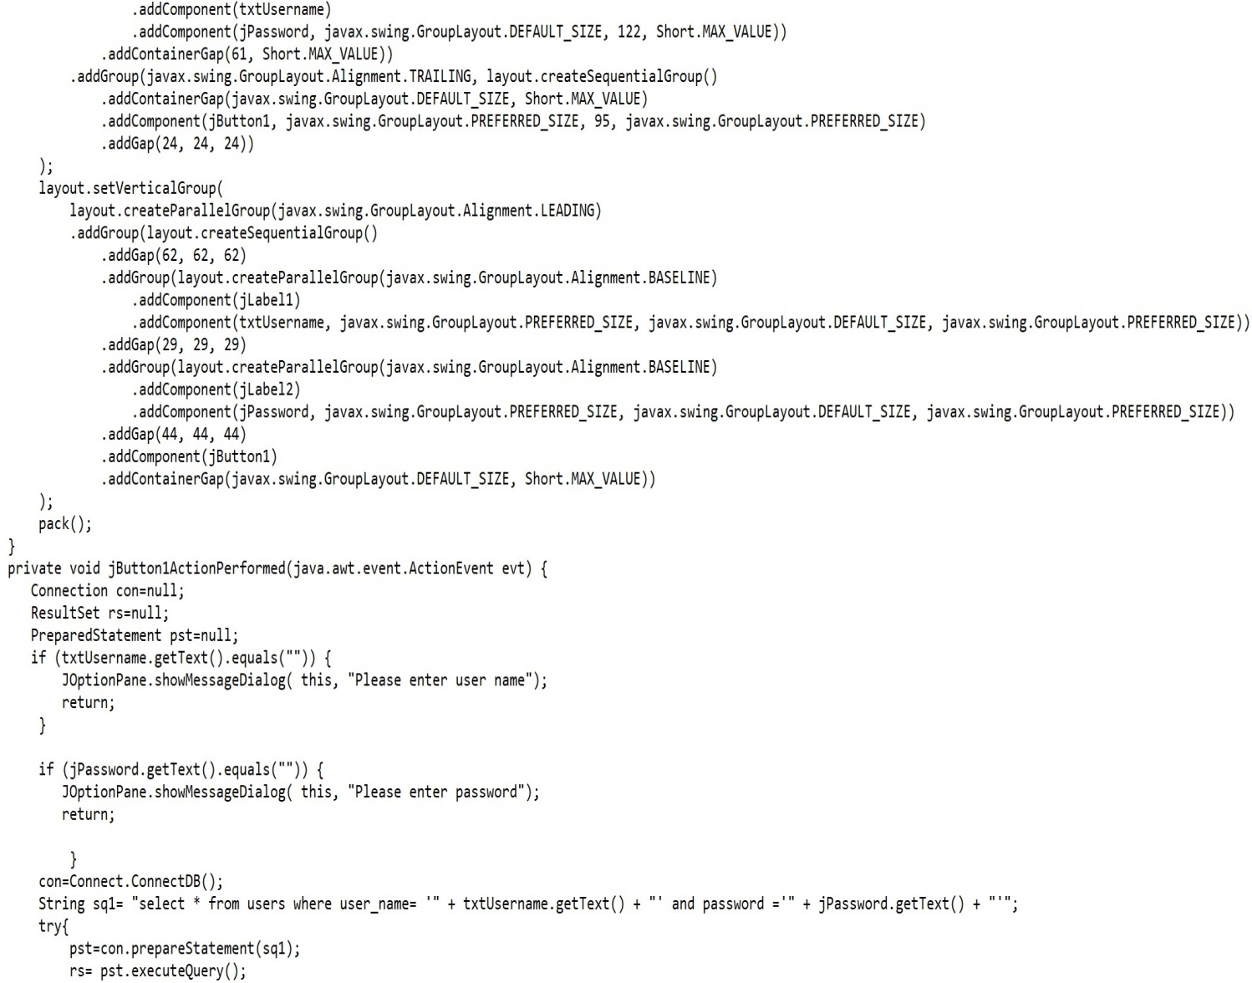
CODING

Slide 12
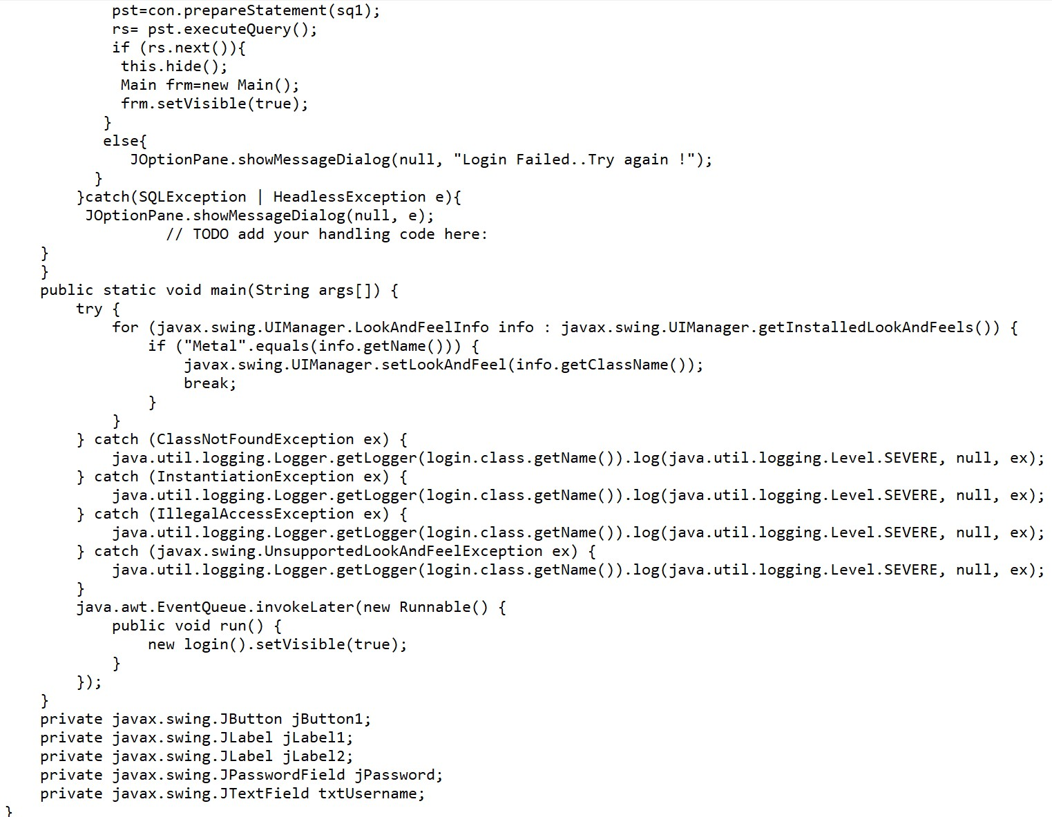
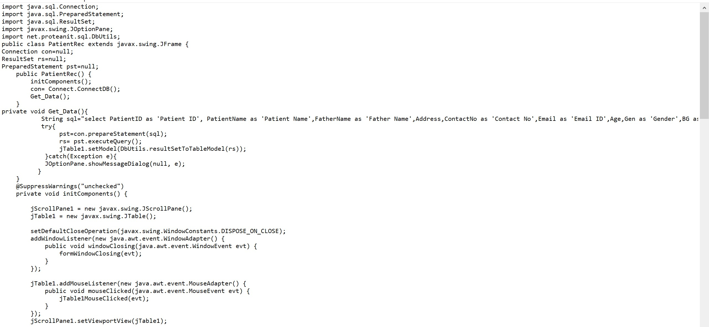

Slide 13
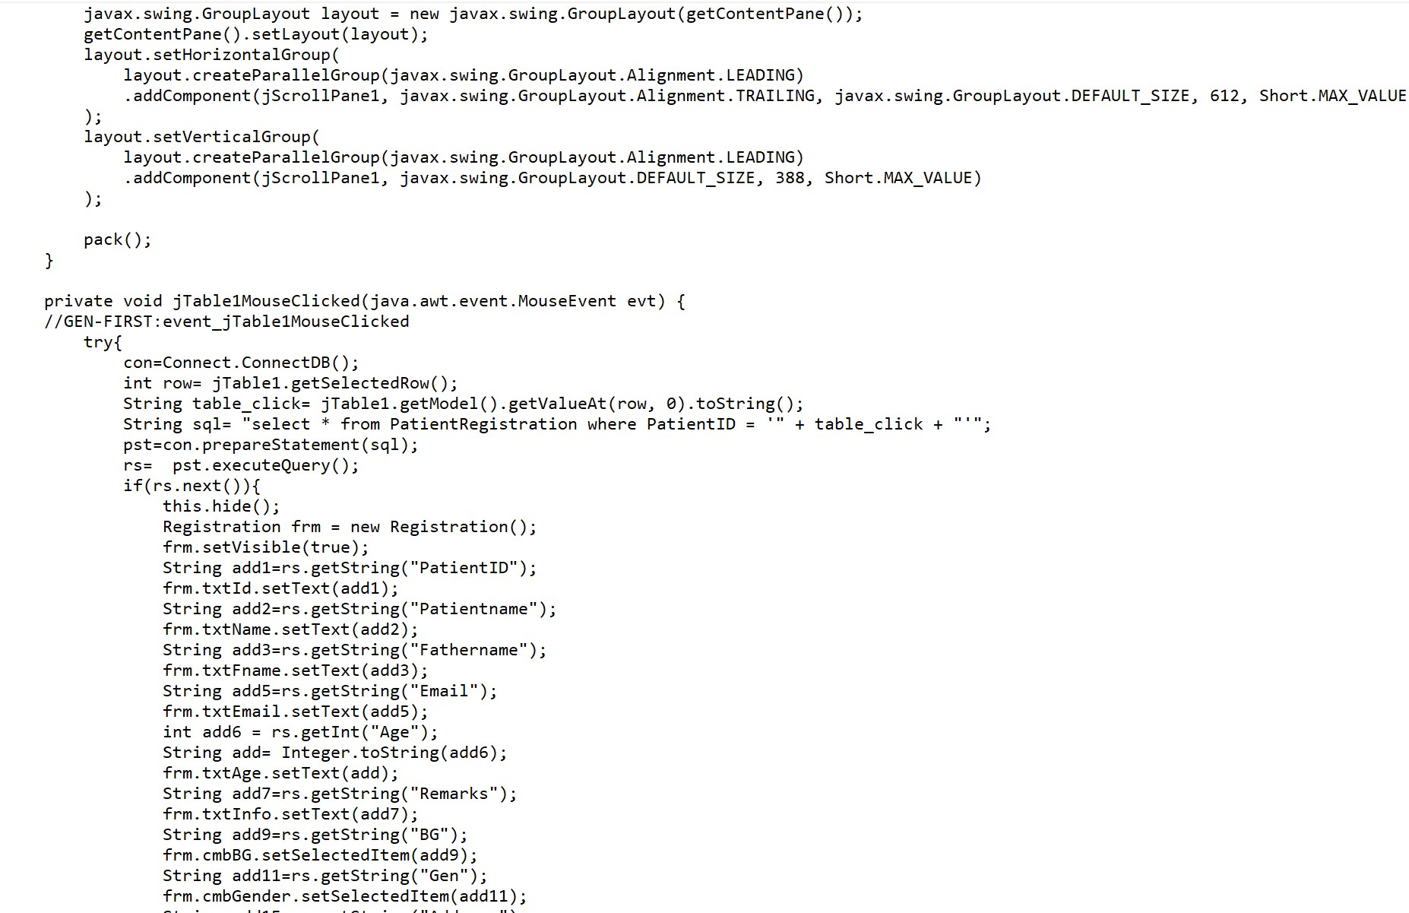
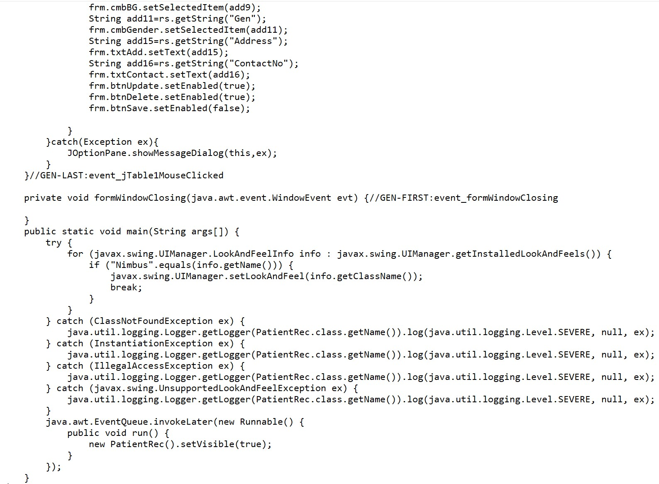

Slide 14
TESTING
Unit Testing:
Unit tests focus on individual components or functions to ensure they work as expected.
In this code, you might create unit tests for methods like update in the Doctor module and patient module.
Since the code doesn't have many standalone methods or functions, unit testing is somewhat limited.
Integration Testing:
Integration tests verify that different components of the system work together correctly.
For this code, you might want to simulate the entire flow of adding a patient, updating medical bills, and displaying patients.
Technical Feasibility:
The software is offline and totally based on python so it doesn't requires any kind of internet and there can’t be any issue regarding component not working correctly.
Resource and Time feasibility: Resources that are required for the project,
Programming Device
Programming Tool (freely available)
Programming individuals

Slide 15
IMPLEMENTATION
Step 1: Implement the Patient Class.
Step 2: Implement the Hospital Class.
Step 3: Implement Unit Tests for Patient Class.
Step 4: Implement Integration Tests for Hospital Class.
Step 5: Run the Tests.
This code will run in java version 3 and may not run in other version.
we have to install the packages required for the code.
It is compatible for Windows, Linux and Mac.

Slide 16
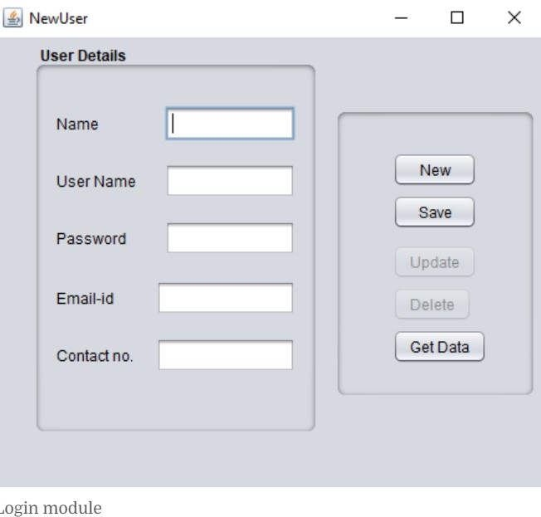
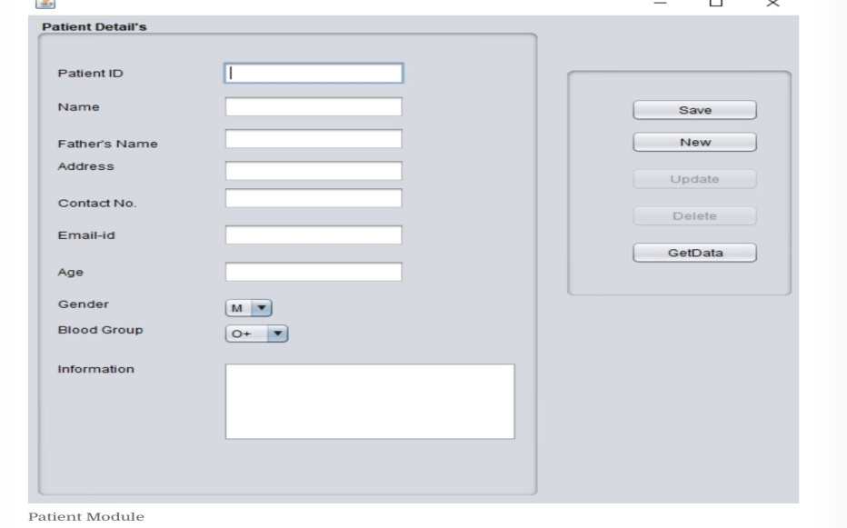
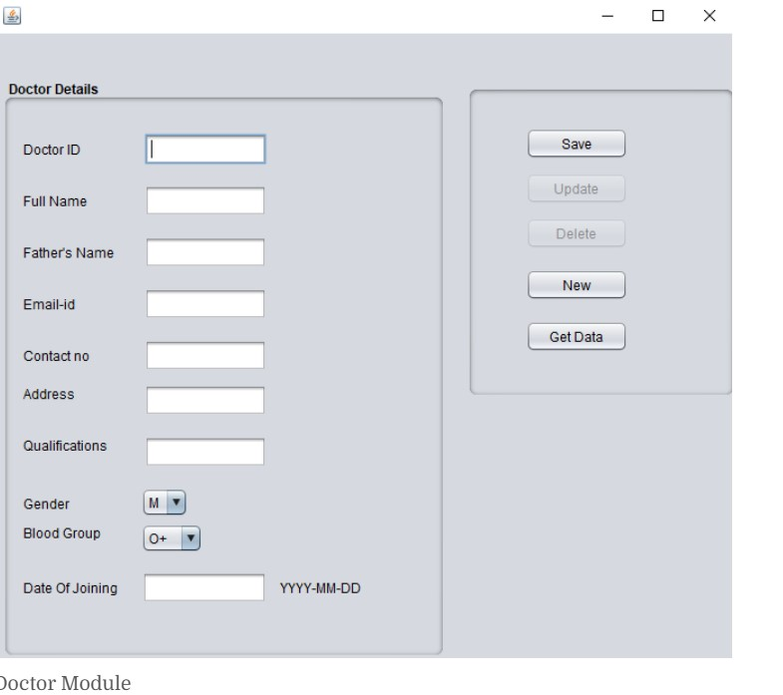
FINAL OUTPUT:

Slide 17
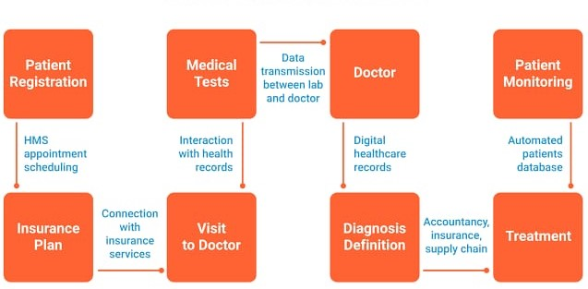
WORK FLOW DIAGRAM FOR HOSPITAL MANAGEMENT SYSTEM:

Slide 18
CONCLUSION
This system aims to simplify the task of the patient and the doctor. It will make patients more relaxed as they do not have to stand in a long queue to fix their appointment and also book an appointment according to their choice in a more convenient way.
Doctors need not worry about managing their appointment. Though you are not going to clinic for taking an appointment, your appointment gets booked from anywhere and however you want.
This helps to save the time of patient. Also the patient can get the doctor of his choice through various filters used in the application. The doctor is also able to view his day to day appointment list which makes it easier for him.
This application will help to optimize the work of patient and doctor. The report above describes how this process has been successfully implemented in the proposed system.
The proposed system has advantages over existing techniques as they lack public key encryption mechanism between the hospital and doctor.
Applying such encryption mechanisms in the communication channel helps to avoid the middle man attack between the doctor and patient.

Slide 19
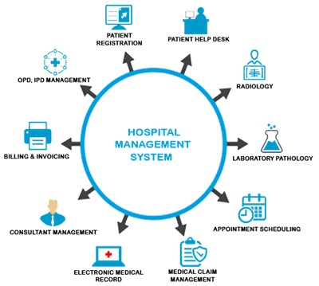
FUTURE ENHANCEMENT
In Future work, This application to develop a cross platforms like IOS, etc.
In adding the more features of hospital management system to develop access with user’s flexibility.
To authenticate the users based on the system users list which is maintained by the operating system
To restrict the usage of all files by the users based on their privileges on the system

Slide 20
REFERNECES
Adler M. J. (2009). Harvard Business Review. Health Care Requires Big Changes to Complement New IT, 87, 20.
Appolinário, F. (2004). Dicionário de MetodologiaCientífica: um Guiapara a Produção do ConhecimentoCientífico.
Arnhold, l.; Schmidt, S. & Bohnenberger, M.C. (2008). Seleção e Implantação de ERP emuma CooperativaMédica no RS: Um Estudo de Caso. In: EncontroAnual da ANPAD. 32, Rio de Janeiro, 2008. Anais... Rio de Janeiro: ANPAD.
Bahensky, J. A.; Jaana, M. & Ward, M. M. (2008). Health Care Information Technology in Rural America: Electronic Medical Record Adoption Status in Meeting the National Agenda. The Journal of Rural Health.
Balfour III, D.C. (2009). et al. Health Information Technology — Results From a Roundtable Discussion. JMCP Supplement to Journal of Managed Care Pharmacy. (January/February).

Slide 21


