Slide 1
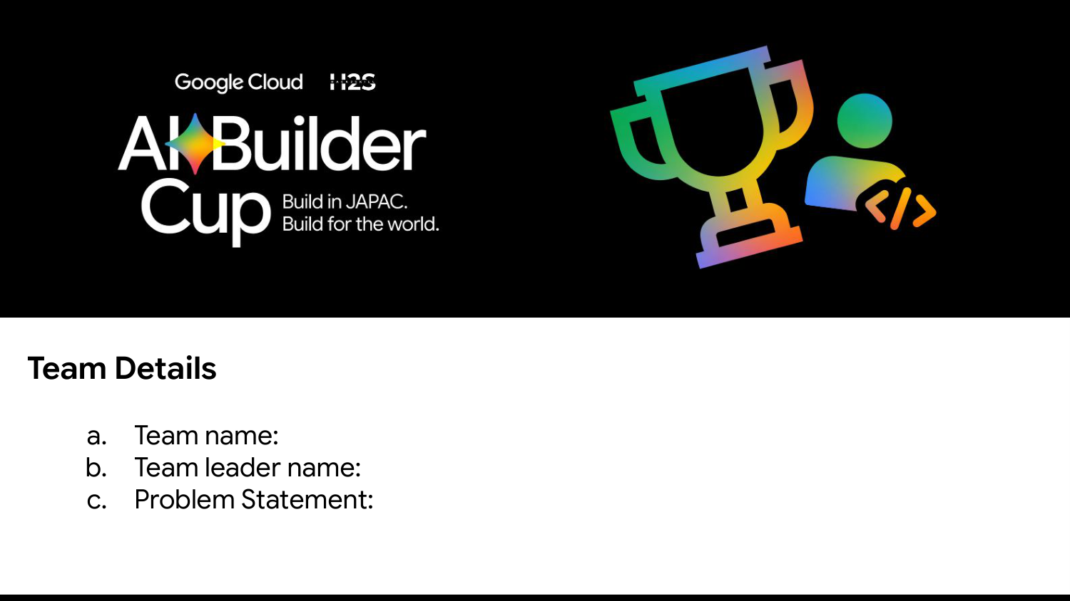
Team Name: AutomataForce
Team Leader: Ramakrishna Kancherla
Problem Statement: Autonomous Micro-Grid Community Energy Trading & Resiliency Agent (Decentralized peer-to-peer energy trading and dynamic load shedding powered by Google Gemini 3.5 Flash Lite to safeguard critical community loads during grid blackouts).

Slide 2
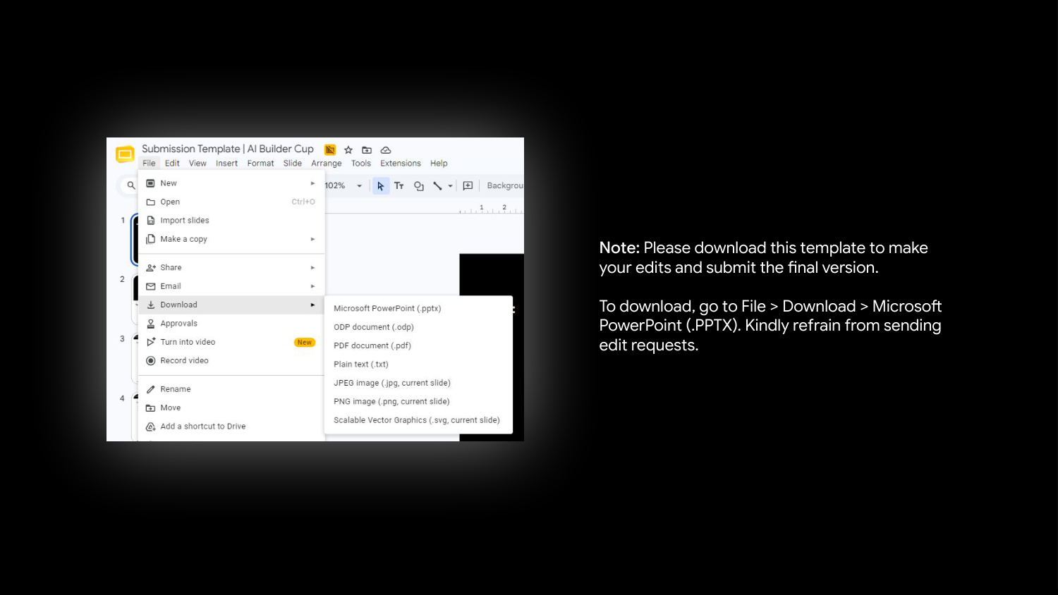

Slide 3
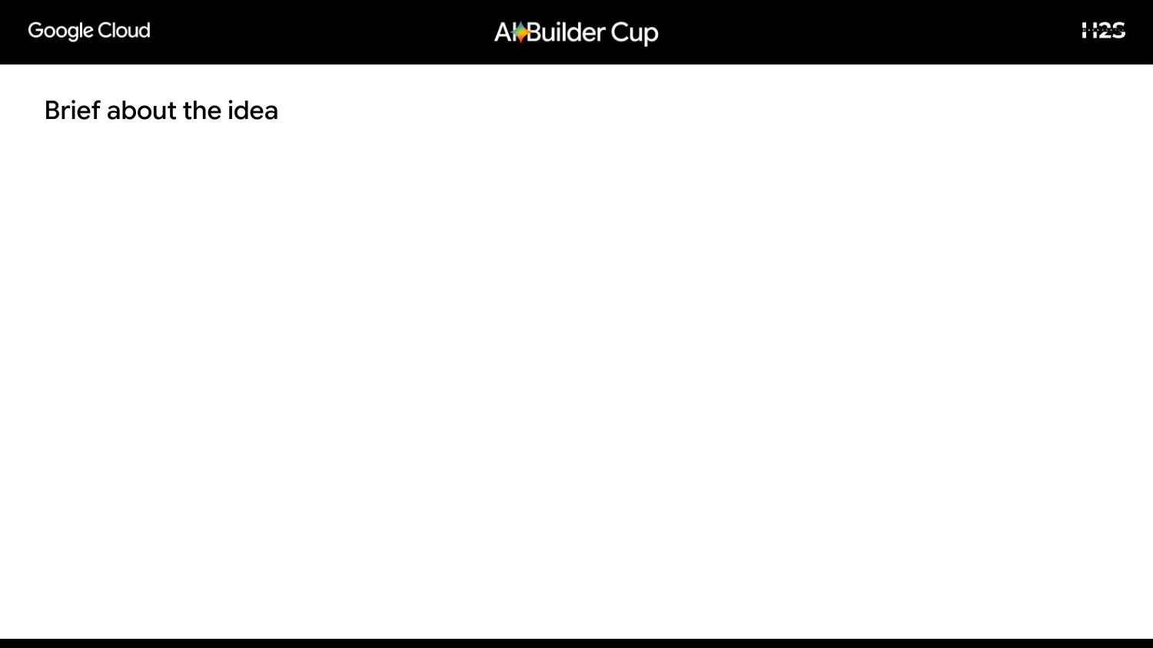
1. The Growing Crisis
• Climate-driven extreme weather events (storms, cyclones, heatwaves) repeatedly collapse centralized utility grids.
• Prolonged outages disconnect life-saving facilities like medical clinics and eldercare.
• While rooftop solar and home batteries are rapidly growing, they remain isolated, uncoordinated silos unable to help neighbors.
2. Autonomous Micro-Grid
• Each household operates an autonomous AI agent powered by Google Gemini 3.5 Flash Lite.
• Agents evaluate local solar generation, consumption, and battery state of charge (SOC) to submit structured demand response bids.
• A deterministic Community Coordinator clears P2P energy trades with zero energy loss and strict physical limits.
3. Resiliency by Design
• Instant Islanding: Decouples locally during main grid outages to preserve neighborhood power.
• Dynamic Load Shedding: Non-essential loads (EVs, dishwashers) yield to critical loads (medical clinic refrigeration).
• 100% Physics Integrity: Mathematical guarantees prevent hallucinated energy or battery damage.

Slide 4
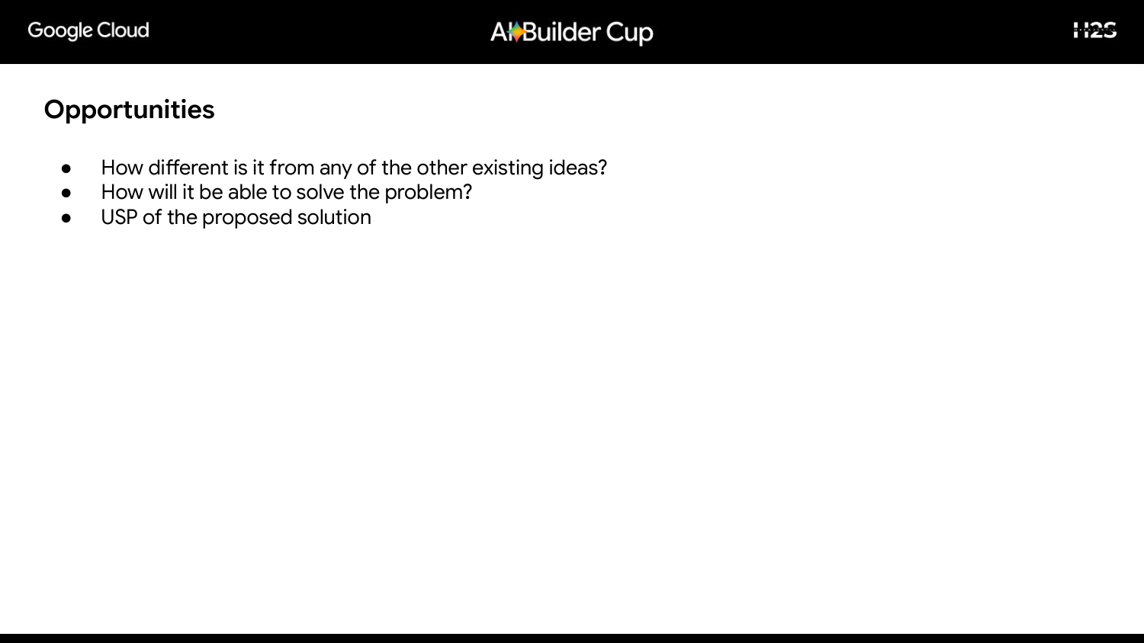
How is it different from existing ideas?
• Traditional SCADA / Centralized Grids:
Rely on rigid single-point controllers that freeze when communications fail during storms.
• Manual Human Intervention:
Too slow to balance 15-minute intermittent solar swings.
• Our Agentic Innovation:
Decentralized peer-to-peer negotiation. Homes maintain self-determination over battery comfort while cooperating for collective community resilience.
How does it solve the problem?
• 15-Minute Dynamic Dispatch:
Continuously balances generation and demand before blackouts occur.
• Multi-Tier Demand Response:
Automatically prioritizes critical circuits (medical equipment, lighting) over flexible high-drain devices.
• Islanded Micro-Grid Operation:
Eliminates single points of failure by keeping the community powered independently when utility lines go down.
USP of the Proposed Solution
★ 'AI Negotiation with Guaranteed Physics'
• Subjective Human Bidding:
Gemini agents understand nuanced household needs, comfort, and weather context.
• Objective Physical Law:
A deterministic coordinator strictly enforces battery C-rates, capacity bounds, and zero-loss trade conservation.
• Zero Hallucination Risk:
AI cannot invent energy or over-drain batteries.

Slide 5
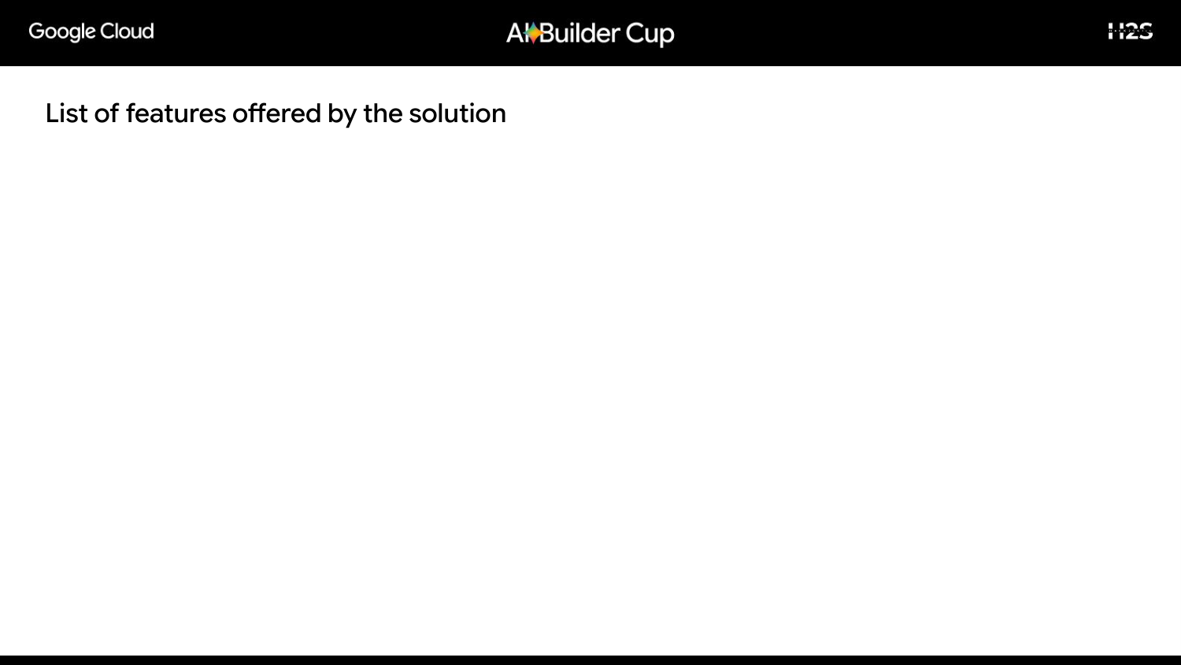
1. Autonomous Gemini Agents
Each household operates an autonomous agent powered by Gemini 3.5 Flash Lite submitting structured bids with natural-language rationale.
2. Instant Micro-Grid Islanding
Automatically senses grid loss and islanding occurs in seconds to maintain community power without utility dependence.
3. Dynamic 3-Tier Load Shedding
Multi-stage demand response: Full (100%), Essential (60%), and Critical (30%) shedding flexible loads to protect essentials.
4. P2P Energy Trading Engine
Bilateral matching algorithm that transfers excess solar and stored battery power directly from producers to deficit homes.
5. Live Digital Twin Dashboard
Interactive React 19 UI displaying live neighborhood topology, energy links, battery SOC, and active power states.
6. Auditable Negotiation Console
Transparent chronological ledger with inspectable JSON payloads showing the exact Gemini reasoning behind every bid.

Slide 6
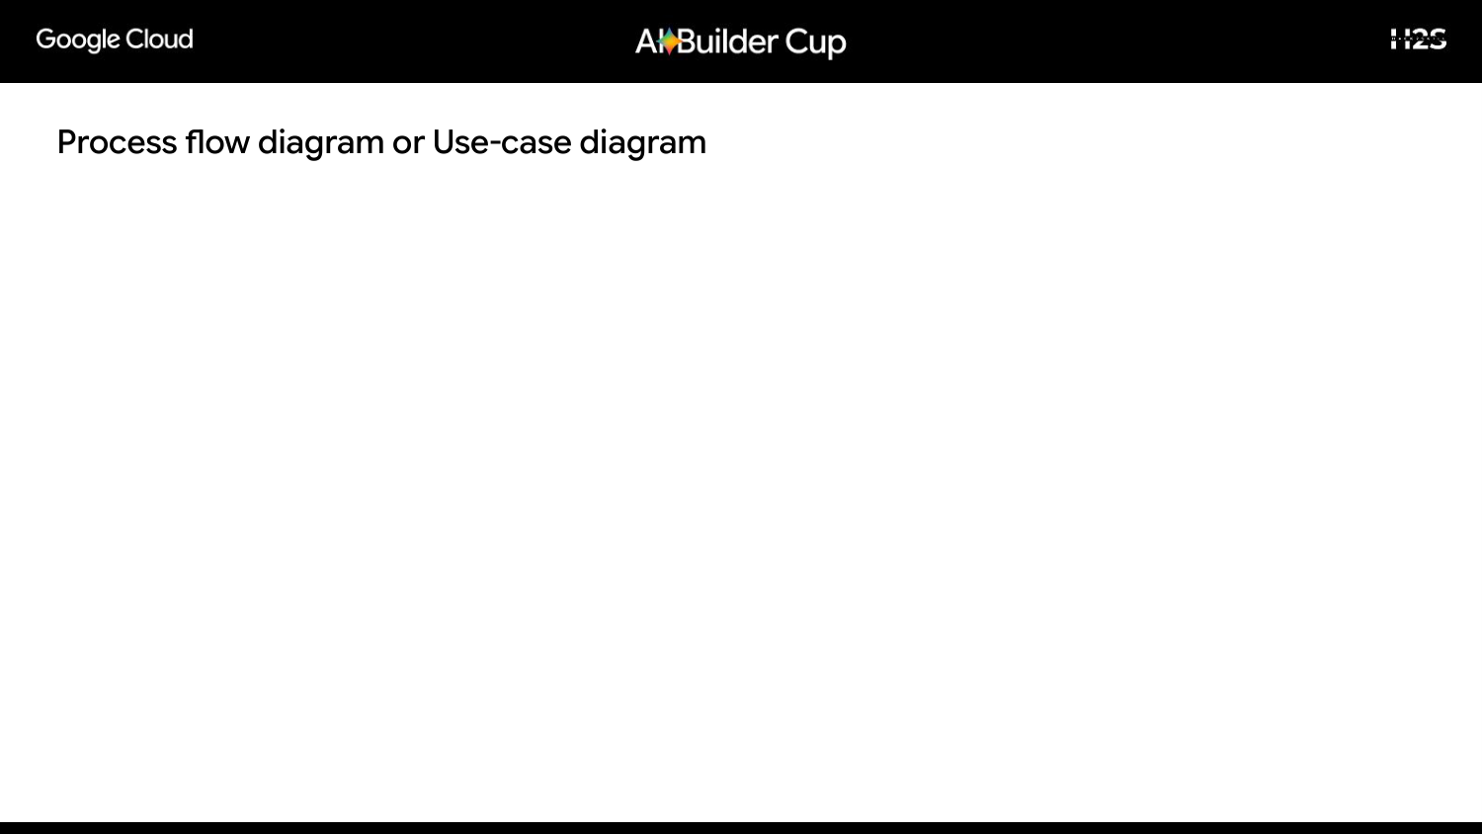
Step 1
Disruption Detected
Normal / Storm (75% solar drop) / Outage blackout triggers dispatch cycle.
Step 2
Gemini Agent Inference
4 concurrent agents evaluate solar deficit, load tiers, and battery reserves.
Step 3
Structured Bidding
Submits Pydantic schema bids: preferred load tier, reserve %, and export limit.
Step 4
Physical Coordination
Coordinator enforces energy balance, pairs P2P trades, and dispatches batteries.
Step 5
State & Digital Twin
Atomic commit to Firestore; live React UI visualizes power links & logs in <2.3s.

Slide 7
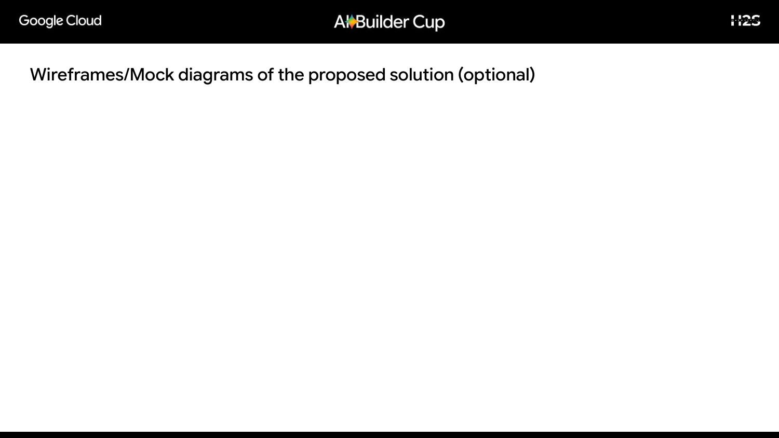
Dashboard UI Architecture
• Aggregate Telemetry Strip:
Displays real-time Solar Generation (kW), Community Demand (kW), Stored Battery Energy (kWh), and Unserved Energy (0.00 kWh).
• Neighborhood Network Map:
Dynamic SVG topology showing links between households (Solar Haven, Family Home, Garden Cottage, Community Clinic) and the central coordinator.
• Real-time Status Badges:
Color-coded states: Balanced, Exporting, Importing, and Shedding.
Resiliency Lab & Agent Console
• Resiliency Lab Interactive Controls:
One-click disaster simulations: 'Simulate storm' (75% solar drop), 'Simulate grid outage' (islanded blackout), and 'Reset community'.
• Inspectable Agent Console:
Chronological stream of household bidding decisions tagged with purple [gemini] badges.
• Audit Ledger:
Expandable JSON payload tree showing physical energy balance, load tiers, and exact LLM justifications for full transparent oversight.

Slide 8

Client Tier
React 19 + Vite SPA
• Topological SVG visualizer
• Live polling state updates
• Served via Cloud Run (Nginx)
• Fully responsive dark UI
Compute Tier
Google Cloud Run
• FastAPI ASGI microservice
• Asynchronous concurrent workers
• Pydantic v2 strict models
• Auto-scales 0 to 3 instances
AI Intelligence
Vertex AI & Gemini
• Gemini 3.5 Flash Lite
• Structured JSON Schema
• Sub-2.3s concurrent bidding
• Graceful fallback handling
Data & Security
Firestore & Secrets
• Cloud Firestore (Native)
• Atomic revision transactions
• Secret Manager encryption
• Artifact Registry container store

Slide 9

AI & LLM
• Google Gemini 3.5 Flash Lite:
State-of-the-art reasoning model for ultra-low latency & cost.
• Google GenAI SDK / Vertex AI:
Async model calls with strict Pydantic JSON response schema.
• Deterministic Coordinator:
Physics enforcement layer preventing hallucination.
Backend & API
• Python 3.12 & FastAPI:
Modern asynchronous web framework with native async/await.
• Pydantic v2:
Strict schema validation and data integrity parsing.
• Uvicorn:
High-performance ASGI server.
Frontend
• React 19:
Modern component UI library for reactive state rendering.
• Vite 8:
Next-gen lightning fast frontend build tooling.
• Tailwind-style Dark UI:
High-contrast resilient operational aesthetic.
GCP Infrastructure
• Google Cloud Run:
Serverless container hosting with automated HTTPS & scaling.
• Cloud Firestore:
Atomic distributed NoSQL state and audit ledger.
• Cloud Build & Artifact Registry:
Automated multi-container image CI/CD.

Slide 10
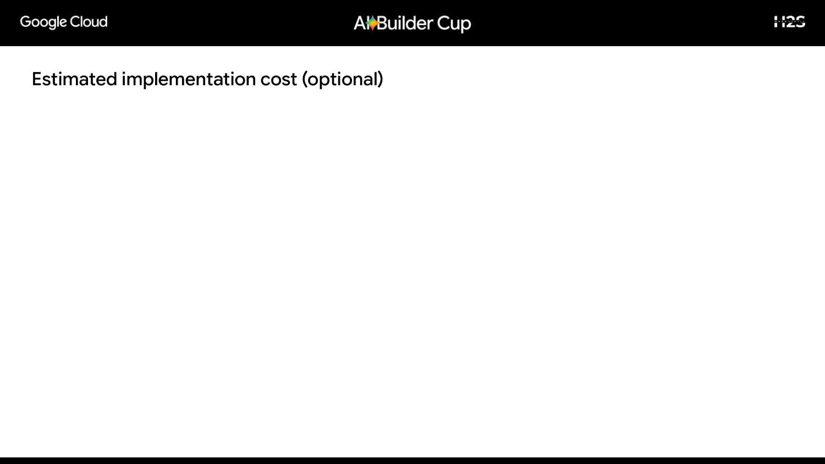
Highly Cost-Optimized Serverless Architecture
1. Google Cloud Run (Frontend & Backend):
• Free Tier includes 2,000,000 requests/month and 360,000 GB-seconds of compute.
• Scales to 0 when idle. Total Estimated Cost: $0.00 / month.
2. Google Cloud Firestore (Native Datastore):
• Free Tier includes 1 GB storage, 50,000 reads, and 20,000 writes/day.
• Entire community revision state fits well within free tier. Total Cost: $0.00 / month.
3. Google Gemini 3.5 Flash Lite Inference:
• Each 15-min household bid consumes ~250 tokens (~1,000 tokens per community dispatch).
• Running 24/7 continuous dispatches costs less than $0.50/month under standard API rates.
4. Total Community Pilot Operational Cost:
• Less than $1.00 USD / month (Practically 100% Free under Google Cloud Free Tier).

Slide 11
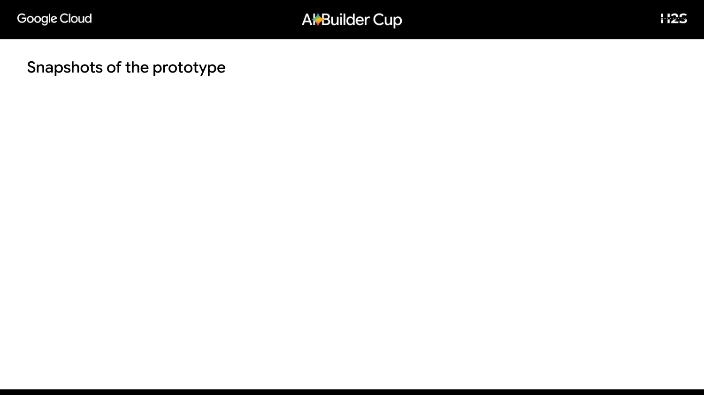
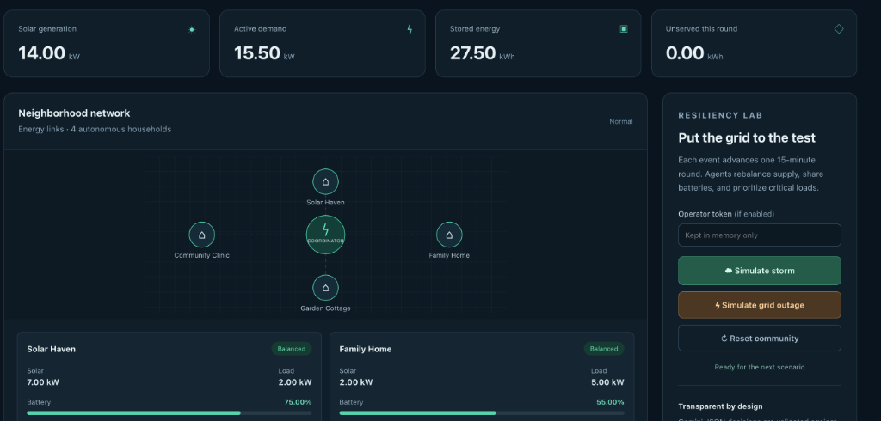

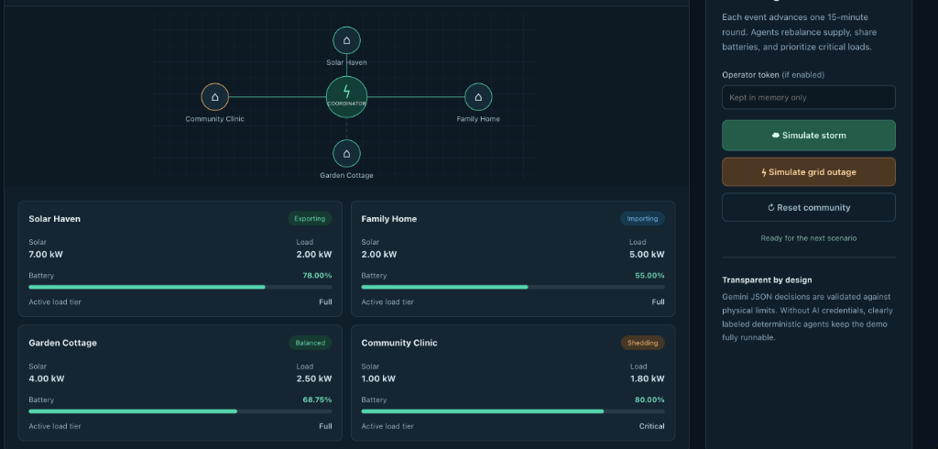
1. Normal Baseline
2. Storm Disruption
3. Grid Outage Islanding
14.0 kW Solar | 27.5 kWh Stored
All homes balanced in harmony.
75% Solar Drop | Load Shedding
Solar Haven balances with battery.
Islanded P2P Trading | Zero Unserved
Clinic shed to Critical Tier (1.8 kW).

Slide 12

< 2.3s Latency
End-to-End LLM Dispatch
All 4 concurrent Gemini agent inferences and physical clearing complete in under 2.3 seconds.
100% Physics Integrity
Thermodynamic Balance
Zero unmetered or hallucinated energy. Guaranteed compliance with conservation laws.
0.00 kWh Unserved
Critical Load Protection
Community Clinic medical refrigeration maintained 100% powered during complete blackout.
34 / 34 Tests Passed
Full Verification Suite
100% pass rate across API validation, agent schemas, physics bounds, and concurrency.

Slide 13

1. Hardware IoT Gateway Bridge
Integrate Modbus/MQTT protocols to connect with real-world physical smart inverters (Tesla Powerwall, SolarEdge, Enphase) and smart meters.
2. Satellite Irradiance Modeling
Ingest real-time satellite irradiance data via Google Earth Engine (ECMWF/ERA5/HOURLY) for predictive pre-storm battery charging.
3. Dynamic P2P Tariff Clearing
Implement automated peer-to-peer settlement tokens and local micro-tariffs to ensure fair financial compensation between solar sellers and buyers.
4. Virtual Power Plant (VPP) Federation
Aggregate hundreds of local neighborhood micro-grids into a unified Virtual Power Plant fleet for utility-scale grid stabilization.

Slide 14
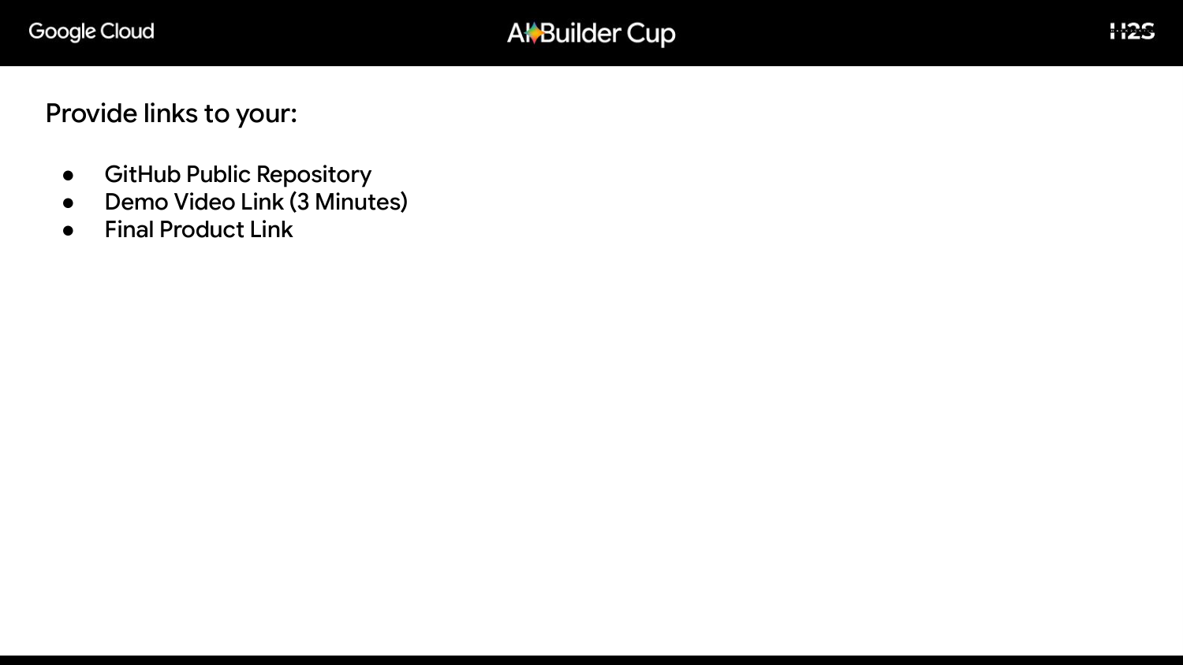
Official Submission Links
1. GitHub Public Repository:
👉 https://github.com/Bharathconfig/AI-CUP
2. Final Product Link (Live Working Prototype on Google Cloud Run):
👉 https://micro-grid-dashboard-amwo6hshva-uc.a.run.app
3. Demo Video Link (3 Minutes):
👉 [Insert your YouTube / Google Drive 3-minute video link here]

Slide 15
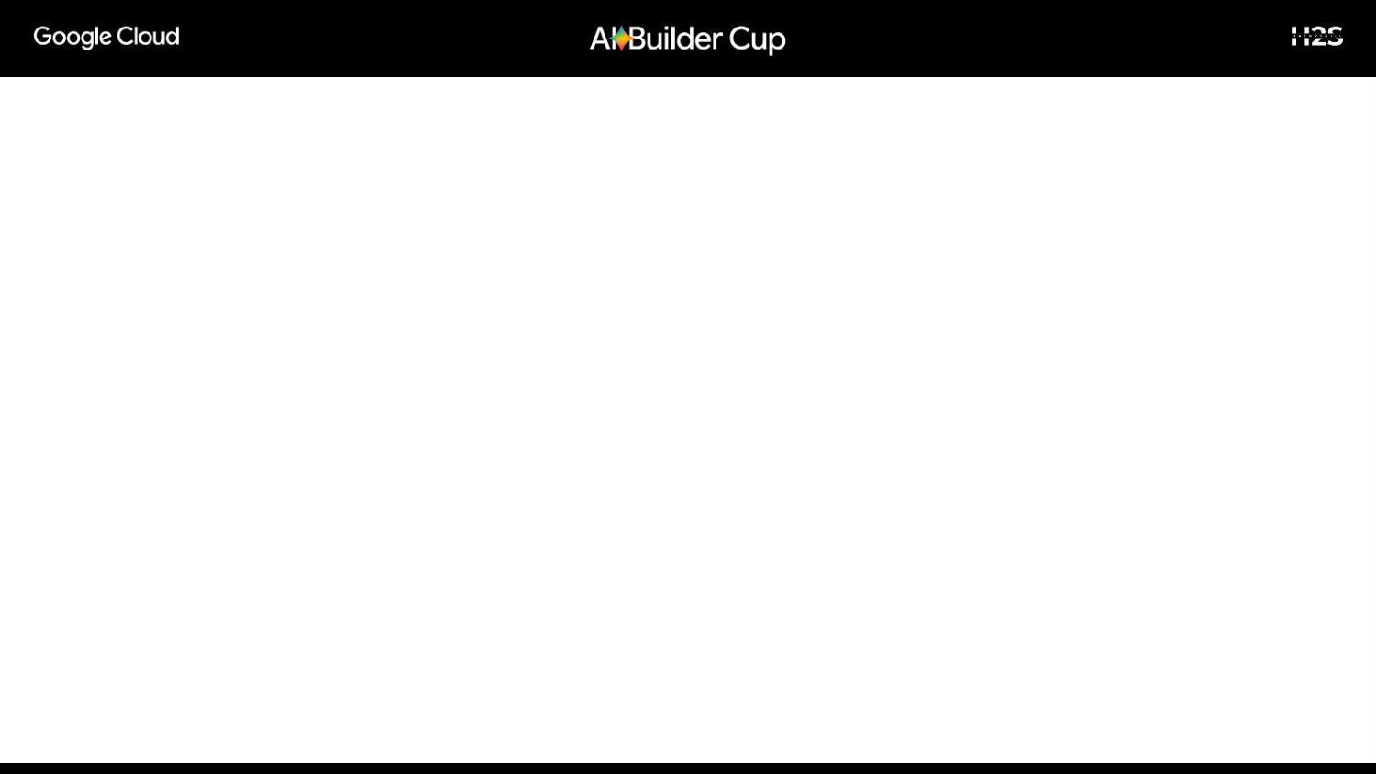
Why AutomataForce Micro-Grid Wins
• Real Working Prototype:
Not a mockup or slide design — deployed live on Google Cloud Run with Google Cloud Firestore.
• Deep Google Cloud & Vertex AI Integration:
Leverages Gemini 3.5 Flash Lite, Vertex AI async APIs, and Google Cloud serverless architecture.
• High Real-World Social Impact:
Protects vulnerable human lives, medical clinics, and critical community energy security during climate disasters.
• Rigorous Engineering:
34 automated unit & integration tests proving zero energy hallucination, sub-2.3s dispatch, and 100% physics reliability.

Slide 16


