Slide 1
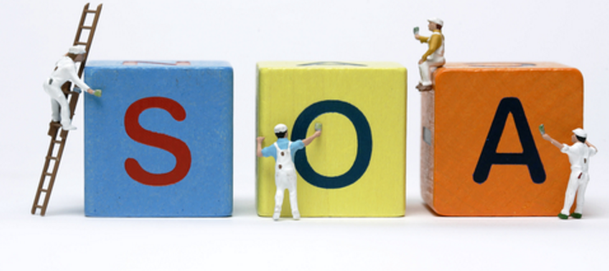
SOA (Service Oriented Architecture)

Slide 2
What is SOA ?
SOA is an architecture pattern in computer software design. In this pattern application components provide services to other components via a communicate protocol.
Basically SOA states that, every component of a system should be a service.
It is essentially a collection of services. These services communicate between each other.
A loosely coupled architecture designed to meet the business needs of the organization.
It is not a specific technology, nor a specific language.

Slide 3
Service ?
Is a logical representation of a repeatable business activity that has a specified outcome (e.g., check customer credit, provide weather data, consolidate drilling reports)
Is self-contained
May be composed of other services
Is a “black box” to consumers of the service
Unit of a Program that servers a business process.

Slide 4
Why SOA?
Code Mobility : client does not care where the service is located. Therefore, an organization has the flexibility to move services to different machines, or to move a service to an external provider.
More Security : An application will therefore have multi-level authentication at both the client level and at the service level.
Support for Multiple Client Types : use multiple clients and multiple client types to access a service.
More Reuse : The developer does not have to worry about compiler versions, platforms, and other incompatibilities that make code reuse difficult.
Better Scalability : This feature promotes scalability since a load-balancer may forward requests to multiple service instances without the knowledge of the service client.
Higher Availability : multiple servers may have multiple instances of a service running on them. If a network segment or a machine goes down, a dispatcher can redirect requests to another service without the client's knowledge.

Slide 5
SOA Principles
Standardized service contract: Services adhere to a communications agreement, as defined collectively by one or more service-description documents.
Service loose coupling: Services maintain a relationship that minimizes dependencies and only requires that they maintain an awareness of each other.
Service abstraction: Beyond descriptions in the service contract, services hide logic from the outside world.
Service reusability: Logic is divided into services with the intention of promoting reuse.
Service autonomy: Services have control over the logic they encapsulate, from a Design-time and a Run-time perspective.
Service statelessness: Services minimize resource consumption by deferring the management of state information when necessary.
Service discoverability: Services are supplemented with communicative meta data by which they can be effectively discovered and interpreted.

Slide 6
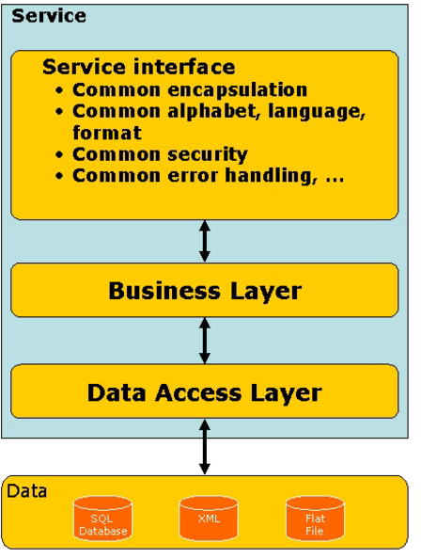
SOA can be Implemented using the below technology
SOAP, RPC
REST
DCOM
CORBA
OPC-UA
Web services
DDS
Java RMI
WCF .
Apache Thrift
SORCER

