Slide 1
REST (Representational State Transfer)

Slide 2
What is REST ?
REST is an architectural style for designing networked applications. REST uses HTTP for making communication between machines.
RESTful applications uses HTTP web requests to post data , read data and delete data. Thus REST uses HTTP for all CRUD operations.
REST is a lightwieght alternative to mechanism like Web services (SOAP, WSDL) , Remote procedure call.

Slide 3
REST as a Service
REST service is platform independent ( server and client can be built using any OS).
Language Independent (C# to Java, Java to C# etc).
Runs on Top of HTTP.
No Built in security. Can use username and password tokens. For encryption , REST can be used on top of HTTPS (Secure Tokens).

Slide 4
REST : “State Trasfer”, in a good REST design operations are self contained and each request carries with all the information's that server needs in order to complete it.

Slide 5
REST VS SOAP
SOAP : (Simple Object Access Protocol)
Heavy weight choice for web service access.
Defines a standard communicate protocol. XML based message exchange.
The WSDL describes set of rules to define the messages, bindings operations and location of service.
SOAP can be over any protocol SMTP, HTTP, FTP etc.
SOAP always makes POST requests.
Supports always XML format.
Caching will be ignored.
REST : (Representational State Transfer)
Light weight and faster.
REST communicates only VIA HTTP.
Can be implemented using any Tool.
Supports, JSON, XML CSV etc formats..
Takes full advantage of web caching.

Slide 6
HTTP methods for RESTFul Services
The HTTP verbs comprise a major portion of our “uniform interface” constraint and provide us the action counterpart to the noun-based resource.
The most commonly used Verbs are POST, GET, PUT, DELETE and PATCH (CRUD) operations.

Slide 7
Recommended return values of the Primary HTTP methods.
HTTP Verb | CRUD | Entire Collection (e.g. /customers) | Specific Item (e.g. /customers/{id})
POST | Create | 201 (Created), 'Location' header with link to /customers/{id} containing new ID. | 404 (Not Found), 409 (Conflict) if resource already exists..
GET | Read | 200 (OK), list of customers. Use pagination, sorting and filtering to navigate big lists. | 200 (OK), single customer. 404 (Not Found), if ID not found or invalid.
PUT | Update/Replace | 404 (Not Found), unless you want to update/replace every resource in the entire collection. | 200 (OK) or 204 (No Content). 404 (Not Found), if ID not found or invalid.
PATCH | Update/Modify | 404 (Not Found), unless you want to modify the collection itself. | 200 (OK) or 204 (No Content). 404 (Not Found), if ID not found or invalid.
DELETE | Delete | 404 (Not Found), unless you want to delete the whole collection—not often desirable. | 200 (OK). 404 (Not Found), if ID not found or invalid.

Slide 8
REST Supported Response Format
REST service supports a variety of response formats in order to offers users with max flexibility. Few of the commonly supported formats are
Extensible Markup Language (XML) is a general purpose text-based structured data specification for data interchange.
JavaScript Object Notation (JSON) is a newer data interchange format that is increasing in popularity since it can be evaluated by JSON parsers into native JavaScript objects
PJSON refers to "Prettified" JSON. It formats JSON with spaces, tabs, and carriage returns in order to improve its human readability, especially during application development and testing. All JSON request and response examples given in this documentation are represented as PJSON for readability.
HyperText Mark-up Language (HTML) is the most popular way to describe the structure and text of a Web page and is a response format supported by the REST services. While it may not be useful as a data interchange format, it may be useful for developing and testing applications with REST services

Slide 9
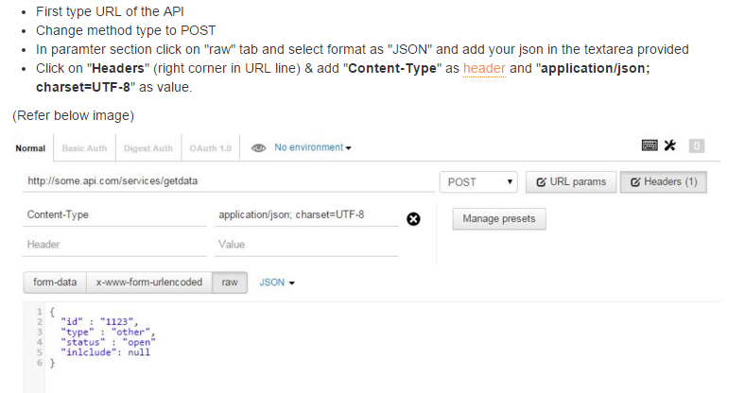
HTTP POST (CREATE)
The POST verb is most often utilized to CREATE new resource. On Successful Creation return HTTP Status code 201.

Slide 10
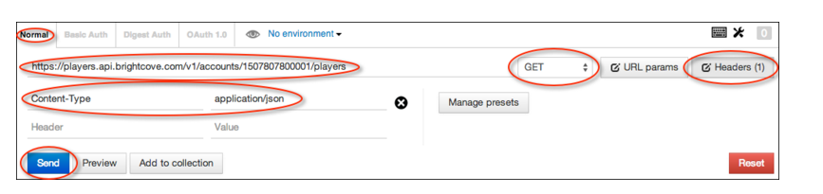
HTTP GET (Read)
Mention the right URL for the API call.
Choose GET method as the HTTP VERB.
Supply the headers, value- pair : Content type – Application/Json or XML etc..

Slide 11
REST Clients available in the Market
POSTMAN (Chrome Extension).
Fiddler
PAW (MAC)
Cocoa ( MAC)
REST Easy (FireFox)
Many more….

Slide 12
REST can be Implemented using Technologies like.
.Net
Java
Ruby and Rails
.Node /Java script
PHP
Python
Perl
Cold Fusion

Slide 13
Frameworks for creating REST ful services
ASP.NET Web API : .Net based framework.
DropWizard : Dropwizard is a Java framework for developing ops-friendly, high-performance, RESTful web services
JerSey : Open source techcology.
RESTEasy : A java API for REST ful web services. It is a JBOSS project.
Swagger .
Spark : Java framework build using light framework.

