Slide 1
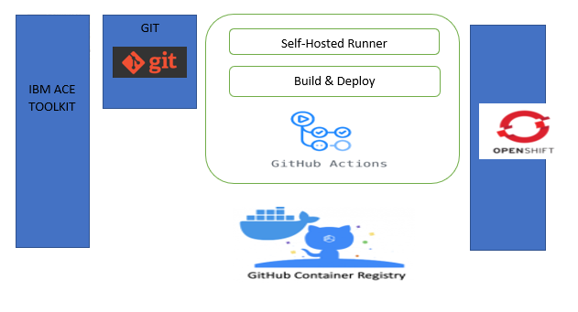
CI/CD APPROACH

Slide 2
Application Structure -1
Rest_Api_Application_Put_Get :
Bar Creation
Building Docker Image
Deploying to OpenShift

Slide 3

Application Structure -2
On Self Hosted Runner
Rest_Api_Application_Put_Get
Source Code
DEV
Bar Creation
Building Docker Image
Deploying to OpenShift
Rest_Api_Application_Put_Get

Slide 4
Category based repo structure
NEW_UBA_POC:
Rest_Api_Application_Put_Get :
Bar Creation
Building Docker Image
Deploying to OpenShift

