Slide 1
OPERATING SYSTEM

Slide 2
UNIT – I
Operating System-Introduction, Structures-Simple Batch, Multi-programmed, Time-shared, Personal Computer, Parallel, Distributed Systems, Real-Time Systems , System components, Operating System services.
Introduction to Linux operating system, linux file system, Linux Utilities

Slide 3
Introduction to Operating System (OS)

Slide 4
What is an Operating System?
Computer System = Hardware + Software
Software = Application Software + System Software(OS)
An Operating System is a system Software that acts as an intermediary/interface between a user of a computer and the computer hardware.
Operating system goals:
  Execute user programs and make solving user problems easier
  Make the computer system convenient to use
  Use the computer hardware in an efficient manner

Slide 5
Characteristics of Operating Systems
Let us now discuss some of the important characteristic features of operating systems:
Device Management: The operating system keeps track of all the devices. So, it is also called the Input/Output controller that decides which process gets the device, when, and for how much time.
File Management: It allocates and de-allocates the resources and also decides who gets the resource.
Job Accounting: It keeps track of time and resources used by various jobs or users.

Slide 6
Memory Management: It keeps track of the primary memory, like what part of it is in use by whom, or what part is not in use, etc. and It also allocates the memory when a process or program requests it.
Processor Management: It allocates the processor to a process and then de-allocates the processor when it is no longer required or the job is done.
Control on System Performance: It records the delays between the request for a service and the system.
Security: It prevents unauthorized access to programs and data using passwords or some kind of protection technique.
Convenience: An OS makes a computer more convenient to use.
Efficiency: An OS allows the computer system resources to be used efficiently.

Slide 7
Functionalities of Operating System
Resource Management: When parallel accessing happens in the OS means when multiple users are accessing the system the OS works as Resource Manager, Its responsibility is to provide hardware to the user. It decreases the load in the system.
Process Management: It includes various tasks like scheduling and termination of the process. It is done with the help of CPU Scheduling algorithms.
Storage Management: The file system mechanism used for the management of the storage. NIFS, CIFS, CFS, NFS, etc. are some file systems. All the data is stored in various tracks of Hard disks that are all managed by the storage manager. It included Hard Disk.

Slide 8
Memory Management: Refers to the management of primary memory. The operating system has to keep track of how much memory has been used and by whom.
It has to decide which process needs memory space and how much. OS also has to allocate and deallocate the memory space.
Security/Privacy Management: Privacy is also provided by the Operating system using passwords so that unauthorized applications can’t access programs or data.

Slide 9
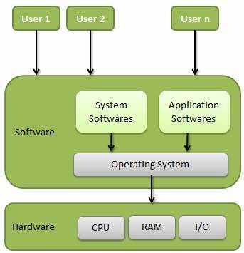

Slide 10
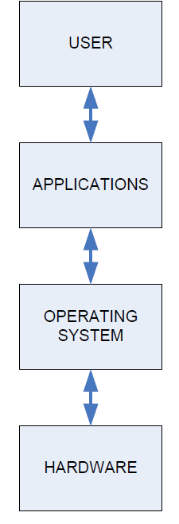
The Structure of Computer Systems
Accessing computer resources is divided into layers.
Each layer is isolated and only interacts directly with the layer below or above it.
If we install a new hardware device
  No need to change anything about the user/applications.
  However, you do need to make changes to the operating system.
  You need to install the device drivers that the operating system will use to control the new device.
If we install a new software application
  No need to make any changes to your hardware.
  But we need to make sure the application is supported by the operating system
  user will need to learn how to use the new application.
If we change the operating system
  Need to make sure that both applications and hardware will compatible with the new operating system.

Slide 11
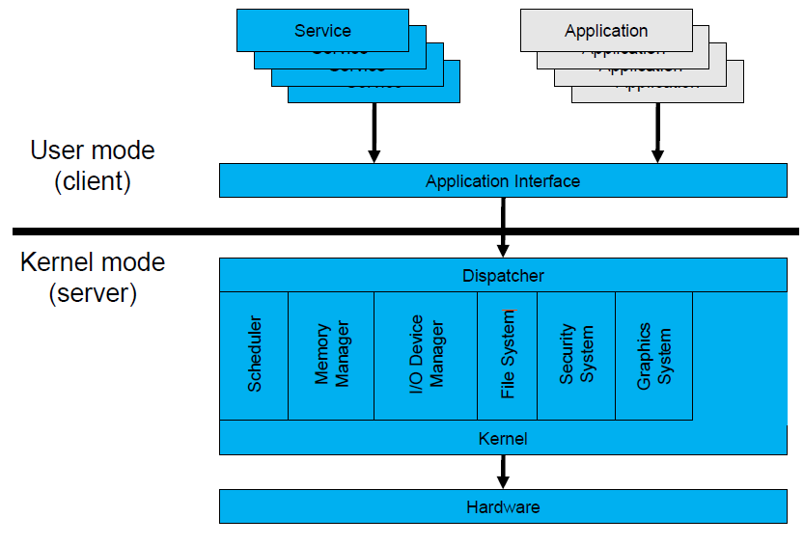
Operating System Mode
The User Mode is concerned with the actual interface between the user and the system.
It controls things like running applications and accessing files.
The Kernel Mode is concerned with everything running in the background.
It controls things like accessing system resources, controlling hardware functions and processing program instructions.
System calls are used to change mode from User to Kernel.

Slide 12
Two Views of Operating System
1. User's View
2. SystemView
Operating System: User View The user view of the computer refers to the interface being used.
Such systems are designed for one user to monopolize its resources, to maximize the work that the user is performing. In these cases, the operating system is designed mostly for ease of use, with some attention paid to performance

Slide 13
Operating System: System View The operating system can be viewed as a resource allocator also.
A computer system consists of many resources like - hardware and software - that must be managed efficiently.
The operating system acts as the manager of the resources, decides between conflicting requests, controls the execution of programs, etc.

Slide 14
Types of Operating System
1. Simple Batch System
2. Multiprogrammed
3. Time-Shared
4. Personal Computer
5. Parallel
6. Distributed Systems
7. Real Time Systems

Slide 15
Simple Batch System
In a Batch Operating System, the similar jobs are grouped together into batches with the help of some operator and these batches are executed one by one.

Slide 16
For example, let us assume that we have 10 programs that need to be executed.
Some programs are written in C++, some in C and rest in Java.
Now, every time when we run these programmes individually then we will have to load the compiler of that particular language and then execute the code.
But what if we make a batch ofthese 10 programmes. The benefit with this approach is that, for the C++ batch, you need to loadthe compiler only once.
Similarly, for Java and C, the compiler needs to be loaded only once and the whole batch gets executed

Slide 17
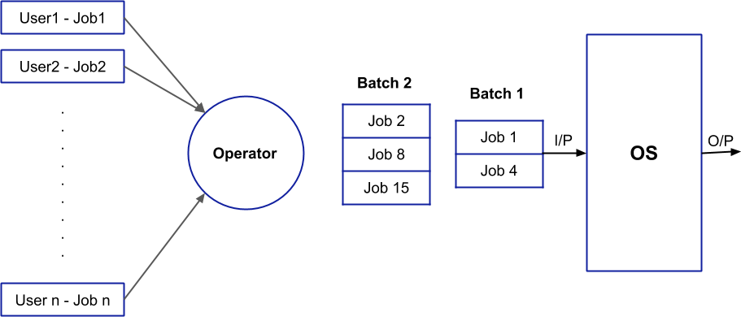

Slide 18
Advantages:
The overall time taken by the system to execute all the programmes will be reduced.
The Batch Operating System can be shared between multiple users.

Slide 19
Disadvantages:
Manual interventions are required between two batches.
The CPU utilization is low because the time taken in loading and unloading of batches is very high as compared to execution time.

Slide 20
Multiprogramming:
Sharing the processor, when two or more programs reside in memory at the same time, is referred as multiprogramming.
Multiprogramming assumes a single shared processor.
Multiprogramming increases CPU utilization by organizing jobs so that the CPU always has one to execute.

Slide 21
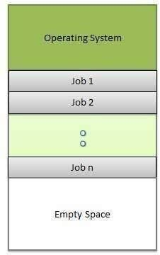

Slide 22
The operating system keeps several jobs in memory at a time.
This set of jobs is a subset of the jobs kept in the job pool.
The operating system picks and begins to execute one of the jobs in the memory.
Multiprogramming operating systems monitor the state of all active programs and system resources using memory management programs to ensures that the CPU is never idle, unless there are no jobs to process.

Slide 23
Advantages
High and efficient CPU utilization.
User feels that many programs are allotted CPU almost simultaneously

Slide 24
Disadvantages
CPU scheduling is required.
To accommodate many jobs in memory, memory management is required

Slide 25
Time Sharing Operating System
In the time-sharing environment, we decide a time that is called time quantum and when the process starts its execution then the execution continues for only that amount of time and after that, other processes will be given chance for that amount of time only.
In the next cycle, the first process will again come for its execution and it will be executed for that time quantum only and again next process will come. This process will continue.

Slide 26
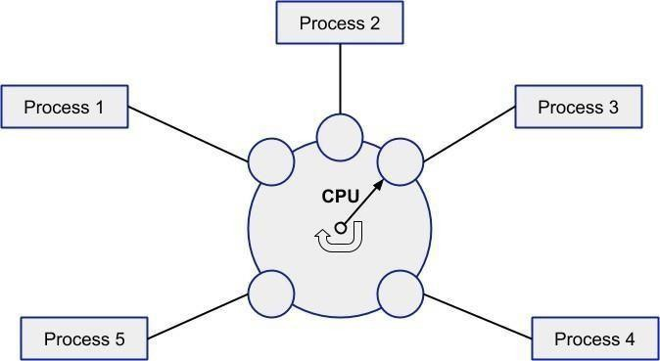
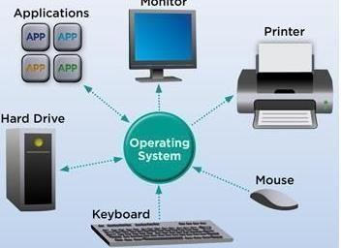

Slide 27
Advantages:
Since equal time quantum is given to each process, so each process gets equal opportunity to execute.
The CPU will be busy in most of the cases and this is good to have case

Slide 28
Disadvantages:
Process having higher priority will not get the chance to be executed first because the equal opportunity is given to each process

Slide 29
Personal Computers
Personal computer operating system provides a good interface to a single user.
Personal computer operating systems are widely used for word processing, spreadsheets and Internet access.
Personal computer operating system are made only for personal.
You can say that your laptops, computer systems, tablets etc. are your personal computers and the operating system such as windows 7, windows 10, android, etc. are your personal computer operating system.

Slide 31
Parallel Processing
Parallel processing requires multiple processors and all the processor works simultaneously in the system.
Here, the task is divided into subparts and these subparts are then distributed among the available
processors in the system.
Parallel processing completes the job on the shortest possible time.
All the processors in the parallel processing environment should run on the same operating system.
All processors here are tightly coupled and are packed in one casing
All the processors in the system share the common secondary storage like the hard disk. As this is the first place where the programs are to be placed.
There is one more thing that all the processors in the system share i.e. the user terminal (from where the user interact with the system). The user need not to be aware of the inner architecture of the machine. He should feel that he is dealing with the single processor only and his interaction with the system would be the same as in a single processor,

Slide 32
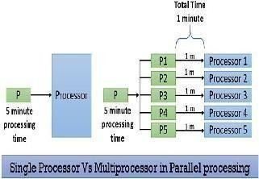

Slide 33
Advantages
It saves time and money as many resources working together will reduce the time and cut potential costs.
It can be impractical to solve larger problems on Serial Computing.
It can take advantage of non-local resources when the local resources are finite.
Serial Computing ‘wastes’ the potential computing power, thus Parallel Computing makes
better work of the hardware.

Slide 34
Disadvantages
  It addresses such as communication and synchronization between multiple sub-tasks and
  processes which is difficult to achieve.
  2.The algorithms must be managed in such a way that they can be handled in a parallel mechanism.

Slide 35
Various autonomous interconnected computers communicate with each other using a shared communication network. Independent systems possess their own memory unit and CPU. These are referred to as loosely coupled systems or distributed systems.
Distributed Operating System

Slide 36
The major benefit of working with these types of the operating system is that it is always possible that one user can access the files or software which are not actually present on his system but some other system connected within this network i.e., remote access is enabled within the devices connected in that network.

Slide 37
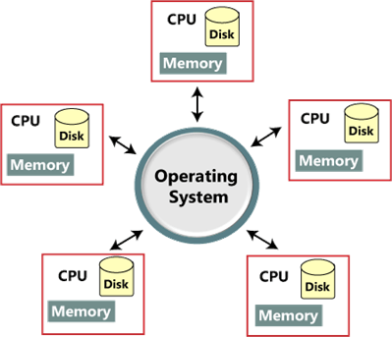

Slide 38
Advantages of Distributed Operating System:
    Since resources are being shared, computation is highly fast and durable
    Load on host computer reduces
    These systems are easily scalable as many systems can be easily added to the network
    Delay in data processing reduces
    Failure of one will not affect the other network communication, as all systems are independent
    from each other

Slide 39
Disadvantages of Distributed Operating System:
Failure of the main network will stop the entire communication
    To establish distributed systems the language which is used are not well defined yet
    These types of systems are not readily available as they are very expensive.

Slide 40
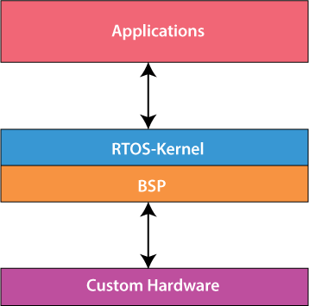
Real-Time Operating System:

Slide 41
Real-Time Operating System
These types of OSs serve real-time systems.
The time interval required to process and respond to inputs is very small.
This time interval is called response time.
Real-time systems are used when there are time requirements that are very strict like
  missile systems,
  air traffic control systems,
  robots, etc.

Slide 42
Hard Real-Time Systems:
These are used for the applications where timing is critical or response time is a major factor; even a delay of a fraction of the second can result in a disaster.
For example, airbags and automatic parachutes that open instantly in case of an accident. Besides this, these systems lack virtual

Slide 43
Soft Real-Time Systems:
These are used for application where timing or response time is less critical. Here, the failure to meet the deadline may result in a degraded performance instead of a disaster.
For example, video surveillance (cctv), video player, virtual reality, etc.

Slide 44
Advantages of real-time operating system:
o The output is more and quick owing to the maximum utilization of devices and system
o Task shifting is very quick, e.g., 3 microseconds, due to which it seems that several tasks are executed simultaneously
o Gives more importance to the currently running applications than the queued application
o It can be used in embedded systems like in transport and others.
o It is free of errors.
Memory is allocated appropriately.
o

Slide 45
Disadvantages of real-time operating system:
o A fewer number of tasks can run simultaneously to avoid errors.
o It is not easy for a designer to write complex and difficult algorithms or proficient programs required to get the desired output.
o Specific drivers and interrupt signals are required to respond to interrupts quickly.
o It may be very expensive due to the involvement of the resources required to work.

Slide 46
System components
Process Management
I/O Device Management
File Management
Network Management
Main Memory Management
Secondary Storage Management
Security Management
Command Interpreter System

Slide 47
Process Management
A process is a program in execution.
A process needs certain resources, including CPU time, memory, files, and I/O devices to accomplish its task.
Simultaneous execution leads to multiple processes. Hence creation, execution and termination of a process are the most basic functionality of an OS
If processes are dependent, than they may try to share same resources. thus task of process synchronization comes to the picture.
If processes are independent, than a due care needs to be taken to avoid their overlapping in memory area.
Based on priority, it is important to allow more important processes to execute first than others.

Slide 48
Device Management or I/O Management
Device controllers are components on the motherboard (or on expansion cards) that act as an interface between the CPU and the actual device.
Device drivers, which are the operating system software components that interact with the devices controllers.
A special device (inside CPU) called the Interrupt Controller handles the task of receiving interrupt requests and prioritizes them to be forwarded to the processor.
Deadlocks can occur when two (or more) processes have control of different I/O resources that are needed by the other processes, and they are unwilling to give up control of the device.
It performs the following activities for device management.
  Keeps tracks of all devices connected to system.
  Designates a program responsible for every device known as Input/output controller.
  Decides which process gets access to a certain device and for how long.
  Allocates devices in an effective and efficient way.
  Deallocates devices when they are no longer required.

Slide 49
File Management
A file is a collection of related information defined by its creator.
File systems provide the conventions for the encoding, storage and management of data on a storage device such as a hard disk.
  FAT12 (floppy disks)
  FAT16 (DOS and older versions of Windows)
  FAT32 (older versions of Windows)
  NTFS (newer versions of Windows)
  EXT3 (Unix/Linux)
  HFS+ (Max OS X)
The operating system is responsible for the following activities in connections with file management:
  ✦ File creation and deletion.
  ✦ Directory creation and deletion.
  ✦ Support of primitives for manipulating files and directories.
  ✦ Mapping files onto secondary storage.
  ✦ File backup on stable (nonvolatile) storage media.

Slide 50
Network Management
Network management is the process of managing and administering a computer network.
A computer network is a collection of various types of computers connected with each other.
Following are the features of network management:
Network administration
Network maintenance
Network operation
Network provisioning
Network security

Slide 51
Main Memory Management
Memory is a large array of words or bytes, each with its own address.
It is a repository of quickly accessible data shared by the CPU and I/O devices.
Main memory is a volatile storage device. When the computer made turn off everything stored in RAM will be erased automatically.
In addition to the physical RAM installed in your computer, most modern operating systems allow your computer to use a virtual memory system. Virtual memory allows your computer to use part of a permanent storage device (such as a hard disk) as extra memory.
The operating system is responsible for the following activities in connections with memory management:
  Keep track of which parts of memory are currently being used and by whom.
  Decide which processes to load when memory space becomes available.
  Allocate and de-allocate memory space as needed.

Slide 52
Secondary Storage Management
The operating system is responsible for the following activities in connection with disk management:
Free space management
Storage allocation
Disk scheduling

Slide 53
Security Management
Security Management refers to a mechanism for controlling the access of programs, processes, or users to the resources defined by a computer controls to be imposed, together with some means of enforcement.

Slide 54
There are several ways for users to interface with the operating system. One of the approaches to user interaction with the operating system is through commands.
The command interpreter accepts and executes the commands entered by a user.
Command Interpreter System executes a user command by calling one or more
number of underlying system programs or system calls.
Command Interpreter System allows human users to interact with the
Operating System and provides convenient programming environment to the users.
Command Interpreter System

Slide 55
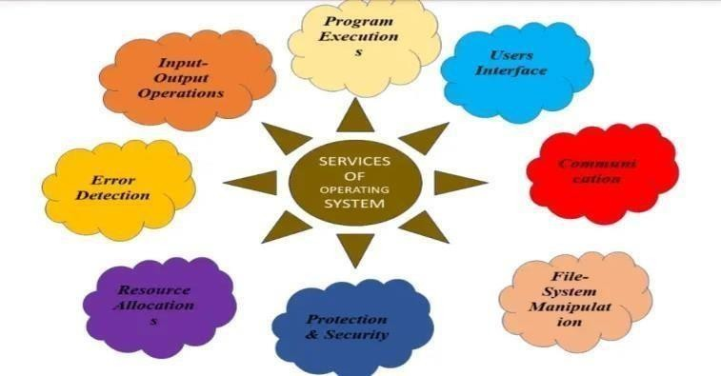
Operting System Services

Slide 56
Program Execution
The operating system Loads program into memory
It also Executes the program
It Handles the program’s execution
It Provides a mechanism for process synchronization
It Provides a mechanism for process communication

Slide 57
I/O Operations
•The communication between the user and devices drivers are managed by the operating system.
•I/O devices are required for anyrunning process. In I/O a file or an I/O devices can be involved.
•I/O operations are the read or write operations which are done with the help of input-output devices.
•Operating system give the access to the I/O devices when it required.

Slide 58
File system manipulation
There are some major activities which are performed by an operating system with respect to file management.
The operating system gives an access to the program for performing an operation on the file.
Programs need to read and write a file.
The user can create/delete a file by using an interface provided by the operating system.
The operating system provides an interface to the user creates/ delete directories.
The backup of the file system can be created by using an interface provided by the perating system.

Slide 59
4)Communication
•Two processes may require data to be transferred between the process.•
Both the processes can be on one computer or a different computer, but are connected through a computer network.

Slide 60
5)Error handling
An error is one part of the system that may cause malfunctioning of the complete system.
The operating system constantly monitors the system for detecting errors to avoid some situations.
•The OS continuously checks for the possible errors.
•The OS takes an appropriate action to correct errors and consistent computing.

Slide 61
6)Resource management
When there are multiple users or multiple jobs running at the same time resources must be allocated to each of them.
•The OS manages all kinds of resources using schedulers.
•CPU scheduling algorithm is used for better utilization of CPU.

Slide 62
Protection
The owners of information stored in a multi-user computer system want to control its use. When several disjoints processes execute concurrently it should not be possible for any process to interfere with another process. Every process in the computer system must be secured and controlled.

Slide 63
Introduction to Linux operating system
The Linux Operating System is a type of operating system that is similar to Unix, and it is built upon the Linux Kernel.
The Linux Kernel is like the brain of the operating system because it manages how the computer interacts with its hardware and resources.
It makes sure everything works smoothly and efficiently.
But the Linux Kernel alone is not enough to make a complete operating system. To create a full and functional system, the Linux Kernel is combined with a collection of software packages and utilities,

Slide 64
The defining component of Linux is the Linux kernel, an operating system kernel first released 5 October 1991 by Linus Torvalds.
Linux was originally developed as a free operating system for Intel x86-based personal computers.
It is a leading operating system on servers and other big iron systems such as mainframe computers and supercomputers more than 90% of today's 500 fastest supercomputers run some variant of Linux
Linux also runs on embedded systems such as mobile phones, tablet computers, network routers, televisions and video game consoles;

Slide 65
Basic Features
Portable –
Open Source
Multi-User.
Multiprogramming
Hierarchical File System

Slide 66
Advantage of Linux Operating System
Low cost:You don‘t need to spend time and money to obtain licenses since Linux and much of its software come with the GNU General Public License
Stability: Linux doesn‘t need to be rebooted periodically to maintain performance levels
Performance:Linux provides persistent high performance on workstations and on networks.
Network friendliness:Linux was developed by a group of programmers over the Internet and has therefore strong support for network functionality; client and server systems can be easily set up on any computer running Linux.
Flexibility: Linux can be used for high performance server applications, desktop applications, and embedded systems.
  Compatibility: It runs all common UNIX software packages and can process all common file formats.

Slide 67
Choice: The large number of Linux distributions gives you a choice. Each distribution is developed and supported by a different organization.
Fast and easy installation: Most Linux distributions come with user-friendly installation and setup programs
Full use of hard disk: Linux continues work well even when the hard disk is almost full
Security: Linux is one of the mo st secure operating systems. ―Walls‖ and flexible file access permission systems prevent access by unwanted visitors or viruses.
Open Source:If you develop software that requires knowledge or modification of the operating system code, LINUX‘s source code is at your fingertips.

Slide 68
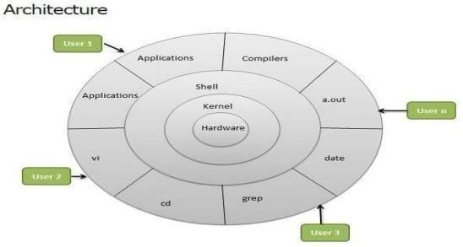

Slide 69
Linux System Architecture is consists of following layers
Hardware layer - Hardware consists of all peripheral devices (RAM/ HDD/ CPU etc).
Kernel - Core component of Operating System, interacts directly with hardware, provides low level services to upper layer components.
Shell - An interface to kernel, hiding complexity of kernel's functions from users. Takes commands from user and executes kernel's functions.
Utilities - Utility programs giving user most of the functionalities of an operating systems.

Slide 70
LINUX File system
In Linux file structure files are grouped according to purpose. Ex: commands, data files, documentation. Parts of a Unix directory tree are listed below

Slide 71
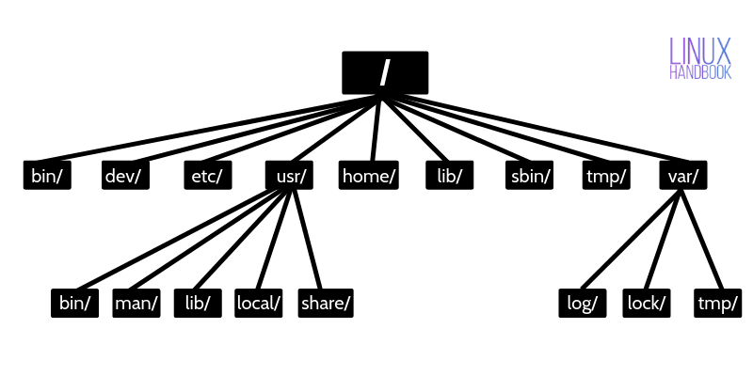

Slide 72
1) / – Root
  Every single file and directory starts from the root directory.
  Only root user has write privilege under this directory.
2) /bin – User Binaries
  Contains binary executables.
  Common linux commands you need to use in single-user modes are located under this directory.
  Commands used by all the users of the system are located here.
  For example: ps, ls, ping, grep, cp.

Slide 73
3) /sbin – System Binaries
  Just like /bin, /sbin also contains binary executables.
  But, the linux commands located under this directory are used typically by system administrator, for system maintenance purpose.
  For example: iptables, reboot, fdisk, ifconfig, swapon
4)/etc – Configuration Files
  Contains configuration files required byall programs.
  This also contains startup and shutdown shell scripts used to start/stop individual programs.
  For example: /etc/resolv.conf, /etc/logrotate.conf

Slide 74
5)/dev – Device Files
  Contains device files.
  These include terminal devices, usb, or anydevice attached to the system.
  For example: /dev/tty1, /dev/usbmon0
6)/proc – Process Information
  Contains information about system process.
  This is a pseudo filesystem contains information about running process. For example:
/proc/{pid} directorycontains information about the process with that particular pid.
  This is a virtual filesystem with text information about system resources.
  For example:/proc/uptime

Slide 75
7)/var – Variable Files
  var stands for variable files.
  Content of the files that are expected to grow can be found under this directory.
  This includes — system log files (/var/log); packages and database files
(/var/lib); emails (/var/mail); print queues (/var/spool); lock files (/var/lock); temp files needed across reboots (/var/tmp);
8)/tmp – Temporary Files
  Directory that contains temporary files created bysystem and users.
Files under this directory are deleted when system is rebooted

Slide 76
9)/usr – User Programs
  Contains binaries, libraries, documentation, and source-code for second level programs.
  /usr/bin contains binary files for user programs. If you can‘t find a user binary under
/bin, look under /usr/bin. For example: at, awk, cc, less, scp
  /usr/sbin contains binary files for system administrators. If you can‘t find a system binary under /sbin, look under /usr/sbin. For example: atd, cron, sshd, useradd, userdel
  /usr/lib contains libraries for /usr/bin and /usr/sbin
  /usr/local contains users programs that you install from source. For example, when youinstall apache from source, it goes under /usr/local/apache2

Slide 77
10)/home – Home Directories
  Home directories for all users to store their personal files.
  For example: /home/john, /home/nikita
11)/boot – Boot Loader Files
  Contains boot loader related files.
  Kernel initrd, vmlinux, grub files are located under /boot
  For example: initrd.img-2.6.32-24-generic, vmlinuz-2.6.32-24-generic

Slide 78
12)/lib – System Libraries
  Contains library files that supports the binaries located under /bin and /sbin
  Library filenames are either ld* or lib*.so.*
  For example: ld-2.11.1.so, libncurses.so.5.7
13)/opt – Optional add-on Applications
  opt stands for optional.
  Contains add-on applications from individual vendors.
  add-on applications should be installed under either /opt/ or /opt/ sub-directory.

Slide 79
14)/mnt – Mount Directory
  Temporary mount directorywhere sysadmins can mount filesystems.
15)/media – Removable Media Devices
  Temporary mount directory for removable devices.
  For examples, /media/cdrom for CD-ROM; /media/floppy for floppy drives;
/media/cdrecorder for CD writer

Slide 80
16)/srv – Service Data
  srv stands for service.
  Contains server specific services related data.
  For example, /srv/cvs contains CVS related data.

Slide 81


