Slide 1
Comprehensive Digital Marketing
Project Work-Tech Mahindra

Slide 2

Part 1: Brand study, Competitor Analysis & Buyer’s/Audience’s Persona
Research Brand Identity: Study the brand's mission, values, vision, and unique selling propositions (USPs).
Brand colours: Purple, Red
Logo:
Tech Mahindra is an Indian multinational technology company that provides information technology (IT) services and solutions. It is a subsidiary of the Mahindra Group, a diversified conglomerate based in India.

Slide 3
Part 1: Brand study, Competitor Analysis & Buyer’s/Audience’s Persona
Mission/Value:
Tech Mahindra, a leading technology services and consulting company, aims to empower individuals, organizations, and societies to achieve their full potential through the innovative use of technology and digital solutions. Their mission reflects a commitment to creating a positive impact on people's lives by leveraging technology to drive growth, efficiency, and transformation.
USP:
Tech Mahindra has a strong focus on providing IT services and solutions to the telecommunications industry. They have extensive domain expertise in this sector, allowing them to understand the unique challenges and requirements faced by telecom companies and offer tailored solutions.
Tagline: "Connected World. Connected Experiences."

Slide 4
Part 1: Brand study, Competitor Analysis & Buyer’s/Audience’s Persona
Analyze Brand Messaging:
Tech Mahindra positioned itself as a forward-thinking technology company, emphasizing its focus on innovation and cutting-edge solutions. The brand messaging highlighted the company's ability to leverage emerging technologies to drive digital transformation for its clients and help them stay ahead in a rapidly evolving digital landscape.
The brand messaging emphasized Tech Mahindra's commitment to creating a connected world. This theme underscores the company's expertise in providing connectivity solutions, enabling seamless communication and integration across various industries and domains.
Examine the brand's tagline:"Connected World,“"Connected Experiences"
The tagline starts with "Connected World," which immediately highlights Tech Mahindra's focus on connectivity. It suggests that the company plays a crucial role in enabling communication and collaboration in an increasingly interconnected global landscape..

Slide 5
Part 1: Brand study, Competitor Analysis & Buyer’s/Audience’s Persona
Competitor Analysis: Select three competitors operating in the same industry or niche as the chosen brand, examine their USPs and online communication.
Competitor 1: https://www.tcs.com/
Tata Consultancy Services (TCS):TCS emphasizes thought leadership and innovation through its website and social media channels. They share insights on emerging technologies, industry trends, and case studies of successful projects to showcase their expertise
Competitor 2: https://www.infosys.com
Infosys:TCS emphasizes thought leadership and innovation through its website and social media channels. They share insights on emerging technologies, industry trends, and case studies of successful projects to showcase their expertise
Competitor 3: https://www.wipro.com
Wipro:Wipro showcases its thought leadership and digital capabilities through its website and social media platforms. They share insights on industry trends, emerging technologies, and their approach to solving complex business challenges.

Slide 6
Part 1: Brand study, Competitor Analysis & Buyer’s/Audience’s Persona
Buyer's/Audience's Persona: Clearly define the target audience for the chosen brand. Consider demographics, psychographics, behaviors, and interests.
Demographics:
Professionals and decision-makers in various industries, including IT, telecommunications, finance, healthcare, retail, and more.
Business leaders, executives, and C-level management looking for technology solutions to drive growth and efficiency.
Government agencies and public sector organizations seeking digital transformation and IT services.
Psychographics:
Technology enthusiasts and early adopters interested in innovative solutions and emerging technologies.
Clients seeking reliable and trustworthy partners with a track record of successful projects and long-term relationships.
Organizations with a global outlook and a willingness to embrace digitalization and modernization.

Slide 7
Part 1: Brand study, Competitor Analysis & Buyer’s/Audience’s Persona
Behaviors:
Actively searching for technology services and solutions to address specific business challenges.
Conducting research and seeking expert advice before making decisions on technology investments.
Seeking partners who can provide end-to-end solutions, from consulting and implementation to support and maintenance.
Interests:
Interest in the latest trends and advancements in technology, such as AI, IoT, cloud computing, cybersecurity, and data analytics.
Focus on digital transformation initiatives to improve operational efficiency and customer experiences.
Interest in sustainable and socially responsible business practices.
Please note that Tech Mahindra's target audience may vary based on the specific services and solutions they offer, as well as their marketing strategies. For the most accurate and up-to-date information about Tech Mahindra's target audience, I recommend referring to their official website or consulting their marketing materials and market research.

Slide 8
Part 2: SEO & Keyword Research
SEO Audit: Do an SEO audit of the brands website
SEO audit for Tech Mahindra or any other website might entail. Keep in mind that specific details and strategies would require a thorough analysis and the latest data.
SEO audit is an ongoing process, and search engine algorithms may change over time. Regularly updating and optimizing your website based on new trends and data is essential to maintain a strong online presence.
Technical SEO: Verify website accessibility for search engines (robots.txt, XML sitemap).
Check for crawl errors and broken links.
Ensure the website is mobile-friendly and responsive.
Improve website speed and performance.
Implement HTTPS for a secure connection.

Slide 9
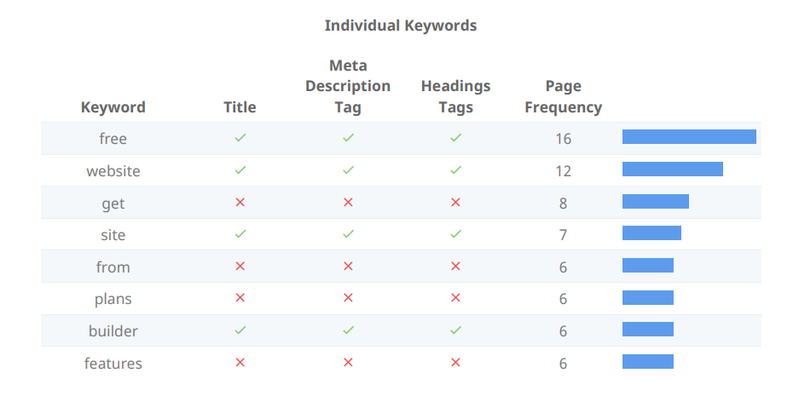

Slide 10
Part 2: SEO & Keyword Research
Company :Tech Mahindra
Keyword Research Objective:
Keyword research is a crucial step in developing an effective SEO strategy for Tech Mahindra. Below, I'll provide you with a general process to conduct keyword research. Keep in mind that the specific keywords you target should align with Tech Mahindra's services, industry, and target audience. Also, using a keyword research tool, like Google Keyword Planner or SEMrush, can help you gather more accurate data.
Keyword research:Keyword research objectives for Tech Mahindra should align with the company's broader business goals and marketing objectives. Here are some key objectives for conducting keyword research
Brand –Related keywords:
Tech Mahindra
Tech Mahindra services
Tech Mahindra solutions
IT services
IT consulting
Digital transformation
.

Slide 11
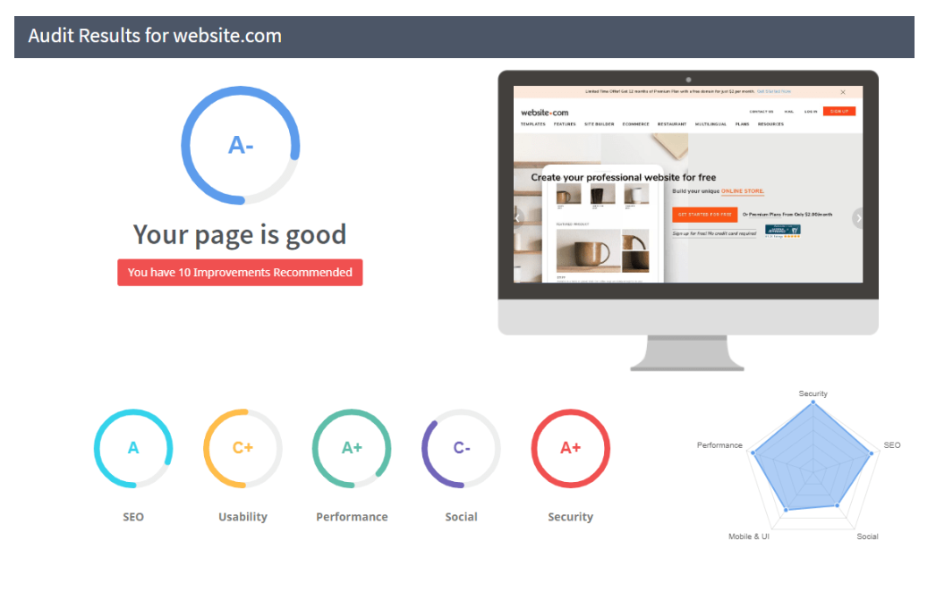

Slide 12
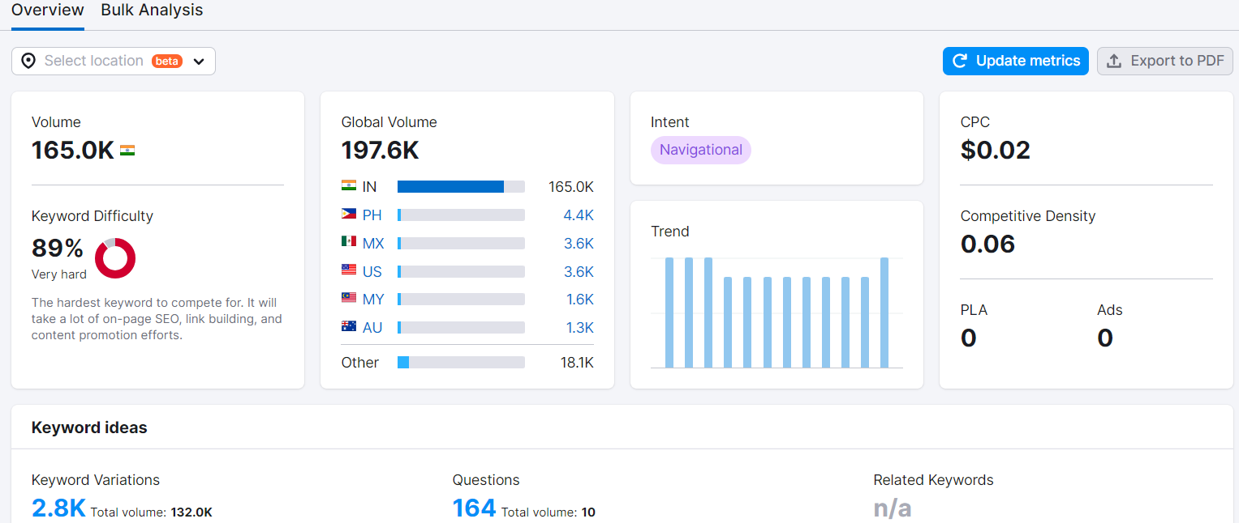

Slide 13
Part 2: SEO & Keyword Research
On page Optimization:
Meta Tag optimization: Optimizing meta tags is an important aspect of on-page SEO for any website, including Tech Mahindra. Here's a guide to optimizing meta tags for the company's web pages
Remember to optimize each page's meta tags individually, tailoring them to the specific content and target audience of that page. Regularly monitor your website's performance in search results and make adjustments to the meta tags as needed to improve click-through rates and search visibility.
Title/Meta Tag:
Write compelling meta descriptions that summarize the page's content (around 150-160 characters).
Include relevant keywords naturally, but don't overstuff.
Use action-oriented language to encourage clicks (e.g., "Discover top-notch IT services at Tech Mahindra!").
Meta Keywords (Optional):
Note that search engines like Google don't use meta keywords for ranking.
If used, include a few relevant keywords related to the page's content.

Slide 14
Part 3: Content Ideas and Marketing Strategies
Content Idea Generation & Strategy:
Content Calender: The remaining month of July content calendar
Tech Mahindra involves planning and organizing the company's content marketing efforts over a specified period. Here's a step-by-step guide to creating a content calendar:
Define Content Marketing Goals: Determine the objectives of Tech Mahindra's content marketing strategy. Common goals may include increasing website traffic, generating leads, improving brand awareness, showcasing thought leadership, or promoting specific services.
Identify Target Audience: Understand the target audience's needs, preferences, pain points, and interests. This information will help tailor the content to resonate with the intended audience.
Research Keywords and Topics: Conduct keyword research to identify relevant topics and high-potential keywords related to Tech Mahindra's services and industry. Focus on creating valuable, informative, and engaging content around these topics.

Slide 15
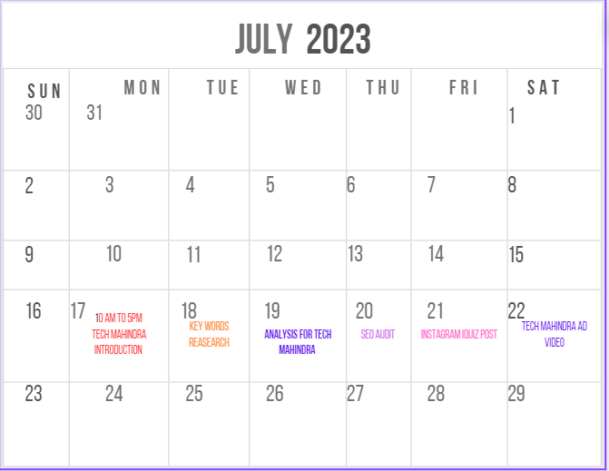
CONTENT CALLANDER

Slide 16
Part 3: Content Ideas and Marketing Strategies
Challenges Encountered:
Rapid Technological Advancements: Staying up-to-date with the latest technologies and ensuring employees have the necessary skills and training to work on cutting-edge projects can be a challenge in the fast-paced tech industry.
Global Competition: The technology services sector is highly competitive, with many global players vying for the same projects and clients. Standing out and differentiating from competitors can be a significant challenge.
Client Expectations and Project Scope: Meeting and managing client expectations, especially in complex and large-scale projects, can be demanding. Ensuring clear communication and scope definition is critical to project success.
Data Security and Privacy: As companies handle sensitive client data, maintaining robust data security measures and compliance with privacy regulations is of utmost importance
Integration Challenges: When working on large-scale projects, integrating new technology solutions with existing systems can be complex and time-consuming.
Digital Transformation: Tech Mahindra may face challenges when assisting clients in their digital transformation journey, as it involves cultural shifts, process changes, and technological upgrades.

Slide 17
Lessons Learned:
Adaptability and Innovation: Embrace a culture of adaptability and innovation to respond to changing market demands and technological advancements effectively.
Client-Centric Approach: Focus on understanding and addressing clients' specific needs and pain points to build long-lasting and successful partnerships.
Talent Development and Training: Invest in continuous learning and training programs to upskill employees and equip them with the latest knowledge and tools.
Collaboration and Partnerships: Forge strategic collaborations and partnerships with other companies and technology providers to expand service offerings and gain access to new markets.
Quality Assurance and Project Management: Implement robust quality assurance and project management processes to ensure consistent and successful project delivery.
Ethical and Social Responsibility: Prioritize ethical business practices and social responsibility initiatives to build trust with clients and stakeholders.

Slide 18
Part 4: Content Creation and Curation (Post creations, Designs/Video Editing, Ad Campaigns over Social Media and Email Ideation and Creation)
Post Creation:
Format 1:Blog Article
Aim : Boost SEO & Provide information about TECH MAHINDRA.
Date:24th july 2023
Topic: Tech Mahindra software
https://www.blogger.com/blog/posts/5489540051863761729

Slide 19
Part 4: Content Creation and Curation (Post creations, Designs/Video Editing, Ad Campaigns over Social Media and Email Ideation and Creation)
Format 2: Video
Date : 29th July 2023
Topic: Brand advertisement
Drive Link:
https://www.youtube.com/watch?v=9OgQsO4VISM&feature=youtu.be

Slide 20

Part 4: Content Creation and Curation (Post creations, Designs/Video Editing, Ad Campaigns over Social Media and Email Ideation and Creation)
Format 3: Creative Meme
Date:20th July 2023
Topic: Tech mahindra
Meme: Innavation to you

Slide 21
Part 4: Content Creation and Curation (Post creations, Designs/Video Editing, Ad Campaigns over Social Media and Email Ideation and Creation)
Instagram Story
We have created three Instagram stories on Tech Mahindra and screenshots and those are provided below:

Slide 22
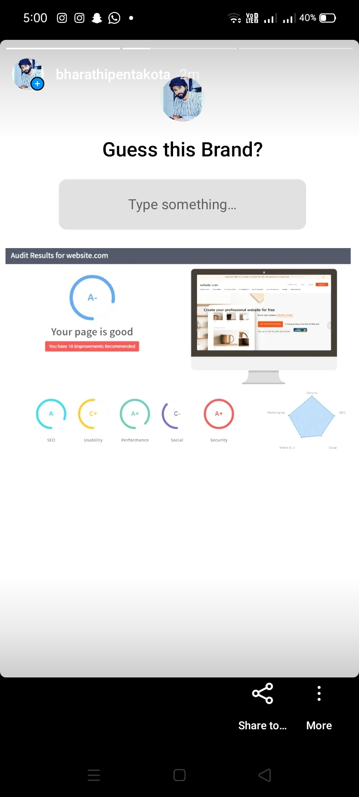
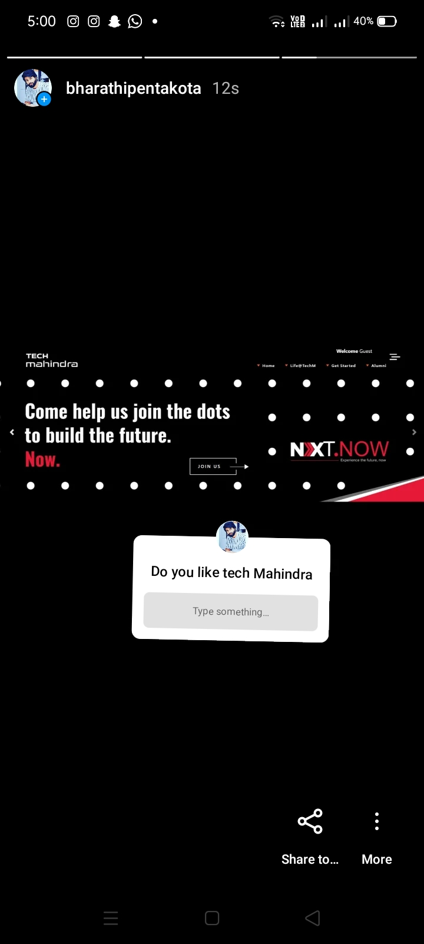
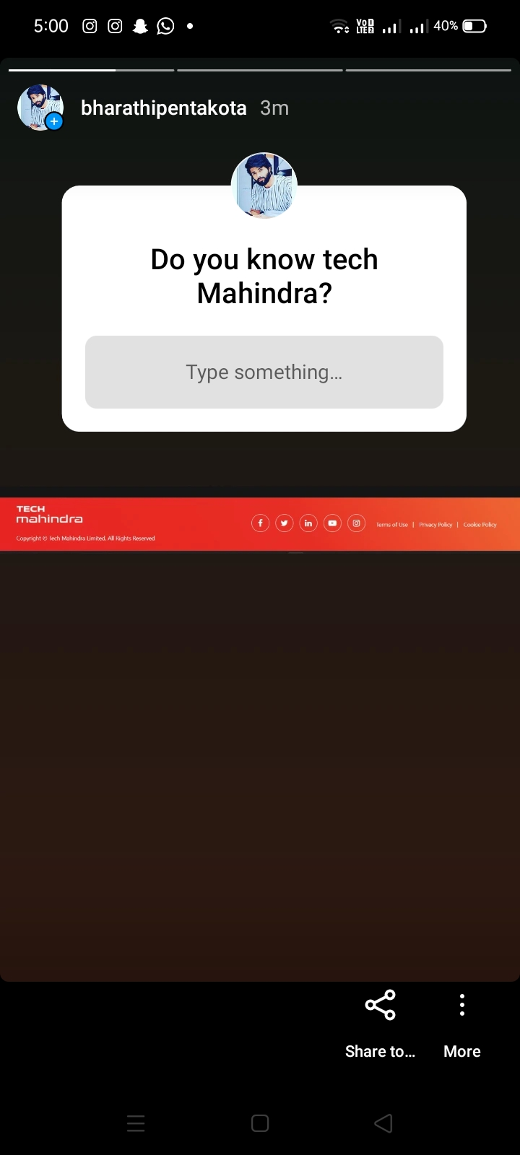

Slide 23
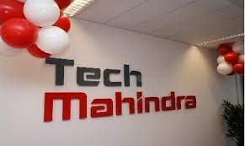
Part 4: Content Creation and Curation (Post creations, Designs/Video Editing, Ad Campaigns over Social Media and Email Ideation and Creation)
Designs/Video Editing
Design:
Video Creation: Advertisement video on TECH MAHINDRA
https://youtu.be/9OgQsO4VISM

Slide 24
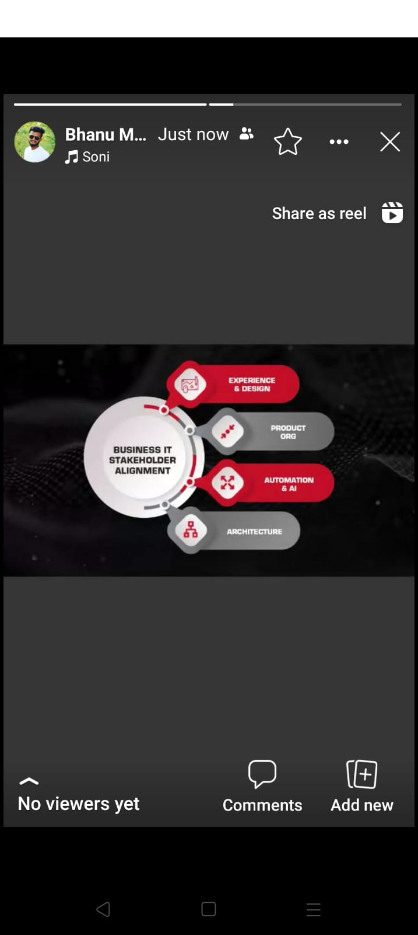
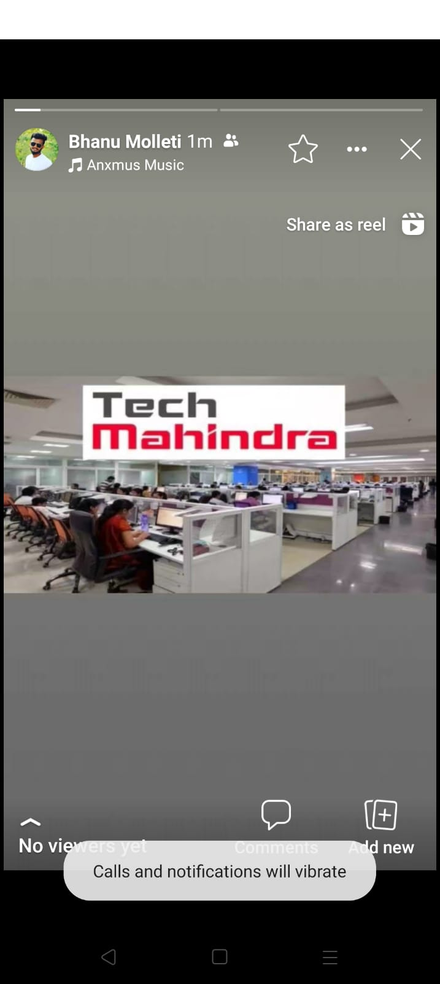
Social Media Ad Campaigns (Facebook)

Slide 25
Part 4: Content Creation and Curation (Post creations, Designs/Video
Editing, Ad Campaigns over Social Media and Email Ideation and Creation)
E mail Ad Campaigns
Ad Campaign for email marketing:
Brand awareness:
Tech Mahindra's brand awareness campaign aims to establish itself as a global leader in innovative technology solutions and digital transformation services. The goal is to create a strong brand presence, increase visibility, and reinforce the company's reputation as a reliable and forward-thinking partner for businesses worldwide.
Tech Mahindra is at the forefront of cutting-edge technology, empowering businesses to thrive in the digital era. We are your strategic partner in achieving success through tailored solutions and a commitment to excellence.
The logo of Tech Mahindra will be prominently featured in all marketing materials to reinforce brand recognition.
Imagery and graphics will depict futuristic technologies, happy clients, and diverse teams collaborating on innovative projects.

Slide 26
Generating leads:
The lead generation campaign aims to attract potential clients and generate high-quality leads for Tech Mahindra's technology solutions and digital transformation services. The goal is to engage the target audience, showcase Tech Mahindra's expertise, and encourage them to take action towards initiating a business partnership.
By implementing a strategic and multi-faceted lead generation campaign, Tech Mahindra can attract potential clients, build relationships, and demonstrate its expertise as a reliable technology partner. Consistent engagement, valuable content, and personalized interactions will help convert leads into satisfied clients, driving business growth for Tech Mahindra.
Referral program: Encourage satisfied clients to refer Tech Mahindra's services to others. Word-of-mouth marketing can be a powerful lead generation tool.
Analyze and refine: Regularly analyze lead generation efforts and their results. Identify what strategies are working best and refine the approach accordingly.

Slide 27
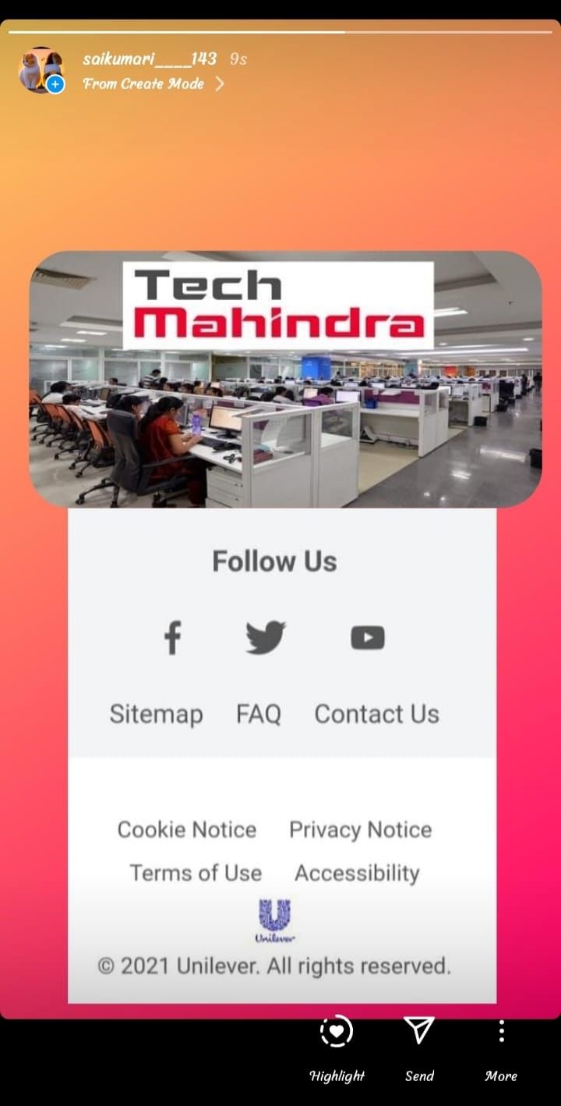
Email Ad Campaign 1- Brand Awareness
(insert emailer image)

Slide 28
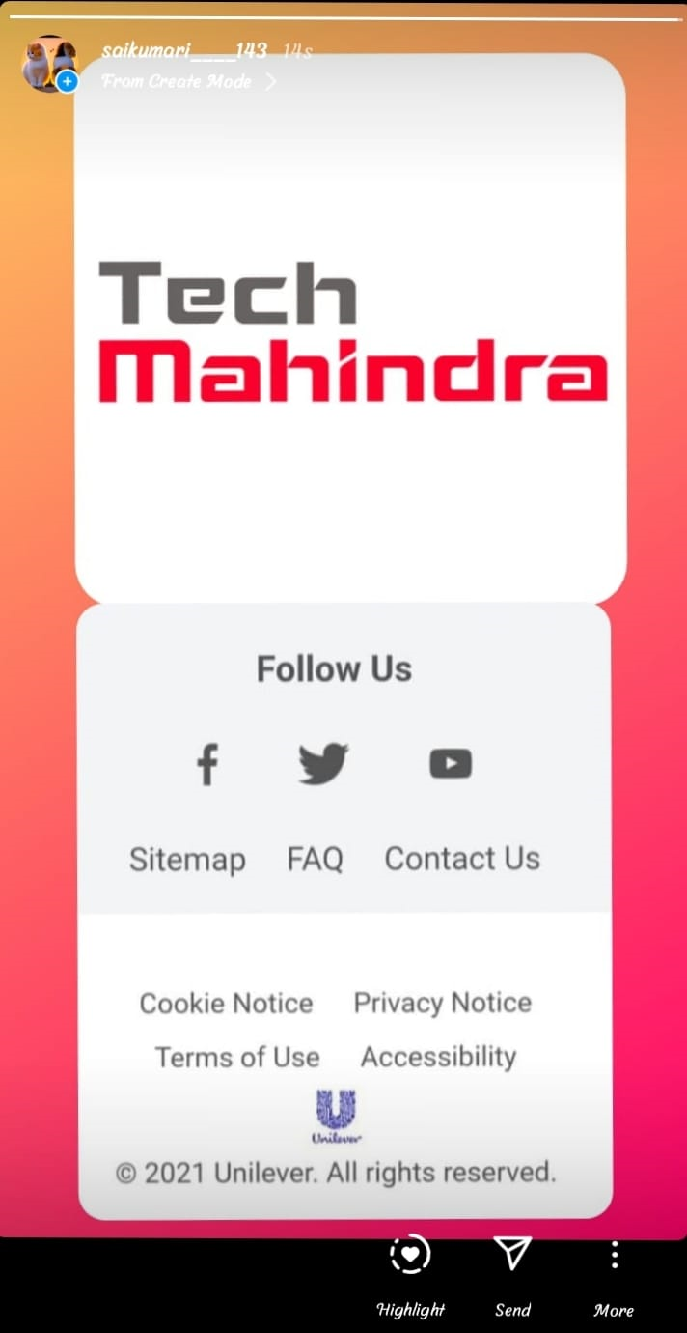
Email Ad Campaign 2 –Lead Genaration
(insert emailer images)

Slide 29
Part 4: Content Creation and Curation (Post creations, Designs/Video
Editing, Ad Campaigns over Social Media and Email Ideation and Creation
Reflect on the content creation and curation process,discussing the challenges
Faced and lessons learned.
The content creation and curation process at Tech Mahindra typically involves a structured approach to developing and sharing valuable content with the target audience. Here's an outline of the general process:
By following a structured content creation and curation process, Tech Mahindra can establish itself as an authoritative voice in the industry and effectively engage with its target audience.
Challenges faced: Tech Mahindra's strong reputation, global presence, and continuous focus on innovation have enabled it to remain competitive and maintain its position as a leading player in the IT services industry. The company's ability to adapt, evolve, and address these challenges will be crucial to its future success.
Economic downturns and market fluctuations can impact the demand for IT services. Tech Mahindra needs to navigate through these uncertainties while maintaining a stable revenue stream.
Clients' expectations are continually increasing, and they demand cost-effective, innovative, and timely solutions. Tech Mahindra must consistently meet and exceed these expectations to retain clients and secure new business.

Slide 30
Lessons learned:
Client-Centric Approach: Putting clients at the center of everything they do and deeply understanding their needs and challenges is crucial. This enables Tech Mahindra to provide tailored solutions and build long-term relationships.
Embrace Innovation: In the rapidly evolving technology landscape, embracing innovation and staying at the forefront of emerging trends is vital. Tech Mahindra must invest in research and development to offer innovative solutions to clients.
Agility and Adaptability: Being agile and adaptable to changing market dynamics and customer demands helps Tech Mahindra maintain a competitive edge. Quick adaptation to new technologies and business models is essential.
Talent Development: Nurturing and retaining top talent is critical for sustained growth. Investing in continuous training and development programs ensures that Tech Mahindra’s
Digital Transformation: As a technology company, Tech Mahindra should be a role model in its own digital transformation journey, leveraging technology to improve internal processes and customer experiences.
Resilience in Uncertain Times: Economic uncertainties and global crises can arise unexpectedly. Being resilient and adaptable during such times is crucial to overcoming challenges and sustaining business continuity.

