Slide 1
Smart Home Energy Management System
PRESENTED BY
BHARATHI SELVARAJ

Slide 2
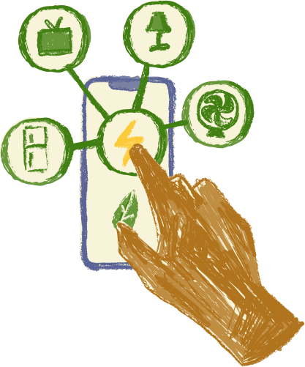
Smart Home Energy Management System
The Smart Home Energy Management System (SHEMS) is a Java-powered web platform that helps monitor, analyze, and manage energy usage within a household.
It continuously observes the electricity consumption of various devices, estimates upcoming usage patterns, and offers guidance to lower overall power costs.
SHEMS includes an interactive dashboard that displays live energy data, highlights peak consumption periods, provides cost projections, and delivers practical tips for improving energy efficiency.

Slide 3

problem
Problem
- Lack of centralized control over smart appliances
- Insecure access to devices, leading to potential misuse
- Difficulty in tracking energy consumption and identifying areas for optimization
existing system
  Homes mostly use basic electricity meters that show only total monthly consumption.
  No real-time tracking or appliance-wise monitoring of energy usage.
  Lacks automated analysis, predictions, and suggestions for reducing power consumption.
2

Slide 4
proposed system
1
2
3
Module 1: Authentication and Role Management
- Main Classes:
1. UserAuthController
2. AuthService
3. UserRepository
Smart Device Management
- Main Classes:
1. Device
2. DeviceController
3. DeviceService
4. DeviceRepository
Real Time Energy Tracking
- Main Classes:
1. UsageLog
2. EnergyTrackingController
3. EnergyTrackingService
4. UsageRepository
4
5
6
Analytics Dashboard
- Main Classes:
1. AnalyticsController
2. AnalyticsService
3. ChartGenerator
4. AnalyticsRepository
Scheduling and Automation
- Main Classes:
1. Schedule
2. SchedulerController
3. SchedulerService
4. NotificationService
5. SchedulerRepository
Recommendation System
- Main Classes:
1. Recommendation
2. RecommendationController
3. RecommendationService
4

Slide 5

system architecture
  Front-End: HTML, CSS, Bootstrap, Thymeleaf
  Back-End: Java 17/21, Spring MVC, Spring Boot, Spring Security
  REST API Layer: Spring Boot REST Controllers
  Persistence Layer: Hibernate / JPA
  Database: MySQL (Workbench) / PostgreSQL
  Deployment: Docker
9

Slide 6
MODULE OBJECTIVE
USE
To provide secure authentication and authorization mechanisms for users, ensuring that only authorized users can access and control smart devices.
AUTHCONTROLLER
AUTHSERVICE
USERREPOSITORY
USER
USE
USE
USE
USE
Represents a system user. Stores login credentials, personal details, and assigned role.
Used for authentication, authorization, and profile management.
Exposes API endpoints for authentication actions such as login, logout, token-based validation, and user registration.
Contains the business logic for authentication:
  Validates credentials
  Hashes/encrypts passwords
  Generates and validates tokens
  Coordinates with UserRepository
Handles database operations related to the User class.
6

Slide 7
WORKFLOW BETWEEN CLASSES
Step 1: User sends login request
Step 2: Controller forwards credentials to service
Step 5: Controller sends response back to user
The USER enters:
  username
  password
This request is sent to AUTHCONTROLLER.login().
It passes the received username & password to: AuthService.validateLogin(username, password)
AuthController prepares final response:
  If login success → send token + role
  If login failed → send error message
Step 3: Service checks database through repository
Step 4: Service validates and generates token
AuthService now needs user data, so it calls: UserRepository.findUserByUsername(username)
Repository fetches the stored:
  password (hashed)
  role
  userId
  name, address
AuthService now performs:
  encryptPassword(inputPassword)
  Compares with stored password
  If matched → generateToken(User)
  If not matched → return false
Finally, the Service returns:
  success/failure
  JWT token if successful
7

Slide 8
CLASS USE,PROPERTY,DATABASEKEY
USER
AUTHCONTROLLER
AUTHSERVICE
USERREPOSITORY
PROPERTIES
PROPERTIES
PROPERTIES
PROPERTIES
  userId : int
  username : String
  password : String
  role : String
  name : String
  address : String
  login(username, password)
  logout()
  register(User)
  validateLogin
(username, password) : boolean
  encryptPassword
(password) : String
  generateToken
(User) : String
  validateToken
(token) : boolean
  findUserByUsername
(username) : User
  saveUser(User)
  updateUser(User)
DATABASE KEY
DATABASE KEY
  Primary Key: userId
  Unique Key: username
  Indexed: role
  Primary Key: userId
  Unique Key: username
  Indexed: role
6

Slide 9
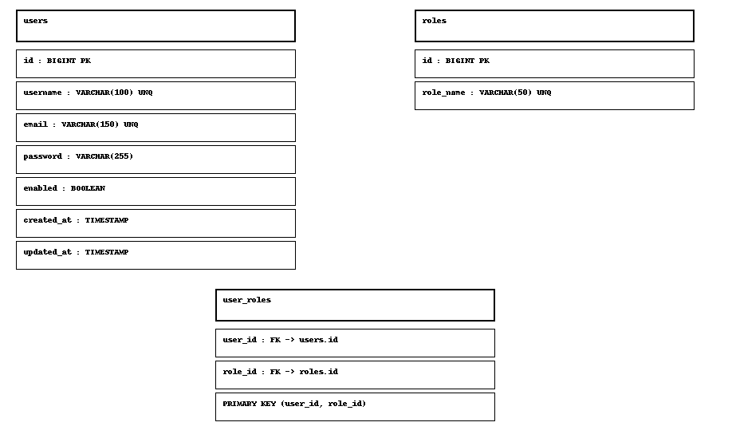
database schema

Slide 10
The End

