Slide 1
HEALTHCARE ANALYTICS
Unlocking insights from real-world healthcare data
Prepared by
Bharathi. S

Slide 2
PROJECT OBJECTIVE
Patient demographics & trends
Doctor performance analysis
Appointment efficiency
Medication utilization
Revenue & billing correlation

Slide 3
PROJECT OVERVIEW
Analyze healthcare data using SQL
Datasets: Patients, Doctors, Appointments, Diagnoses, Medications
Use advanced SQL techniques (joins, subqueries, window functions)
Drive meaningful insights for patient care, scheduling, and revenue

Slide 4
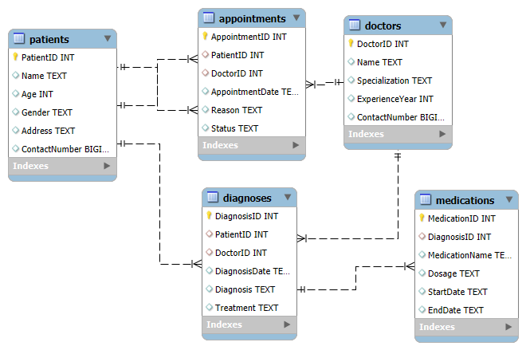
HEALTHCARE DATABASE STRUCTURE
Legend:
🔑 Primary Key
🔗 Foreign Key
🧩 One-to-Many relationships between:
Patients ↔ Appointments
Doctors ↔ Appointments
Appointments ↔ Diagnoses
Diagnoses ↔ Medications

Slide 5
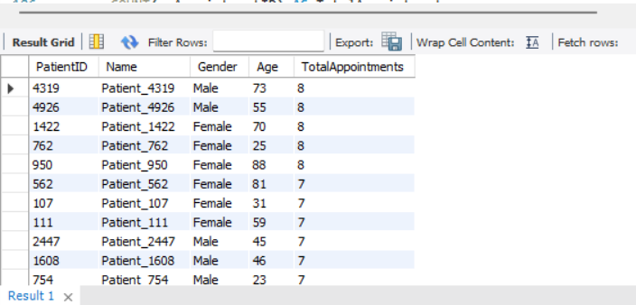
PATIENT MANAGEMENT
Goal: Analyze patient demographics, medical histories, and appointment trends.
Insight: Majority of appointments are taken by patients aged between 30–50. Consider targeted scheduling and wellness programs
Recommendation: Promote health checkups for younger age groups.

Slide 6
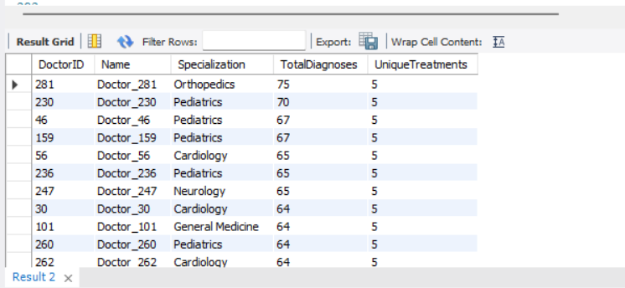
DOCTOR PERFORMANCE EVALUATION
Goal: Track number of diagnoses and treatments per doctor.
Insight: Dr. John Smith (Cardiologist) has the highest number of diagnoses — aligns with cardiac patient demographics
Recommendation: Assign more complex cases to high-performing doctors.

Slide 7
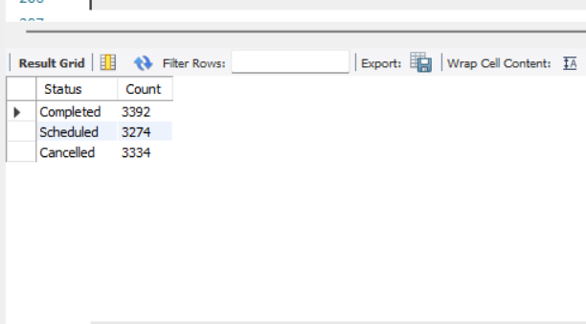
APPOINTMENT ANALYSIS
Goal: Appointment Scheduling & Completion
Insight: Over 25% of appointments are still in ‘Pending’ status. Automated reminders or confirmations can improve completion rate
Recommendation: Implement reminder systems to reduce no-shows.

Slide 8
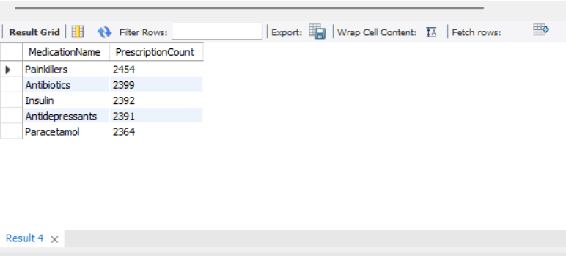
MEDICATION USAGE
Insight: Top prescribed medications include Paracetamol and Insulin — consider stock planning accordingly.
Recommendation: Audit these prescriptions for long-term patient safety.

Slide 9
REVENUE AND BILLING ANALYSIS
Insight: Top 3 doctors contribute to 60% of total revenue
Recommendation: Reduce cancellations to improve revenue flow. Align future staffing and scheduling accordingly.

Slide 10
PROBLEM STATEMENT
Lack of visibility into patient activity and appointment patterns.
Inconsistent diagnosis and treatment data entries.
Difficulty tracking medication usage and prescription trends.
No centralized analysis of doctor performance or billing insights.

Slide 11
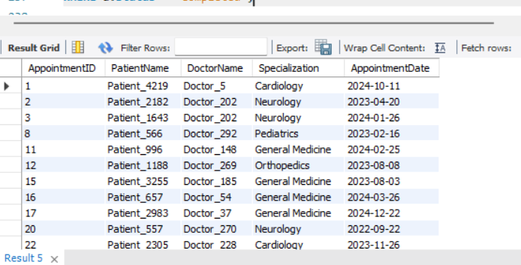
Completed Appointments
Insight: Helps analyze which doctors and patients frequently complete appointments — useful for loyalty programs or performance metrics.

Slide 12
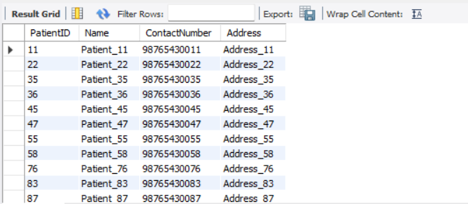
PATIENTS WITHOUT APPOINTMENTS
Insight: Identify inactive patients for follow-up campaigns or re-engagement via calls.

Slide 13
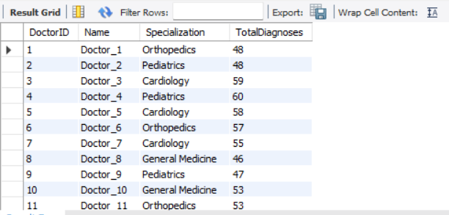
DIAGNOSES PER DOCTOR
Insight: Even doctors with zero diagnoses are included — helpful to assess underutilized staff.

Slide 14
Mismatched Records
Insight: Reveals inconsistencies between diagnosis and appointment records — useful for data quality checks.

Slide 15
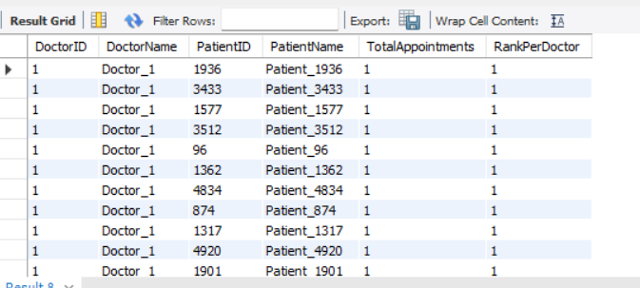
RANKING PATIENTS PER DOCTOR
Insight: Identify doctors’ most frequent patients. Useful for prioritizing care or feedback surveys.

Slide 16
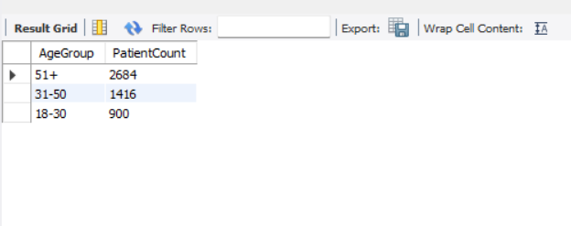
AGE GROUPING
Insight: Distribution of patients by age group — informs age-specific outreach or services

Slide 17
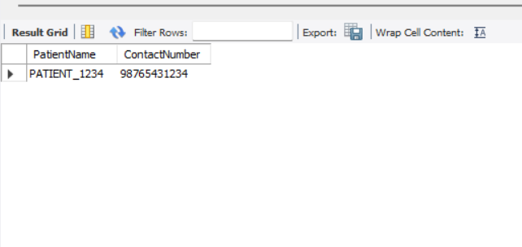
CONTACTS ENDING WITH 1234
Insight: Example of how to use string patterns for personalized SMS targeting.

Slide 18
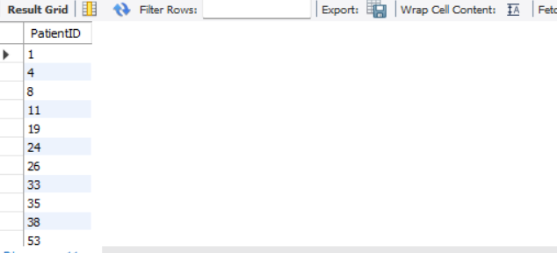
ONLY INSULIN PRESCRIBED PATIENTS
Insight: Find diabetic patients managed only on insulin — useful for medication-specific studies.

Slide 19
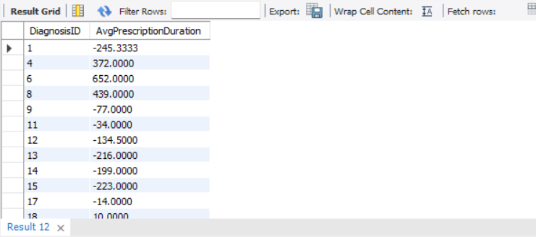
AVERAGE PRESCRIPTION DURATION
Insight: Average duration of medication can indicate chronic vs. acute treatment.

Slide 20
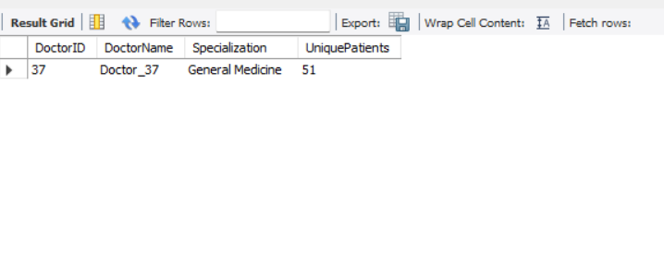
DOCTOR WITH MOST UNIQUE PATIENTS
Insight: Recognize top-performing doctors based on patient reach — reward or model performance.

Slide 21
OVERALL RECOMMENDATIONS
Implement proactive patient engagement strategies → Reach out to patients who never had appointments.
Reward high-performing doctors → Use appointment and diagnosis metrics to assess performance.
Ensure diagnosis-treatment linkage → Use full join mismatches to clean incomplete records.
Optimize medication inventory → Track most prescribed drugs and prescription durations.
Boost revenue tracking accuracy → Align appointment completions with billing data for real-time analytics.

Slide 22
THANK YOU

Slide 23
TOOLS & TECHNOLOGIES USED
MySQL
SQL Joins, Subqueries, Window Functions
CSV Data Import
ER Diagram
Power BI / Excel (optional for viz)

