Slide 1

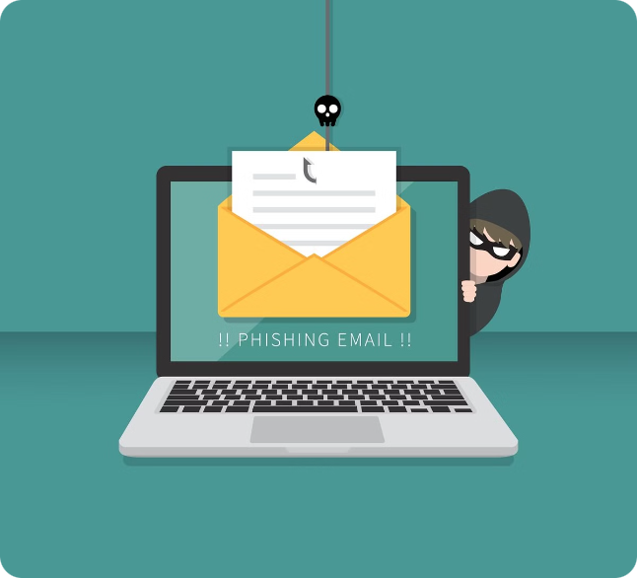
Recognizing and Avoiding Phishing Threats
Phishing is a type of cybercrime where attackers try to trick you into revealing sensitive information or installing malware. By understanding common phishing tactics, you can protect yourself and your organization from these deceptive threats.

Slide 2

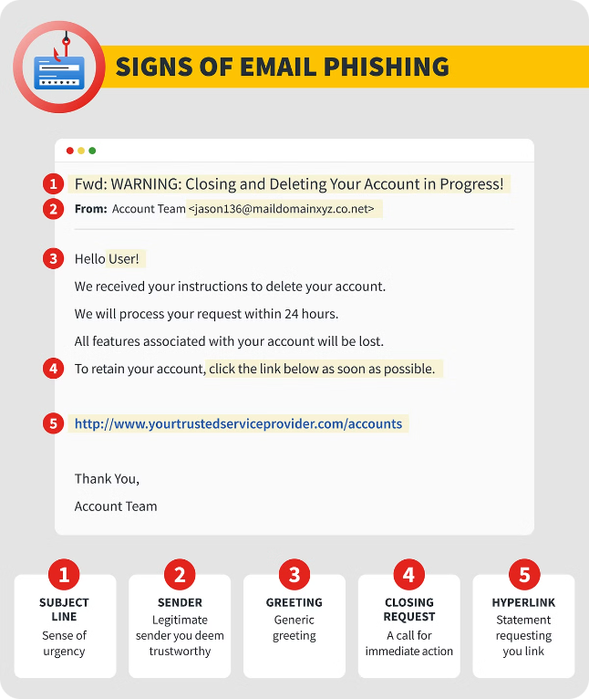
Recognizing Phishing Emails
1
Suspicious Sender
2
Urgent Requests
Look out for emails from unfamiliar or questionable email addresses.
Beware of emails that create a false sense of urgency to get you to act quickly.
3
Generic Greetings
4
Requests for Sensitive Info
Phishing emails often use generic salutations instead of personalized greetings.
Legitimate companies will never ask you to share passwords or other private data over email.

Slide 3
Identifying Suspicious Websites
Incorrect URLs
Unsecured Connections
Sketchy Design
Phishing sites often use URLs that are slightly different from the real company's website.
Look for the "https://" prefix and a valid SSL certificate to ensure a website is secure.
Phishing sites may have poor design, misspellings, or inconsistent branding compared to the real website.

Slide 4
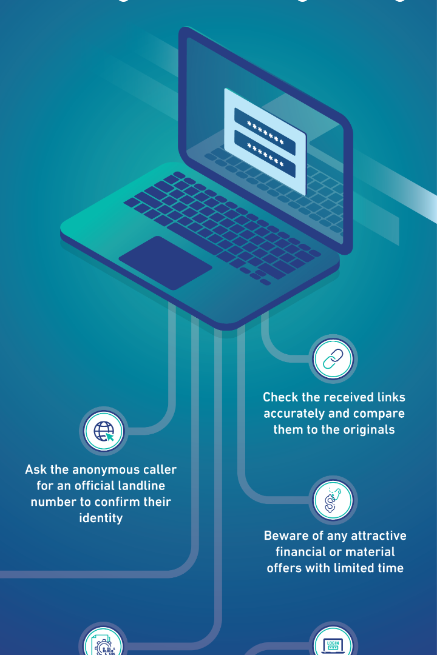
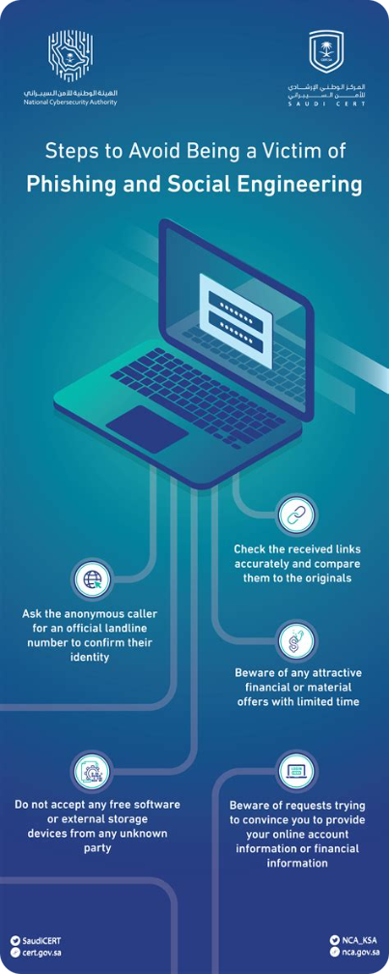
Protecting Against Social Engineering
Be Cautious of Unsolicited Calls
Question Unusual Requests
Verify the identity of anyone claiming to be from a company or organization before sharing information.
If someone is asking you to do something out of the ordinary, be skeptical and verify their authority.
Trust Your Instincts
Get a Second Opinion
If a situation feels "off" or makes you uncomfortable, it's better to err on the side of caution.
When in doubt, consult with a colleague or manager before responding to any suspicious requests.

Slide 5

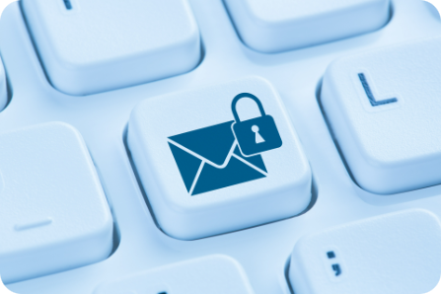




Best Practices for Email Security
Update Software
Use Strong Passwords
Enable 2FA
Be Cautious of Links
Keep your devices and software up-to-date to protect against the latest threats.
Two-factor authentication adds an extra layer of security to your accounts.
Hover over links to verify the destination before clicking.
Create unique, complex passwords for each of your online accounts.

Slide 6

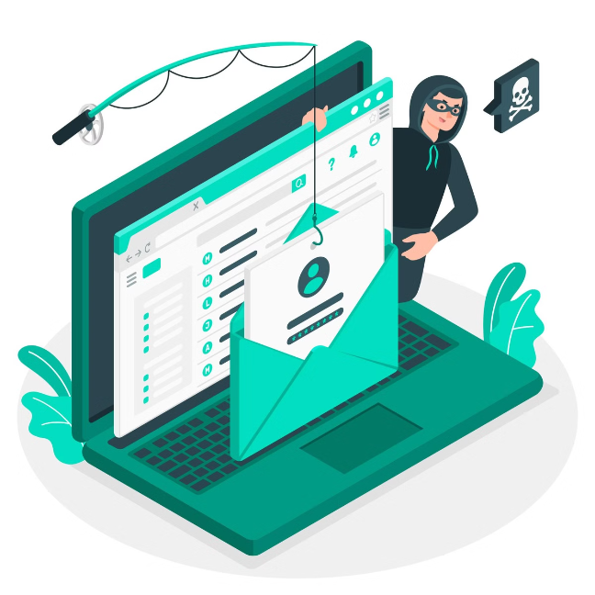
Staying Vigilant on Social Media
1
Research Connections
Verify the identity of anyone who sends you a friend request or message on social media.
2
Beware of Fake Profiles
Scammers often create false social media accounts to impersonate real people or organizations.
3
Watch for Suspicious Posts
Be wary of social media posts that ask you to click on links or download attachments.

Slide 7

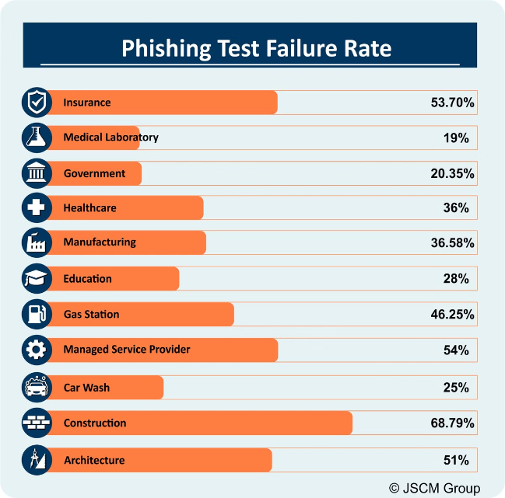



Reporting and Responding to Phishing
Notice a Phishing Attempt
If you suspect you've received a phishing email or encountered a suspicious website, don't ignore it.
Report the Incident
Notify your organization's security team or the appropriate authorities to help stop the threat.
Take Remedial Action
Change any compromised passwords, scan your devices for malware, and monitor your accounts for suspicious activity.

Slide 8

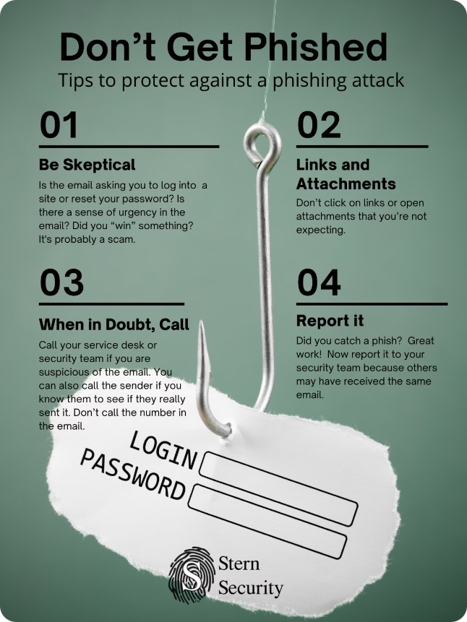
Key Takeaways
1
Stay Vigilant
2
Verify, Verify, Verify
Be cautious of unsolicited emails, links, and requests for sensitive information.
Always double-check the source and authenticity of any suspicious communication.
3
Report Phishing Attempts
4
Implement Security Best Practices
Notify the appropriate authorities to help combat these deceptive threats.
Use strong passwords, enable two-factor authentication, and keep your software up-to-date.

