Slide 1

DOQFY – DOCUMENT VERIFICATION USING BLOCK CHAIN
BATCH MEMBERS
G.KAVIYABHARATHI 812420104041
S.MOHAMED TAWFEEQ 812420104060
K.MOHAMED YUNUS 812420104062
M.MUFTHI MOHAMED 812420104064
GUIDED BY:
Mrs. R.DEEPA, M.E.,
ASSISTANT PROFESSOR / CSE

Slide 2
DOMAIN
BLOCKCHAIN TECHNOLOGY:
Blockchain technology, characterized by its decentralized, distributed ledger system, revolutionizes digital transactions by ensuring secure and transparent record-keeping across a network of computers. Essential components include decentralization, cryptography, consensus mechanisms, and smart contracts, collectively enabling trust and reliability without the need for intermediaries.

Slide 3
INTRODUCTION
In today's digital age, the authenticity and integrity of documents play a crucial role in various aspects of our lives, from academic certificates and legal documents to financial records and identity verification. However, the prevalence of document fraud and tampering poses significant challenges, undermining trust and reliability in traditional document verification systems. Blockchain technology, renowned for its decentralized and immutable ledger system, offers a promising solution to the issues of document fraud and tampering. By recording document verification transactions on a blockchain.

Slide 4
OBJECTIVE
Blockchain technology is being used for document verification to enhance security, efficiency, and transparency in digital copyright management.
This decentralized ledger ensures accurate and secure verification of digital documents, addressing challenges in rights confirmation, authorization, and maintenance within the digital copyright industry.

Slide 5
EXISTING SYSTEM
Centralized digital copyright management system faces challenges due to its lack of transparency and efficiency, reliance on intermediaries.
Unauthorized access, which compromises the integrity of digital copyrights and leads to disputes over rights.

Slide 6
PROPOSED SYSTEM
The proposed system uses blockchain technology to revolutionize document verification by utilizing decentralized networks.
Eliminating the need for centralized authorities and enabling autonomous verification process.

Slide 7
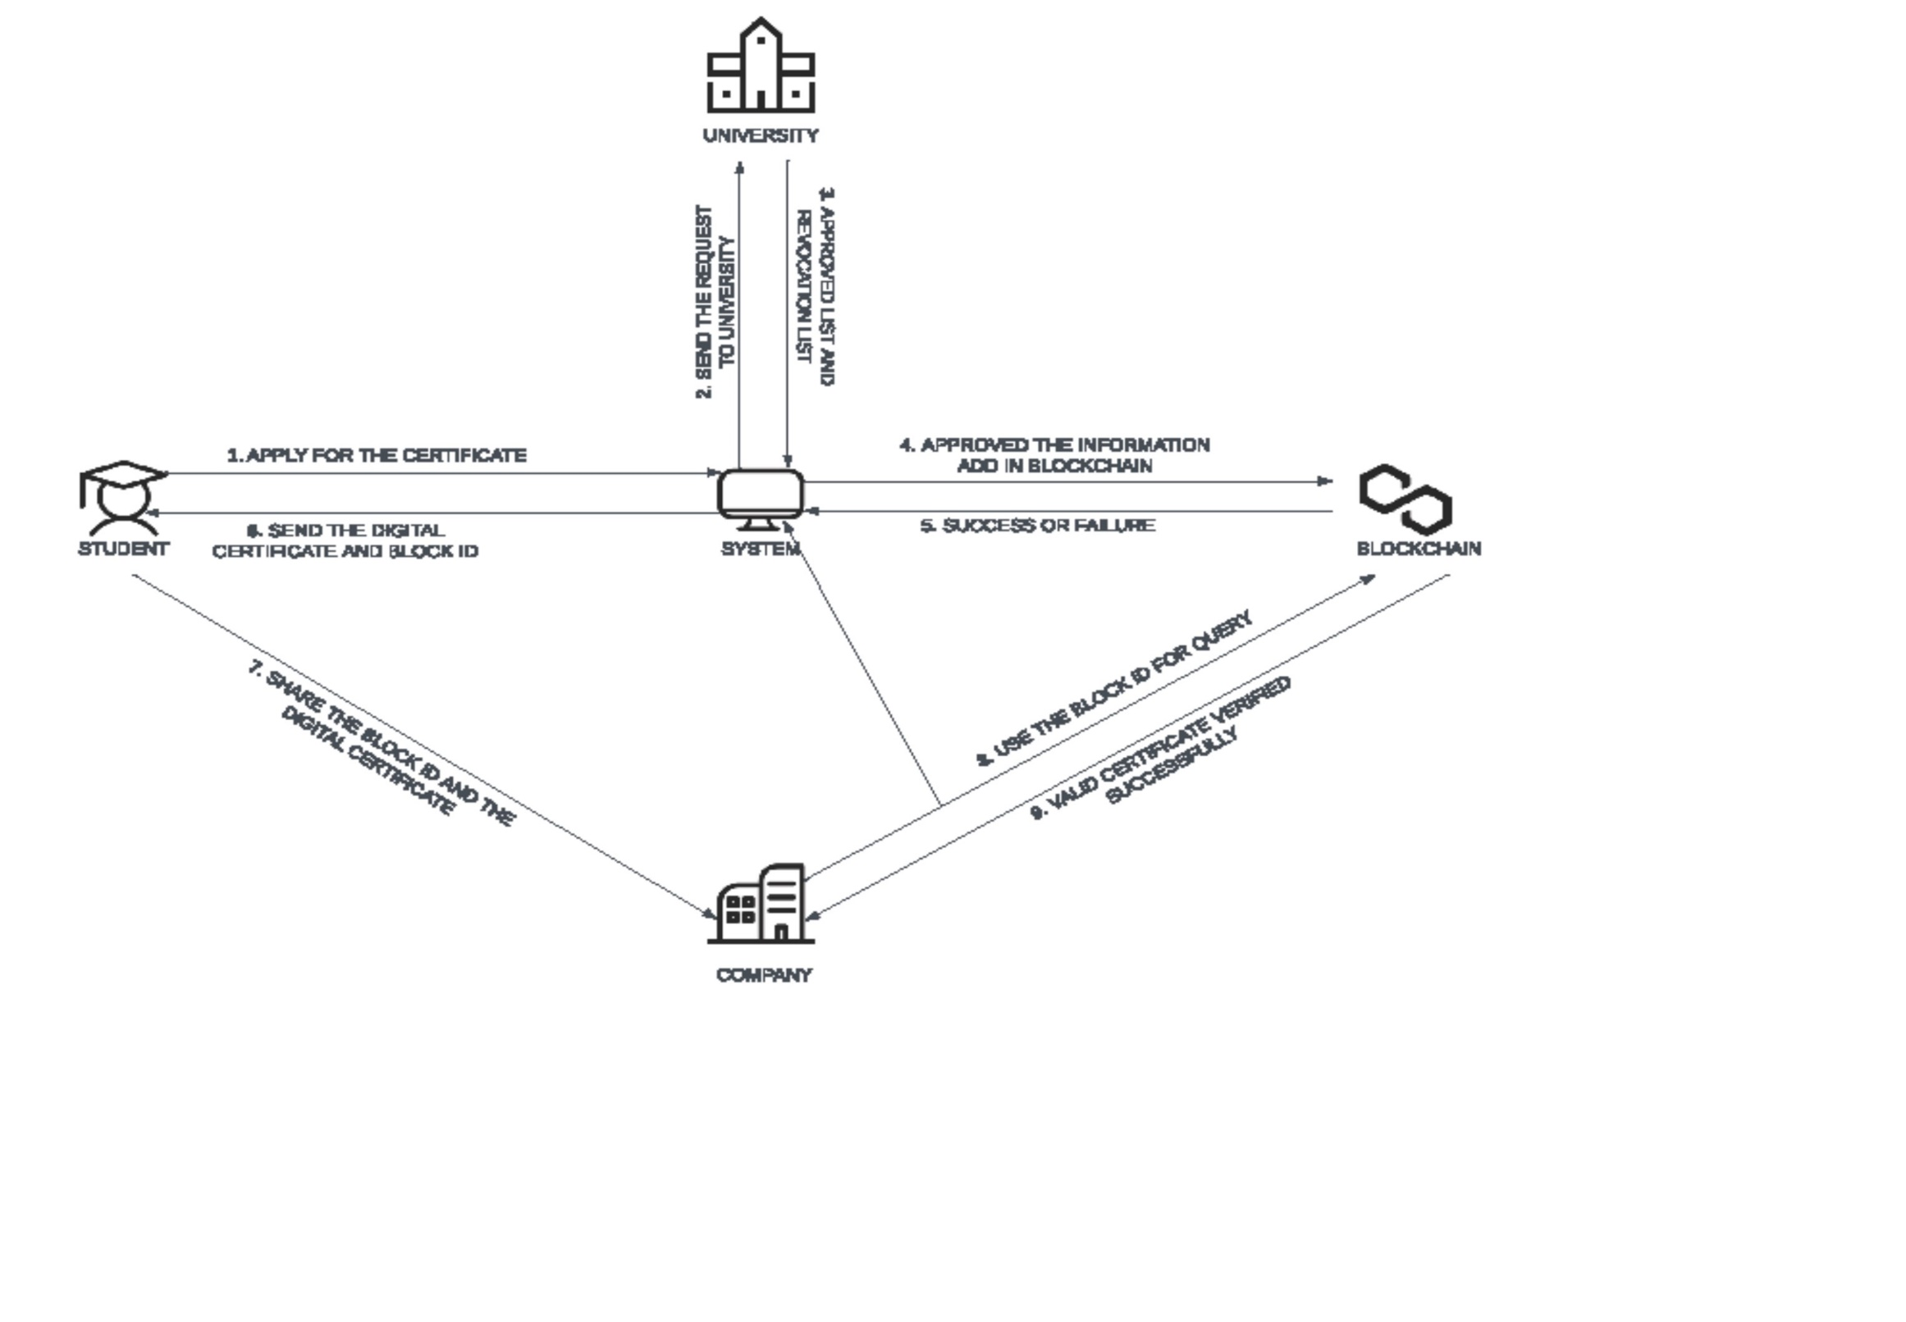
SYSTEM ARCHITECTURE

Slide 8
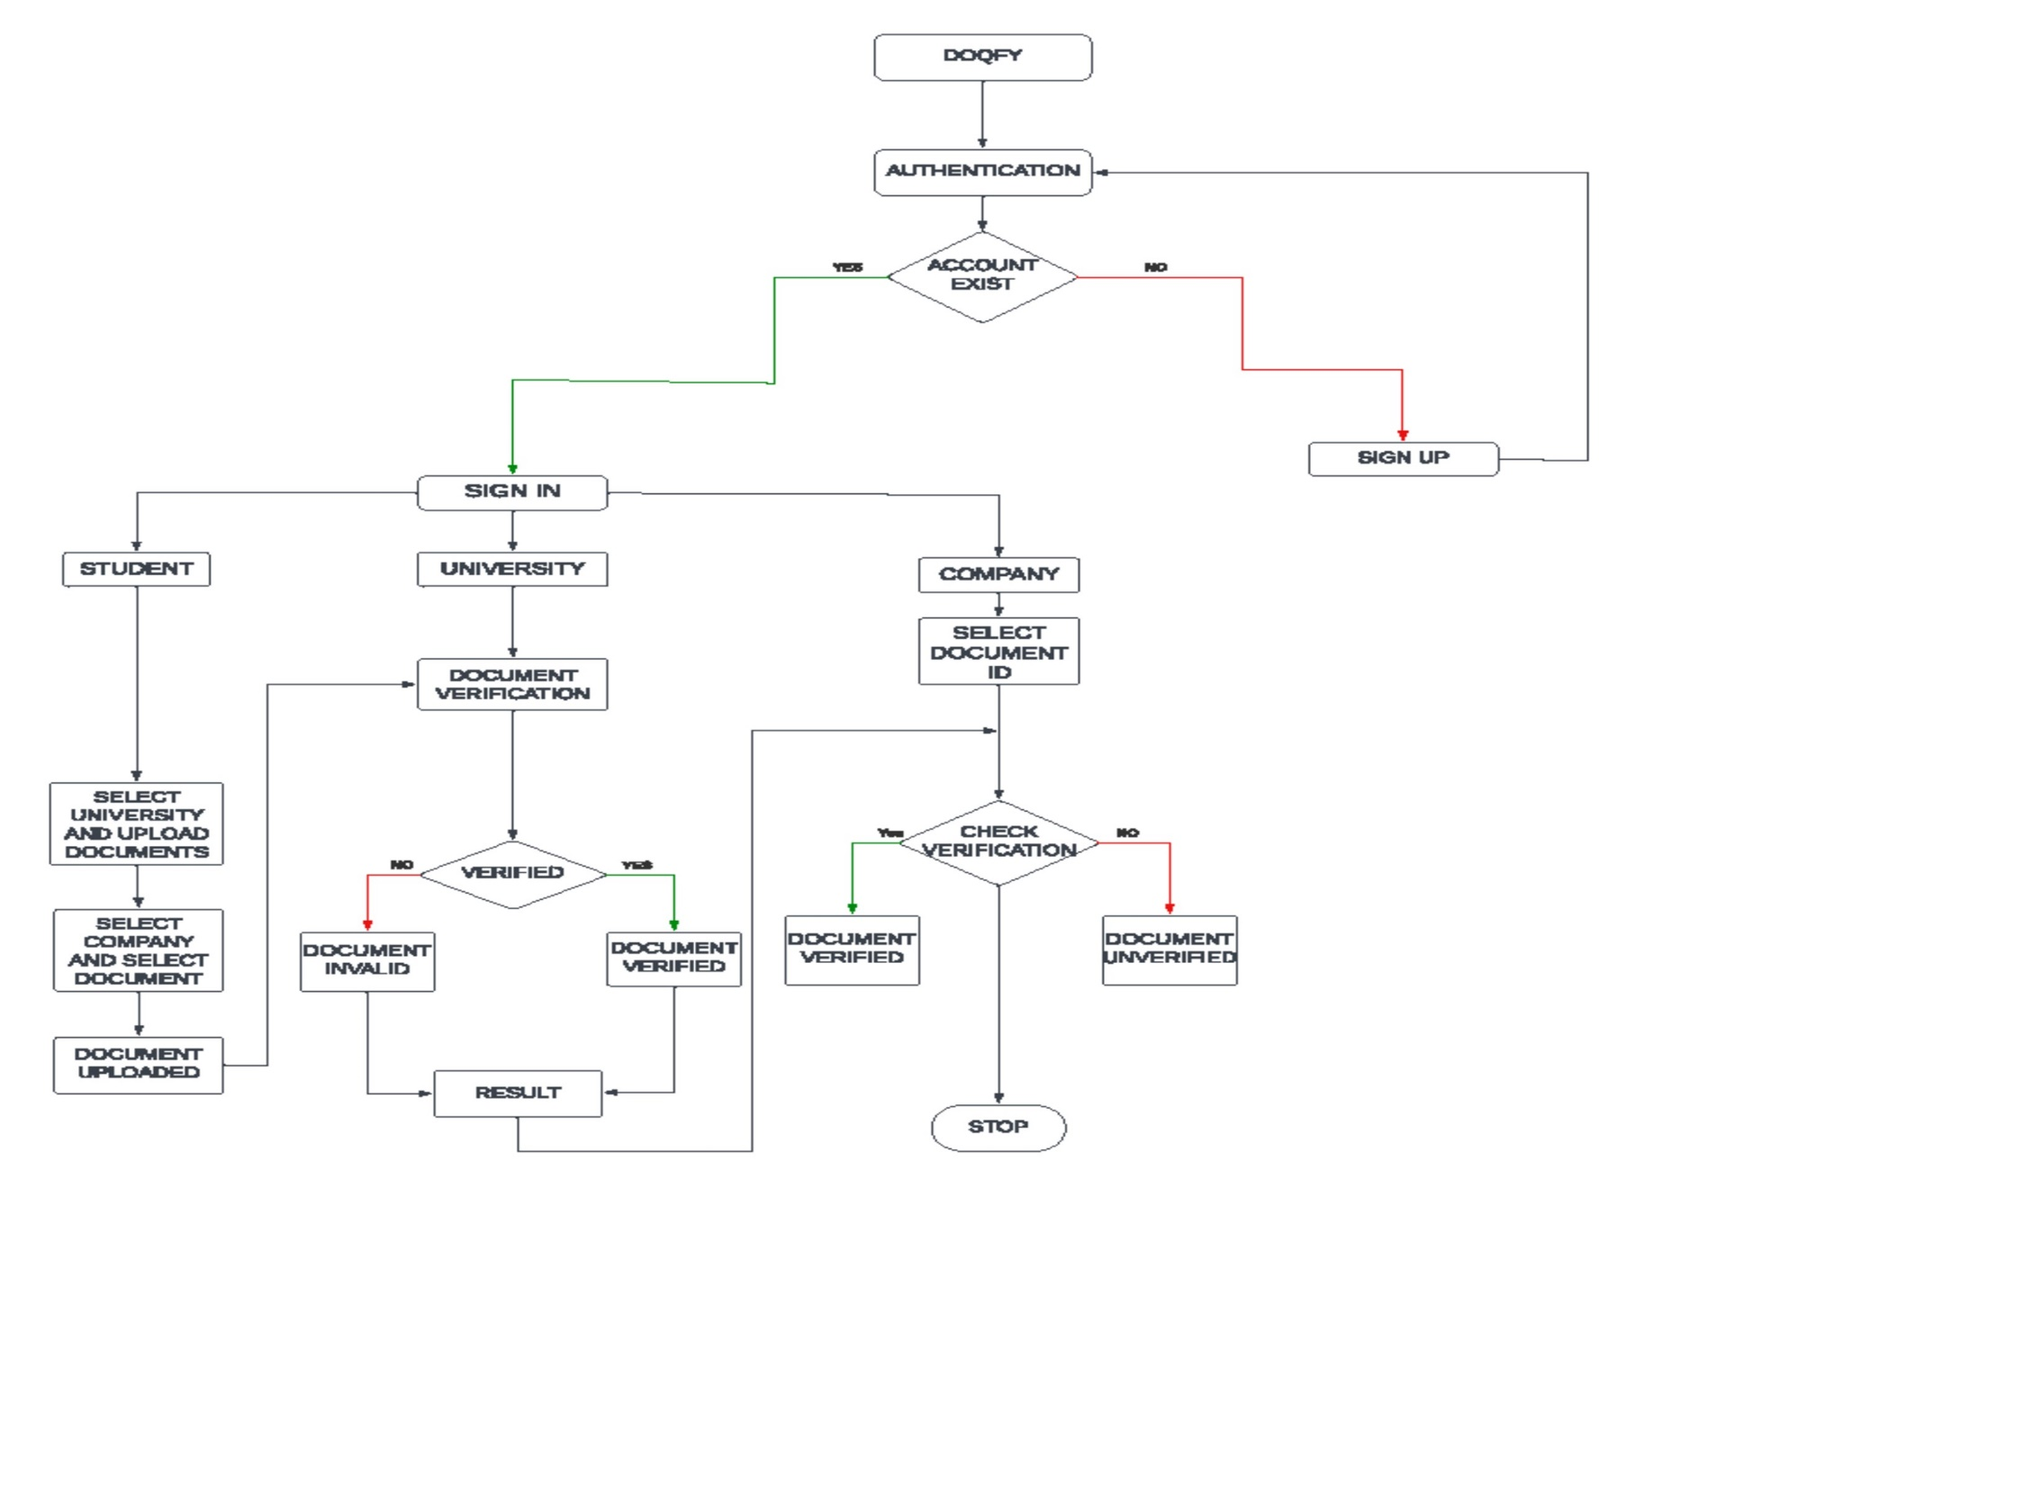
DATA FLOW DIAGRAM

Slide 9
REQUIREMENTS
HARDWARE REQUIREMENTS
CPU type : Mid Range – CPU Intel i5
Clock speed : 3.0 GHz with multiple cores
Ram size : 8GB
Hard disk capacity : 1000GB

Slide 10


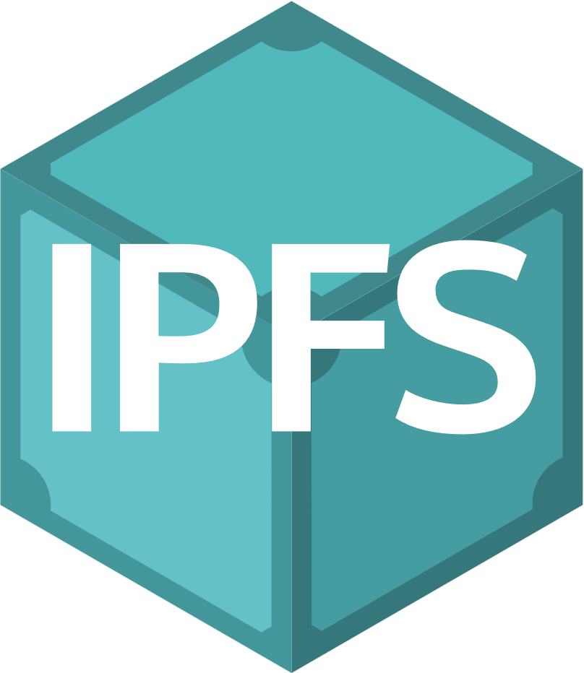
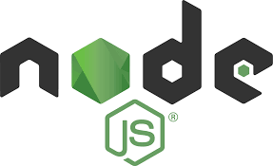
SOFTWARE REQUIREMENTS
Ganache
IPFS
Node.Js
Metamask
Operating System : Windows OS

Slide 11
IMPLEMENTATION OF MODULES
Decentralized User Registration Module
Identity Verification Module
Student Identity Vault Module
Credential Forge Module
HireGuard Module

Slide 12
MODULE DESCRIPTION
Decentralized User Registration Module:
Users authenticate themselves securely through the login module.
Identity Verification Module:
New users register for the system through the signup module.
Student Identity Vault Module:
Features include document submission, verification status tracking, and access to educational resources.

Slide 13
Credential Forge Module:
Administrative tasks such as verification approval and document storage are handled within this module.
Hire Guard Module:
Features include document verification for job applications, access to verified candidate profiles, and collaboration with educational institutions.

Slide 14
LITERATURE SURVEY
S. NO | TITLE | AUTHOR | ABSTRACT | METHODOLOGY | RESULTS | YEAR | ADVANTAGES | DIS ADVANTAGES
1. | Secure Document Verification Using Blockchain and Zero-Knowledge Proofs | Smith, J. et al. | This paper presents a novel approach to secure document verification using blockchain and zero-knowledge proofs. It introduces a protocol for verifying document authenticity without revealing sensitive information. | Development of a cryptographic protocol for document verification combining blockchain and zero-knowledge proofs. | Demonstration of enhanced privacy and security in document verification processes through the proposed protocol. | 2018 | Blockchain ensures tamper-proof record-keeping, while zero-knowledge proofs allow for verification without revealing sensitive information, thus ensuring privacy. | Implementing secure document verification using blockchain and zero-knowledge proofs can be complex and resource-intensive.It may require specialized technical expertise and infrastructure

Slide 15
LITERATURE SURVEY
S. NO | TITLE | AUTHOR | ABSTRACT | METHODOLOGY | RESULTS | YEAR | ADVANTAGES | DIS ADVANTAGES
2. | Decentralized Document Verification Using Blockchain | Patel, A. et al | This study explores the feasibility of using blockchain for decentralized document verification. It proposes a methodology for implementing a blockchain-based verification system and evaluates its effectiveness in ensuring document integrity and authenticity. | Development of a blockchain-based document verification system using smart contracts and distributed ledger technology | Analysis of the potential benefits and limitations of blockchain technology for document verification. | 2019 | By leveraging blockchain technology, decentralized document verification can provide enhanced trust and transparency. Since blockchain records are immutable and distributed across multiple nodes, it eliminates the need for a centralized authority, reducing the risk of fraud | Implementing decentralized document verification using blockchain may face scalability challenges. As the number of transactions increases, blockchain networks can become congested, leading to slower transaction processing times and higher fees.

Slide 16
KEY FEATURES
Immutable Ledger: Documents verified on the blockchain are recorded in an immutable ledger, meaning that once a verification transaction is added to the blockchain, it cannot be altered or deleted.
Cryptographic Security: Each transaction is encrypted using cryptographic algorithms, ensuring confidentiality and integrity. Digital signatures are also used to verify.
Smart Contracts: Smart contracts play a crucial role in automating the document verification process. Predefined rules and conditions encoded in smart contracts ensure that verification requests are processed.

Slide 17
METHODOLOGY
The methodology involves thorough research, analysis, design, prototyping, implementation, testing, and evaluation of blockchain technology's applications in document verification and digital copyright management. It includes development of a frontend application, backend server, and smart contracts, with rigorous testing and evaluation for performance, usability, efficiency, and security.

Slide 18
ADVANTAGES
Transparency and Immutability
Decentralization
Efficiency and Automation
Global Accessibility
Improved Rights Management
Auditable and Traceable

Slide 19
CONCLUSION
Through automated smart contracts, global accessibility, and enhanced security measures, it fosters a fair, efficient, and accountable ecosystem for creators, distributors, and consumers alike.

Slide 20
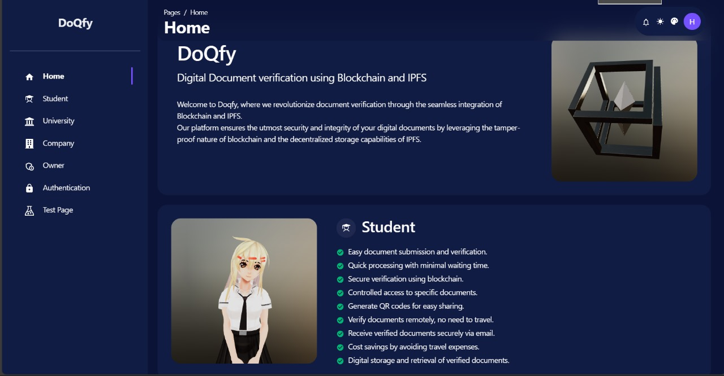
SCREENSHOTS
DASHBOARD

Slide 21
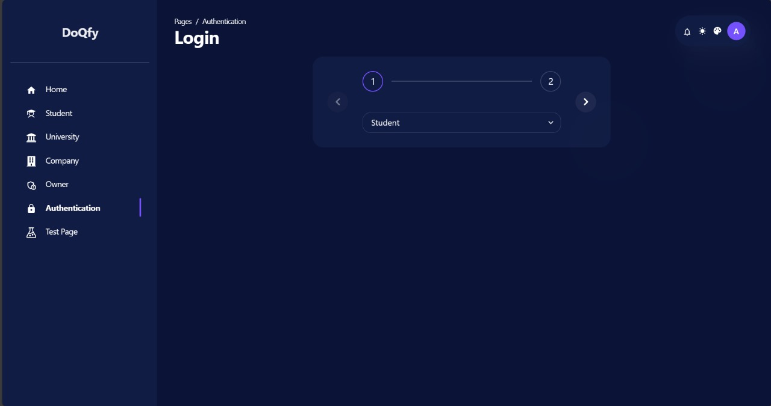
LOGIN

Slide 22
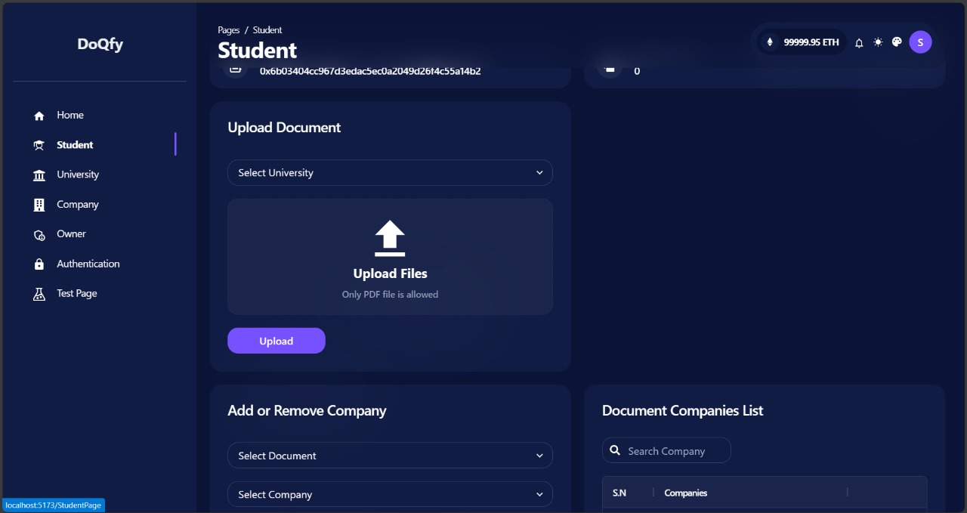
STUDENT

Slide 23
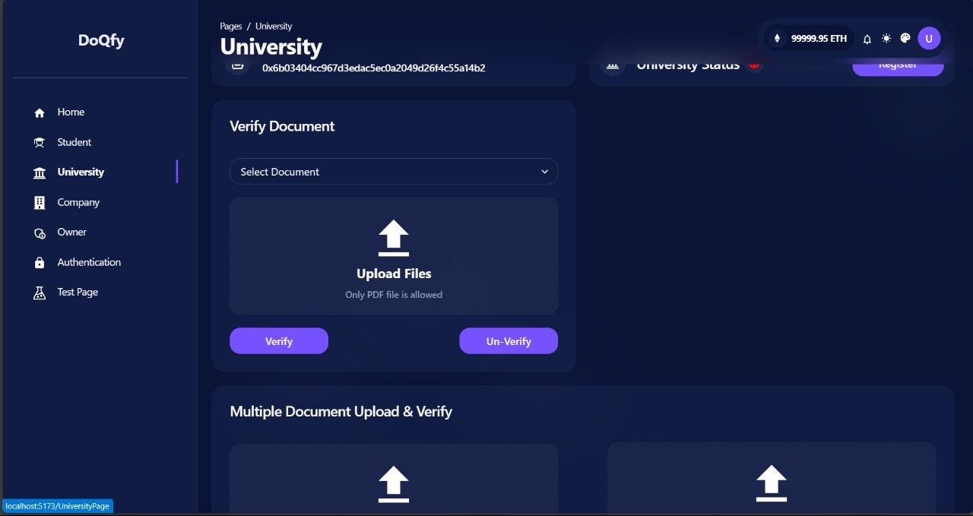
UNIVERSITY

Slide 24
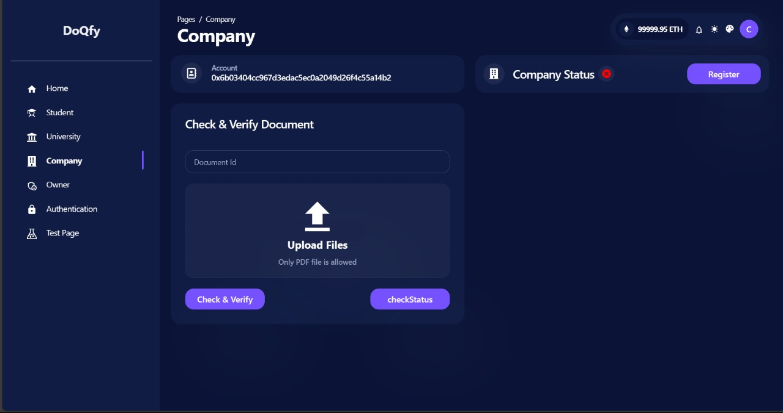
COMPANY

Slide 25
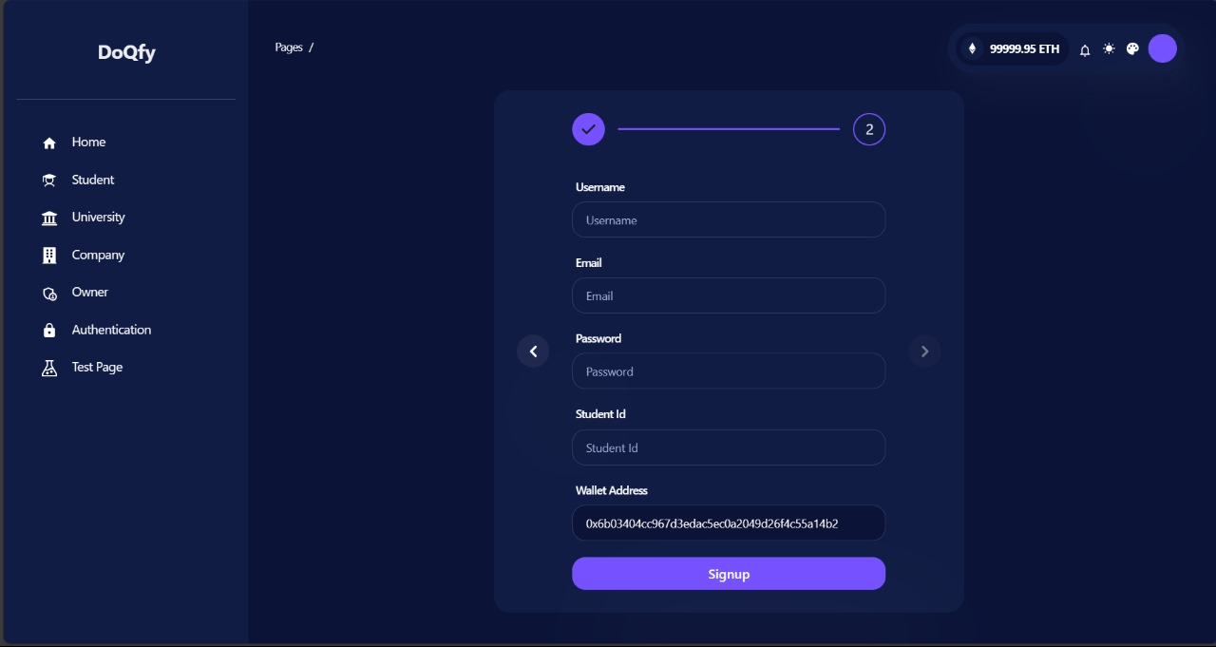
SIGNUP PAGE

Slide 26
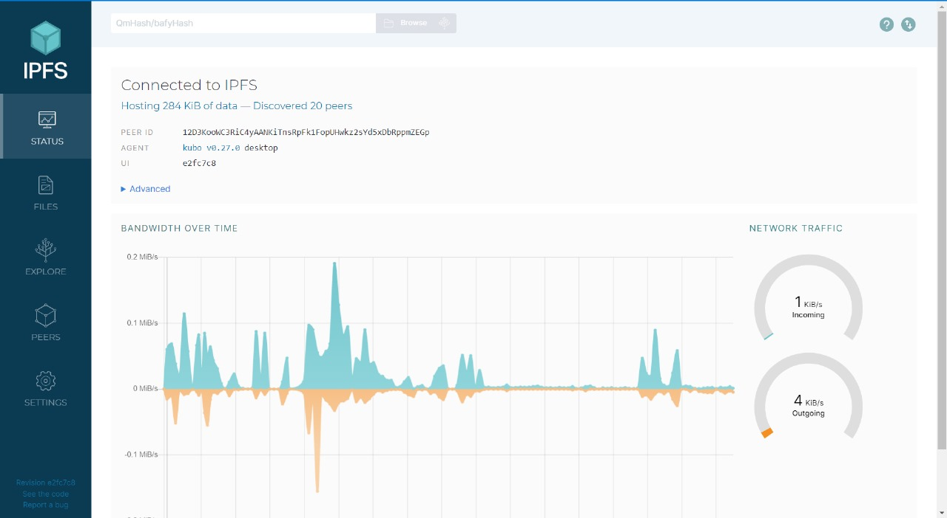
IPFS CONNECT

Slide 27
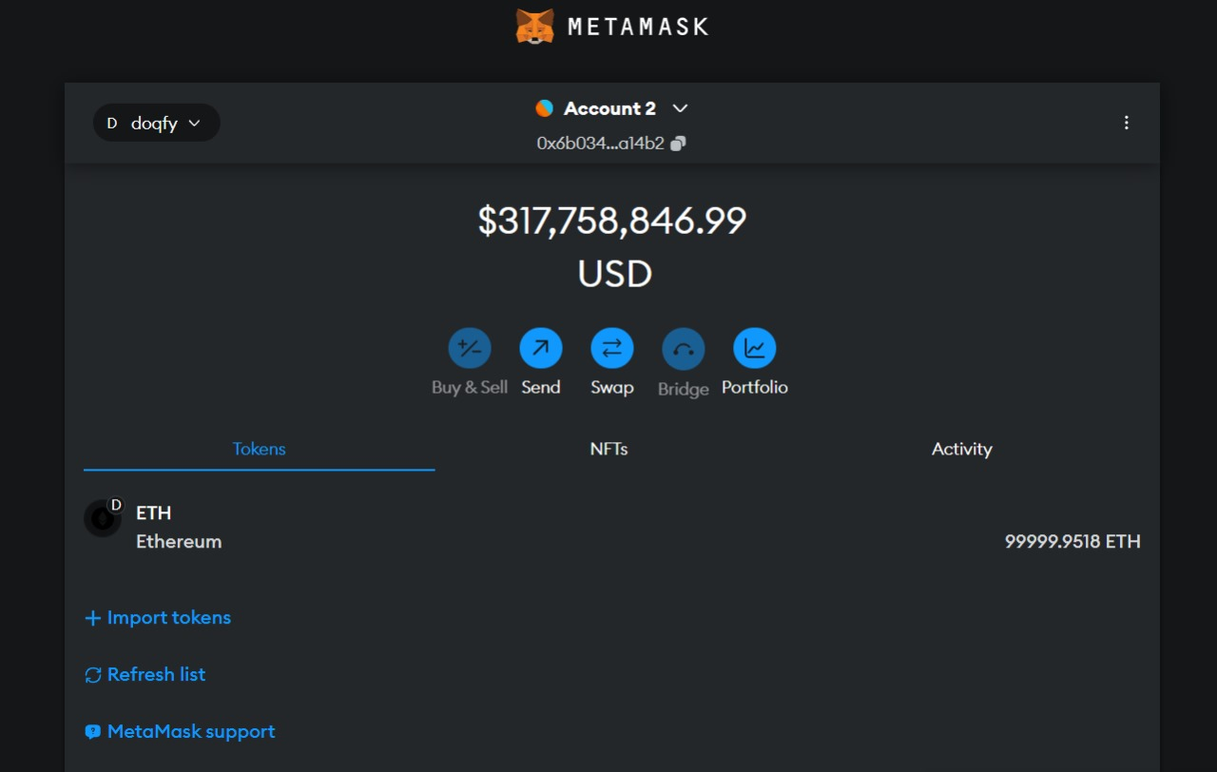
METAMASK

Slide 28
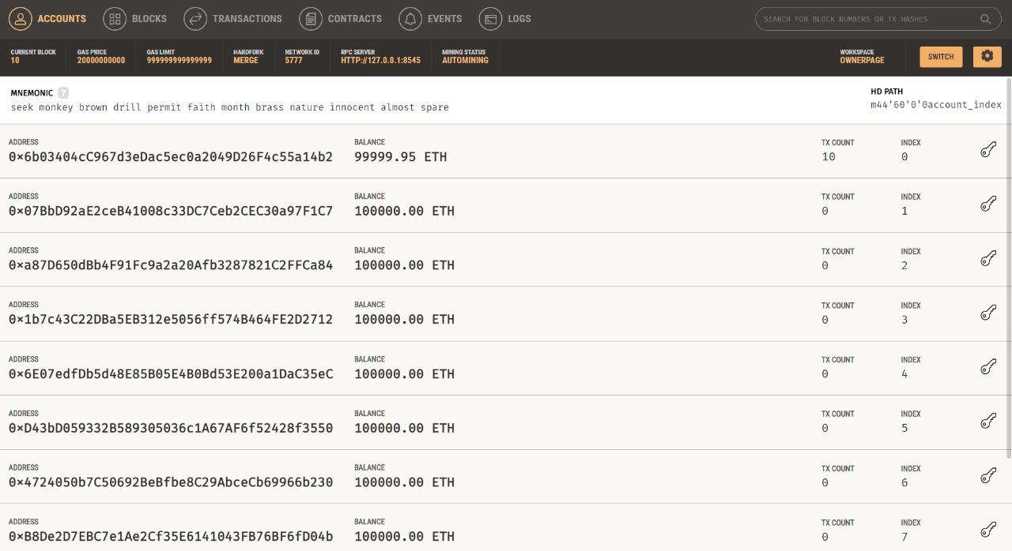
TRANSACTION

Slide 29
THANK YOU

