Slide 1
OOPs in Python
By:
Dharna Ahuja

Slide 2
What is OOP?
Python is a multi-paradigm programming language. Meaning, it supports different programming.
One of the popular approach to solve a programming problem is by creating objects. This is known as Object-Oriented Programming (OOP).

Slide 3
What is OOPS
Object-oriented programming is a programming paradigm based on the concept of "objects", which can contain data and code: data in the form of fields, and code, in the form of procedures.
A feature of objects is that an object's own procedures can access and often modify the data fields of itself.

Slide 4
In Python, the concept of OOP follows some basic principles:
Object
Class
Method
Inheritance
Polymorphism
Data Abstraction
Encapsulation

Slide 5
Object
An object has two characteristics:
attributes
behavior
Let's take an example:
Parrot is an object,
name, age, color are attributes
singing, dancing are behavior

Slide 6
Class
A class is group of objects with same attributes and common behaviours. It is basically a blueprint to create objects.
let us take the example of mobile phone. A Windows phone, Android phone and i-phone, all fall into the category of mobile phones. All of these are instances of a class, say Mobile_phone and are called objects. .

Slide 7
Syntax
Class classname:
//body of the class
//class methods
Creating object of the class:
Objectname=classname()

Slide 8
Basic OOP Program
class Car:
pass
ford=Car()
honda=Car()
audi=Car()
ford.speed=200
honda.speed=20
audi.speed=250
ford.color='red'
honda.color='blue'
audi.color='black'
print(ford.speed)
print(ford.color)

Slide 9
In the previous program. Ford,audi and honda are the instances of the class.also called the objects.
In the previous program, the speed and color are the attributes of the objects.

Slide 10
Adding Behaviors to the Class
The __init__() method:
This method serves as a constructor of the class. It is used to initialize some attributes or some functions because this is the first method which will be called when we create instance of the class.
class classname:
def __init__(self):
//body of the method

Slide 11
Assigning Values to the __init__ method
class Chair: color='' price=0 def __init__(self): self.color='red' self.price=200 c1=Chair() c2=Chair() print(c1.color) print(c1.price)

Slide 12
Parameterized Constructor
class Chair: color='' price=0 def __init__(self,color,red): self.color=color self.price=red c1=Chair('red',120) c2=Chair('green',200) print(c1.color) print(c1.price)

Slide 13
Self Keyword
Now, if you try to access the attribute of any of the objects like color or speed, the code will give an error because we havent assigned these values to any attribute inside the car class.
To assign the values we use the self keyword
It can have any name other than self.
Every method must have the self keyword as its first argument.

Slide 14
So, we do the following changes:
class Car: def __init__(self,speed,color): self.speed=speed self.color=color ford=Car(200,'red')
print(ford.speed)

Slide 15
User defined methods
A method is a block of code that is used to change the functionality of a class.
class Chair: color='' price=0 c=0 def __init__(self,color,red): self.color=color self.price=red def calc_discount(self): if self.price>700: self.price=self.price-0.05*self.price def display(self): print(self.price) c1=Chair('red',800) c2=Chair('green',200) c1.calc_discount() c1.display()

Slide 16
Program
Write a program using classes and objects to take the employee name and salary as input and calculate the total salary after deducting 0.2% salary from it.
Write a Python class which has two methods get_String and print_String. get_String accept a string from the user and print_String print the string in upper case
Write a Python class named Rectangle constructed by a length and width and a method which will compute the area of a rectangle.

Slide 17
Encapsulation
Encapsulation provides data security to a class.
It prevents users to change the data of a class.

Slide 18
Example
class Car: def __init__(self): self.__updatesoftware() def drive(self): print("driving") def __updatesoftware(self): print("updating software") blackcar=Car() blackcar.drive()

Slide 19
Member Variables
There are two types of member variables in a class:
Public Member
Private Member
Public member variable can be accessed outside the class.
Private member variables cannot be accessed outside the class and are denoted by double underscore.

Slide 20
How to access private method inside a class?
We can access a private method of a class inside the class by calling it inside a public method.
We have to use ‘self’ keyword to call a private method.
E.g:
def public_method(self): print(self.a) print(self.__c) print('public') self.__private_method()

Slide 21
Python Inheritance
Classes in Python can be extended , creating new classes which retain characteristics of the base class.
This process, is called inheritance.
Involves a superclass and a subclass.
The subclass inherits the members of the superclass, on top of which it can add its own members.

Slide 22
Simple Inheritance
Inheritance can be achieve by passing the parent class as an argument in the class definition of child class.

Slide 23
class Parent:
parentname=""
childname=""
def show_parent(self):
print(self.parentname)
class Child(Parent):
def show_child(self):
print(self.childname)
ch1=Child()
ch1.parentname="Mark"
ch1.childname="John"
ch1.show_parent()
ch1.show_child()

Slide 24
Multiple Child Classes
In this type of Inheritance two to more child classes can inherit from a parent class.

Slide 25
class Parent:
parentname=""
childname=""
def show_parent(self):
print(self.parentname)
class Son(Parent):
def show_child(self):
print(self.childname)
class Daughter(Parent):
def show_child(self):
print(self.childname)
s=Son()
s.parentname="Mark"
s.childname="John"
s.show_parent()
s.show_child()
d=Daughter()
d.parentname="Riya"
d.childname="alice"
d.show_parent()
d.show_child()'''

Slide 26
Multiple Parent Class
In multiple inheritance one child class can inherit multiple parent classes.

Slide 27
Multilevel Inheritance
In this type of inheritance, a class can inherit from a child class or derived class.

Slide 28
Example Call Parent Class Constructor from Child Class in Python
In this type of inheritance parent class attributes initialized using child class constructor.

Slide 29
Super()
class Parent:
def __init__(self,name):
print("This is",name)
class Son(Parent):
def __init__(self,son):
self.son=son
super().__init__("john")
def showDetails(self):
print("The name is",self.son)
s=Son("mark")
s.showDetails()

Slide 30
Polymorphism
Sometimes an object comes in many types or forms.
If we have a button, there are many different draw ouputs(round button, check button,square button, button with image) but they do share the same logic: onClick()
We access them using the same method. This idea is called Polymorphism.

Slide 31
Method Overriding
Override means having two methods with the same name but doing different tasks.
It means that one of the methods overrides the other.
Method overriding is used when programmer want to modify the existing behavior of a Method.

Slide 32
class Person:
name=""
age=0
def __init__(self,name,age):
self.name=name
self.age=age
def displayData(self):
print(self.name)
print(self.age)
class Employee(Person):
def __init__(self,name,age):
self.name=name
self.age=age
def displayData(self):
print(self.name)
print(self.age)
p=Person('dharna',25)
p.displayData()
e=Employee('alok',26)
e.displayData()

Slide 33
class Person:
def __init__(self,name,age):
self.name=name
self.age=age
def displayData(self):
print(self.name)
print(self.age)
class Employee(Person):
def __init__(self,emp_id):
super().__init__('alok',26)
self.emp_id=emp_id
def displayData(self):
print(self.name)
print(self.age)
print(self.emp_id)
p=Person('dharna',25)
p.displayData()
e=Employee(34)
e.displayData()

Slide 34
class Add: def result(self,a,b): self.a=a self.b=b print(self.a+self.b) class Multi(Add): def result(self,a,b): self.a=a self.b=b # super(Multi, self).result(5,6) print(self.a*self.b) m=Multi() m.result(5,6)

Slide 35
Method Overloading
In Python, you can define a method in such a way that there are multiple ways to call it.
Given a single method or function, we can specify the number of parameters our self.

Slide 36
class Employee:
def hello_employee(self,name=None):
if name is not None:
print("Hello",name)
else:
print("Hello")

Slide 37
class Area:
def find_area(self,a=None,b=None):
if a!=None and b!=None:
print(a*b)
elif a!=None:
print(a*a)
else:
print("Nothing to find")
a=Area()
a.find_area()
a.find_area(2,3)
a.find_area(2)

Slide 38
Example-1
class MyClass: def sum(self,a=None,b=None,c=None): if a!=None and b!=None and c!=None: s=a+b+c elif a!=None and b!=None: s=a*b return s ob=MyClass() print(ob.sum(10,20))

Slide 39
Abstraction
Abstract classes are classes that contain one or more abstract methods.
An abstract method is a method that is declared, but contains no implementation.
Abstract classes cannot be instantiated, and require subclasses to provide implementations for the abstract methods.

Slide 40
Abstract Class
A class derived from ABC class which belongs to abc module, is called abstract class in Python.
ABC class is known as Meta Class which means a class that defines the behavior of other classes. So we can say, Meta Class ABC defines that the class which is derived from it becomes an abstract class.
Abstract Class can have abstract method.
Abstract Class needs to be extended and its method implemented.

Slide 41
Example
from abc import ABC,abstractmethod class Father(ABC): @abstractmethod def disp(self): pass class Child(Father): def disp(self): print("My name is dharna") def calc(self): print('Hello') myc=Child() myc.calc() myc.disp()

Slide 42
Python - Magic or Dunder Methods
Magic methods in Python are the special methods that start and end with the double underscores.
They are also called dunder methods. Magic methods are not meant to be invoked directly by you, but the invocation happens internally from the class on a certain action.
For example, when you add two numbers using the + operator, internally, the __add__() method will be called.

Slide 43
Built-in classes in Python define many magic methods.
Use the dir() function to see the number of magic methods inherited by a class.
For e.g.:
dir(int)
As you can see above, the int class includes various magic methods surrounded by double underscores.
For example, the __add__ method is a magic method which gets called when we add two numbers using the + operator. Consider the following example.
num=10
num.__add__(5)

Slide 44
__new__() method
Languages such as Java and C# use the new operator to create a new instance of a class.
In Python the __new__ magic method is implicitly called before the __init__() method.
The __new__() method returns a new object, which is then initialized by __init__().
class Parent:
def __new__(cls):
print("sfsff")
inst=object.__new__(cls)
return inst
def __init__(self):
print("Hello")
self.name='Satya'
p=Parent()

Slide 45
__str__() method
Another useful magic method is __str__().
It is overridden to return a printable string representation of any user defined class.
We have seen str() built-in function which returns a string from the object parameter.
For example,str(12) returns '12’.
When invoked, it calls the __str__() method in the int class.
num=12
str(num)
int.__str__(num)

Slide 46
Let us now override the __str__() method in the Employee class to return a string representation of its object.
class Employee:
def __init__(self):
self.name='Swati'
self.salary=10000
def __str__(self):
return 'name='+self.name+' salary=$'+str(self.salary)

Slide 47
Modules
The act of patitioning a program into individual components is called modularity.
A module is a seperate unit in itself.
For e.g. If someone has created a module say, PlayAudio to play different audio formats coming from different sources. E.g. Mp3player,fm radio player,dvd player etc,.
Now while writing a different program someone wants to incorporate fm-radio into it,he needs not re-write the code for it.Rather,he can use the fm-radio functionality from PlayAudio module.

Slide 48
Importing Modules in a Python Program
To import the entire module:
the import <module> command
To import selected objects from a module:
the from <module> import<object> command

Slide 49
Importing entire module
import module1,module2,...

Slide 50
Using Random Module
import random
random()-> It returns a random floating point number between 0.0 and 1.0
print(random.random())
randint(a,b)-> a<=N<=b(both inclusive)

Slide 51
To generate a random floating-point number between range lower to upper using random():
Multiply random() with difference of upper limit with lower limit i.e.(upper-lower)
Add to it lower limit
print(random.random()*35-15)+15)
print(random.randint(15,35))

Slide 52
Packages
Let's create a package named mypackage, using the following steps:
Create a new folder named D:\MyApp.
Inside MyApp, create a subfolder with the name 'mypackage’.
Create an empty __init__.py file in the mypackage folder.
create modules greet.py in the mypackage subfolder.
Importing a Module from a Package
__init__.py
from .greet import SayHello
The specified functions can now be imported in the interpreter session or another executable script.
Create test.py in the MyApp folder to test mypackage.
from mypackage import SayHello
SayHello()

Slide 53
OS Module
It is possible to automatically perform many operating system tasks.
The OS module in Python provides functions for creating and removing a directory (folder), fetching its contents, changing and identifying the current directory, etc.

Slide 54
Creating Directory
We can create a new directory using the mkdir() function from the OS module.
import os
os.mkdir("D:\\tempdir")

Slide 55
Changing the Current Working Directory
We must first change the current working directory to a newly created one before doing any operations in it. This is done using the chdir() function.
import os os.chdir("d:\\tempdir")
There is a getcwd() function in the OS module using which we can confirm if the current working directory has been changed or not.
os.getcwd()

Slide 56
In order to set the current directory to the parent directory use ".." as the argument in the chdir() function.
os.chdir("d:\\tempdir") os.getcwd() os.chdir("..") os.getcwd() 'd:\\'

Slide 57
Removing a Directory
The rmdir() function in the OS module removes the specified directory either with an absolute or relative path.
Also, for a directory to be removed, it should be empty. For example, tempdir will not be removed if it is the current directory.
We have to change the current working directory and then remove tempdir.

Slide 58
os.chdir("D:\\tempdir")
#os.rmdir("D:\\tempdir")
os.chdir("..")
os.rmdir("tempdir")

Slide 59
List Files and Sub-directories
The listdir() function returns the list of all files and directories in the specified directory.
print(os.listdir("D:\\"))
If we don't specify any directory, then list of files and directories in the current working directory will be returned.
os.listdir()

Slide 60
Statistics Module
The statistics module provides functions to mathematical statistics of numeric data. The following popular statistical functions are defined in this module.
The mean() method calculates the arithmetic mean of the numbers in a list.
import statistics statistics.mean([2,5,6,9])

Slide 61
Packages
We organize a large number of files in different folders and subfolders based on some criteria, so that we can find and manage them easily.
a package in Python takes the concept of the modular approach to next logical level. As you know, a module can contain multiple objects, such as classes, functions, etc. A package can contain one or more relevant modules.
Let's create a package named mypackage, using the following steps:

Slide 62
Create a new folder named myApp
Inside myApp create a subfolder with the name 'mypackage’.
Create an empty __init__.py file in the mypackage folder.
Using a Python-aware editor like IDLE, create modules greet.py and functions.py with the following code:
def SayHello(name):
print("Hello ", name)
def sum(x,y):
return x+y
def average(x,y):
return (x+y)/2
def power(x,y):
return x**y

Slide 63
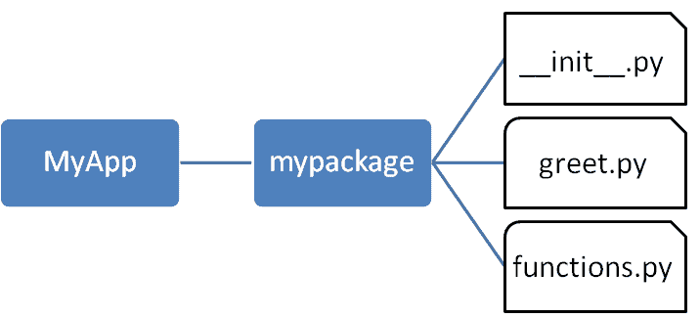

Slide 64
Importing a Module from a Package
Import the functions module from the mypackage package and call its power() function.
from mypackage import functions
functions.power(3,2)

Slide 65
The median() method returns the middle value of numeric data in a list.
statistics.median([1,2,3,8,9])
The mode() method returns the most common data point in the list.
statistics.mode([2,5,3,2,8,3,9,4,2,5,6])
The stdev() method calculates the standard deviation on a given sample in the form of a list.
statistics.stdev([1,1.5,2,2.5,3,3.5,4,4.5,5])

Slide 66
Bubble Sorting
It is a simple sorting algorithm that repeatedly steps through the list to be sorted, compares each pair of adjacent items and swaps them if they are in the wrong order.
The pass through the list is repeated until no swaps are needed, which indicates that the list is sorted. The algorithm, which is a comparison sort, is named for the way smaller elements "bubble" to the top of the list.
5 1 4 2 8

Slide 67
a=[64,25,12,22,11]
n=len(a)
for i in range(n):
for j in range(0,n-1):
if a[j]>a[j+1]:
a[j],a[j+1]=a[j+1],a[j]
for i in range(0,n):
print(a[i])

Slide 68
Selection Sort
Selection sort breaks the input list in two parts, the sorted part which initially is empty, and the unsorted part, which initially contains the list of all elements.
The algorithm then selects the minimum value of all the unsorted file and swaps it with the first unsorted value, and then increases the sorted part by one.

Slide 69
arr[] = 64 25 12 22 11 // Find the minimum element in arr[0...4]
// and place it at beginning 11 25 12 22 64
// Find the minimum element in arr[1...4]
// and place it at beginning of arr[1...4] 11 12 25 22 64
// Find the minimum element in arr[2...4]
// and place it at beginning of arr[2...4] 11 12 22 25 64
// Find the minimum element in arr[3...4]
// and place it at beginning of arr[3...4]
11 12 22 25 64

Slide 70
a=[64,25,12,22,11]
for i in range(len(a)):
min_idx=i#1
for j in range(i+1,len(a)):
if(a[min_idx]>a[j]):
min_idx=j#1 min_idx=2
a[i],a[min_idx]=a[min_idx],a[i]
for i in range(len(a)):
print(a[i])

Slide 71
Insertion Sort
Insertion sort is a simple sorting algorithm that works similar to the way you sort playing cards in your hands.
The array is virtually split into a sorted and an unsorted part. Values from the unsorted part are picked and placed at the correct position in the sorted part.

Slide 72
Algorithm
To sort an array of size n in ascending order:
1: Iterate from arr[1] to arr[n] over the array. 2: Compare the current element (key) to its predecessor. 3: If the key element is smaller than its predecessor, compare it to the elements before. Move the greater elements one position up to make space for the swapped element.

Slide 73
12, 11, 13, 5, 6
Let us loop for i = 1 (second element of the array) to 4 (last element of the array)
i = 1. Since 11 is smaller than 12, move 12 and insert 11 before 12 11, 12, 13, 5, 6
i = 2. 13 will remain at its position as all elements in A[0..I-1] are smaller than 13 11, 12, 13, 5, 6
i = 3. 5 will move to the beginning and all other elements from 11 to 13 will move one position ahead of their current position. 5, 11, 12, 13, 6
i = 4. 6 will move to position after 5, and elements from 11 to 13 will move one position ahead of their current position. 5, 6, 11, 12, 13

Slide 74
arr=[12,11,13,5,6]
for i in range(1,len(arr)):
key=arr[i]
j=i-1
while(j>=0 and key <arr[j]):
arr[j+1]=arr[j]
j=j-1
arr[j+1]=key

Slide 75
Binary Search
Search a sorted array by repeatedly dividing the search interval in half.
Begin with an interval covering the whole array. If the value of the search key is less than the item in the middle of the interval, narrow the interval to the lower half.
Otherwise narrow it to the upper half. Repeatedly check until the value is found or the interval is empty.

Slide 76
Compare x with the middle element.
If x matches with middle element, we return the mid index.
Else If x is greater than the mid element, then x can only lie in right half subarray after the mid element. So we recur for right half.
Else (x is smaller) recur for the left half.

Slide 77
arr=[2,3,4,10,40]
search=int(input("Enter the element"))
high=len(arr)-1
low=0
while(low<=high):
mid=(low+high)//2
if(search==arr[mid]):
print(mid)
if(search<arr[mid]):
high=mid-1
else:
low=mid+1

Slide 78
Data Structures
Liner Data Structures
These are the data structures which store the data elements in a sequential manner:
Array: It is a sequential arrangement of data elements paired with the index of the data element.
Linked List: Each data element contains a link to another element along with the data present in it.
Stack: It is a data structure which follows only to specific order of operation. LIFO(last in First Out) or FILO(First in Last Out).
Queue: It is similar to Stack but the order of operation is only FIFO(First In First Out).

Slide 79
Stack in Python
A stack is a linear data structure that stores items in a Last-In/First-Out (LIFO) or First-In/Last-Out (FILO) manner.
In stack, a new element is added at one end and an element is removed from that end only. The insert and delete operations are often called push and pop.

Slide 80
The functions associated with stack are:
empty() – Returns whether the stack is empty – Time Complexity : O(1)
size() – Returns the size of the stack – Time Complexity : O(1)
top() – Returns a reference to the top most element of the stack – Time Complexity : O(1)
push(g) – Adds the element ‘g’ at the top of the stack – Time Complexity : O(1)
pop() – Deletes the top most element of the stack – Time Complexity : O(1)

Slide 81
Implementation using list
Python’s buil-in data structure list can be used as a stack.
Instead of push(), append() is used to add elements to the top of stack stack=[]
stack.append('a')
stack.append('b')
stack.append('c')
print('Initial stack')
print(stack)
print("Elements popped from stack")
print(stack.pop())
print(stack.pop())
print(stack.pop())
print(stack)
#Create a function which takes a number in the argument and check if it is
#an even number or not.
pop() removes the element in LIFO order.

Slide 82
class Stack:
def __init__(self):
self.stack=[]
def add(self,data):
if data not in self.stack:
self.stack.append(data)
return True
else:
return False
def peek(self):
return self.stack[-1]
def remove(self):
if(len(self.stack)==-1):
print("No element found")
else:
print(self.stack.pop())

Slide 83
a=Stack()
a.add("Mon")
a.add("Tue")
a.add("Wed")
print(a.stack)
a.remove()
a.remove()
a.remove()

Slide 84
Implementation using collections.deque
Python stack can be implemented using deque class from collections module.
Deque is preferred over list in the cases where we need quicker append and pop operations from both the ends of the container,

Slide 85
from collections import deque
stack=deque()
stack.append('a')
stack.append('b')
stack.append('c')
print(stack)
print(stack.pop())
print(stack.pop())
print(stack)

Slide 86
Reverse string using Stack
def revstring(mstr):
stack=[]
for ch in mstr:
stack.append(ch)
revstr=''
while len(stack):
revstr=revstr+stack.pop()
return revstr
print(revstring("martin"))

Slide 87
Queue in Python
Like stack, queue is a linear data structure that stores items in First In First Out (FIFO) manner. With a queue the least recently added item is removed first.
A good example of queue is any queue of consumers for a resource where the consumer that came first is served first.

Slide 88
queue=[]
queue.append('a')
queue.append('b')
queue.append('c')
print(queue)
print(queue.pop(0))
print(queue.pop(0))
print(queue)

Slide 89
class Queue:
def __init__(self):
self.queue=[]
def enqueue(self,item):
self.queue.append(item)
def dequeue(self):
if len(self.queue)<1:
return None
return self.queue.pop(0)
def size(self):
return len(self.queue)
q=Queue()
q.enqueue(12)
q.enqueue(14)
q.enqueue(20)
print(q.dequeue())
print(q.dequeue())
print(q.size())

Slide 90
Implementation using collections.deque
Queue in Python can be implemented using deque class from the collections module.

Slide 91
from collections import deque
q=deque()
q.append('a')
q.append('b')
q.append('c')
print(q)
print(q.popleft())
print(q.popleft())
print(q)

Slide 92
Implement Stack using Queues
We are given a Queue data structure that supports standard operations like enqueue() and dequeue().
We need to implement a Stack data structure using only instances of Queue and queue operations allowed on the instances.
A stack can be implemented using two queues. Let stack to be implemented be ‘s’ and queues used to implement be ‘q1’ and ‘q2’. Stack ‘s’ can be implemented in two ways:
Method 1 (By making push operation costly) This method makes sure that newly entered element is always at the front of ‘q1’, so that pop operation just dequeues from ‘q1’. ‘q2’ is used to put every new element at front of ‘q1’.

Slide 93
1. Create a class Queue with instance variable items initialized to an empty list. 2. Define methods enqueue, dequeue and is_empty inside the class Queue. 3. The method enqueue appends data to items. 4. The method dequeue dequeues the first element in items. 5. The method is_empty returns True only if items is empty. 6. Create a class Stack with instance variable queue1 and queue2 initialized to empty queues. 7. Define methods push, pop and is_empty inside the class Stack. 8. The method push takes an argument and enqueues it in queue1. Then every element of queue2 is dequeued and enqueued in queue1. The names of queue1 and queue2 are then switched. 9. The method pop dequeues from queue2 and returns the dequeued value. 10. The method is_empty returns True only if queue2 is empty.

Slide 94
class Queue:
def __init__(self):
self.items=[]
def is_empty(self):
return self.items==[]
def enqueue(self,data):
self.items.append(data)
def dequeue(self):
return self.items.pop(0)

Slide 95
class Stack:
def __init__(self):
self.q1=Queue()
self.q2=Queue()
def is_empty(self):
return self.q2.is_empty()
def push(self,data):
self.q1.enqueue(data)
while not self.q2.is_empty():
x=self.q2.dequeue()
self.q1.enqueue(x)
self.q1,self.q2=self.q2,self.q1

Slide 96
def pop(self):
return self.q2.dequeue()
s=Stack()
s.push(1)
s.push(2)
s.push(3)
s.push(4)
print(s.pop())
print(s.pop())
print(s.pop())

Slide 97
Implementing Queues Using Stacks
class Queue:
def __init__(self):
self.s1=Stack()
self.s2=Stack()
def is_empty(self):
return self.s1.is_empty() and self.s2.is_empty()
def enqueue(self,data):
self.s1.push(data)
def dequeue(self):
if self.s2.is_empty():
while not self.s1.is_empty():
popped=self.s1.pop()
self.s2.push(popped)
return self.s2.pop()

Slide 98
class Stack:
def __init__(self):
self.items=[]
def is_empty(self):
return self.items==[]
def push(self,data):
self.items.append(data)
def pop(self):
return self.items.pop()

Slide 99
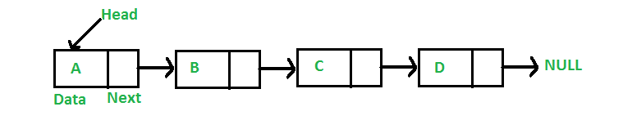
Linked List
Like arrays, Linked List is a linear data structure. Unlike arrays, linked list elements are not stored at a contiguous location; the elements are linked using pointers.

Slide 100
Why Linked List?
Arrays can be used to store linear data of similar types, but arrays have the following limitations.
1) The size of the arrays is fixed: So we must know the upper limit on the number of elements in advance. Also, generally, the allocated memory is equal to the upper limit irrespective of the usage. 2) Inserting a new element in an array of elements is expensive because the room has to be created for the new elements and to create room existing elements have to be shifted.
For example, in a system, if we maintain a sorted list of IDs in an array id[].
id[] = [1000, 1010, 1050, 2000, 2040].

Slide 101
And if we want to insert a new ID 1005, then to maintain the sorted order, we have to move all the elements after 1000 (excluding 1000)
.Deletion is also expensive with arrays until unless some special techniques are used. For example, to delete 1010 in id[], everything after 1010 has to be moved.

Slide 102
Representation:
A linked list is represented by a pointer to the first node of the linked list.
The first node is called the head. If the linked list is empty, then the value of the head is NULL. Each node in a list consists of at least two parts:
1) data 2) Pointer (Or Reference) to the next node
LinkedList can be represented as a class and a Node as a separate class. The LinkedList class contains a reference of Node class type.

Slide 103
Start with a single node
class Node:
def __init__(self,data,next=None):
self.data=data
self.next=next
first=Node(3)
print(first.data)

Slide 104
Join nodes to get a linked list
The next step is to join multiple single nodes containing data using the next pointers, and have a single head pointer pointing to a complete instance of a Linked List.
Using the head pointer, we will be able to traverse the whole list, even perform all kinds of list manipulations while we are at it.

Slide 105
class Node:
def __init__(self,data,next=None):
self.data=data
self.next=next
class LinkedList:
def __init__(self):
self.head=None
ll=LinkedList()
ll.head=Node(3)
print(ll.head.data)

Slide 106
def printList(self):
current=self.head
while(current):
print(current.data)
current=current.next

Slide 107
ll=LinkedList()
ll.head=Node(1)
second=Node(2)
third=Node(3)
ll.head.next=second
second.next=third
ll.printList()

Slide 108
Add required methods to the LinkedList class
def insert(self,data):
newNode=Node(data)
if(self.head):
current=self.head
while(current.next):
current=current.next
current.next=newNode
else:
self.head=newNode
def printList(self):
current=self.head
while(current):
print(current.data)
current=current.next

Slide 109
Inserting a node
A node can be added in three ways:
1) At the front of the linked list 2) After a given node. 3) At the end of the linked list.

Slide 110
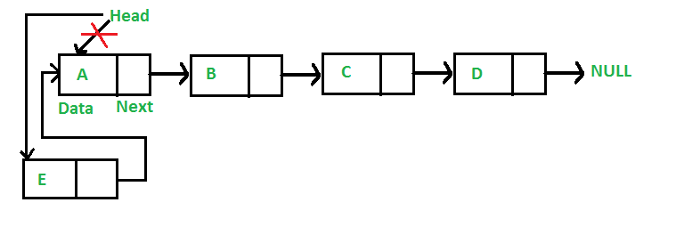
Add a node at the front
The new node is always added before the head of the given Linked List.
And newly added node becomes the new head of the Linked List.
For example if the given Linked List is 10->15->20->25 and we add an item 5 at the front, then the Linked List becomes 5->10->15->20->25.
Let us call the function that adds at the front of the list is push(). The push() must receive a pointer to the head pointer, because push must change the head pointer to point to the new node

Slide 111
def insert_at_front(self,data):
new_node=Node(data)
new_node.ref=self.start_node
self.start_node=new_node

Slide 112
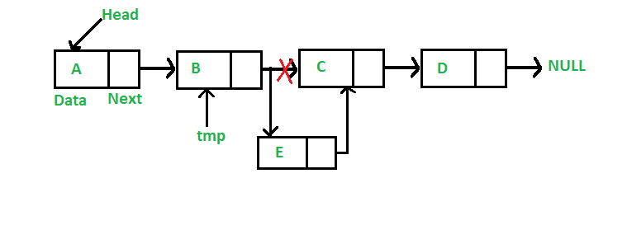
Add a node after a given node
We are given pointer to a node, and the new node is inserted after the given node.

Slide 113
def insert_after_item(self,x,data):
n=self.start_node
print(n.ref)
while n is not None:
if n.item==x:
break
n=n.ref
if n is None:
print("item not in the list")
else:
new_node=Node(data)
new_node.ref=n.ref
n.ref=new_node

Slide 114
Add a node at the end
def insert_at_end(self,data):
new_node=Node(data)
if self.start_node is None:
self.start_node=new_node
return
n=self.start_node
while n.ref is not None:
n=n.ref
n.ref=new_node

Slide 115
Deleting a Node
def delete_at_start(self):
if self.start_node is None:
print("The list has no element to delete")
return
self.start_node=self.start_node.ref

Slide 116
Deleting at the End
def delete_at_end(self):
if self.start_node is None:
print("no element")
return
n=self.start_node
while n.ref.ref is not None:
n=n.ref
n.ref=None

Slide 117
Check for balanced parentheses in an expression
Given an expression string exp, write a program to examine whether the pairs and the orders of “{“, “}”, “(“, “)”, “[“, “]” are correct in exp.
Input: exp = “[()]{}{[()()]()}” Output: Balanced
Input: exp = “[(])” Output: Not Balanced

Slide 118
Algorithm:
Declare a character stack S.
Now traverse the expression string exp
If the current character is a starting bracket (‘(‘ or ‘{‘ or ‘[‘) then push it to stack.
If the current character is a closing bracket (‘)’ or ‘}’ or ‘]’) then pop from stack and if the popped character is the matching starting bracket then fine else parenthesis are not balanced.
After complete traversal, if there is some starting bracket left in stack then “not balanced”

Slide 119
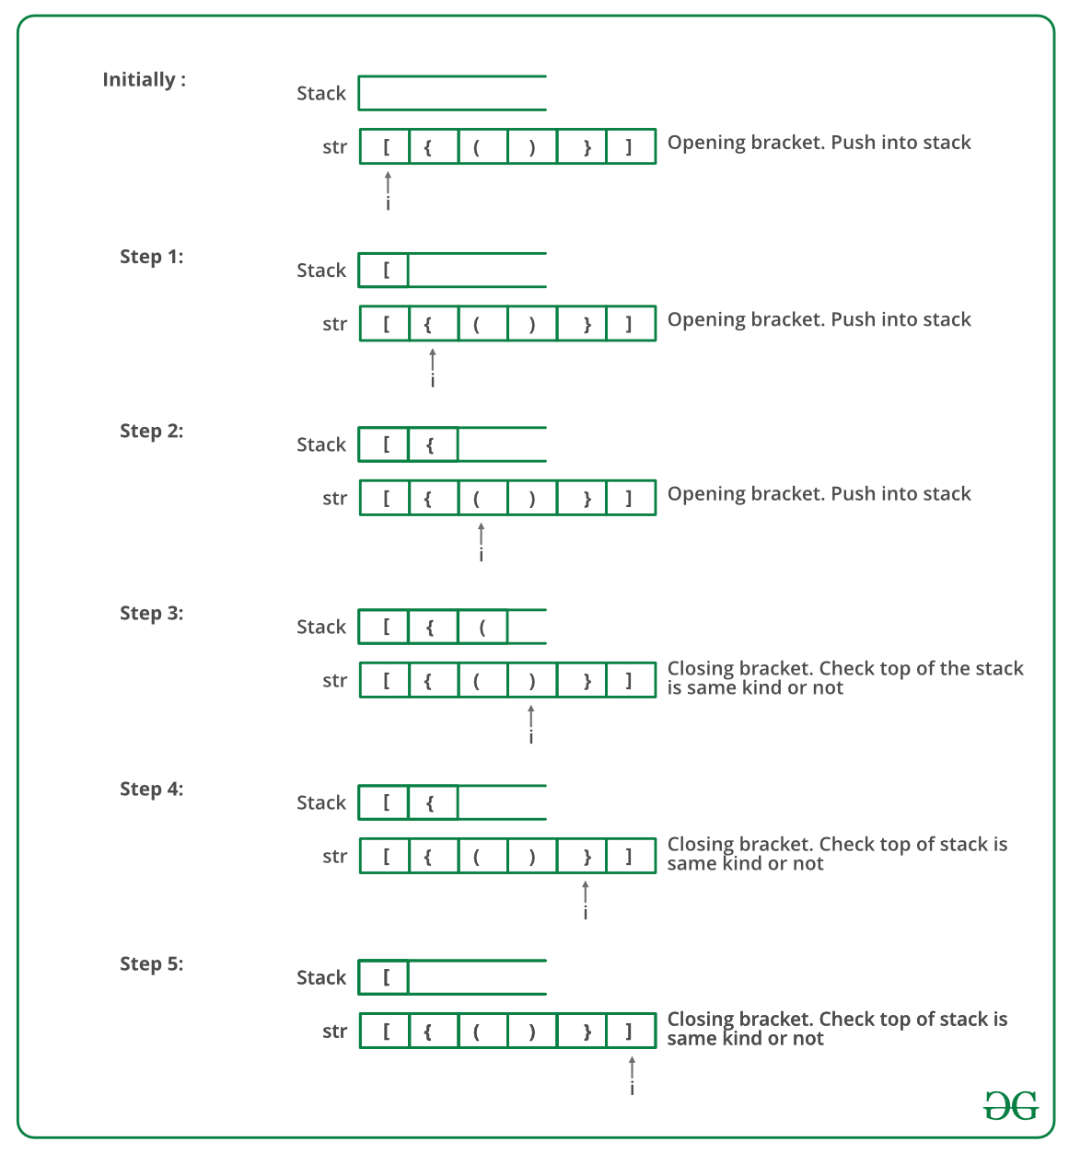

Slide 120
def areParanthesisBalanced(expr):
stack=[]
for ch in expr:
if ch in ["(","{","["]:
stack.append(ch)
else:
if not stack:
return False
current_char=stack.pop()
if current_char=='(':
if ch!=")":
return False
if current_char=='{':
if ch!="}":
return False
if current_char=='[':
if ch!="]":
return False

Slide 121
if stack:
return False
return True
expr="{()}[]"
if areParanthesisBalanced(expr):
print("Balanced")
else:
print("Not Balanced")

Slide 122
Divide and Conquer Algorithm
A divide and conquer algorithm is a strategy of solving a large problem by
breaking the problem into smaller sub-problems
solving the sub-problems, and
combining them to get the desired output.

Slide 123
Here are the steps involved:
Divide : Divide the given problem into sub-problems using recursion.
Conquer: Solve the smaller sub-problems recursively. If the subproblem is small enough, then solve it directly.
Combine: Combine the solutions of the sub-problems which is part of the recursive process to get the solution to the actual problem.

Slide 124
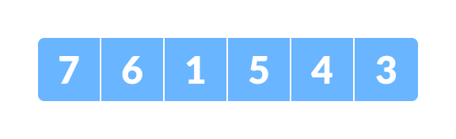
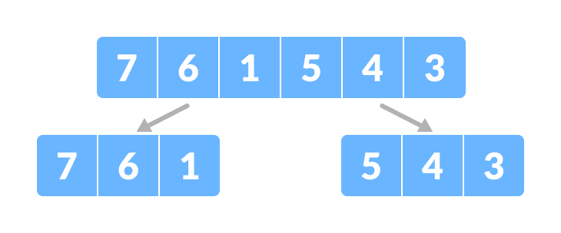
Here, we are going to sort an array using the divide and conquer approach (ie. merge sort).
Divide the array into two halves.

Slide 125
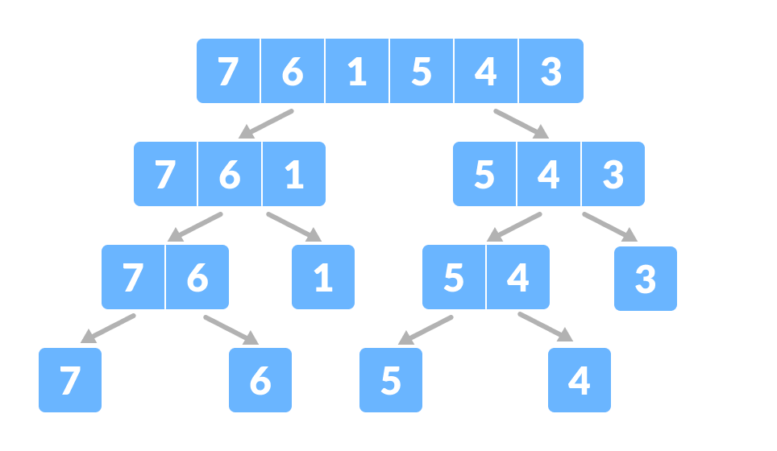
Again, divide each subpart recursively into two halves until you get individual elements.

Slide 126
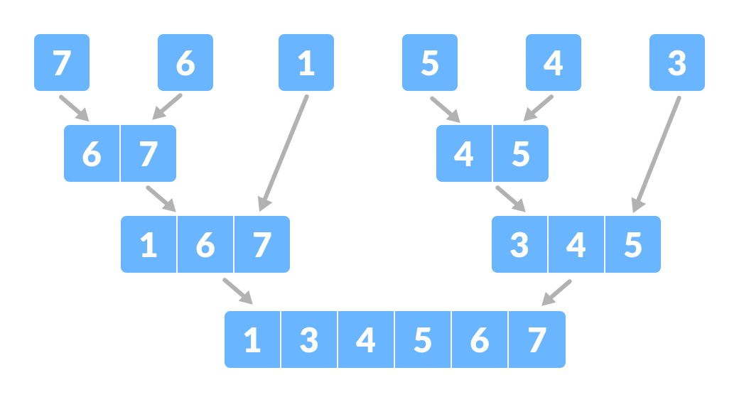
Now, combine the individual elements in a sorted manner. Here, conquer and combine steps go side by side.

Slide 127
Suppose we had to sort an array A. A subproblem would be to sort a sub-section of this array starting at index p and ending at index r, denoted as A[p..r].
Divide If q is the half-way point between p and r, then we can split the subarray A[p..r] into two arrays A[p..q] and A[q+1, r].
Conquer In the conquer step, we try to sort both the subarrays A[p..q] and A[q+1, r]. If we haven't yet reached the base case, we again divide both these subarrays and try to sort them.
Combine When the conquer step reaches the base step and we get two sorted subarrays A[p..q] and A[q+1, r] for array A[p..r], we combine the results by creating a sorted array A[p..r] from two sorted subarrays A[p..q] and A[q+1, r].

Slide 128
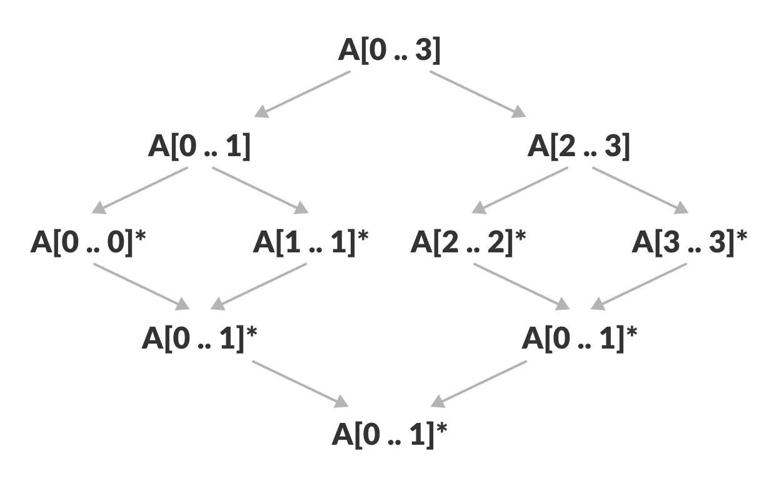
The MergeSort Algorithm
The MergeSort function repeatedly divides the array into two halves until we reach a stage where we try to perform MergeSort on a subarray of size 1 i.e. p == r.
After that, the merge function comes into play and combines the sorted arrays into larger arrays until the whole array is merged.

Slide 129
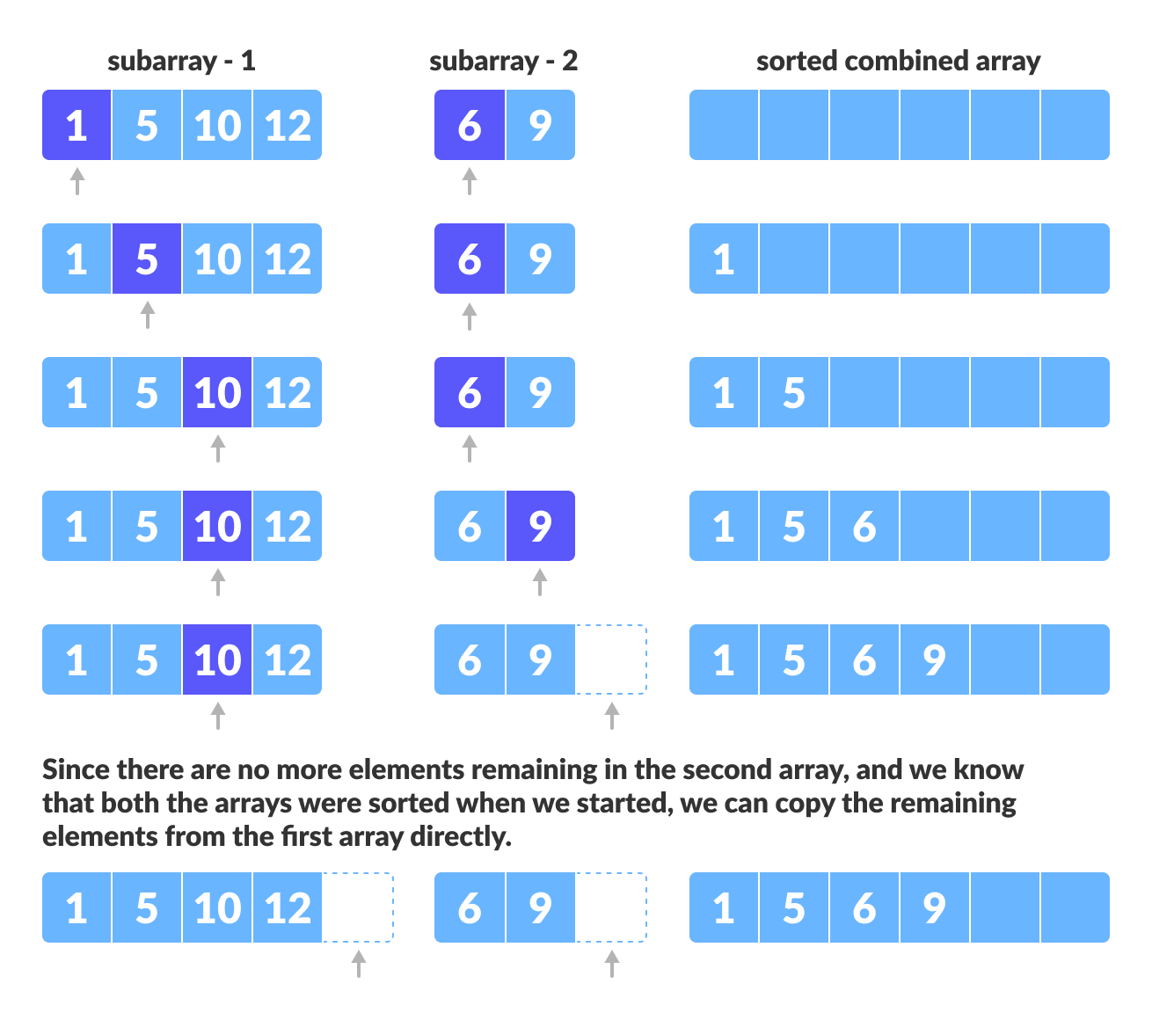

Slide 130
def mergeSort(arr):
if len(arr)>1:
mid=len(arr)//2
left=arr[:mid]
right=arr[mid:]
mergeSort(left)
mergeSort(right)
i=j=k=0
while i<len(left) and j<len(right):
if left[i]<right[j]:
arr[k]=left[i]
i+=1
else:
arr[k]=right[j]
j+=1
k+=1

Slide 131
while i<len(left):
arr[k]=left[i]
i+=1
k+=1
while j<len(right):
arr[k]=right[j]
j+=1
k+=1
def printList(arr):
for i in range(len(arr)):
print(arr[i],end="")
print()
arr=[12,11,13,5,6,7]
printList(arr)
mergeSort(arr)
printList(arr)

Slide 132
Binary Tree
Trees: Unlike Arrays, Linked Lists, Stack and queues, which are linear data structures, trees are hierarchical data structures.
Tree Vocabulary: The topmost node is called root of the tree. The elements that are directly under an element are called its children. The element directly above something is called its parent. For example, ‘a’ is a child of ‘f’, and ‘f’ is the parent of ‘a’. Finally, elements with no children are called leaves.

Slide 133
Why Trees?
1. One reason to use trees might be because you want to store information that naturally forms a hierarchy. For example, the file system on a computer:
2. Trees (with some ordering e.g., BST) provide moderate access/search (quicker than Linked List and slower than arrays).
3. Trees provide moderate insertion/deletion (quicker than Arrays and slower than Unordered Linked Lists). 4. Like Linked Lists and unlike Arrays, Trees don’t have an upper limit on number of nodes as nodes are linked using pointers.

Slide 134
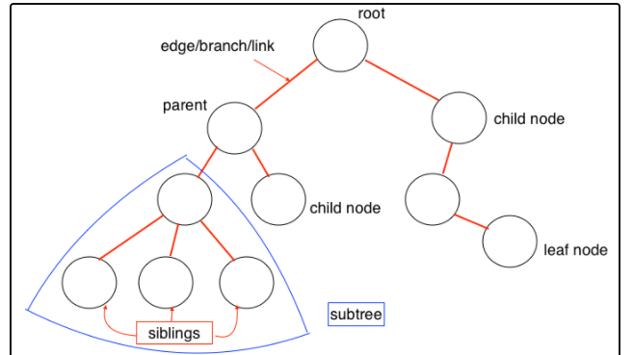

Slide 135
Main applications of trees include:
1. Manipulate hierarchical data. 2. Make information easy to search (see tree traversal). 3. Manipulate sorted lists of data. 4. As a workflow for compositing digital images for visual effects. 5. Router algorithms 6. Form of a multi-stage decision-making (see business chess).

Slide 136
Binary Tree
A tree whose elements have at most 2 children is called a binary tree. Since each element in a binary tree can have only 2 children, we typically name them the left and right child.
Binary Tree Representation : A tree is represented by a pointer to the topmost node in tree. If the tree is empty, then value of root is NULL. A Tree node contains following parts. 1. Data 2. Pointer to left child 3. Pointer to right child

Slide 137
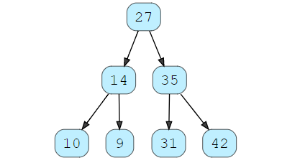

Slide 138
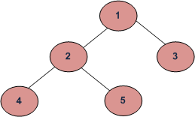
Tree Traversals (Inorder, Preorder and Postorder)
Unlike linear data structures (Array, Linked List, Queues, Stacks, etc) which have only one logical way to traverse them, trees can be traversed in different ways. Following are the generally used ways for traversing trees.
Depth First Traversals: (a) Inorder (Left, Root, Right) : 4 2 5 1 3 (b) Preorder (Root, Left, Right) : 1 2 4 5 3 (c) Postorder (Left, Right, Root) : 4 5 2 3 1
Breadth First or Level Order Traversal : 1 2 3 4 5

Slide 139
Let's think about how we can read the elements of the tree in the image shown above.
Starting from top, Left to right
1 -> 12 -> 5 -> 6 -> 9
Starting from bottom, Left to right
5 -> 6 -> 12 -> 9 -> 1
Although this process is somewhat easy, it doesn't respect the hierarchy of the tree, only the depth of the nodes.
Instead, we use traversal methods that take into account the basic structure of a tree i.e.

Slide 140
Inorder traversal
First, visit all the nodes in the left subtree
Then the root node
Visit all the nodes in the right subtree
inorder(root->left)
display(root->data)
inorder(root->right)

Slide 141
Let's visualize in-order traversal. We start from the root node.
We traverse the left subtree first. We also need to remember to visit the root node and the right subtree when this tree is done.

Slide 142
Inorder Traversal
Algorithm Inorder(tree)
1. Traverse the left subtree, i.e., call Inorder(left-subtree)
2. Visit the root.
3. Traverse the right subtree, i.e., call Inorder(right-subtree)

Slide 143
def printinorder(root):
if root:
printinorder(root.leftval)
print(root.val,end=" ")
printinorder(root.rightval)

Slide 144
Preorder Traversal
Algorithm Preorder(tree)
1. Visit the root.
2. Traverse the left subtree, i.e., call Preorder(left-subtree)
3. Traverse the right subtree, i.e., call Preorder(right-subtree)

Slide 145
def printpreorder(root):
if root:
print(root.val,end=" ")
printpreorder(root.leftval)
printpreorder(root.rightval)

Slide 146
Postorder Traversal
Algorithm Postorder(tree)
1. Traverse the left subtree, i.e., call Postorder(left-subtree)
2. Traverse the right subtree, i.e., call Postorder(right-subtree)
3. Visit the root.

Slide 147
def PrintPostorder(root):
if root:
PrintPostorder(root.leftval)
PrintPostorder(root.rightval)
print(root.val,end=" ")

Slide 148
class Node:
def __init__(self,data):
self.left=None
self.right=None
self.data=data
def PrintTree(self):
print(self.data)
root = Node(27)
root.PrintTree()

Slide 149
class Node:
def __init__(self,key):
self.leftval=None
self.rightval=None
self.val=key
def printinorder(root):
if root:
printinorder(root.leftval)
print(root.val,end=" ")
printinorder(root.rightval)
root=Node(1)
root.leftval=Node(2)
root.rightval=Node(3)
printinorder(root)
print()

Slide 150
Insertion
The insert method compares the value of the node to the parent node and decides whether to add it as a left node or right node.
Remember: if the node is greater than the parent node, it is inserted as a right node; otherwise,​ it’s inserted left.
Finally, the PrintTree method is used to print the tree.

Slide 151
def insert(self, data):
# Compare the new value with the parent node
if self.data:
if data < self.data:
if self.left is None:
self.left = Node(data)
else:
self.left.insert(data)
elif data > self.data:
if self.right is None:
self.right = Node(data)
else:
self.right.insert(data)
else:
self.data = data

Slide 152
Print the tree
def PrintTree(self):
if self.left:
self.left.PrintTree()
print( self.data),
if self.right:
self.right.PrintTree()

Slide 153
Deleting Node
flag = False
class Node:
def __init__(self,val):
self.val = val
self.left = None
self.right = None
def Preorder(root):
if root is None:
return
print(root.val,end = " ")
Preorder(root.left)
Preorder(root.right)

Slide 154
def leafDelete(root,x):
global flag
if root is None:
return
if (root.left == None) and (root.right == None) and (root.val == x):
flag = True
return None
root.left = leafDelete(root.left,x)
root.right = leafDelete(root.right,x)
return root

Slide 155
root = Node(4);
root.left = Node(5);
root.right = Node(9);
root.left.left = Node(3);
root.left.right = Node(1);
root.right.left = Node(7);
k = int(input('Enter value of Leaf node to be deleated:'))
root = leafDelete(root,k)
if flag:
Preorder(root)
else:
print('Node with given value',k,'Is not Leaf Node')

Slide 156
Tic-Tac Toe Game
player=1
board=[' ',' ',' ',' ',' ',' ',' ',' ',' ',' ']
Win=1
Draw=-1
Running=0
Stop=1
Game=Running
Mark='X'
def DrawBoard():
print(" %c | %c | %c " % (board[1],board[2],board[3]))
print("___|___|___")
print(" %c | %c | %c " % (board[4],board[5],board[6]))
print("___|___|___")
print(" %c | %c | %c " % (board[7],board[8],board[9]))
print(" | | ")
def checkposition(x):
if(board[x]==' '):
return True
else:
return False

Slide 157
def checkwin():
global Game
if(board[1]==board[2] and board[2]==board[3] and board[1]!=''):
Game=Win
elif(board[4]==board[5] and board[5]==board[6] and board[4]!=' '):
Game=Win
elif(board[7]==board[8] and board[8]==board[9] and board[7]!=' '):
Game=Win
elif(board[1]==board[4] and board[4]==board[7] and board[1]!=' '):
Game=Win
elif(board[2]==board[5] and board[5]==board[8] and board[2]!=' '):
Game=Win
elif(board[3]==board[6] and board[6]==board[9] and board[3]!=' '):
Game=Win
elif(board[1]==board[5] and board[5]==board[9] and board[5]!=' '):
Game=Win
elif(board[3]==board[5] and board[5]==board[7] and board[5]!=' '):
Game=Win
elif(board[1]!=' ' and board[2]!=' ' and board[3]!=' ' and board[4]!=' ' and board[5]!=' ' and board[6]!=' ' and board[7]!=' ' and board[8]!=' ' and board[9]!=' '):
Game=Draw
else:
Game=Running

Slide 158
while(Game==Running):
DrawBoard()
if(player%2!=0):
print("Player 1's chance")
Mark='X'
else:
print("Player 2's chance")
Mark='O'
choice=int(input("Enter the position"))
if(checkposition(choice)):
board[choice]=Mark
player+=1
checkwin()

Slide 159
DrawBoard()
if(Game==Draw):
print("Game Draw")
elif(Game==Win):
player-=1
if(player%2!=0):
print("Player 1 Won")
else:
print("Player 2 Won")

Slide 160
Reversing list using recursion
l=[1,2,4,6]
def recursive(l):
if len(l)==0:
return []
else:
return [l.pop()]+recursive(l)
print(recursive(l))

