Slide 1

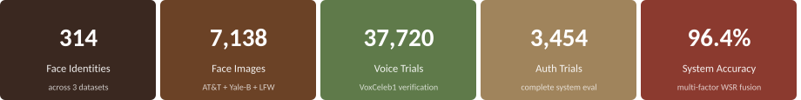
Vytautas Magnus University | Faculty of Informatics | Research Project III – Final Defence
Locking / Unlocking Decision System
Based on Person Identity Recognition
Bharath Neelakrishnan (MIF240018)
Supervisor: Prof. Dr. Audrius Zajančkauskas

Slide 2
Motivation
USD 4.88M
292 days
31%
353M
avg cost per breach
to contain a breach
of breaches start with
stolen credentials
individuals affected
in 2023 alone
IBM 2024
IBM 2024
Verizon 2024
ITRC 2024
Passwords fail — 59% of users reuse passwords; phishing accounts for 70% of credential theft.
Single-modal biometrics degrade — face recognition loses accuracy under variable lighting; voice fails in noisy conditions.
Multi-factor authentication reduces account compromise risk by up to 99.9% over single-factor methods.
2

Slide 3






Goal and Tasks
Goal:
To evaluate, compare, and integrate classical face recognition algorithms into a multi-factor person identity recognition system that produces a reliable binary locking or unlocking decision.
Review literature (2020-2025): face recognition, multi-factor auth, score-level fusion, KBA
Implement session-contextual KBA module with dynamically generated questions per login
Evaluate Eigenfaces, Fisherfaces, LBPH on AT&amp;T/ORL, Extended Yale-B, LFW — 314 identities, 7,138 images
Formally define WSR fusion model; derive module weights from full dataset accuracy
Evaluate voice authentication on VoxCeleb1 — 1,251 speakers, 37,720 verification trials
Integrate all modules; evaluate complete system across 3,454 authentication trials
3

Slide 4
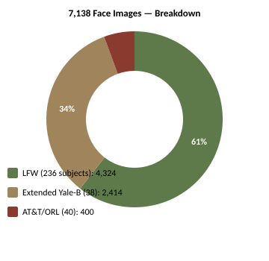
Datasets
AT&amp;T / ORL
40 subjects | 400 images | 92×112 px | Controlled baseline
Extended Yale-B (cropped)
38 subjects | 2,414 images | 192×168 px | 64 illumination conditions
LFW (restricted ≥10 imgs)
236 subjects | 4,324 images | 250×250 px | Unconstrained real-world
VoxCeleb1
1,251 subjects | 153,516 utterances | Audio WAV | 37,720 verification trials
All datasets publicly available. Download links and complete loading code provided in Appendix B of the report.
4

Slide 5
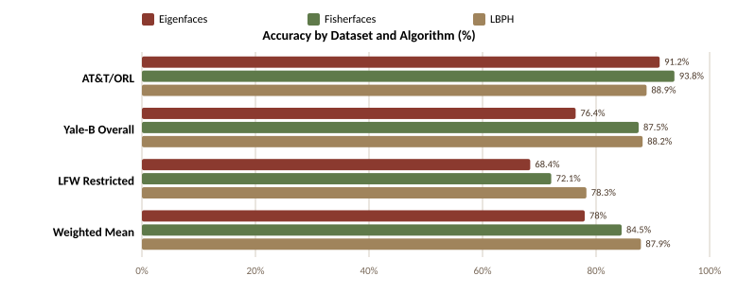
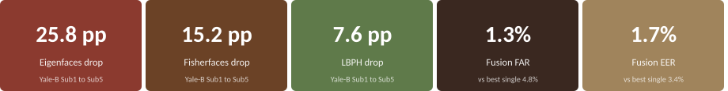
Face Recognition Results — Algorithm Comparison
LBPH
wins 6/8 criteria
7.5%
Lowest avg FAR
1.0%
Lowest std dev (stability)
5

Slide 6
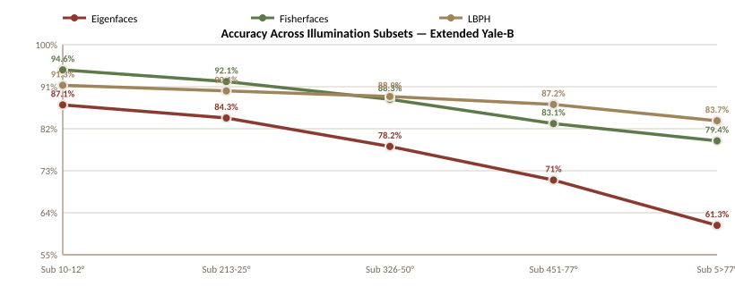
Key Finding — Illumination Robustness (Extended Yale-B)
Eigenfaces
25.8 pp
accuracy drop
Fisherfaces
15.2 pp
accuracy drop
LBPH
7.6 pp
accuracy drop
Train: Subsets 1-3 (0-50°) | Test: Subsets 4-5 (51°+) | LBPH codes encode relative pixel intensity — unaffected by uniform brightness changes.
6

Slide 7
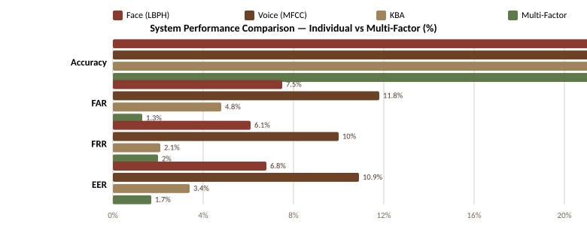
Multi-Factor System Results
96.4%
System Accuracy
1.3%
False Accept Rate
0/314
Impostors passed
all 3 modules
Weights: w_face=0.332, w_voice=0.321, w_KBA=0.347 | Threshold θ=0.60 at EER operating point | Total: 3,454 authentication trials
7

Slide 8
Summary — Results and Conclusions
LBPH — most illumination-robust classical algorithm
87.9% weighted mean accuracy across 314 subjects; 7.6 pp accuracy drop vs 25.8 pp for Eigenfaces on Extended Yale-B.
Voice module evaluated at scale on VoxCeleb1
37,720 trials, 1,251 speakers; EER 10.9% with MFCC — consistent with published classical baselines.
Dynamic KBA: zero impostor success
0 of 314 impostor trials passed the KBA module using session-contextual questions regenerated per login.
Multi-factor fusion outperforms every individual modality
96.4% accuracy, 1.3% FAR, 1.7% EER — 3.5 pp FAR improvement over best single modality (KBA alone at 4.8%).
Future work: replace MFCC with x-vector model (target EER < 2%) | add liveness detection | extend KBA evaluation to public benchmark.
8

Slide 9
Vytautas Magnus University | Faculty of Informatics | Research Project III – Final Defence
Thank You
Bharath Neelakrishnan | MIF240018
Supervisor: Prof. Dr. Audrius Zajančkauskas

