Slide 1

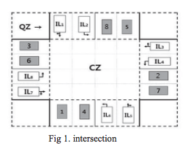
X
X
X
X
X
X
X
X
X
X
X
X
X
X
X
X
X
X
X
X

Slide 2
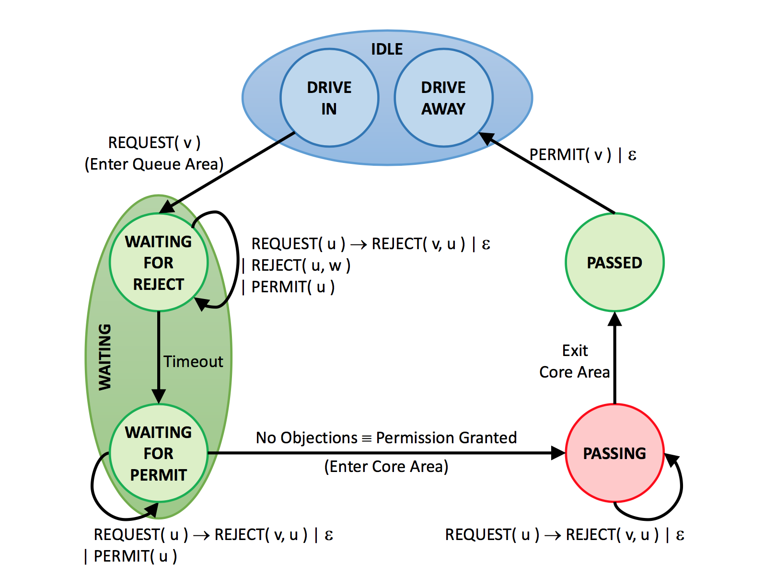
Arrive -> broadcast REQUEST(v)
choc_pos = [chocolate_factory(row) for row in table if row['over70'] == 1]

Slide 3
choc_pos = [chocolate_factory(row) for row in table if row['over70'] == 1]
REQUEST(u) -> either add to HILIST and send PERMIT(u)
or REJECT(v,u) and add to lowlist
REJECT(u,v) -> we are rejected, add w to HILIST
PERMIT(u) -> remove u from HILIST
TIMEOUT -> next state

Slide 4
REQUEST(u) -> REJECT(v,u) + LOWLIST
REJECT(u,v) -> we are rejected (late), add u to HILIST
PERMIT(u) -> remove u from HILIST
HILIST is empty -> move to next state
choc_pos = [chocolate_factory(row) for row in table if row['over70'] == 1]

Slide 5
REQUEST(u) -> REJECT(v,u) + LOWLIST
REJECT(u,v) -> ERROR
PERMIT(u) -> ERROR
Done -> next state
choc_pos = [chocolate_factory(row) for row in table if row['over70'] == 1]

Slide 6
choc_pos = [chocolate_factory(row) for row in table if row['over70'] == 1]
Send PERMIT to all in LOWLIST
Done -> out of system

Slide 7
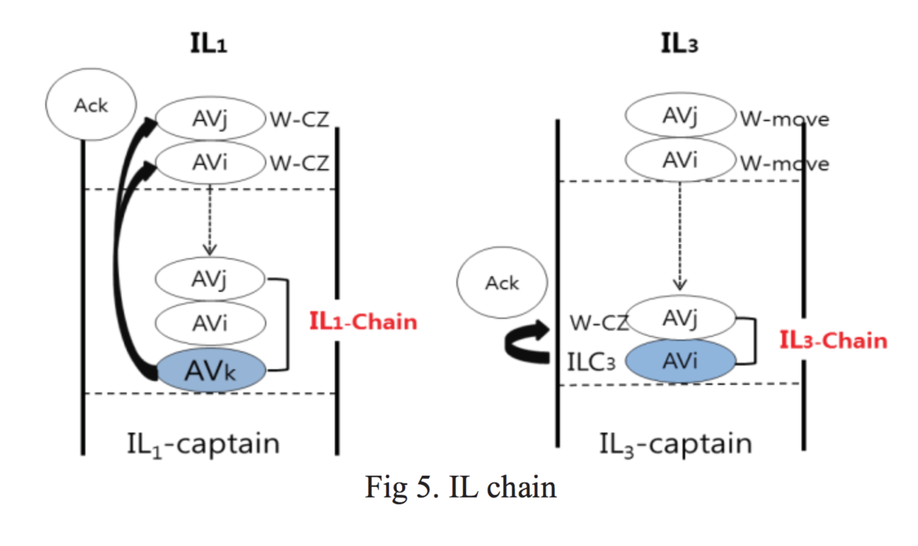
Park

Slide 8
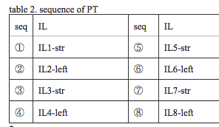
Token Passing - Clockwise

Slide 9
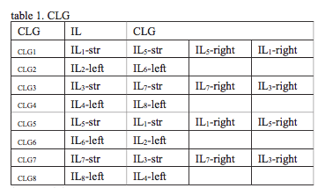
Sub-Token Passing

Slide 10
Inefficient table?

Slide 11
Alternative?

Slide 12
Token management?
How does first car to arrive get token?
What if no car (no captain) for a lane? How does it get skipped?
What if no one to pass token to?

