Slide 1


Data curation and Modelling 11.05.2021
Submitted By –
BHARATH KUMAR
NANDA KUMAR
11014144

Slide 2
CONTENTS
Dataset
SMART strategy
Deducing the question
Process
Data Profiling
Data Quality Dimensions
Transformation
Analytics

Slide 3
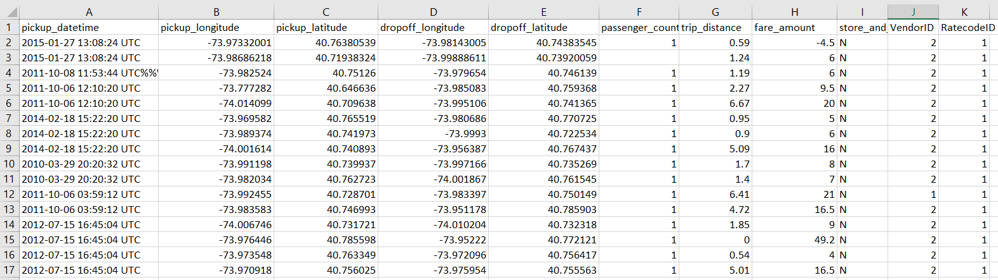
Dataset
Newyork taxi data

Slide 4
SMART Strategy Board
Purpose Panel
Mission statement : To find out the cities which has more trips and to find out the avg/most common fare amount
Vision statement: NY taxi committee can increase taxi’s on locations which has high trips to make profit and people can decide whether to travel or not based on average cost
Customer Panel
Finance Objective
Revenue, Cost etc
Target Market : Potential middle budget customers
Value Proposition :
Finance Panel
Competition & Risk Panel
What factors are threatening our success?
Operations Panel
Partners :
Core Competencies :
Resources Panel
Key infrastructure deliverables
IT Systems and Data
Key people and talent delivarables

Slide 5
Question
1.To find out the cities which has more trips ?
2.To find out the avg/most common fare amount ?
3.Predicting the fare amount based on trip distance ?
It is solved using linear regression algorithm,folium package on python
Seite 5

Slide 6
Process
Number of columns
Duplicate and missing values
Unique values
Completeness-Accuracy-Consistency-conformity
Selecting dataset
Load data
Data Profiling
Data Cleaning
Data Analytics using folium,linear regression
Data Analysis
Seite 5

Slide 7
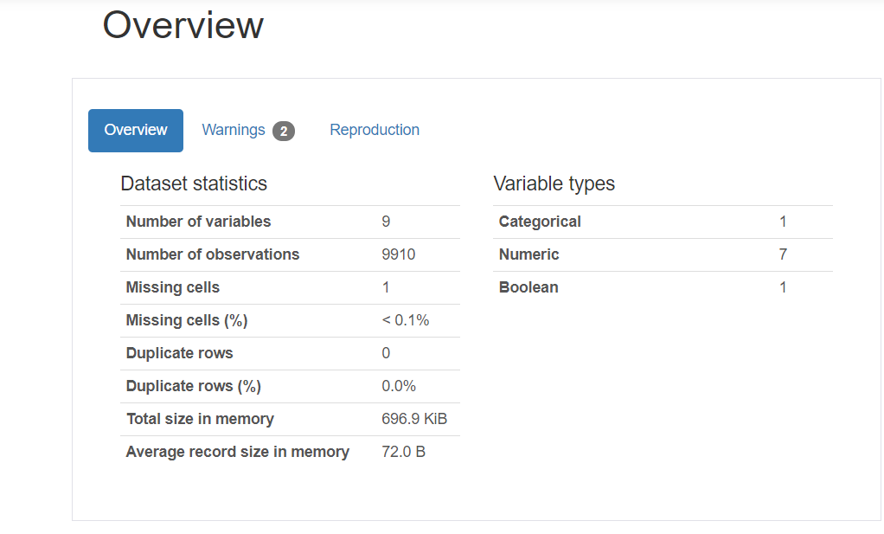
Data Profiling
Data is clean above 90 percent which is obvious through summary
It is made using profile report under pandas profiling

Slide 8
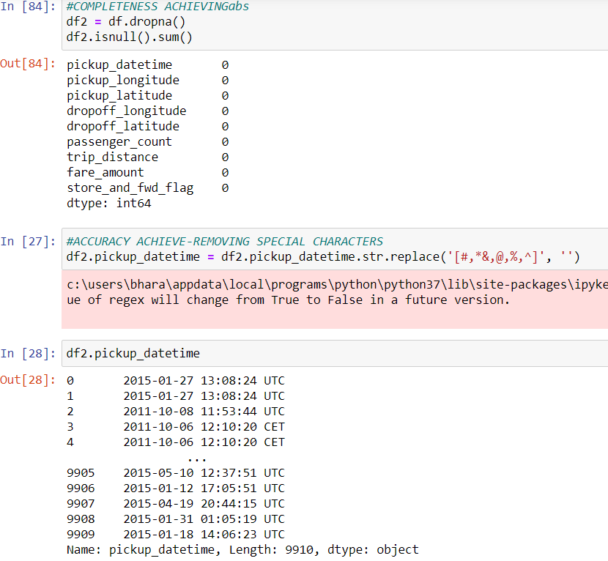
Data Cleaning
Data cleaning to achieve completeness ,validity,accuracy, conformity is made using python packages

Slide 9
Star Schema
Dimension table
Location
pickup_longitude
pickup_latitude
dropoff_longitude
dropoff_latitude
Fact table
VendorID
RatecodeID
Pickup_datetime
Dimension table
Dimension table
Passenger_count
Passenger_dimension
Cost
trip_distance
fare_amount

Slide 10
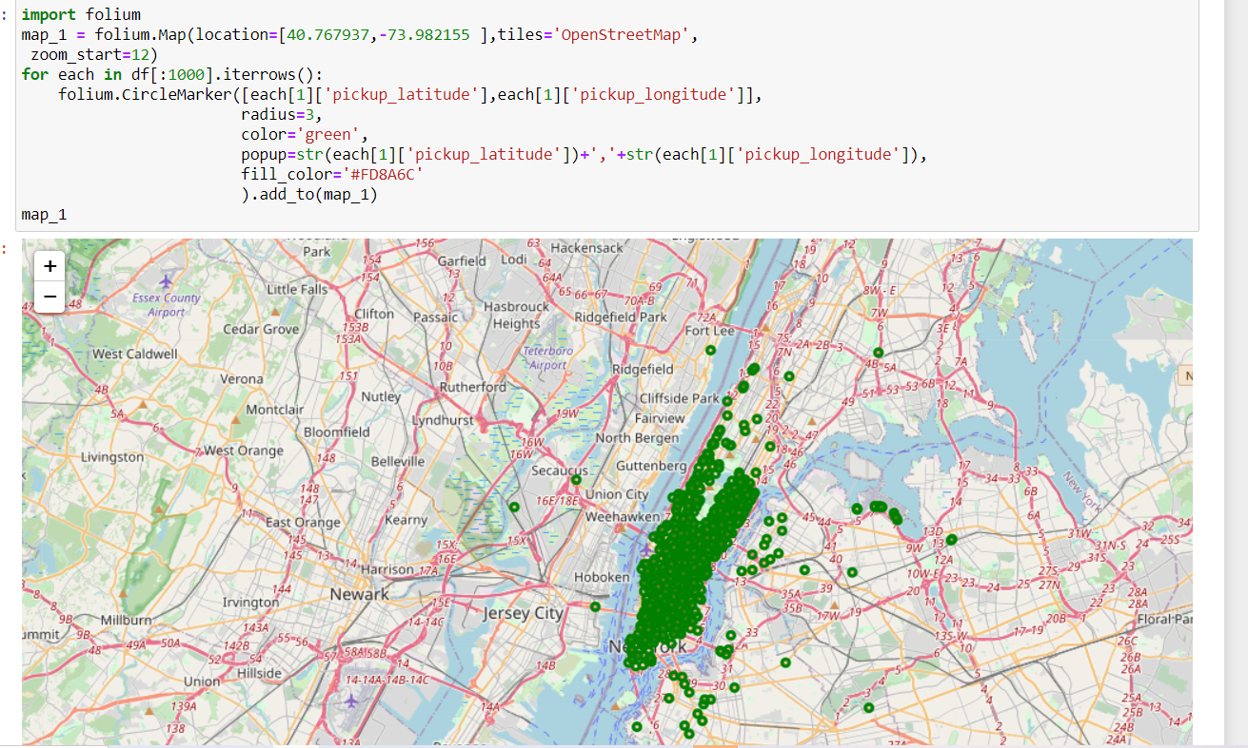
Data Analytics
Cities which has more number of trips has been visualisd using folium package

Slide 11
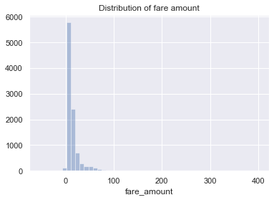
most occured fare amount on the taxi

Slide 12
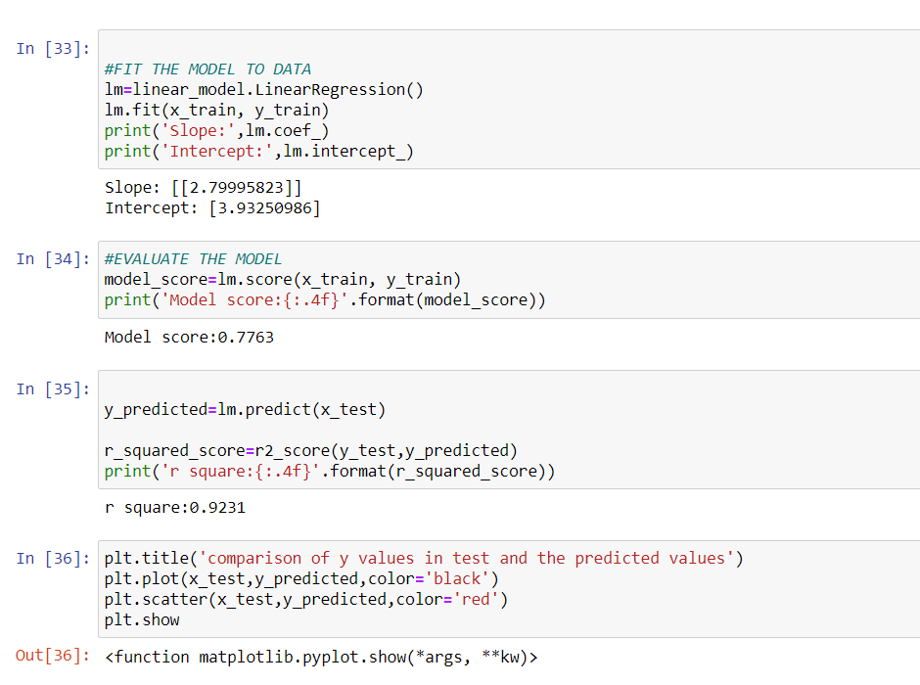
Predicting fare amount based on trip distance

Slide 13
THANK YOU

