Slide 1







Technology Trend Analysis
Madireddy Bharath Kumar Reddy
2024/24/08

Slide 2



OUTLINE
Executive Summary
Introduction
Methodology
Results
Visualization – Charts
Dashboard
Discussion
Findings & Implications
Conclusion
Appendix

Slide 3

EXECUTIVE SUMMARY
Current Technology Usage Trend
Language
Database
Platform
Web frame
Future Technology Trend
Language
Database
Platform
Web frame
Demographics Survey
Country & Gender Difference

Slide 4

INTRODUCTION
Analyze technology trend in software and web development among developers around the world
Purpose of this Analysis
Identify the top programming languages, database, platform and web frame skills in demand
Identify skill requirements for future
Identify human resource gap in the industry
Audience for this Presentation
Programmers
IT industry leaders
Computer science students

Slide 5

METHODOLOGY
Data Collection (Sources)
Stack overflow developer 2019 survey
GitHub job postings
Programming languages annual salary
Data Wrangling
Data Exploration
Data Cleaning
Data Visualization
Python matplotlib & turtle
IBM Cognos
Presentation

Slide 6
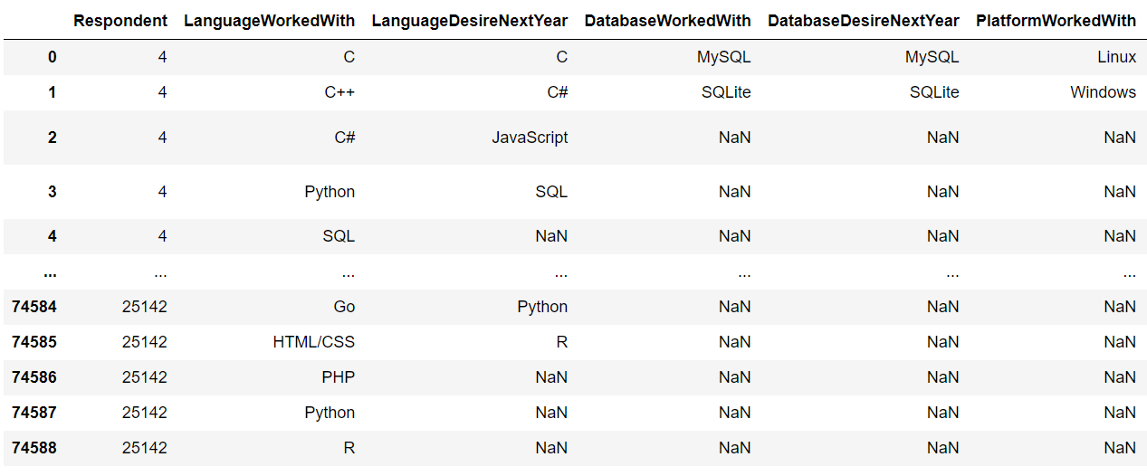
RESULTS

Slide 7
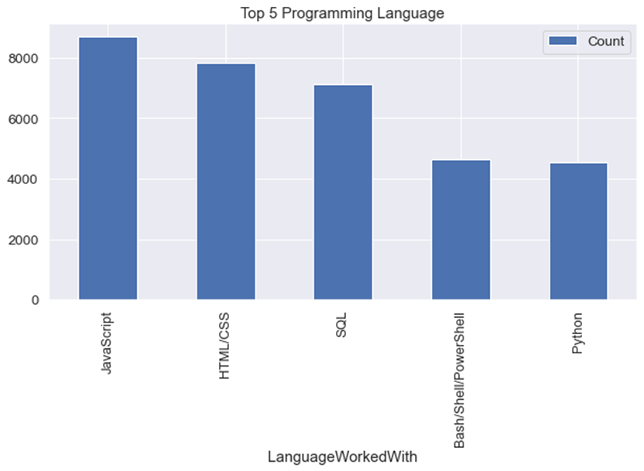
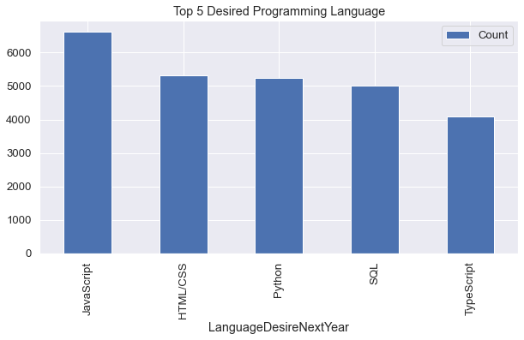
PROGRAMMING LANGUAGE TRENDS
Current Year
Next Year

Slide 8
PROGRAMMING LANGUAGE TRENDS - FINDINGS & IMPLICATIONS
Findings
JavaScript is top trending language in the world
Python and TypeScript are becoming more and more popular
HTML/CSS and SQL still has great portion in language usage trend
Implications
Web developments and Web developers are still in high demands
JavaScript and TypeScript are crucial to learn for developers
Python is the new trending language, especially popular in AI fields

Slide 9
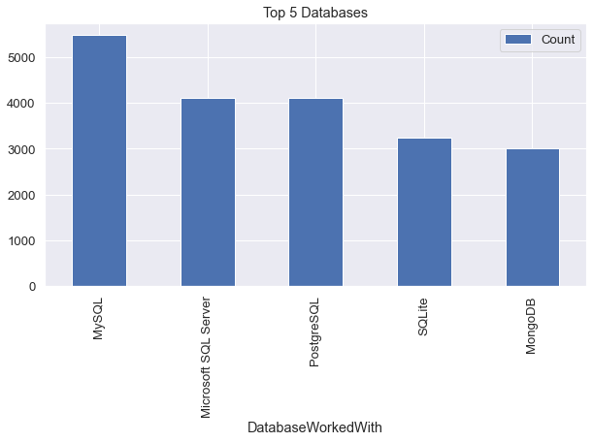
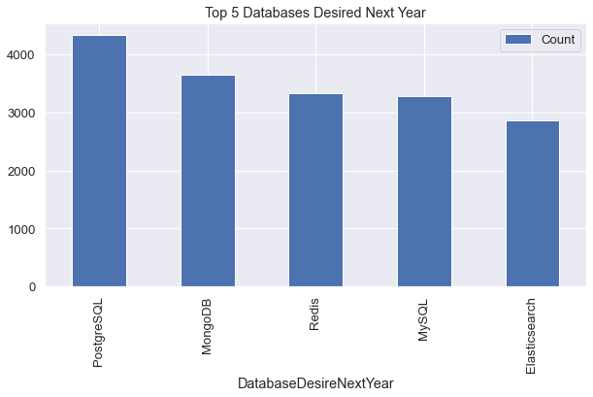
DATABASE TRENDS
Current Year
Next Year

Slide 10
DATABASE TRENDS - FINDINGS & IMPLICATIONS
Findings
MySQL is the most popular database
There are still a lot of companies using Microsoft SQL Server
MongoDB and Redis are the most favorable NoSQL database
Implications
Open-source databases like MySQL are still preferable
Software development and Big Data technology still requires SQL
NoSQL databases will make an impact for relational databases

Slide 11

DASHBOARD
The permanent link of the read-only view of the Cognos dashboard:
https://dataplatform.cloud.ibm.com/dashboards/fe52d392-0d9c-4f29-8996-389531352958/view/6e1bdc0911b91dfc56efe6e4079979037f652454e1bb8b0b83867b495e607197a96f12c7c87a495cd9425037fbee4708cc

Slide 12
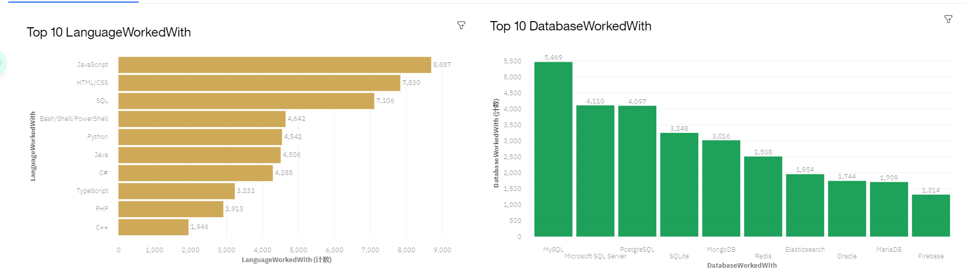
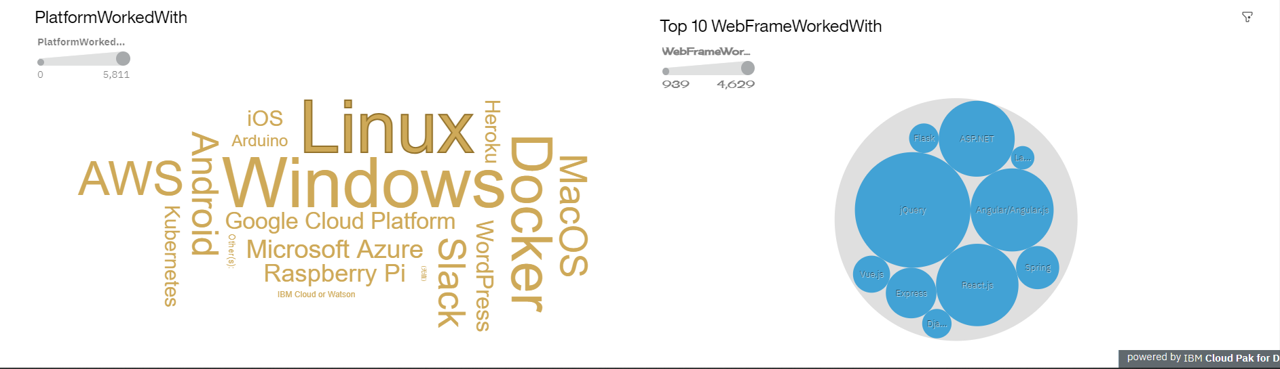
CURRENT TECHNOLOGY USAGE

Slide 13
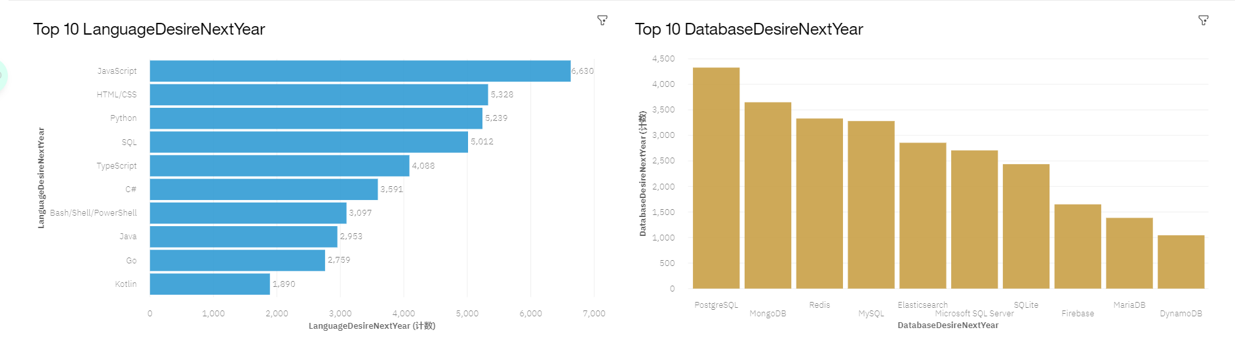
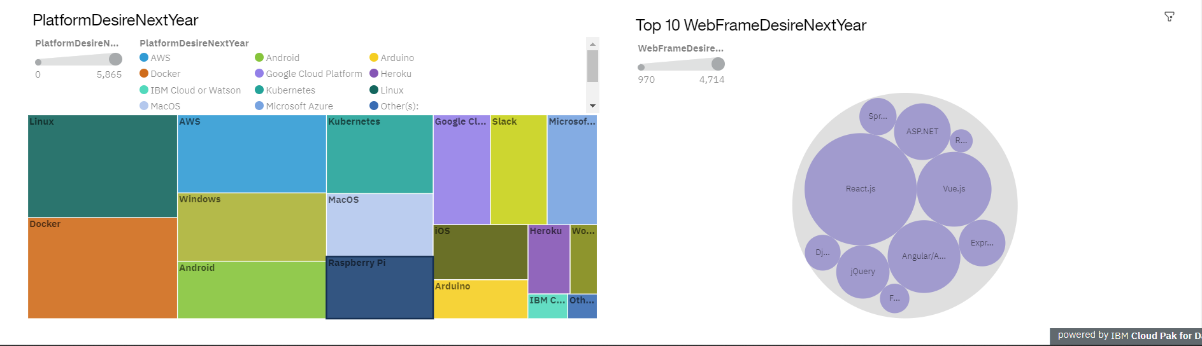
FUTURE TECHNOLOGY TREND

Slide 14
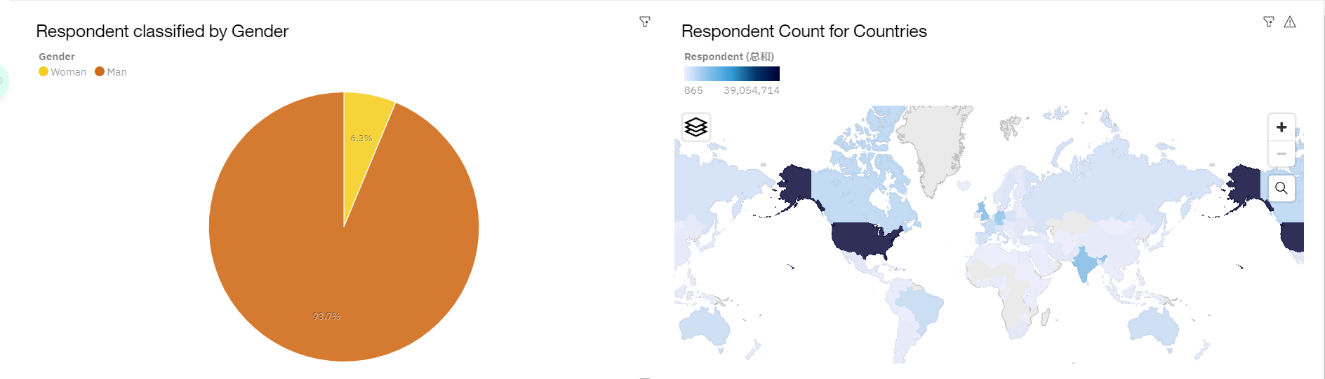
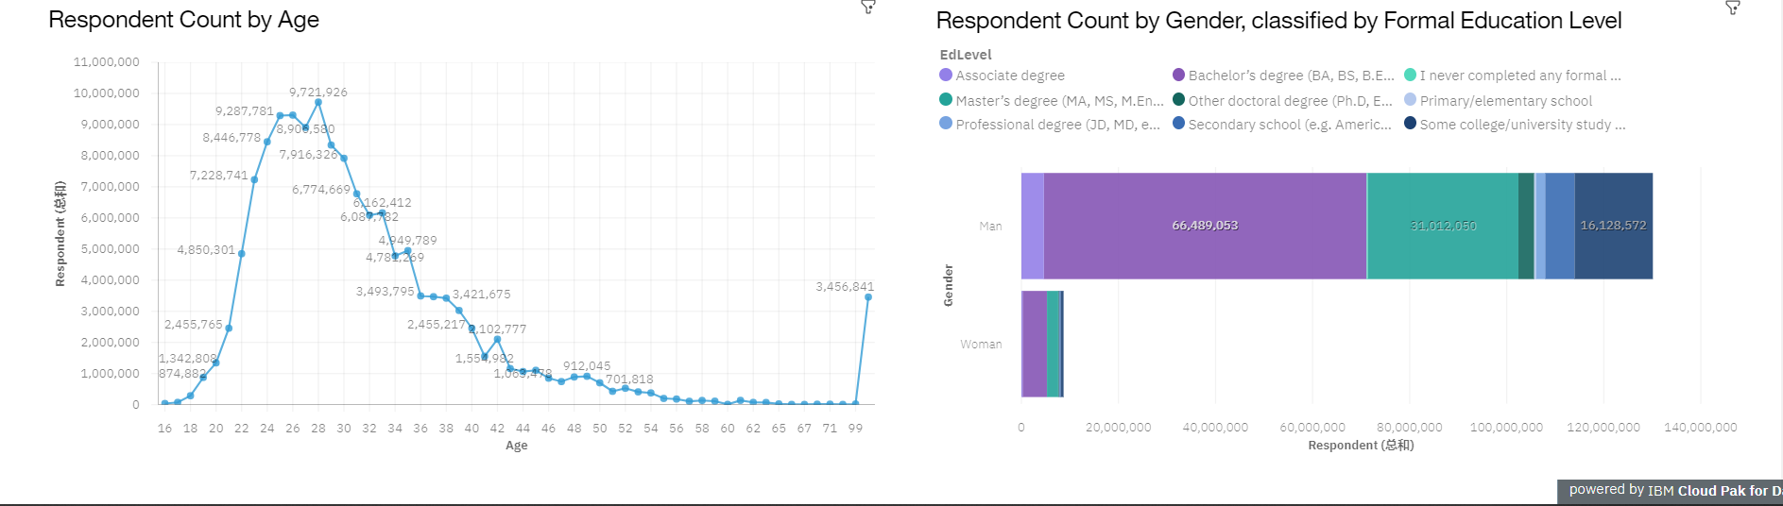
DEMOGRAPHICS

Slide 15
DISCUSSION
Technology Usage Trend Now and Future
Gender, Age and Education Discrimination in IT Industry

Slide 16
OVERALL FINDINGS & IMPLICATIONS
Findings
Technology trends changes every year
USA is the top technology country
There are extreme gender and age discrimination
Docker and AWS are the most popular platform
Implications
Programmers should always follow the latest technology trends
More countries should have the equal chance to be exposed to new technology
Gender and Age should not be one of the concerns or benefits of Employment

Slide 17

CONCLUSION
Technology Trends
Programming Languages, Database, Platform and Web frame Trends
Demographics Trends
Gender and Education
Programming Languages Trends and Salary Trends

Slide 18

APPENDIX
IBM Cognos Dashboard Embedded (CDE) is an AI-fueled business intelligence service that supports the entire data analytics cycle, from discovery to operationalization. It provides users with data discovery capabilities to visually explore and interact with their data to identify the key insights for improving data driven decisions. Users can perform data discovery and then quickly assemble that information into interactive, visually appealing dashboards; all without the need of formal training.

Slide 19
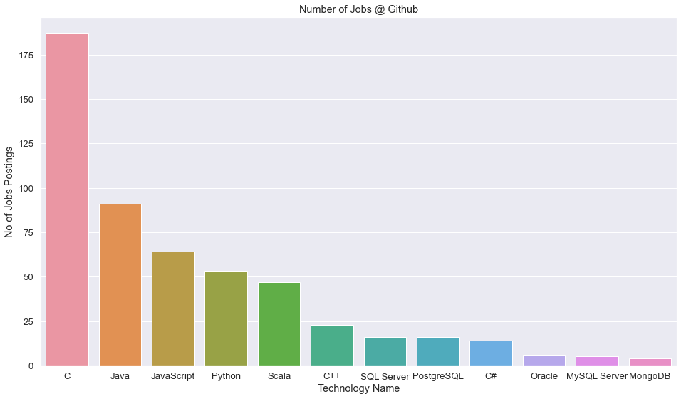
GITHUB JOB POSTINGS

Slide 20
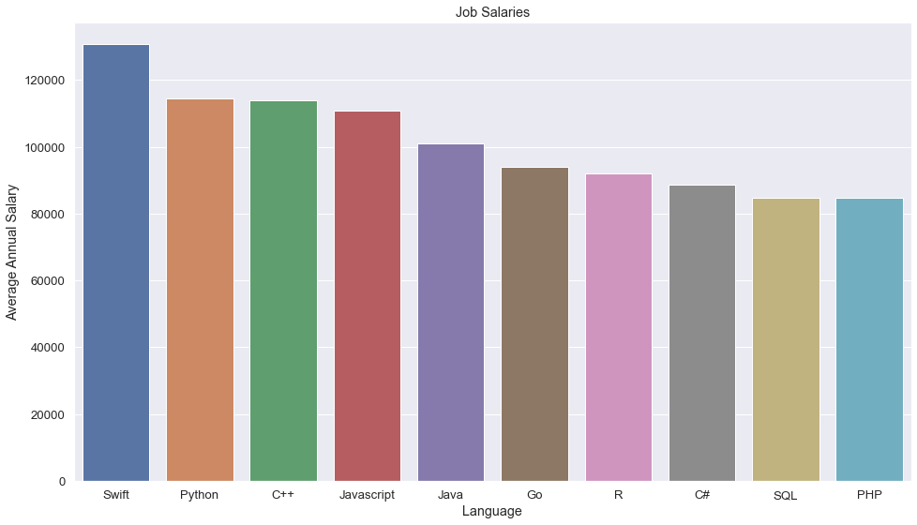
POPULAR LANGUAGES

