Slide 1
OVERPASS
Eldhose Peter
Rajath Rajeev
Arjun Suresh
Bharath M

Slide 2
Opportunity
A lot of people tend to forget to take their medicines on time. This on a long term basis does have severe impact on their health.
That is where we the team OVERPASS found the opportunity to overcome and improve on the same scenario.
We wish to automate the attentiveness and awareness of patients towards their medicines and its routines.

Slide 3
Existing systems
There are a lot of apps to help us improve on our health. For example: Glucose Buddy, uChek, WebMD etc.
They have a lot of features which are very beneficial like goal setting, disease condition infos, diet specifications etc.
Our idea focuses on a particular aspect that Is the medicine time and specifications.
So our idea will improve the efficiency of the current technologies.

Slide 4
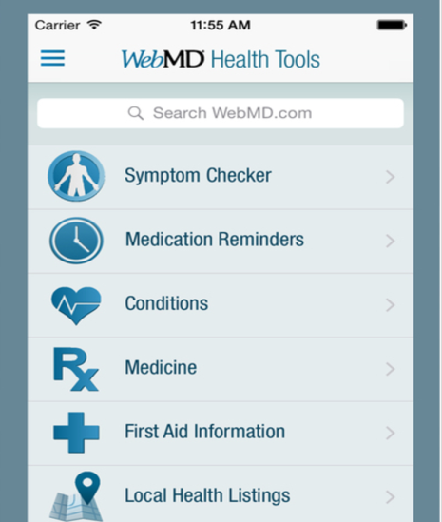
Existing systems
Example

Slide 5
The M_Cognizance App

Slide 6
Problem statement
Scope of project
Existing system
Proposed soln
Intended audience
Block diagrams &
description in detail Hardware requirements Software requirements
Conclusion

