Slide 1
Employee Data Analysis using Excel
STUDENT NAME : M. BHARATH
REGISTER NO :312201231
AUTUNM110312201231
AE6EF9E6498AEABAE234CE7C5
DEPARTMENT :B.COM ( GENERAL)
COLLEGE : D.R.B.C.C.C. HINDU COLLEGE,
PATTABIRAM

Slide 2
PROJECT TITLE
Employee Performance Analysis using Excel

Slide 3
PROJECT OVERVIEW
.
It defines as a employees goals ,identifying gender,collecting data, analysis data using tools and implementation improvements to enhance performamce

Slide 4
AGENDA
Project Overview
Problem Statement
End Users
Our Solution and Proposition
Dataset Description
Modelling Approach
Results and Discussion
Conclusion

Slide 5
PROBLEM STATEMENT
It provides a system wide analysis of workflow , talent, product quality , and other key indicators of organizational success

Slide 6

WHO ARE THE END USERS?
They are individuals who interact directly with the final software application , haerdwarwes , or ditial services to meets their specific requirements
End users are
Employers
Employees
Orgainsations
IT institutions

Slide 7
OUR SOLUTION AND ITS VALUE PROPOSITION
FORMULA : performance level
PIVOT TABLE :summary
GRAPH: data visualization

Slide 8
Dataset Description
Employee data set –Kaggle
10 features
Emp id –numerical
Name –text
Gender- male female
Emp status –text
FTE – numerical
Performance level – text

Slide 9
THE "WOW" IN OUR SOLUTION
PERFORMANCE LEVEL =IFS( G2 >=0.9” VERRY HIGH”, G2 >= 0.5 “HIGH” , G2 >=0.4 “ MED “ ,”TRUE” , “ LOW “)
3/21/2024 Annual Review
9

Slide 10
MODELLING
DATA COLLECTION :
KAGGLE
NM dash board
Performance level :
Very high
High
Low
PIVOT TABLE :
SUMMARY
GRAPH :
Visualization
10

Slide 11
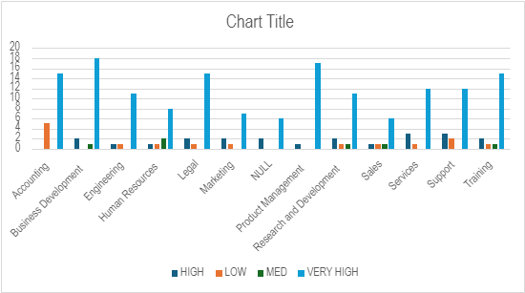
RESULTS
11

Slide 12
conclusion
I conclude that the summarize an employee performance during a review period , highlights their strength , and identify areas of improvements

