Slide 1

APP DEVELOPMENT
What it is and why it's important

Slide 2
Is app more versatile than web?
APPLICATION DEVELOPMENT
What is platform-specific software?
How to develop an App?
What is meant by UI and UX?
What is meant by app development?
Trends in app development

Slide 3
What is Flutter?
Developed by Google: Flutter is an open-source UI software development kit created by Google.
First Released in 2017: Officially released in May 2017, it has quickly become popular among developers.
Cross-Platform Development: Enables developers to create natively compiled applications for mobile (iOS, Android), web, desktop, and embedded devices from a single codebase.
Written in Dart: It uses Dart language, which was also developed by Google, is optimized for UI development, and provides smooth performance.
High-Performance Rendering Engine: Skia, a powerful 2D graphics engine, is used for rendering, ensuring high performance across different platforms.
Single Codebase: Allows to develop apps with one codebase that runs on multiple platforms, reducing development time and effort.
Rich Widget Library: Offers a wide range of pre-designed widgets that follow the Material Design guidelines and Cupertino (iOS) design principles.
Hot Reload: Feature allows developers to see the results of code changes in real-time without restarting the app, significantly speeding up the development process.
Strong Community Support: A large and active community, along with extensive documentation and tutorials, makes it easier for developers to find help and resources.

Slide 4
Why Flutter is Better than Other Cross-Platform Apps like React Native or Ionic
Performance: Flutter’s architecture allows direct compilation to native ARM code, eliminating the performance bottlenecks seen in other frameworks like React Native, which uses a JavaScript bridge.
Consistency: Ensures consistent performance and appearance across different platforms, unlike Ionic, which may have platform-specific inconsistencies due to its reliance on web technologies.
Rich Set of Widgets: Flutter comes with a comprehensive set of pre-designed widgets that adhere to platform-specific design principles, unlike React Native, which relies heavily on third-party libraries.
Hot Reload: Both React Native and Flutter offer hot reload, but Flutter’s implementation is generally more reliable and faster.
Single Language (Dart): Using Dart for both UI and business logic reduces the complexity of dealing with multiple languages, as is often the case with React Native (JavaScript) and Ionic (HTML/CSS/JavaScript).
High Performance UI: Flutter’s custom rendering engine ensures smooth animations and transitions, providing a high-performance UI experience.
Access to Native Features: Flutter offers easy access to native APIs via platform channels, enabling developers to leverage device-specific features efficiently.
Developer Productivity: Flutter’s tooling, hot reload, and comprehensive widget library significantly boost developer productivity compared to the more fragmented tooling ecosystems of React Native and Ionic.

Slide 5
What is the Core of Flutter Framework and How it Works Behind the Hood
Layered Architecture: Comprises three main layers - the framework, the engine, and the embedder.
Framework (Dart): The upper layer is written in Dart and provides a rich set of libraries and tools for building applications.
Engine (C++): The middle layer, written in C++, includes the Skia graphics library for rendering, Dart runtime, and text layout engine.
Embedder: The lowest layer is platform-specific code that bridges the engine with platform APIs and manages the app lifecycle.
Skia Graphics Library: Used for rendering, Skia ensures high-performance graphics and consistent UI across platforms.
Dart VM: The Dart virtual machine provides a runtime for executing Dart code, enabling features like hot reload.
Ahead-of-Time (AOT) Compilation: For production builds, Dart code is compiled ahead-of-time to native ARM code, ensuring optimal performance.
Asynchronous Programming: Dart’s async and await keywords enable efficient asynchronous programming, crucial for smooth user experiences.
Reactive Framework: Flutter’s reactive framework updates the UI automatically when the app’s state changes, similar to React.
Event Loop: Manages events and UI updates, ensuring that the app remains responsive and performs well.

Slide 6
About Widget, Element, Render Tree
Widget Tree: Represents the structure of the UI; every element in Flutter is a widget.
Stateless Widgets: Widgets that do not hold any state, rendering once and never re-rendering unless explicitly told.
Stateful Widgets: Widgets that hold state, allowing them to re-render when the state changes.
Element Tree: Manages the relationship between widgets and their respective render objects, keeping track of the widget configuration.
Render Tree: Describes the layout and painting of widgets, handling the actual rendering on the screen.
Widget Lifecycle: Stateless and Stateful widgets have different lifecycles, dictating how they are created, updated, and destroyed.
Build Method: Both Stateless and Stateful widgets use a build method to describe how to display themselves.
Context: Each widget has a BuildContext, which provides information about the position of the widget in the widget tree.
Render Objects: Render objects perform layout calculations and paint operations, forming the render tree.
Element Binding: Elements bind the widget tree to the render tree, ensuring that changes in the widget tree propagate to the render tree.

Slide 7
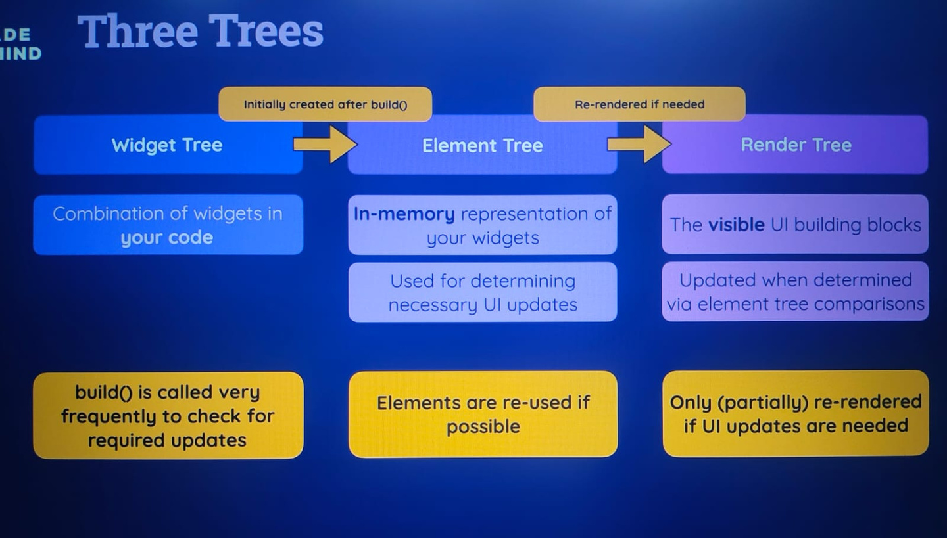

Slide 8
Widget Binding and Actual Tree Structure on Widget Construction
Initial Widget Construction: When a Flutter app starts, the main() function calls runApp(), which inflates the widget tree.
Widget Creation: Each widget is instantiated and added to the widget tree.
Element Creation: For each widget, a corresponding element is created, forming the element tree.
Render Object Creation: Elements create and manage render objects, forming the render tree.
Element Binding: Elements bind widgets to render objects, ensuring a seamless flow of data and layout.
Widget Configuration: Elements store the configuration of their associated widgets, allowing them to rebuild when necessary.
BuildContext: Provides information about the widget’s location in the tree and is used to look up other elements and render objects.
Rebuild Mechanism: When a widget’s state changes, it triggers a rebuild, updating the widget and its corresponding element and render object.
Layout Pass: The render tree performs a layout pass to calculate the size and position of each render object.
Paint Pass: After layout, the render tree performs a paint pass, rendering each object on the screen.

Slide 9
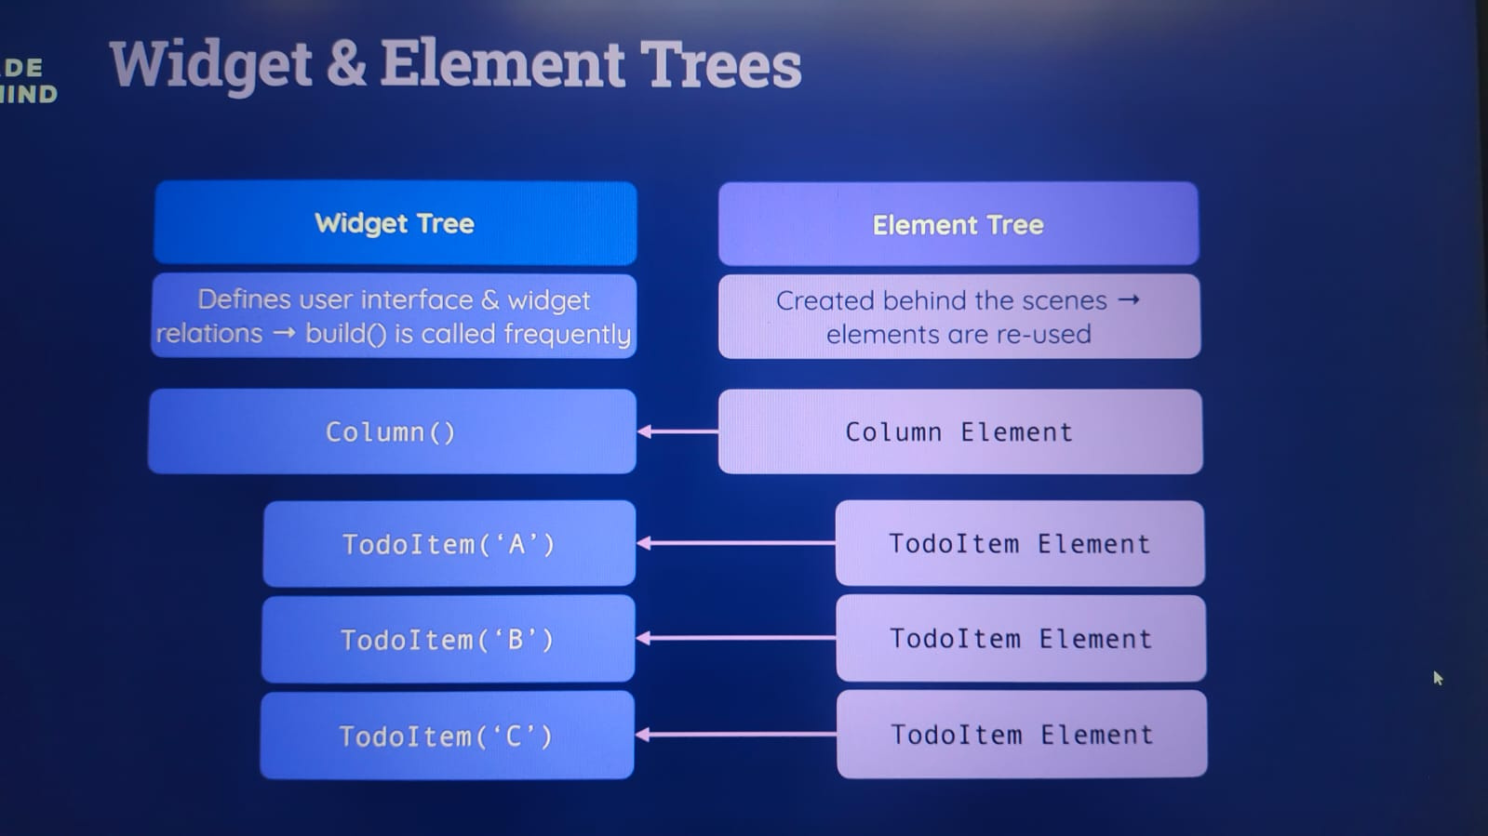

Slide 10
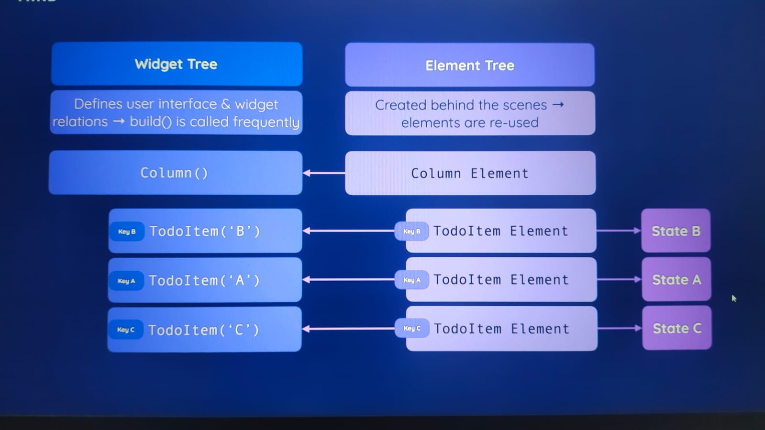

Slide 11
How the State of the Data is Maintained in the Element Tree
Stateful Widgets: Widgets that maintain state across builds, allowing them to change dynamically.
State Object: Each Statefulwidget has a corresponding State object that holds the widget’s state.
setState() Method: Used to notify the framework that the state has changed, triggering a rebuild of the widget.
Element Tree Maintenance: The element tree keeps track of the stateful elements and their associated state objects.
State Preservation: During a rebuild, the framework reuses existing state objects, preserving the state across rebuilds.
Context and State: BuildContext is used to access the state of other widgets and communicate between widgets.
InheritedWidget: Used to propagate state down the widget tree, allowing child widgets to access and react to changes in the state.
Provider Package: Simplifies state management by providing a dependency injection system and a way to propagate state changes.
Global State Management: Techniques like BLoC (Business Logic Component) and Redux can be used for managing global state across the app.
Lifecycle Methods: Methods like initState(), dispose(), and didUpdateWidget() manage the state lifecycle, ensuring proper initialization and cleanup.

Slide 12
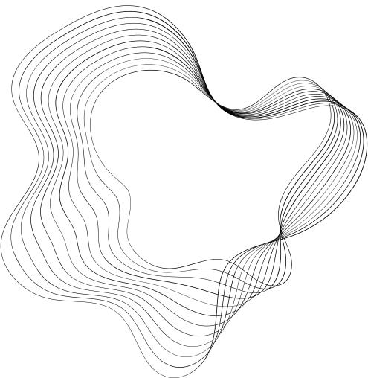

OUR
PROJECTS

Slide 13
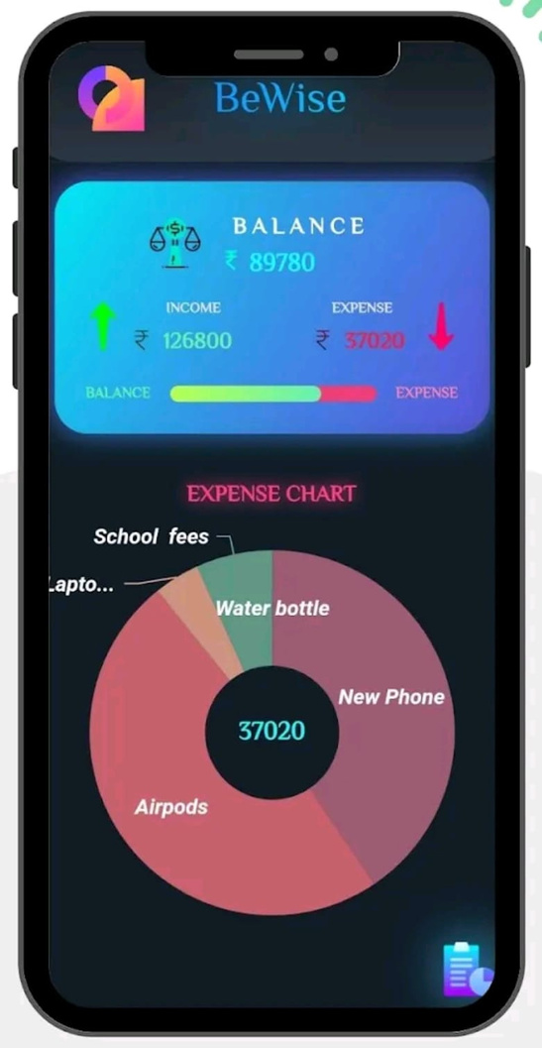
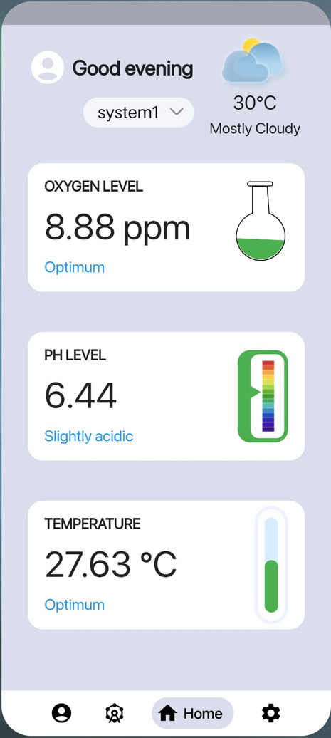
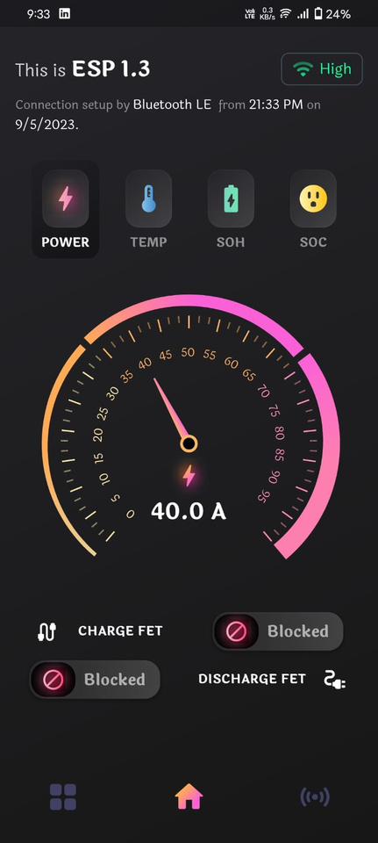

Slide 14
Thank you!

