Slide 1
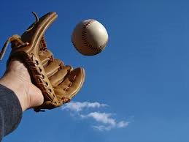
Mini Project CATCH BALL
S.BHARATH REDDY (1602-20-737-007)
B.MADHUKAR REDDY (1602-20-737-023)
V.SUJITH KUMAR (1602-20-737-049)

Slide 2
ABSTRACT
In this project we present a ball catcher embedded with Tkinter module.
The gameplay Graphics is good enough and the controls are simple for the users.
. A simple GUI is provided for the easy gameplay. It’s easy to operate and understand by users.
The gameplay design is so simple that user won’t find it difficult to use and navigate.

Slide 3
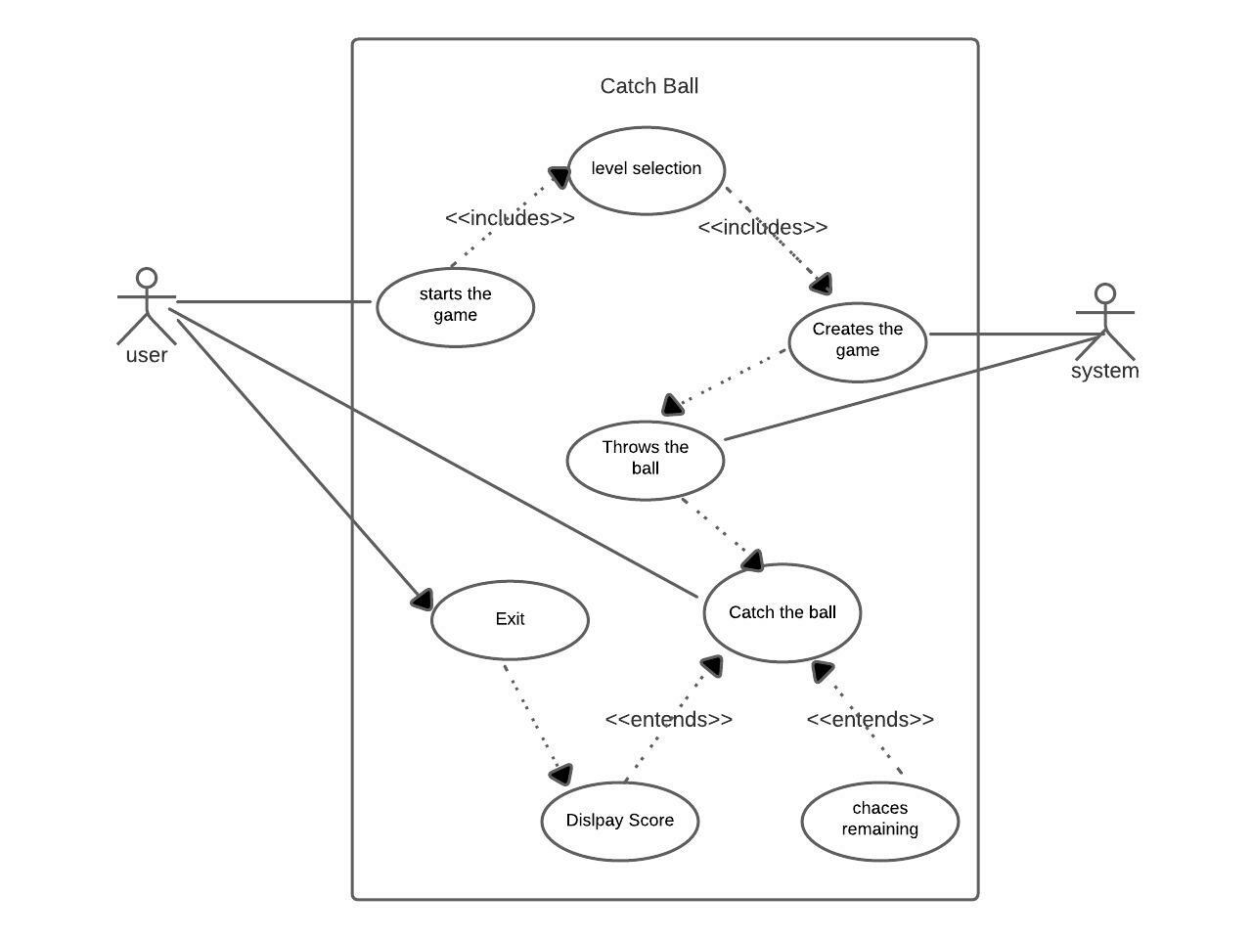
Use – Case Diagram

Slide 4
TECHNOLOGY USED:
Hardware Requirements:
Minimum Ram required: 512 mb
Minimum Disk Space required: 50 mb
Processor: core i3 or above
Software Requirements:
Python 3.9 Latest Build
Windows Desktop version (7/8/10/11)
PyCharm IDE for windows devices

Slide 5
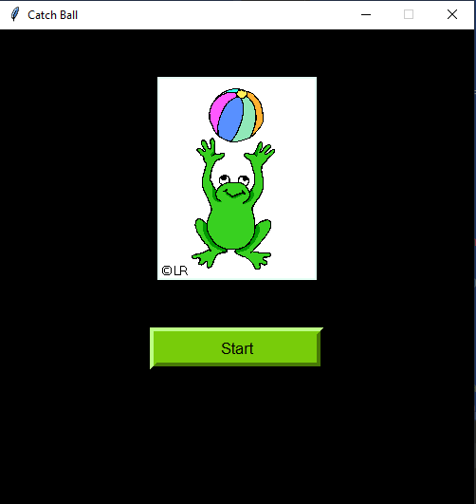
Result:

Slide 6
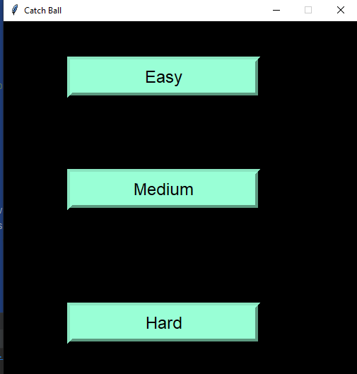

Slide 7
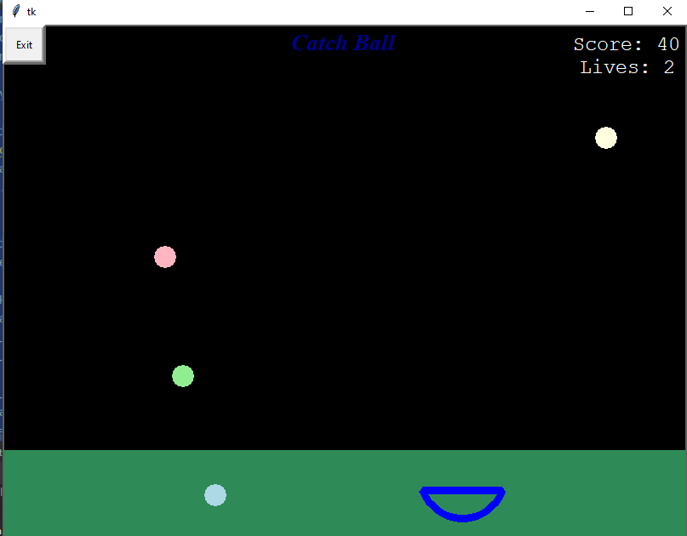

Slide 8
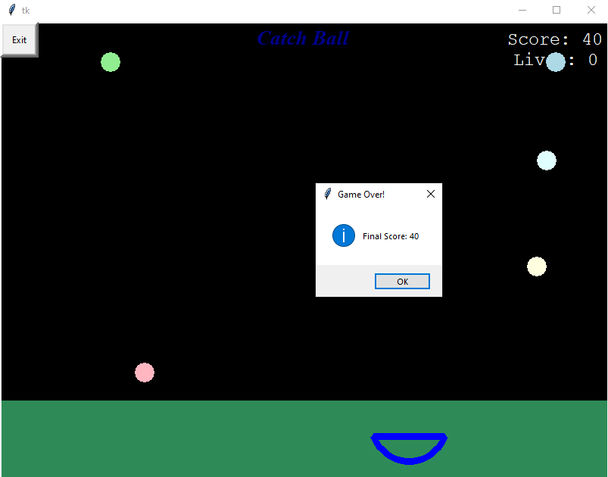

Slide 9
CONCLUSION:
With this project we have learnt about various built-in methods, modules and packages. We have how learnt to implement GUI.
We gained so much information about how various modules work and how various packages are used to implement GUI.
We learnt how to play music using pygame package and build GUI using tkinter package
To conclude, this game lets childrenhave fun. We wish to carry this spirit and work on many more projects in future.

Slide 10
FUTURE SCOPE:
● Level Extension
● Improve Graphical Representation
● Introduce new game features
● Take user responses through website and produce web rank list.
THANK YOU

