Slide 1
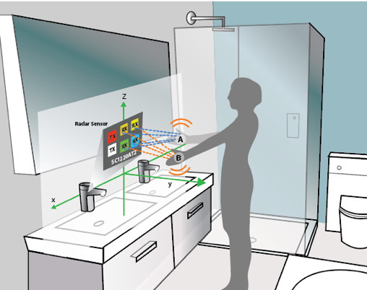
IOT-Based Smart Public Restroom
By
D.Salinth
V.Vinoth
M.Bharath kumar
S.Vignesh

Slide 2
Agenda
Introduction to IoT
The Need for Smart Public Restrooms
Components of a Smart Public Restroom
Key Features and Benefits
Implementation and Connectivity
Case Studies
Challenges and Considerations
Future of Smart Public Restrooms
Q&A

Slide 3
Introduction to IoT
What is IoT ?
IoT in everyday life
IoT in public facilities

Slide 4
The Need for Smart Public Restrooms
Challenges in Traditional Public Restrooms
Importance of Hygiene and Accessibility
Sustainability and Resource Management

Slide 5
Components of a Smart Public Restroom
Smart Sensors
Automated Dispensers
Data Analytics
Communication Networks

Slide 6
Key Features and Benefits
Touchless Operation
Real-time Monitoring
Energy Efficiency
Cost Savings
Improved Hygiene
Enhanced User Experience

Slide 7
Implementation and Connectivity
Integration with Existing Infrastructure
Wireless Connectivity (Wi-Fi, 5G, LoRaWAN)
Centralized Control and Management

Slide 8
Case Studies
Examples of Smart Public Restrooms in Cities
Demonstrated Benefits and Impact

Slide 9
Challenges and Considerations
Privacy and Security Concerns
Maintenance and Reliability
Initial Costs vs. Long-term Savings

Slide 10
Future of Smart Public Restrooms
Evolving Technology Trends
Expansion and Adoption
Potential for Customization

Slide 11
Conclusion
Recap of Key Points
Emphasize the Positive Impact of IoT on Public Restrooms

Slide 12
Thank you

