Slide 1

Cursor Pointer Control Using Eye Movements
UQ22CA741A - Capstone Project - Phase 1
Presentation #2
Student Details
Guide Details
Name : BHARATH.S
SRN : PES1PG22CA044
Mr.Santosh S Katti

Slide 2
Cursor Pointer Control Using Eye Movements
Abstract
Controlling the mouse by a physically challenged person is really a tough one. To find a solution for the people who cannot use the Mouse physically.
There is no such proper system that can help physically challenged people for using a personal computer.
The proposed system, helps the users in controlling a desktop without the usage of their hands.
The proposed system will use the concepts of eye movement, head movement, blink detection to track the user’s eye.
The algorithm enables individual to control the computer cursor movements to the left ,right ,up ,down and click.

Slide 3
Cursor Pointer Control Using Eye Movements
Problem Scenario
Currently as today, there are around 21 million people in India who are suffering from one or more than one physical disabilities which constitutes around 2 percent of India’s population.
In today’s era computers have become a significant part of our lives. Such people cannot readily use the computer system.
The main objective is to develop a system which can help such people who are physically disabled but visually intact to use the computer system, so that their physical disability won’t hinder their abilities to use a computer.

Slide 4
Cursor Pointer Control Using Eye Movements
Proposed Solution
In the proposed system includes the face detection, face tracking, eye detection and interpretation of a sequence of eye blinks in real time for controlling the cursor.
Conventional method of interaction with the computer with the mouse is replaced with the human eye movements.
This technique will help the paralyzed person, physically challenged people especially person without hands to compute efficiently and with the ease of use.
Firstly, the system recognizes face and focuses on the eye location. Based on the eye and head movement the user will control the cursor by moving left and right.
The user can use click operation of the mouse by blinking the eye.

Slide 5
Cursor Pointer Control Using Eye Movements
Scope
Provide a affordable eye-tracking system.
To control the cursor of a computer with eyes.
Allow physically disabled people to use computers.
To provide a real-time accurate eyes gesture control system.
To provide a hand free mouse control system.

Slide 6
Cursor Pointer Control Using Eye Movements
Literature Survey
Title:- Eye tracking mouse for human computer interaction
Published in:- 2013 E-Health and Bioengineering Conference (EHB)
Authors:-Robert Gabriel Lupu, Florina Ungureanu, Valentin Siriteanu.
In 2013, a system was developed which used eye tracking system. It uses different eye-tracking techniques to make the system reliable. The issue in this system is that if any liquid is found in eyes, it will not work. Like female use eyeliner or mascara in their eyes, so the system stops working in those situations._{[1]}

Slide 7
Cursor Pointer Control Using Eye Movements
Literature Survey
Title:- Face and eye tracking for controlling computer functions
Published in:- 2014 11th International Conference on Electrical Engineering/Electronics, Computer, Telecommunications and Information Technology (ECTI-CON)
Authors:-Chairat kraichan, Suree Pumrin
In 2014, a face and eye-controlled system were developed which were based on MATLAB.It uses a webcam to control the mouse by eye and face movement. The issue in this system is that this system only works in a few centimeter radius. _{[2]}

Slide 8
Cursor Pointer Control Using Eye Movements
Literature Survey
Title:- Pupil centre coordinates detection using the circular Hough transform technique
Published in: 2015 38th International Spring Seminar on Electronics Technology (ISSE)
Authors:-Radu Gabriel Bozomitu, Alexandru pasarica, Vlad Cehan, Cristian Rotariu, Constantin Barabasa
In 2015, a Pupil center coordinate detection using the circular Hough transform technique was introduced. In this system, the webcam uses Hough Transform Techniques to detect the pupil of a person. The issue in this system was that it takes a lot of time and is not a real-time system. It first captures the body after that, it move to face then eyes and finally to the pupil taking a lot of time. _{[3]}

Slide 9
Cursor Pointer Control Using Eye Movements
Literature Survey
Title:- An image based eye controlled assistive system for paralytic patients.
Published in: 2017 2nd International Conference on Communication Systems, Computing and IT Applications (CSCITA).
Authors:-Michelle Alva, Neil Castellino, Rashmi Deshpande, Kavita Sonawane, Monalisa Lopes.
In 2017 a better system was introduced by the authors. This system is developed for the paralytic patients. This system uses webcam through MATLAB and moves the mouse cursor by using the pupil of a person. The issue in this system is that it takes a lot of time in detecting the pupil of a person. It uses a lot of algorithms and techniques to detect the pupil._{[4]}

Slide 10
Cursor Pointer Control Using Eye Movements
Literature Survey
Title:- An eye tracking algorithm based on hough transform
Published in: 2018 International Symposium on Consumer Technologies (ISCT)
Authors:-Aleksei Bukhalov, Viktoriia Chafonova
In 2018, an eye tracking algorithm based on Hough transform was developed. This system detects the face and eyes of a person. It uses a webcam to detect user’s face and eyes. The system is based on MATLAB. The issue in this system is of real-time tracking and time-speed issue. The system is quite slow and it needs a high-quality computer system to work properly which is costly._{[5]}

Slide 11
Cursor Pointer Control Using Eye Movements
Tools and Technologies
Python---V3.8.10
OpenCv---V4.8.1
Mediapipe---V0.10.9
Pyauto GUI---V0.9.54

Slide 12
Cursor Pointer Control Using Eye Movements
Requirement Analysis
Hardware Requirements
Laptop or Pc with Web Camera
8gb RAM or more
256gb or more SSD
Processor ---Intel i3 or higher/AMD
Software Requirements
Operating system---windows , linux , mac
Python libraries---opencv , mediapipe , pyautogui

Slide 13
Cursor Pointer Control Using Eye Movements
Functional Requirements
Face Detection:-The system uses a camera to track the user's eyes, it need to initially detect and recognize the user's face to establish a reference point for eye tracking.
Eye Location:-The system can accurately identify and locate the position of the user's eyes within an video frame in real time.
Eye Tracking:-The system accurately track the movement of both eyes. It provides real-time updates on the position and gaze direction of the eyes.
Cursor Control:-The system allows users to control the on-screen cursor using their right eye movements.
Click Actions:-Users will be able to perform click actions using eye blinks.

Slide 14
Cursor Pointer Control Using Eye Movements
Non-Functional Requirements
Performance:-The system responds to user eye movements with minimum latency to provide a seamless and responsive user experience. Eye location tracking accuracy is high.
Usability:-The system will be easy to learn and use, even for individuals with limited computer experience.
Reliability:-The system operates reliably over extended periods of use, with minimal errors or crashes .The system will be able to handle errors gracefully and recover from failures.
Compatibility:-The system is compatible with multiple operating systems (e.g., Windows, macOS, Linux) and compatible with a range of cameras.

Slide 15

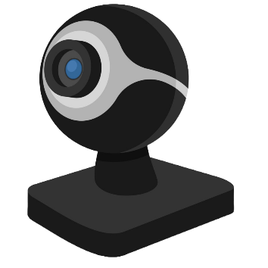

Cursor Pointer Control Using Eye Movements
Architecture Diagram
Face Detection
Eye controlled Software
Eye Detection
Cursor Movements
And click operations
Blink Detection
User
Interface
Services

Slide 16
Cursor Pointer Control Using Eye Movements
Process Flow
Start
Access Camera
And start
capturing video
Detect Face
Eye and head moved to left
Blink detected
Eye and
Head moved
right
Find eye location
No
No
No
Yes
Yes
Yes
Stop cursor
Cursor shifted
to right
Cursor shifted
to left
Cursor clicks
Yes
Close camera
End

Slide 17
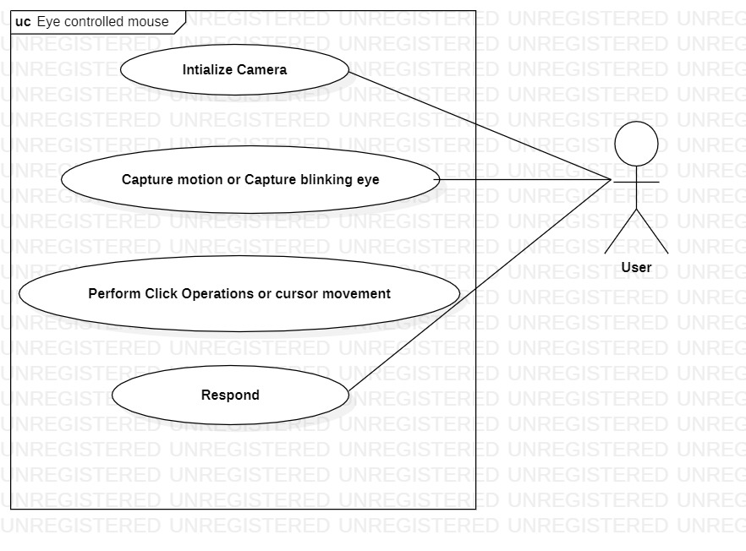
Cursor Pointer Control Using Eye Movements
Use Case Diagram

Slide 18
Cursor Pointer Control Using Eye Movements
Application in Real World
Computer Accessibility for the Individuals with physical disabilities
Hands-Free Computing
Assistive Drawing and Design

Slide 19
Cursor Pointer Control Using Eye Movements
References
“Eye tracking mouse for human-computer interaction” https://ieeexplore.ieee.org/document/6707244/ (2013)
“Face and eye tracking for controlling computer functions” https://ieeexplore.ieee.org/document/6839834/ (2014)
“Pupil center coordinates detection using the circular Hough transform technique” https://ieeexplore.ieee.org/document/7248041/ (2015)
“An image-based eye controlled assistive system for paralytic patients” https://ieeexplore.ieee.org/document/8066549/ (2017)
“An eye tracking algorithm based on Hough transform” https://ieeexplore.ieee.org/document/8408915/ (12.5.2018)

Slide 20

THANK YOU
BHARATH.S
PES1PG22CA044

