Slide 1


K.RAMAKRISHNAN COLLEGE OF TECHNOLOGY
(AUTONOMOUS), TRICHY.
COLLEGE MANAGEMENT SYSTEM
PRESENTED
BHARATHWAJ T G
2303811710421018
SUPERVISOR
Mr. M. Saravanan, M.E.,
AP/CSE.

Slide 2
PRESENTATION OVERVIEW
Objective
Project Introduction
Problem Statement
Methodologies (Programming concepts relevant to problem statement)
Architecture of the proposed system
List of Modules
Merits
Results and Discussion
Queries

Slide 3
OBJECTIVE
The objective of the College Management System is to provide an efficient platform for managing student, faculty, course, and department data while ensuring role-based access control for different users. The system should handle key operations such as student enrollment, faculty assignment, timetable scheduling, and course management. The system must also be scalable, user-friendly, and designed with performance optimization and data persistence in mind for long-term reliability.

Slide 4
PROJECT INTRODUCTION
The College Management System is a desktop-based application developed using Java and Swing. The system is designed to simplify and automate the management of students, faculty, and academic records. This project aims to enhance efficiency in handling college operations by providing a user-friendly interface for administrators, faculty members, and other stakeholders.

Slide 5
PROBLEM STATEMENT
Previously, managing student and faculty data in colleges was a tedious and fragmented process, with no centralized system to handle multiple tasks efficiently. This project addresses the problem by providing an integrated platform where users can manage multiple operations such as adding, modifying, searching, and deleting records for both students and faculty. By implementing separate panels for students and faculty, along with a secure user authentication system, the project enables streamlined data management and report generation. This not only enhances the overall user experience but also simulates real-world college administrative functionality, making processes faster, more accurate, and highly efficient

Slide 6
METHODOLOGIES
Object-Oriented Design: Use classes and encapsulation for modular and scalable code.
Data Management: Student and faculty data are handled using Java Collections (e.g., ArrayList, HashMap) to store, retrieve, and manage records efficiently.
Event-Driven Programming: A graphical user interface (GUI) is developed using Swing components such as buttons, text fields, and labels.
Business Logic: Core functionalities such as adding, modifying, deleting, and searching for student and faculty records are implemented in a modular way.
Exception Handling: Manage errors using custom and standard exceptions.
User Interface Design: Create an intuitive and interactive GUI for seamless navigation.

Slide 7
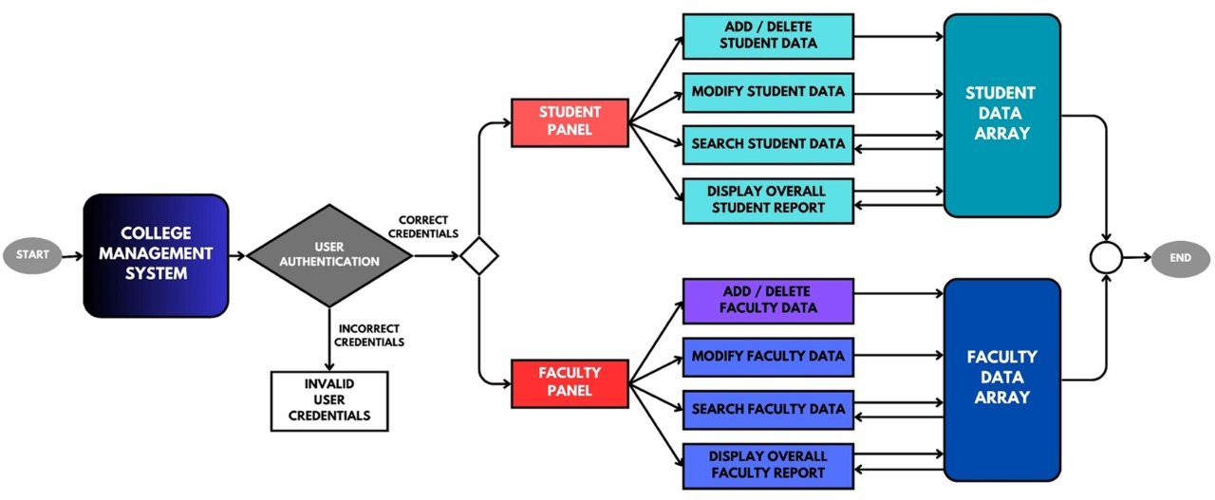
ARCHITECTURE OF THE PROPOSED SYSTEM

Slide 8
LIST OF MODULES
Add Student Data : The entered data is stored in the Student Data module,which likely includes a database.
Modify Student Data : The updated data is saved in the Student Data module.
Searching Student Data: The search results are displayed to the user.
Displaying Overall Student Data: The retrieved data is presented to the user in a suitable format (e.g.,tables, lsts)

Slide 9
MERITS
Efficient Data Management:
Provides a centralized platform to manage student and faculty data, ensuring better organization and accessibility.
Time-Saving:
Automates repetitive administrative tasks, reducing manual effort and saving valuable time for staff and administrators.
Error Reduction:
Minimizes human errors in data entry, updates, and record-keeping through automated processes.
Secure System:
User authentication ensures that only authorized personnel can access sensitive information, enhancing data security.

Slide 10
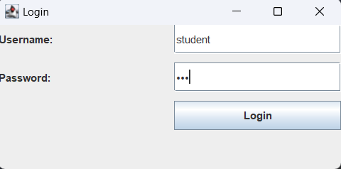
RESULTS AND DISCUSSION

Slide 11
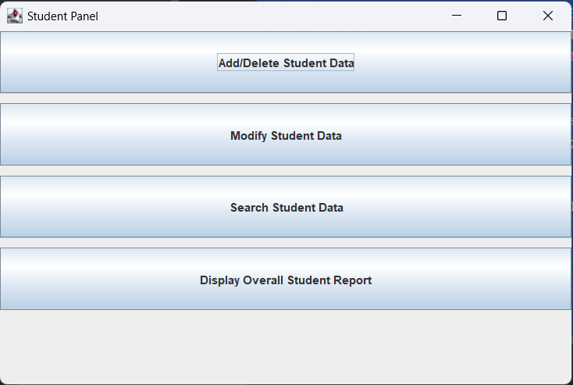
RESULTS AND DISCUSSION

Slide 12
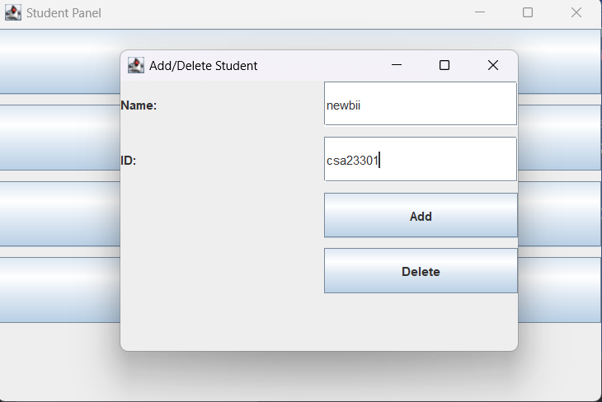
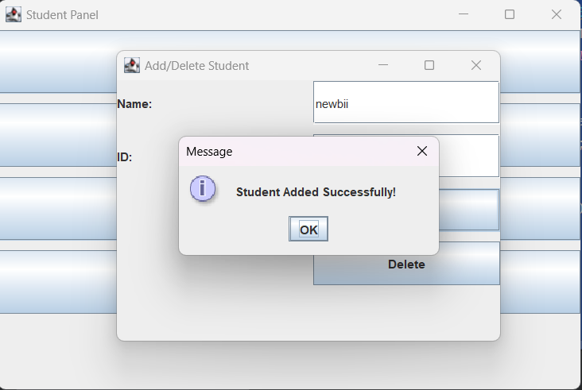
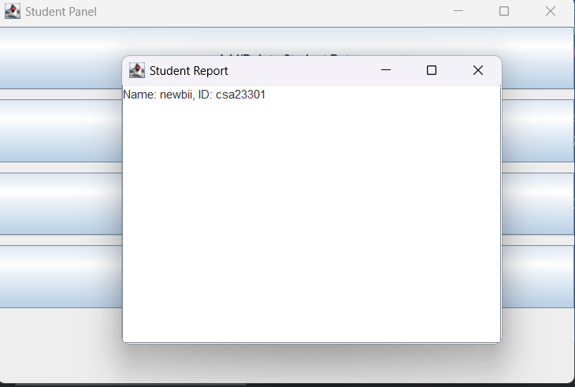

Slide 13
QUERIES ?

