Slide 1
Customer Churn Analysis
By Bharathwaj

Slide 2
Description:
A certain bank in North America wants to perform customer churn analysis, as the credit card business of the bank is not performing very well. Churn analysis will help the bank evaluate the customers who have stopped purchasing the credit card of the bank and figure out measures to reduce the banks customer loss rate.

Slide 3
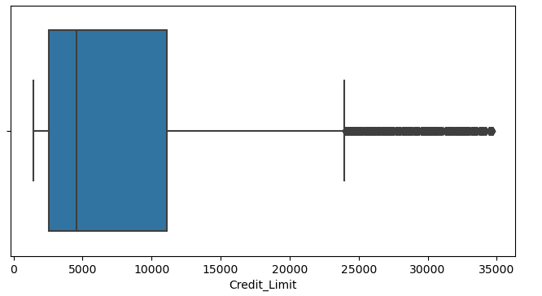
Data pre-processing in python:
Here we can see there are outliers from the box plot graph.

Slide 4
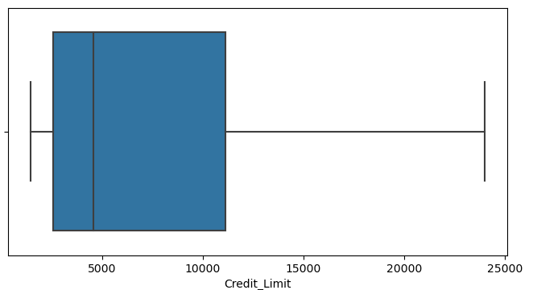
Removing of outliers:
The outliers are removed using IQR method and we can see there are no outliers in box plot.

Slide 5
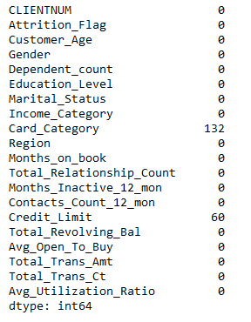
Identifying nulls:
Here we can see there nulls in two columns we can use data imputation techniques and replace the null values with mean, mode.

Slide 6
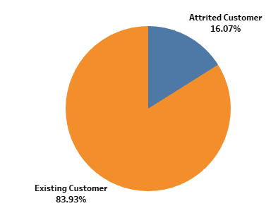
Attrited and existing customers:
The existing customers count is more than the attrited customers here we can see in the pie chart.

Slide 7
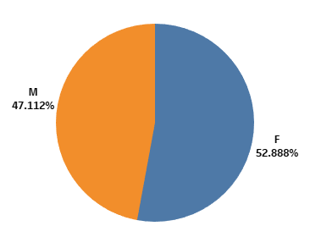
Gender wise Attrited and existing customers:
Female customers has more number of attrited and existing customers when compared with male customers.

Slide 8
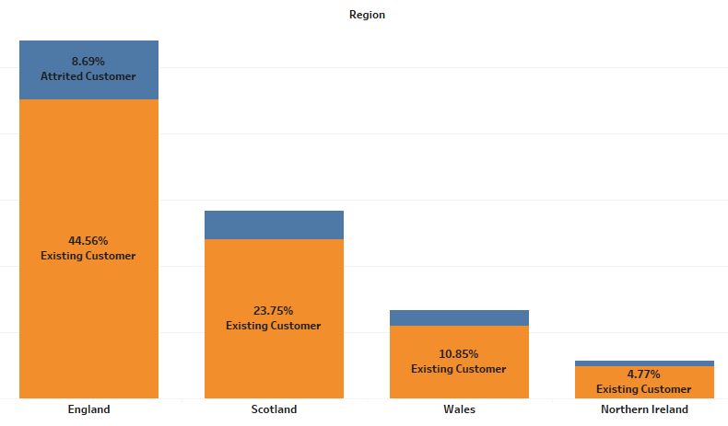
Region wise percentage of Attrited and Existing customers:
England country has more number of attrited and existing customer when compared with other countries.

Slide 9
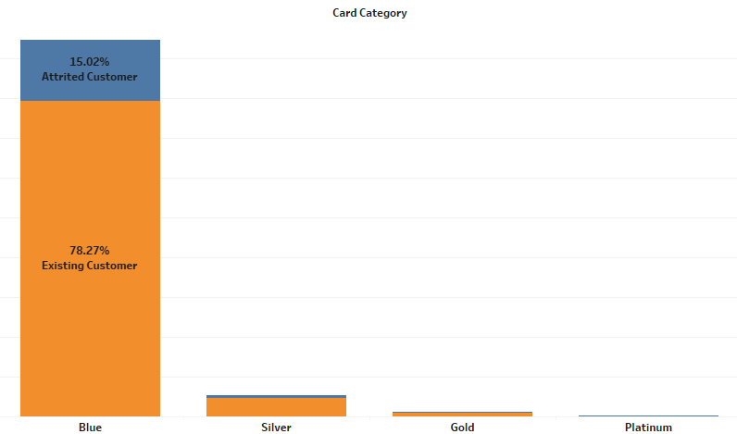
Card category wise Attrited and existing customers:
Blue category card has more number of attrited and existing customers.

Slide 10
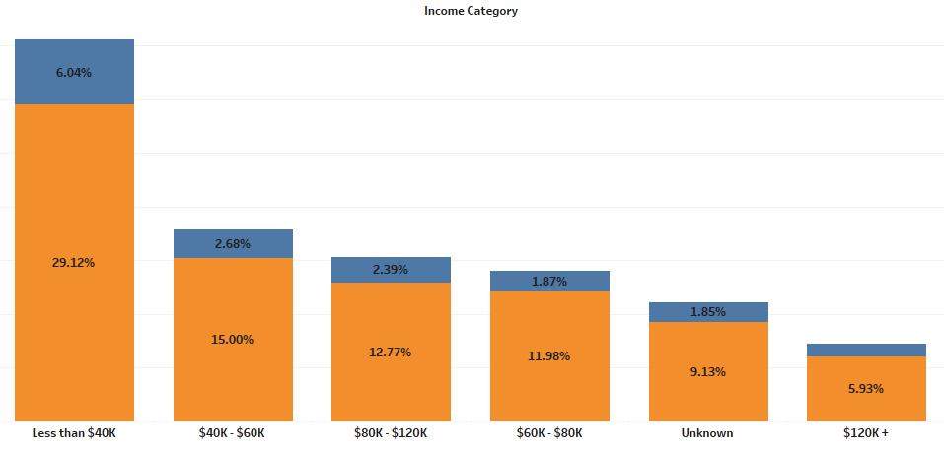
Income category wise Attrited and Existing customers:
Customers with income less than $40k are more when compared with remaining category wise income.

Slide 11
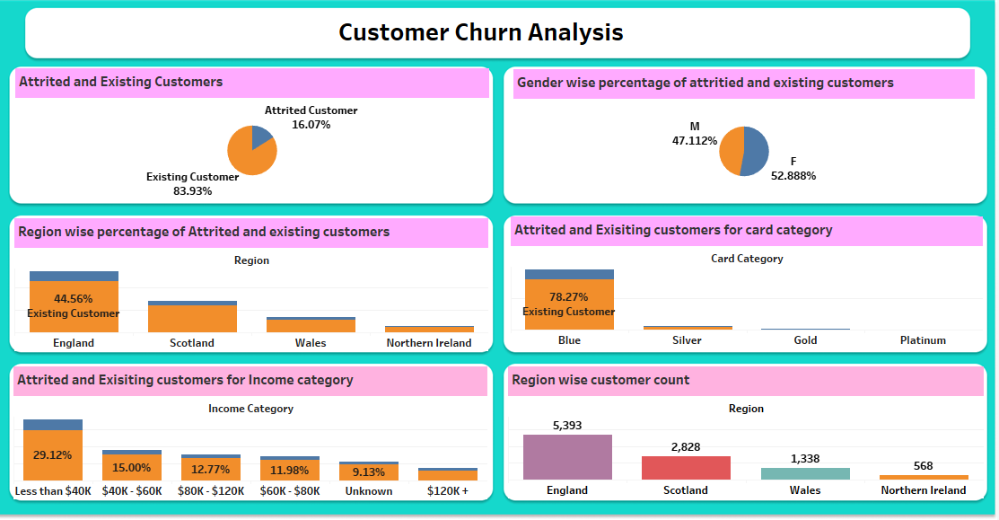
Dashboard:

Slide 12
Conclusion:
Female customers are more Attrited number of customers.
England region has highest number of Attrited number of customers.
In Blue card category customers are more Attrited when compared with remaining card category.
In the income category whose income is less than $40k are more number of attrited customers.
Banks needs to consider these points and for reducing the customers loss rate.

Slide 13
Thank you

