Slide 1
MOVIE RENTAL DATA ANALYSIS
BY
BHARATHWAJ

Slide 2
Description:
Movie On Rent is a chain of movie rental stores operating in a certain country. It has a collection of movies in DVD and Blue disc formats. The management of the company wants to analyze what kind of movies are most often rented, which Genre they belong to, and which actors appeared in them. It will help the management stock up the inventory as per audience’s preferences for improved business.

Slide 3
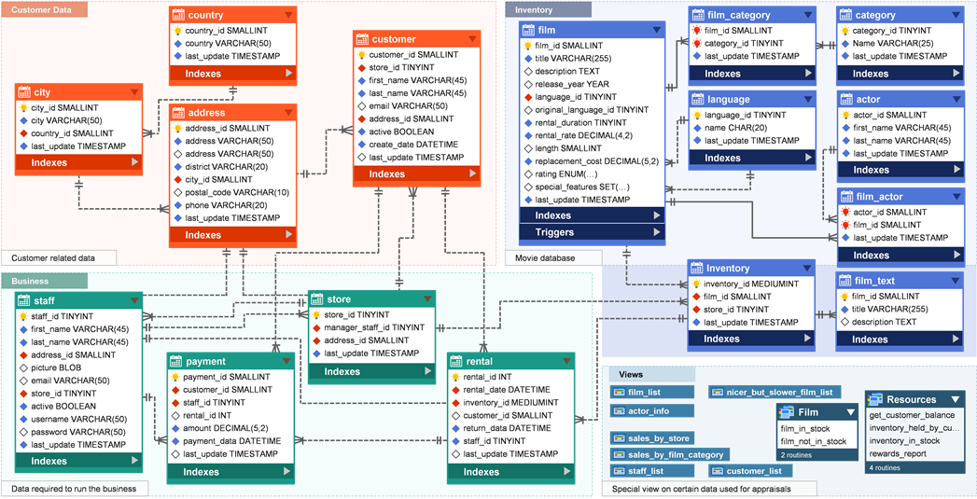
Sakila Database Schema Diagram: :

Slide 4
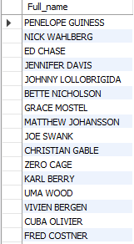
Combine two columns to get the full name of actors:
To get the full name of all the actors I have used concat function to combine two columns so that we can get full name of all the actors from actor table.

Slide 5

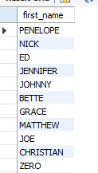
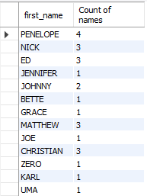
Description of the methods:
To get the unique names i have used distinct character to get the unique values of first_name and used count function to get the count of values from the actor table.

Slide 6
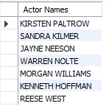
Fetching all actor names from the particular movie:
To get the full names of all actors used concat function to combine the two columns firstname and lastname.
Used joins to get data from multiple tables and used where condition to filter title with film name of Agent Truman.

Slide 7
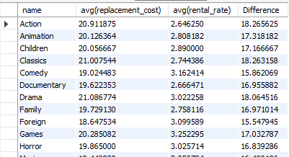
Retrieving of data from multiple tables:
First I have found the average of replacement cost and rental rates using avg aggregate function.
Used joins to join multiple tables and used group by for grouping of category names.
Used having clause to filter the data having values greater than 15.

Slide 8

Retrieving of data from multiple tables with movie count greater than 70:
First joined multiple tables to retrieve the data from selected columns.
Used groupby to group the data using category names
Used having clause to get the values greater than 70.

Slide 9
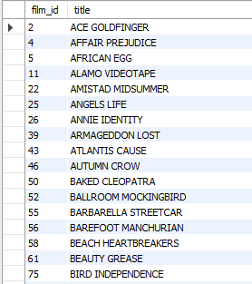
Movies that are suitable for children of below 13 years of age:
Management wants to now which movies is suitable for children so I have taken movies with rating ‘G’.
I have taken filmid, title from film used where clause and given condition as movies with rating ‘G’.

Slide 10
Conclusion:
Action, Animation, Children category movies are often rented and they are having more demand, so the management need to stock up these category of movies.

Slide 11
Thank you

