Slide 1
World Population by Country
By Bharathwaj

Slide 2
About Dataset:
The US Census Bureau's world population clock estimated that the global population as of September 2022 was 7,922,312,800 people and was expected to reach 8 billion by mid-November of 2022. This total far exceeds the 2015 world population of 7.2 billion. The world's population continues to increase by roughly 140 people per minute, with births outweighing deaths in most countries.
Overall, however, the rate of population growth has been slowing for several decades. This slowdown is expected to continue until the rate of population growth reaches zero (an equal number of births and deaths) around 2080-2100, at a population of approximately 10.4 billion people. After this time, the population growth rate is expected to turn negative, resulting in global population decline.

Slide 3
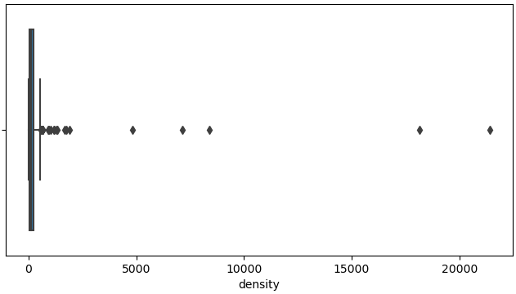
Data Preprocessing in python:
There are outliers present in the columns so we need to perform outlier analysis.

Slide 4
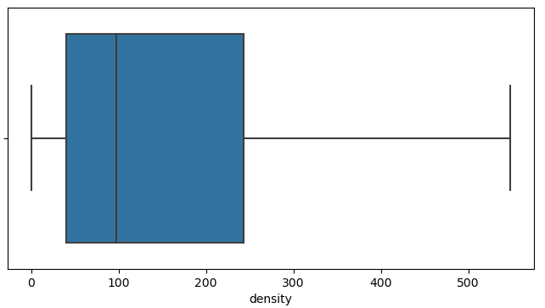
Identifying and removing of outliers:
The outliers are removed using IQR method in python after removing outliers we can see from the graph on left.

Slide 5
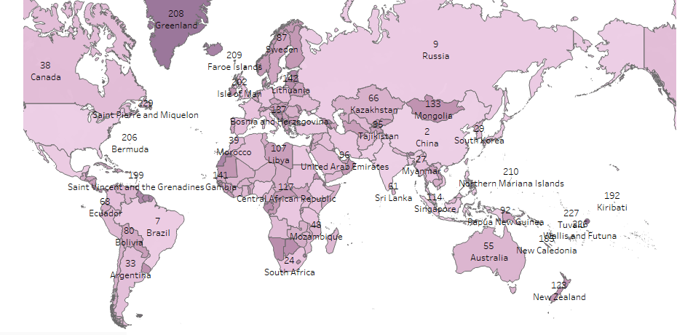
Rank wise countries in Population:
Rank wise countries in population.
India is number 1 ranked in population.

Slide 6
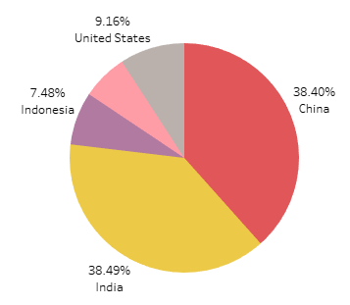
Top 5 countries based on world percentage population:
India is top in world percentage population and there is very slight difference between India and china population.

Slide 7
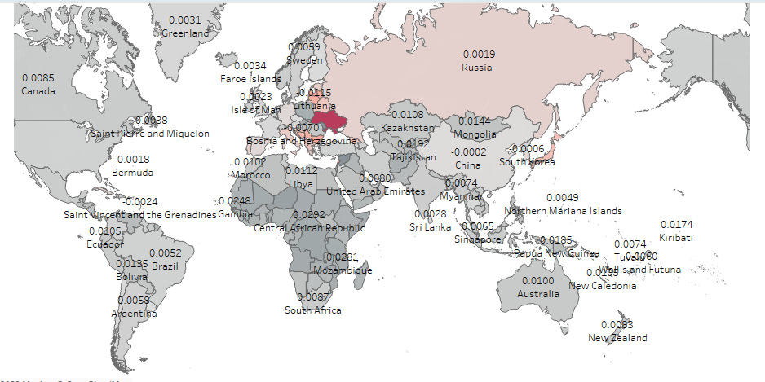
Country wise growth rate:
Syria country has the highest growth rate among other countries.

Slide 8
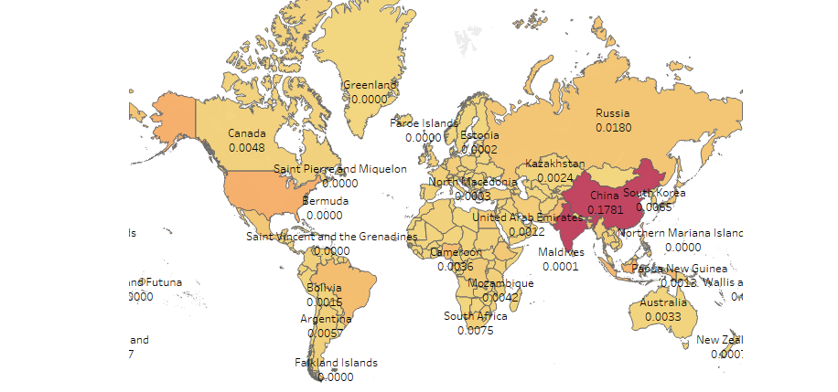
Country wise world percentage:
India has the highest world percentage followed by china.

Slide 9
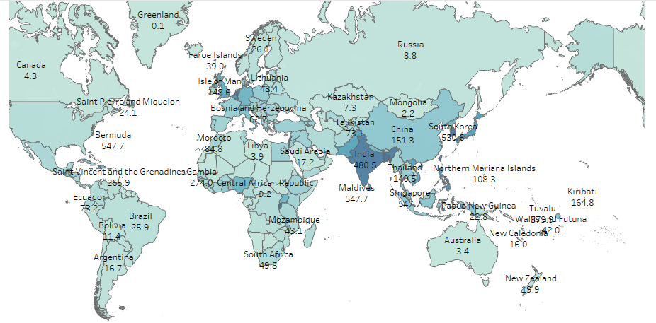
Country wise Density:
In the countries Maldives and Bangladesh the density is more.

Slide 10
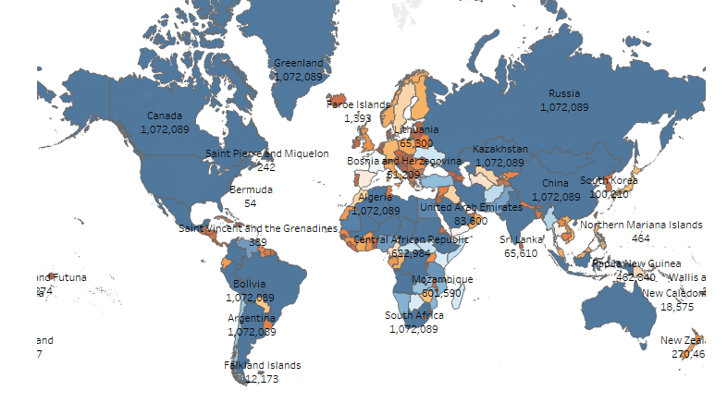
Country wise Area :
Russia country has the highest area among the other countries.

Slide 11
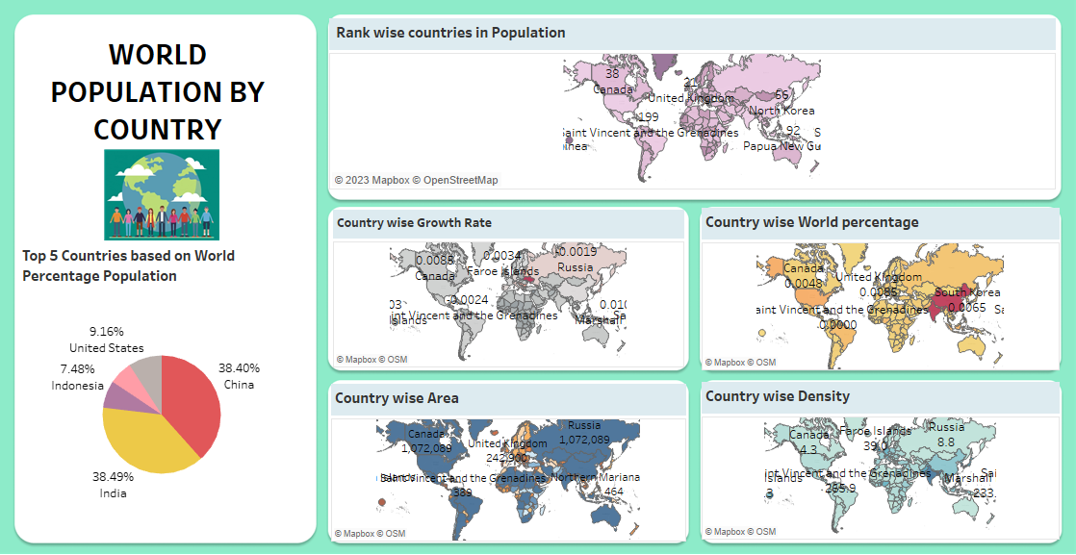
Dashboard:

Slide 12
Conclusion:
India has the highest population among other countries it is increasing year by year and there is slight difference between India and china population.

Slide 13
Thank you

