Slide 1


SMART INDIA HACKATHON 2024
TITLE PAGE
Problem Statement ID – SIH1637
Problem Statement Title- Mobile App for Direct Market Access for Farmers
Theme- Agriculture, Food Tech & Rural Development
PS Category- Software
Team ID - ISIH -016
Team Name- Sudo_Sync

Slide 2
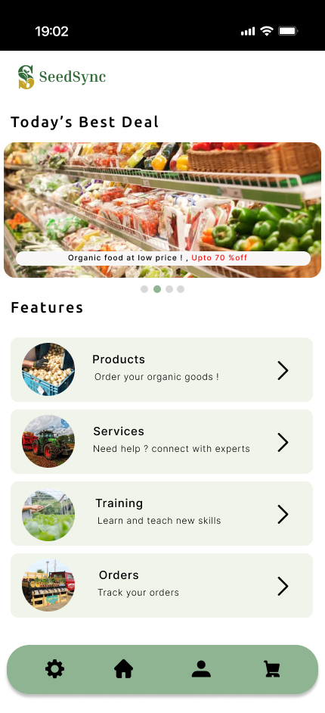
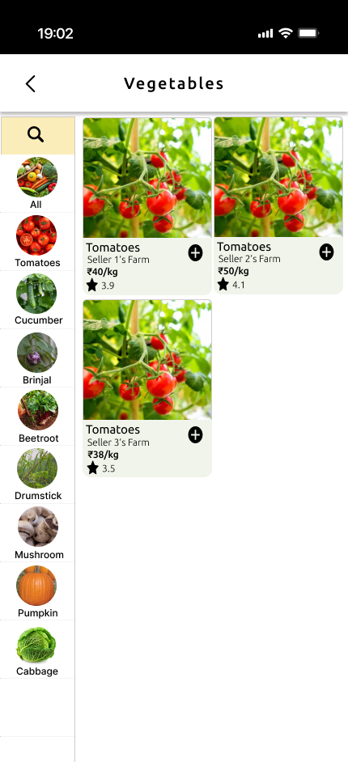
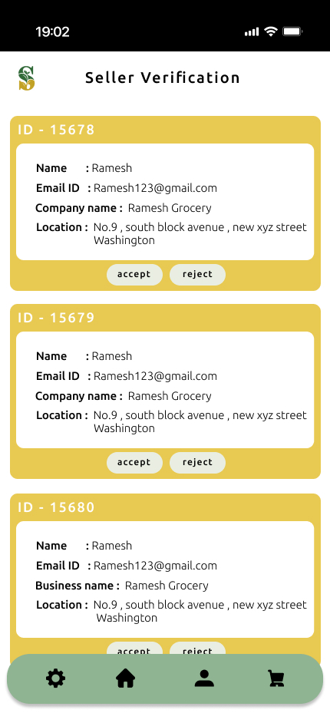

IDEA TITLE
Sudo_Sync
Seed Sync – Harvesting Farmer and market connection
Detailed Explanation of the Proposed Solution:
  Farmers directly connect with consumers and retailers, bypassing intermediaries, for increased profits.
  Smart inventory management provides real-time stock tracking, preventing overstocking or shortages.
  Buyers can bid and negotiate prices in real-time via an in-app bidding system.
How it Addresses the Problem:
  No intermediaries : It allows farmers to retain more profits by eliminating middlemen.
  Flexible bidding enables prices to adapt to market demand for optimized revenue.
  Timely alerts keep users informed of stock levels and transactions, ensuring smoother operations.
Key Innovations:
  Real-time bidding increases engagement and revenue with live pricing and negotiations.
  Streamlined transactions secure payments and reduce administrative overhead.
  Multi-platform access ensures seamless interaction across devices for farmers and consumers.

Slide 3
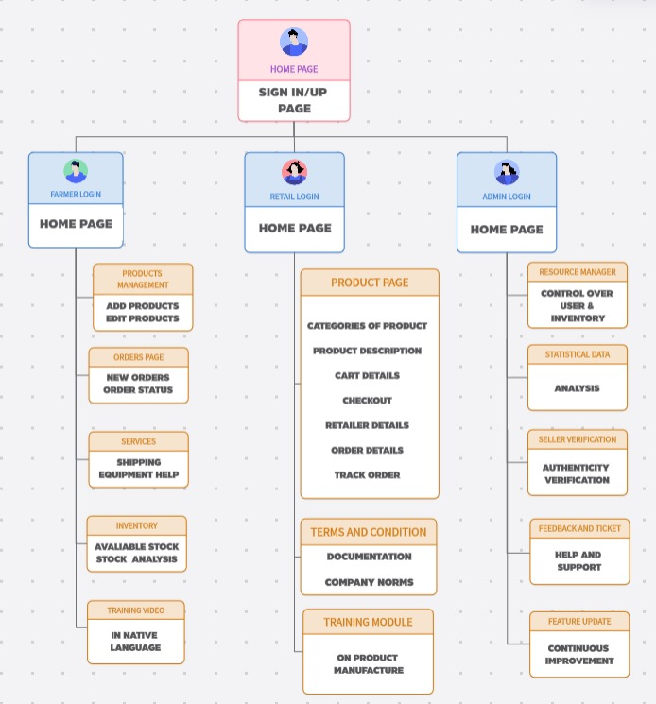
TECHNICAL APPROACH
Sudo_Sync
TECH STACK
APP OVERVIEW
Flutter is used as the cross-platform framework for building mobile, web, and desktop applications from a single codebase.
MySQL serves as the open-source relational database management system.
XAMPP provides a local server environment for development and testing.
Firebase offers real-time database services, authentication, and cloud messaging for mobile and web applications.
PHP is the server-side scripting language for backend development and web functionality.

Slide 4
FEASIBILITY AND VIABILITY
Sudo_Sync
Reliable technologies ensure smooth development, but Technical Feasibility and Challenges arise in system integration. Modular design can help.
Open-source tech lowers costs, but Economic Feasibility and Financial Risks arise from development and scalability. Phased development and cloud can help.
Multi-language support aids Operational Feasibility and User Adoption, but farmers face a learning curve that tutorials and accurate translations can help overcome.
The app links farmers and consumers, showing Market Feasibility and Competition, but unique features and targeted marketing are needed to stand out.
Compliance with regulations is vital for Social Feasibility and Data Security, but protecting data is tough. Strong encryption and updated protocols ensure compliance.
The app shows Scalability and Performance Optimization but faces legal challenges. Legal experts ensure compliance.

Slide 5





IMPACT AND BENEFITS
Sudo_Sync
Potential Impact on the Target Audience:
Benefits of the Solution:
Increased income through direct sales and optimized bidding.
Enhances the standard of living for farmers.
Expanded market access beyond local boundaries.
Higher income for farmers due to eliminating middlemen.
Greater control over pricing and transactions.
Lower costs for consumers and retailers through direct transactions.
Secure and simplified transactions enhance the buying experience.
Smart inventory management minimizes food waste.

Slide 6
RESEARCH AND REFERENCES
Sudo_Sync
Details / Links of the reference and research work
Farmers:
Higher Income: Study on Direct Market Access for Farmers: "Impact of Eliminating Middlemen on Farmers' Profit Margins: Evidence from Direct-to-Consumer Sales" - Journal of Agricultural Economics (sagepub.com)
Consumers and Retailers:
Access to Fresh Produce: Analysis of Fresh Produce Supply Chains: "Direct Market Access for Fresh Produce: Enhancing Quality and Availability for Consumers" - Food Quality and Preference Journal (sciencedirect.com)
Agricultural Sector:
Increased Market Efficiency: Research on Market Efficiency in Agriculture: "The Role of Technology in Improving Market Efficiency: A Case Study of Agricultural Marketplaces" - International Journal of Agricultural Management (tandfonline.com)
Local Communities:
Economic Development: Study on Economic Impact of Agricultural Technology: "Economic Benefits of Technology-Driven Agricultural Solutions for Local Communities" - Journal of Rural Studies (elsevier.com)
App Users:
User Education: "Effectiveness of In-App Tutorials and Support Forums in Enhancing User Engagement and Skill Development" - Journal of Information Technology Education (jite.org)

