Slide 1
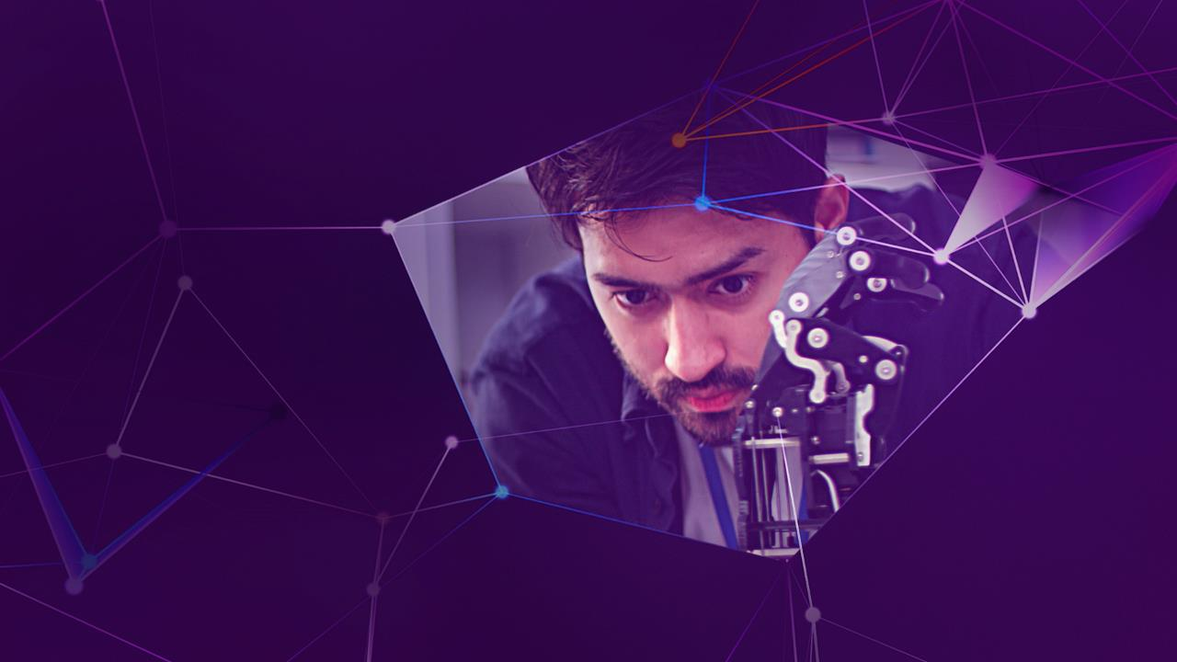

Accenture Innovation Challenge
Harness Generative AI to develop innovative solutions that boost business and societal growth

Slide 2

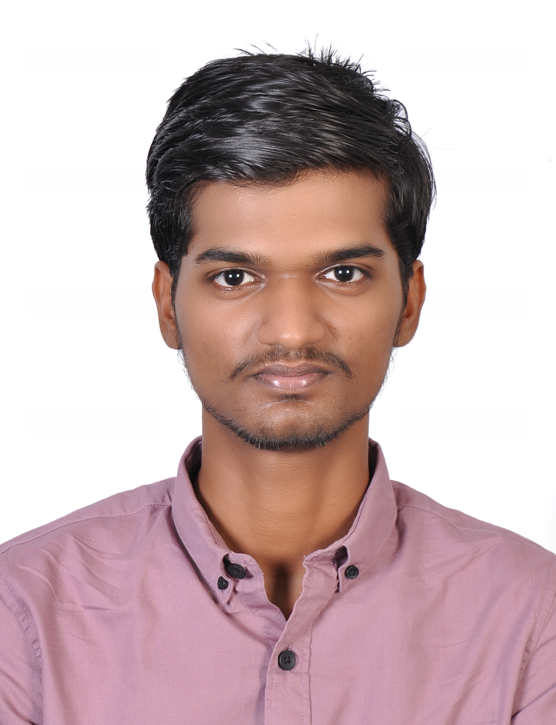
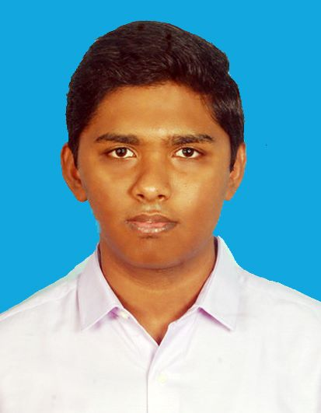
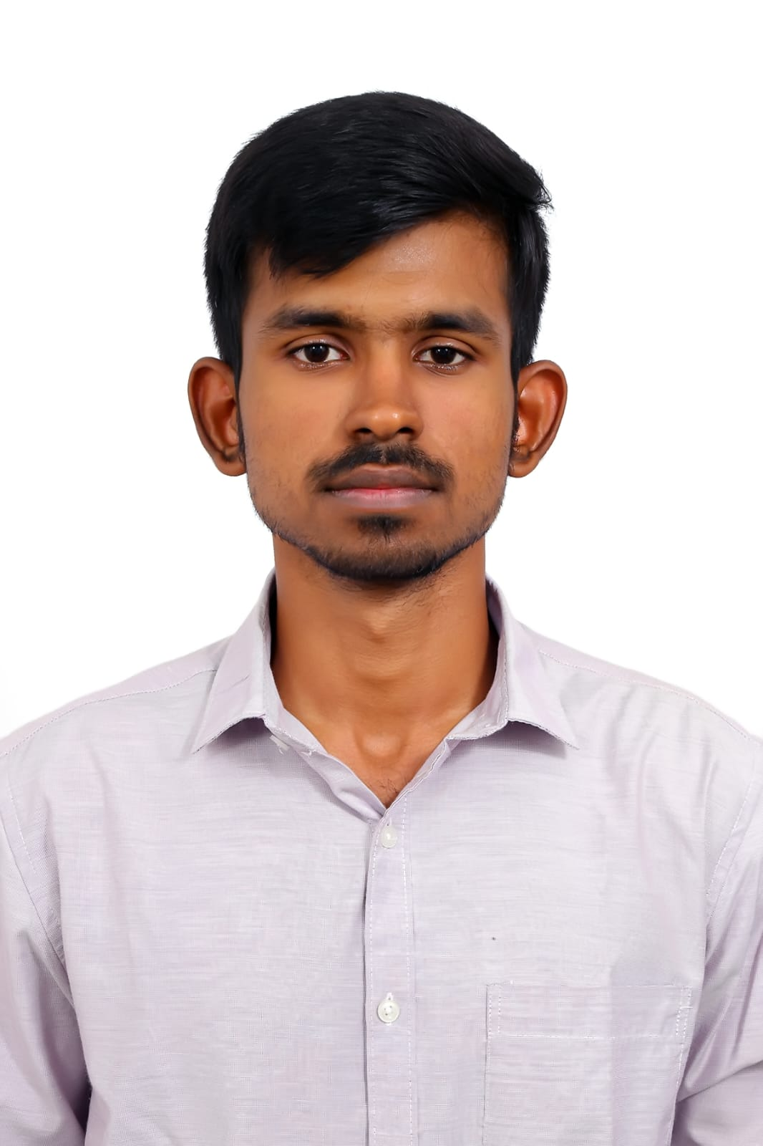
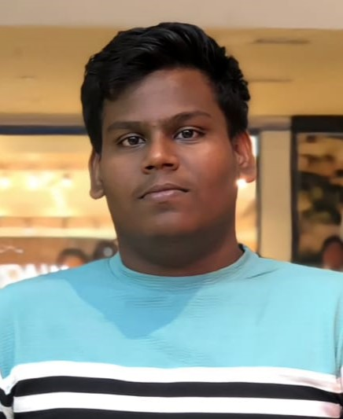
Team details
TEAM NAME: Ctrl Shift Hack
Bharathwaj K S
(Team Leader)
Ilaro Kagoo S
College: SIMATS ENGINEERING
Stream: B TECH AI AND DS
Year of graduation: 2025
College: SIMATS ENGINEERING
Stream: B TECH AI AND ML
Year of graduation: 2025
Photo
Dinakaran N J
Manik Rakshan I
College: SIMATS ENGINEERING
Stream: BE CSE
Year of graduation: 2025
College: Vellore Institute of Technology - Chennai
Stream: Integrated MTech Software Engineering
Year of graduation: 2026

Slide 3
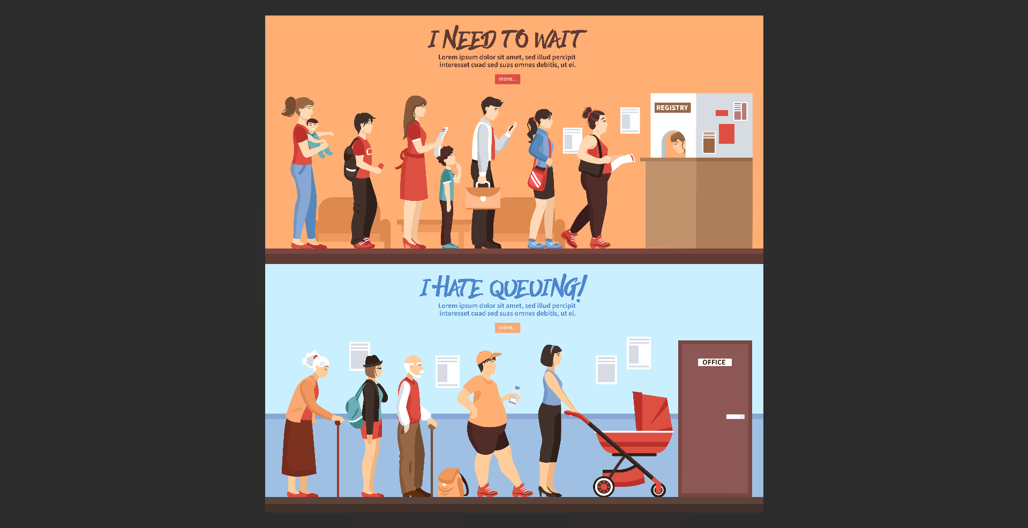
Describe the problem statement (200 words)
Traditional Hospital Management Challenges
Inefficiency & Frustration: Many hospitals and clinics continue to rely on outdated, manual processes for critical tasks such as appointment scheduling, bed allocation, and managing patient records. This leads to increased waiting times, inefficiencies, and errors, frustrating both patients and healthcare workers.
High Dependency on Manual Labor: Manual operations in hospitals create bottlenecks. Human errors in booking, managing inventory, and assigning beds can lead to miscommunication, prescription errors, and even life-threatening situations.
Lack of Patient-Centric Solutions: Patients often struggle with accessing important information—like doctor availability or medical records—resulting in limited transparency and engagement in their own healthcare journey.
Sanitas Curae addresses these issues by transforming traditional management into a seamless, AI-driven experience that empowers both healthcare providers and patients.

Slide 4

Proposed solution / your big Idea (200 words)
Sanitas Curae – Transforming Healthcare with Technology
Our Big Idea:
Sanitas Curae is a comprehensive digital ecosystem designed to replace outdated, labor-intensive hospital systems with efficient, AI-powered solutions. By integrating modern technology, Sanitas Curae streamlines core hospital functions, offering patient-centric care.
Technology Stack:
Flutter: A powerful mobile framework used to create an intuitive and engaging user interface, ensuring a seamless experience for both patients and healthcare staff.
PHP & XAMPP: Backend operations are handled using PHP with XAMPP, providing a robust and scalable server environment for managing hospital data and operations efficiently.
SQL: A relational database system used to securely store and retrieve patient data, ensuring quick access to medical records, appointments, and inventory.
Python: Leveraged for AI-powered features, such as dynamic scheduling algorithms, inventory predictions, and the chatbot, enhancing overall efficiency.
Firebase: Used for real-time data synchronization, ensuring instant updates for doctor availability, appointment schedules, and more.
Sanitas Curae brings together these technologies to offer an integrated solution, significantly reducing manual intervention, boosting accuracy, and elevating patient engagement.

Slide 5
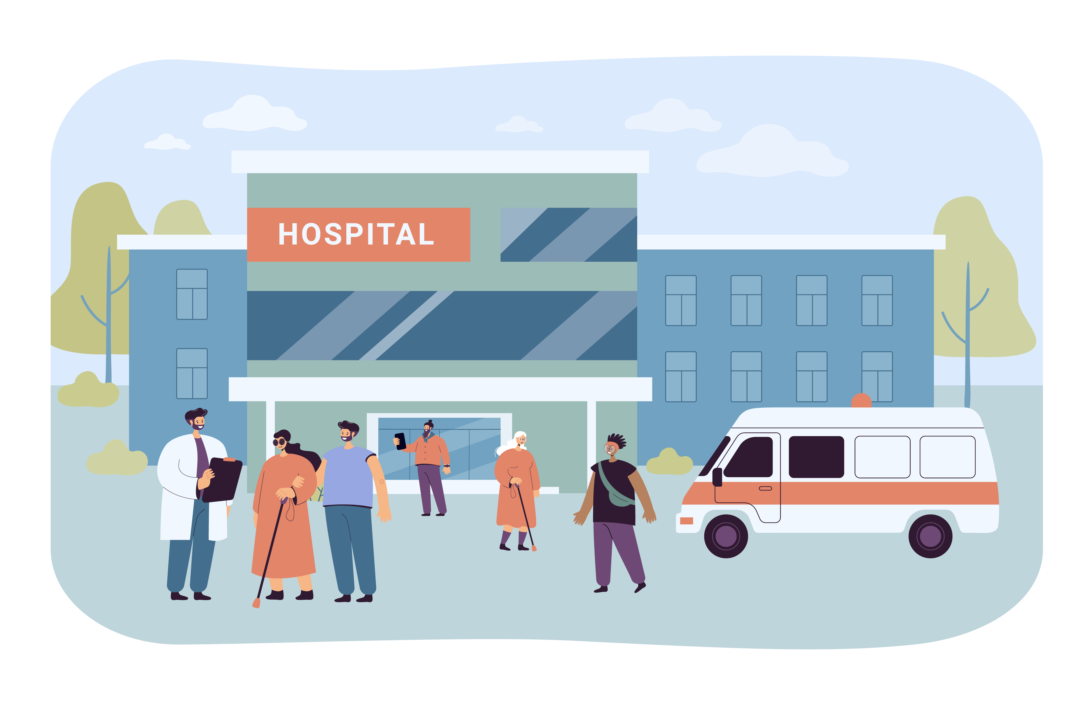
How does your innovation accelerate change with the power of Technology? (200 words)
Technology-Driven Transformation in Healthcare
Accelerating Change:
Sanitas Curae harnesses cutting-edge technology to revolutionize hospital management, driving efficiency and enhancing patient care. By automating key processes, our solution accelerates change in the following ways:
AI-Powered Automation: Our system uses Python-driven algorithms to automate scheduling, bed allocation, and inventory management, reducing human errors and eliminating inefficiencies. This automation allows healthcare workers to focus on providing quality care, rather than administrative tasks.
Real-Time Data & Decision Making: Leveraging Firebase, Sanitas Curae provides real-time updates on doctor availability, inventory levels, and patient information. This enables informed decision-making and faster responses, ultimately leading to better patient outcomes.
Seamless Patient Experience: Built using Flutter, our mobile application delivers an easy-to-use interface, making healthcare more accessible to patients. The generative AI chatbot enhances patient engagement by providing instant insights and answers to health-related questions, reducing the need for in-person consultations for minor queries.
Sanitas Curae harnesses the power of technology to improve efficiency, workflows, and provide a more patient-centered experience in healthcare management.

Slide 6
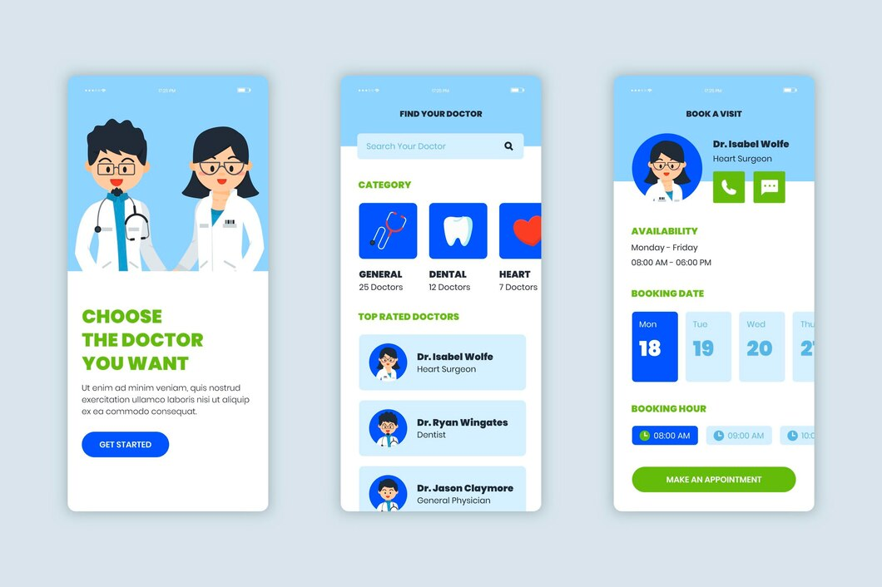
The Application design

Slide 7

How is your solution different/unique from other solutions in market? (150 words)
What Sets Sanitas Curae Apart
Uniqueness in the Market:
End-to-End Automation: Unlike other solutions, Sanitas Curae fully automates major hospital functions—dynamic appointment scheduling, bed allocation, inventory management—drastically reducing dependency on manual intervention, improving efficiency across all levels.
AI-Powered Patient Engagement: Our generative AI chatbot goes beyond standard virtual assistants by analyzing patient medical records to provide meaningful insights. This feature empowers patients with personalized information, enhancing their understanding of their own health.
Real-Time Synchronization: Powered by Firebase, Sanitas Curae offers real-time updates for critical elements like doctor availability, appointments, and inventory—ensuring both patients and staff are always in the loop, without any delays or miscommunication.
Comprehensive Digital Ecosystem: Sanitas Curae integrates multiple systems under one platform—e-billing, e-medical records, doctor schedules—offering a seamless experience that’s missing in traditional, fragmented hospital management systems.
These differentiators make Sanitas Curae a truly disruptive solution that elevates both operational efficiency and patient-centric care.
  PATENT FILED: No
Do you have a working model/prototype: No
If not, will you be able to show working prototype during finale. Yes/No

Slide 8


Please share a 1-minute video of your idea (embed on this PPT or add a downloadable link)
Video of our Idea:-
https://youtu.be/LNs0vSoSUjA

Slide 9
Thank you!

