Slide 1


SMART INDIA HACKATHON 2024
TITLE PAGE
Problem Statement ID – SIH1788
Problem Statement Title- Development and Implementation of Face Recognition Technology in the Police Department
Theme- Smart Automation
PS Category- Software
Team ID - ISIH -011
Team Name- Sudo_Sync

Slide 2

IDEA TITLE
FaceReconX
FaceReconX – Empowering Security, One Face at a Time
Detailed Explanation of the Proposed Solution:
  FaceReconX helps law enforcement identify suspects and missing persons using real-time facial recognition, improving public safety.
  It integrates with police databases for high-accuracy recognition, even in different lighting, angles, or occlusion.
  Real-time alerts notify officers when a match is found, speeding up response time.
How it Addresses the Problem:
  No intermediaries It allows farmers to retain more profits by eliminating middlemen.
  Flexible bidding enables prices to adapt to market demand for optimized revenue.
  Timely alerts keep users informed of stock levels and transactions, ensuring smoother operations.
Key Innovations:
  Real-time bidding increases engagement and revenue with live pricing and negotiations.
  Streamlined transactions secure payments and reduce administrative overhead.
  Multi-platform access ensures seamless interaction across devices for farmers and consumers.

Slide 3
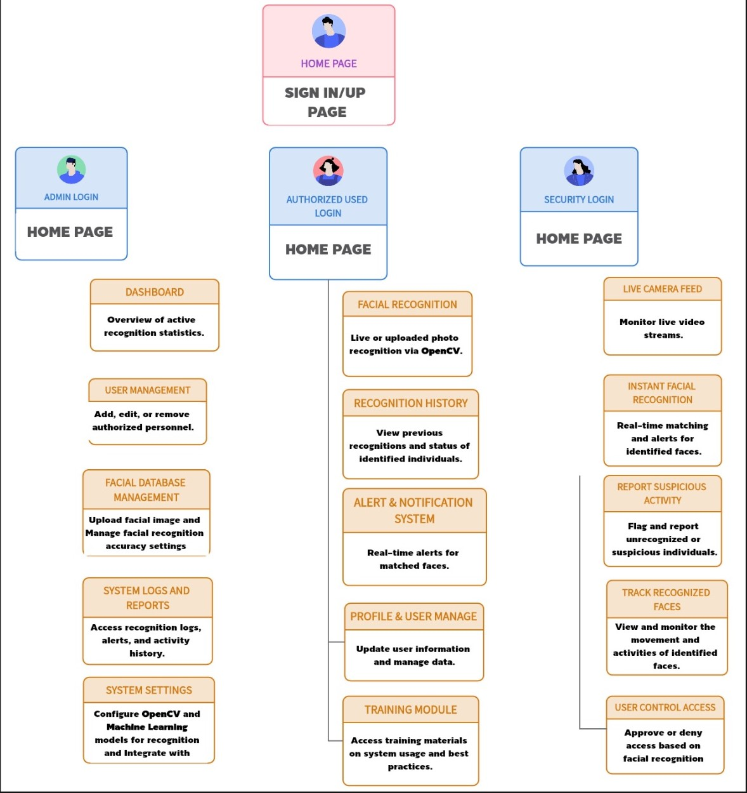
TECHNICAL APPROACH
FaceReconX
TECH STACK
APP OVERVIEW
Flutter is used as the cross-platform framework for building mobile, web, and desktop applications from a single codebase.
MySQL serves as the open-source relational database management system.
XAMPP provides a local server environment for development and testing.
Firebase offers real-time database services, authentication, and cloud messaging for mobile and web applications.
PHP is the server-side scripting language for backend development and web functionality.

Slide 4
FEASIBILITY AND VIABILITY
FaceReconX
Technical feasibility leverages open-source technologies to reduce costs, though challenges like system latency and accuracy in varied conditions may occur.
Economic feasibility utilizes open-source frameworks to lower development costs, with phased implementation for better resource allocation.
Operational feasibility offers multi-platform support, enabling officers to use the app on mobile devices with a user-friendly interface that requires minimal training.
Market feasibility highlights that, despite competition, FaceReconX stands out for its enhanced accuracy, secure encryption, and easy integration with existing systems.
Legal feasibility ensures compliance with privacy laws and encryption protocols, supporting the ethical use of biometric data.
Scalability and performance are supported as the system grows with law enforcement data, while regular optimizations and legal reviews ensure ongoing compliance.

Slide 5

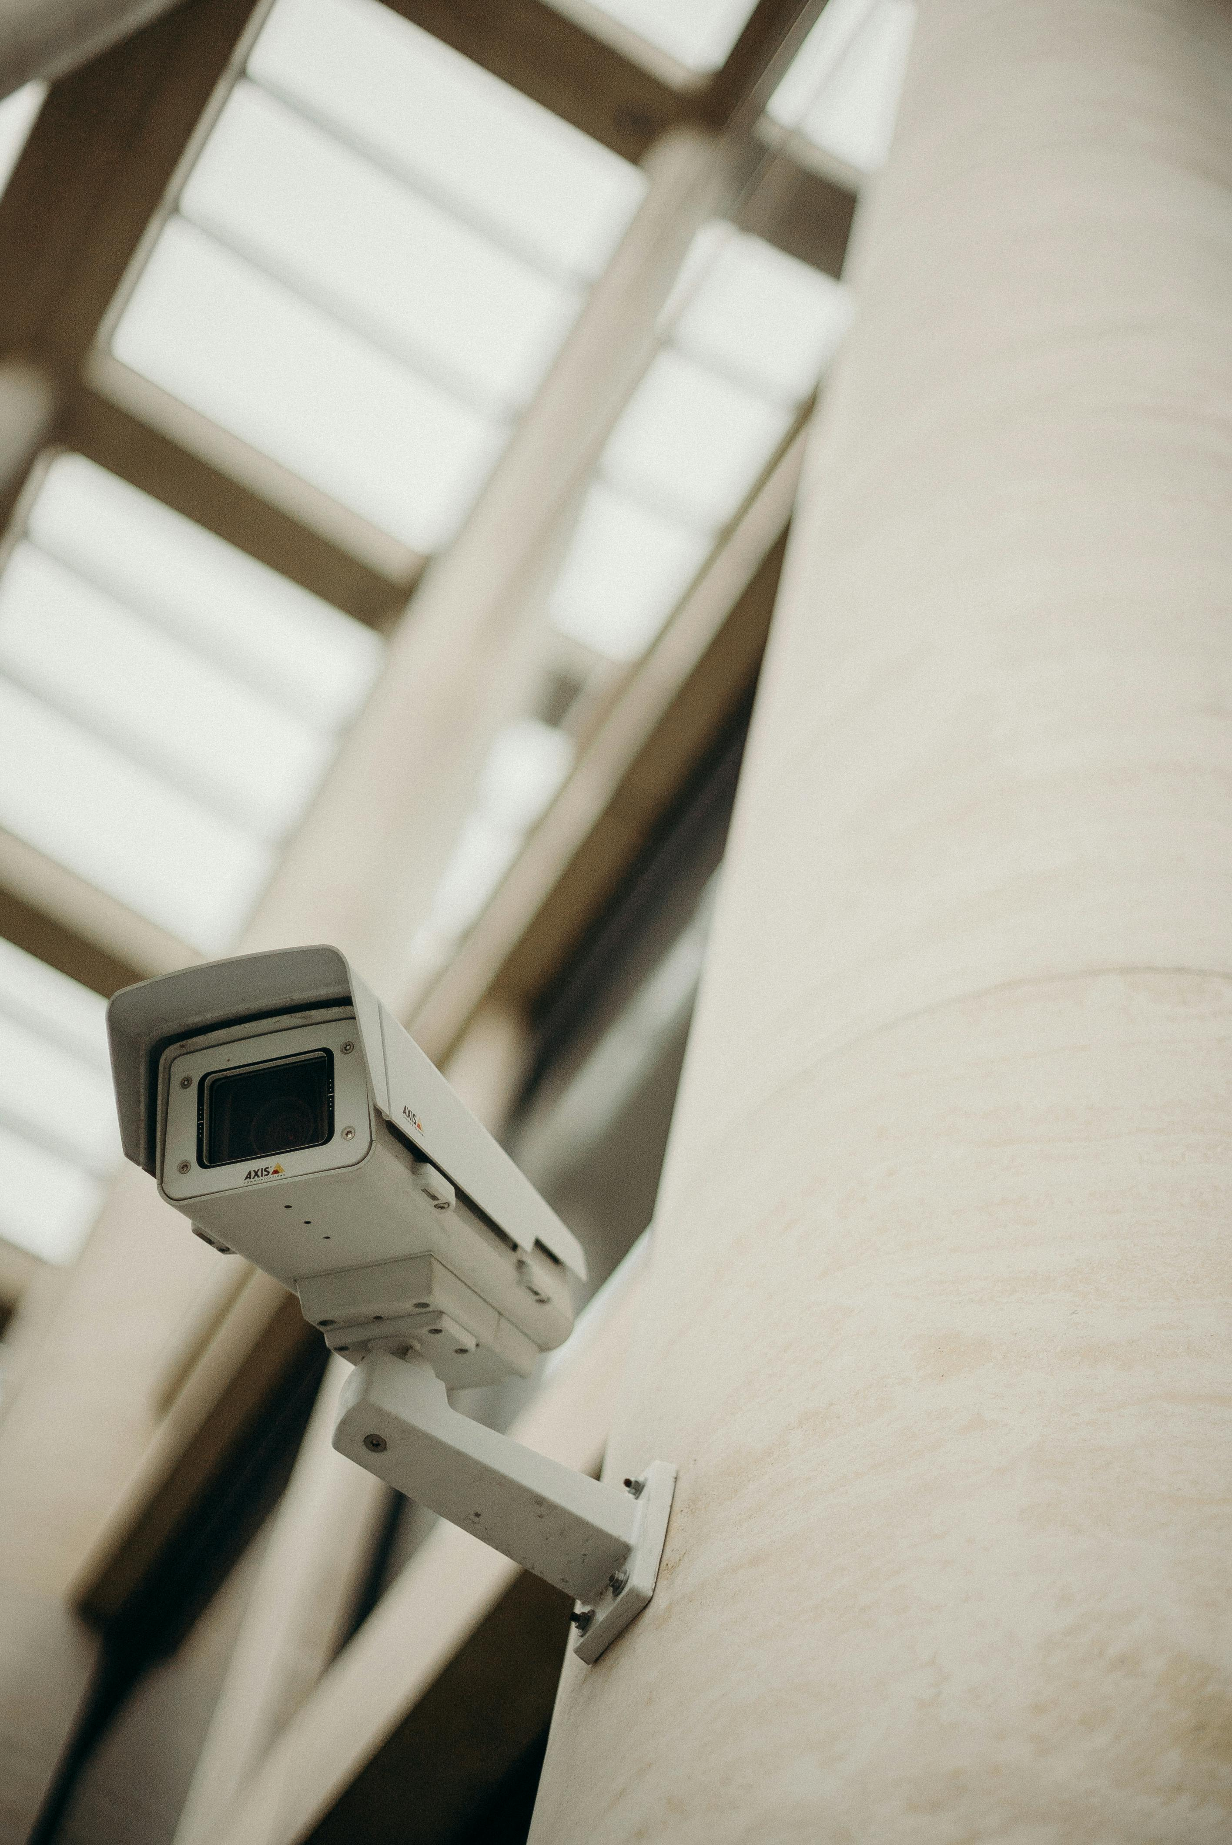



IMPACT AND BENEFITS
FaceReconX
Potential Impact on the Target Audience:
Benefits of the Solution:
Faster and more reliable suspect identification, helping reduce crime rates.
Public safety improves with faster, accurate suspect apprehension.
Improved recovery rates for missing persons.
Time efficiency lets officers focus on leads with real-time matches.
Enhanced public trust through faster and accurate identification.
Operational enhances by streamlined investigations via database integration.
Secure and simplified transactions enhance the buying experience.
Ethical use is ensured with data protection and anti-bias measures.

Slide 6
RESEARCH AND REFERENCES
FaceReconX
Details / Links of the reference and research work
Face Recognition Technology:
  Accuracy and Reliability: "Evaluating Face Recognition Algorithms Across Various Conditions" – IEEE Transactions on Biometrics.
Law Enforcement and Data Security:
  Privacy and Ethical Concerns: "Ensuring Privacy in Law Enforcement Through Secure Face Recognition Systems" – Journal of Legal and Ethical Issues.
Operational Impact:
  Improving Police Efficiency: "The Role of Technology in Modernizing Law Enforcement Operations" – Police Science & Technology Journal.
Social and Ethical Implications:
  Community Perception: "Balancing Public Safety and Privacy: Challenges of Implementing Face Recognition Technology" – Journal of Social Ethics and Technology.

