Slide 1
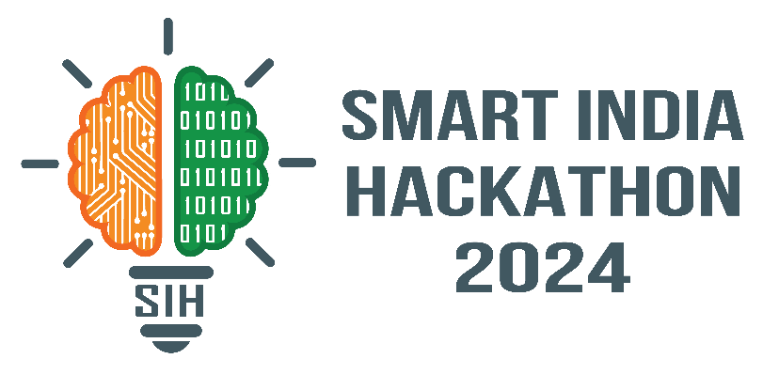

SMART INDIA HACKATHON 2024
TITLE PAGE
Problem Statement ID – 1620
Problem Statement Title- Queuing models in OPDs/ availability of beds/ admission of patients. A hospital based solution is ideal which can be integrated with city wide module
Theme- MedTech / BioTech / HealthTech
PS Category- Software
Team ID- ISIH - 011
Team Name- Sudo_Scope

Slide 2
IDEA TITLE
Sudo_Scope
SmartQueue - Reimagining Hospital Management
Detailed explanation of the proposed solution: | How it addresses the problem: | Innovation and uniqueness of the solution:
Intelligent Queuing System:
Advanced Automated Queuing System, with virtual wait room and smart token allocation for OPD’s through algorithm.
Dynamic Bed Management:
Dynamic Bed allocation based on real time availability.
Reduced OPD Wait Times:
Smart queuing reduces patient wait times, allowing doctors to see more patients.
Optimized Bed Utilization:
Real-time bed allocation ensures efficient use of available beds.
Reduced OPD Wait Times:
Smart queuing reduces patient wait times, allowing doctors to see more patients.
Optimized Bed Utilization:
Real-time bed allocation ensures efficient use of available beds.
Streamlined Admission Process:
Paper less Admission form, Doctor’s prescription, Medical reports and Curated Billing System.
Smart Inventory Management:
Real time connection with Inventory Database to track medicine and supply levels
Simplified Admission Process:
Digital admission forms reduce paperwork and speed up patient processing..
Improved Inventory Management:
Real-time tracking prevents shortages of medicines and supplies.
Simplified Admission Process:
Digital admission forms reduce paperwork and speed up patient processing..
Improved Inventory Management:
Real-time tracking prevents shortages of medicines and supplies.
Cross Platform application:
An efficient application for seamless for any application platform.
User Friendly UI/UX :
The UI/UX design primary motto is provide a user friendly experience.
Patient Empowerment:
Patients can manage appointments and see their wait time through an app.
Staff Efficiency:
Automated processes reduce administrative burdens, allowing staff to focus on care.
Patient Empowerment:
Patients can manage appointments and see their wait time through an app.
Staff Efficiency:
Automated processes reduce administrative burdens, allowing staff to focus on care.

Slide 3





TECHNICAL APPROACH
Sudo_Scope
Frontend:
Flutter: Cross-platform framework for building natively compiled applications for mobile, web, and desktop from a single codebase.
Database:
MySQL: Open-source relational database management system.
Server & Hosting:
XAMPP: Local server environment for development and testing.
Real-time Data and Inventory:
Firebase: Platform for building mobile and web applications, providing services like real-time database, authentication, and cloud messaging.
Backend:
PHP: Server-side scripting language suitable for web development and backend functionality.

Slide 4






FEASIBILITY AND VIABILITY
Sudo_Scope
Analysis of the Feasibility of the Idea: | Potential Challenges and Risks: | Strategies for Overcoming Challenges:
01
Technical Feasibility:
01
System Integration:
01
Compatibility Testing:
Reliable technologies like Flutter, PHP, and Firebase ensure smooth development and maintenance.
Compatibility issues may arise when integrating with existing hospital systems.
Thorough planning, testing, and pilot implementations to resolve integration issues.
Economic Feasibility:
02
Data Security:
02
Security Protocols:
02
Optimized resource use and reduced waste justify the investment with cost savings.
Protecting patient data requires robust and compliant security measures.
Implement industry-standard security protocols and encryption to protect patient data.
03
Operational Feasibility:
03
User Adoption:
03
Comprehensive Training:
The solution integrates seamlessly with existing hospital workflows and infrastructure.
Effective training is crucial to ensure that hospital staff can use the system efficiently.
Provide hands-on training to hospital staff, addressing practical use and concerns.
Market Feasibility:
04
Resistance to Change:
04
Change perception:
04
Growing demand for hospital management solutions offers significant market potential.
Some staff may resist adopting new technology and workflows.
Make necessary changes beforehand by consult with staffs for better workflow.
05
Social Feasibility:
05
Scalability Issues:
05
Scalable Design:
Positive social impact through improved patient care and reduced waiting times.
Managing large data volumes and ensuring system responsiveness under heavy load.
Develop a scalable system architecture to handle future growth and maintain high performance.
Scalability:
06
Performance Optimization:
06
Continuous Monitoring
06
The solution is designed to grow with hospital needs, ensuring long-term viability.
Continuous monitoring to maintain system performance is essential.
Regular performance checks and updates to ensure the system remains efficient.

Slide 5

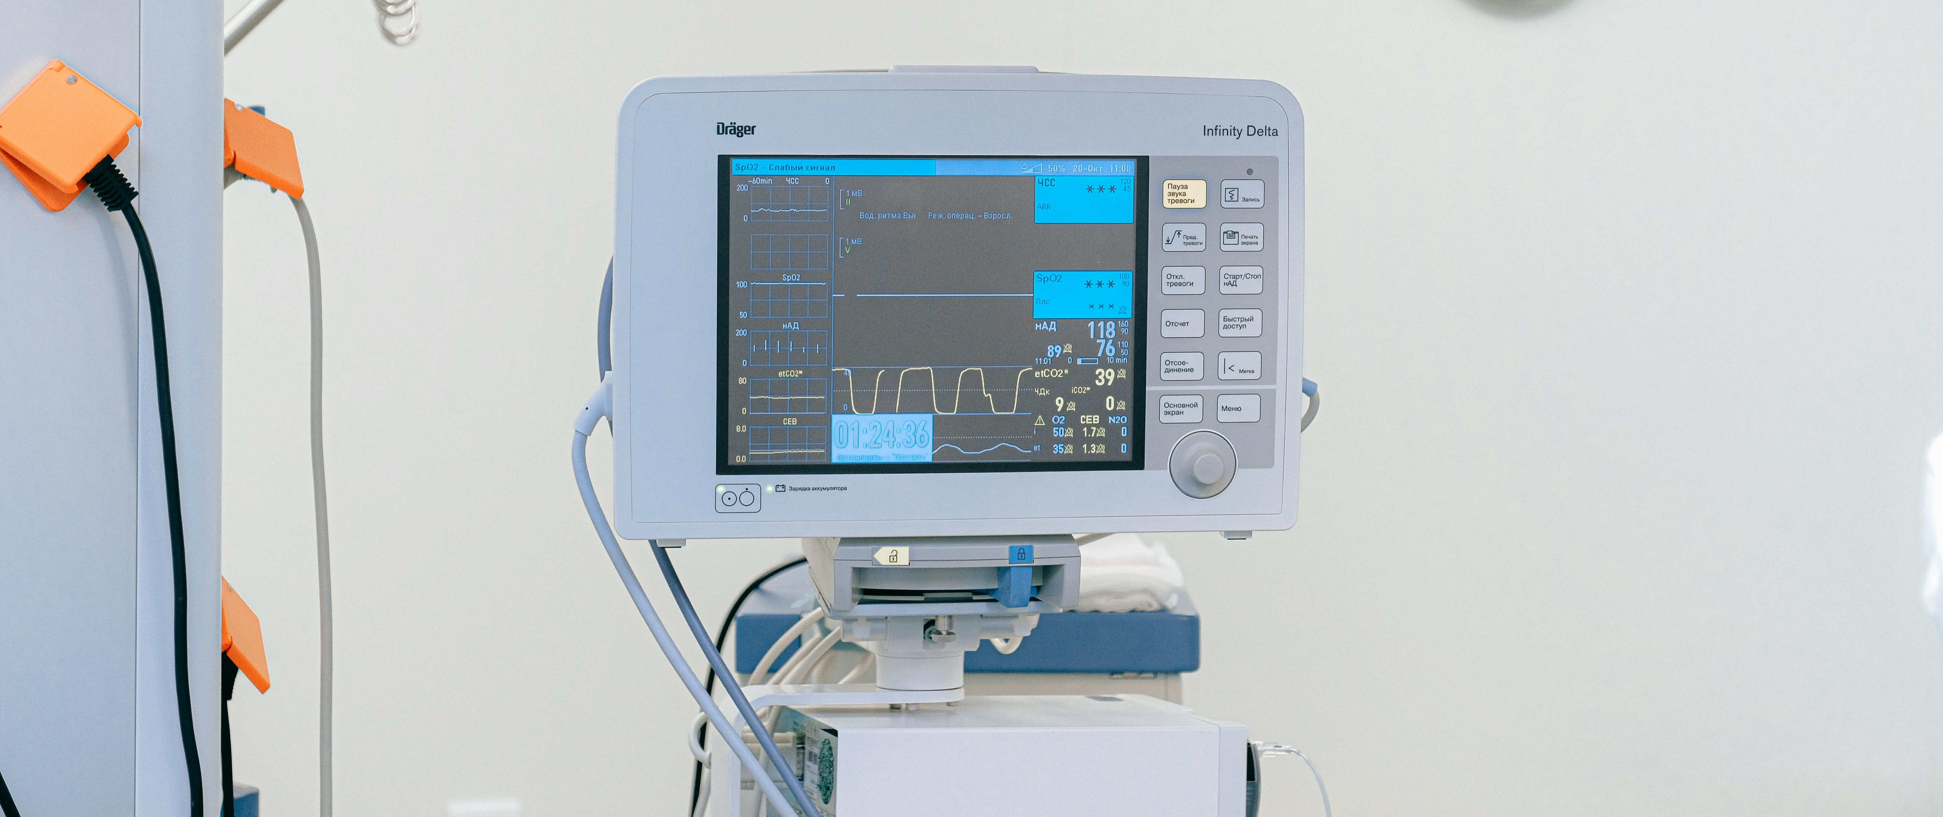

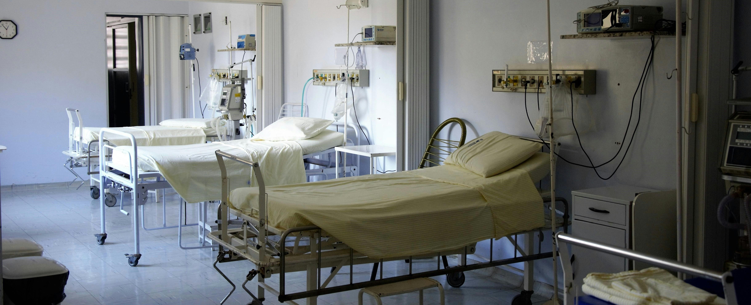

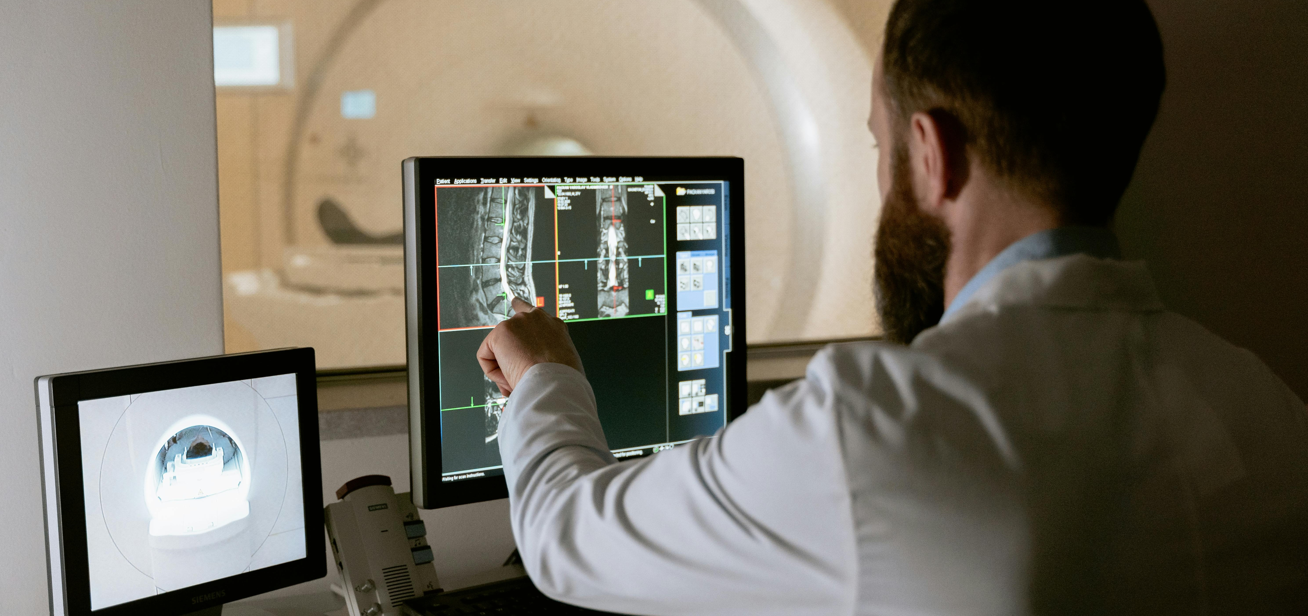
IMPACT AND BENEFITS
Sudo_Scope
Potential Impact on the Target Audience: Target Audience: Patients, Hospital Staff, Hospital Administration. | Benefits of the Solution:
Impact
Patients:
Reduced waiting times and faster access to care.
Improved communication and transparency regarding appointments and procedures.
Enhanced convenience through mobile app accessibility.
Increased satisfaction with overall hospital experience.
Social Benefits:
Better Patient Care: Faster care, shorter waits, better communication.
Happy Patients: Efficient, convenient experience means satisfied patients.
Greater Access: Mobile app makes healthcare more accessible.
Hospital Staff:
Streamlined workflows and reduced administrative burden.
Access to real-time data for informed decision-making.
Improved efficiency in bed management and resource allocation.
Enhanced focus on patient care rather than administrative tasks.
Economic Benefits:
Lower Costs: Optimized resource use, less waste, efficient bed management.
More Revenue: Higher patient turnover and capacity potential.
Streamlined Operations: Efficient workflows and reduced admin burden.
Hospital Administration:
Optimized resource utilization and cost savings.
Improved bed turnover rates and increased patient capacity.
Enhanced operational efficiency and streamlined workflows.
Data-driven insights for better resource planning and decision-making.
Positive reputation and increased patient satisfaction.
Environmental Benefits:
Less Paper: Digitized processes minimize paper usage.
Reduced Waste: Optimized inventory management minimizes waste.
Time conservation: This application helps patients to efficiently plan and schedule appointments for time conservation.

Slide 6
RESEARCH AND REFERENCES
Sudo_Scope
Details / Links of the reference and research work
Queuing Models and Optimization:
Research on Queuing Theory in Healthcare Hospital Bed Management: (PDF) ‘Queuing-Model’ to optimize Patient waiting time in Out Patient Department (OPD) of a Super-speciality public hospital of India. (researchgate.net)
Hospital Bed Management:
Study on Bed Management Strategies: (PDF) An exploratory study of bed management (researchgate.net)
Hospital Admission Processes:
Analysis of Hospital Admission Procedures: Standardizing admission and discharge processes to improve patient flow: A cross sectional study - PMC (nih.gov)
Inventory Management in Hospitals:
Research on Hospital Inventory Control: Inventory Management and Pharmaceutical Supply Chain Performance of Hospital Pharmacies in Bahrain: A Structural Equation Modeling Approach - Shaju George, Safaa Elrashid, 2023 (sagepub.com)
Mobile Applications in Healthcare:
Benefits of Mobile Health Apps: Effectiveness of Mobile Health Application Use to Improve Health Behavior Changes: A Systematic Review of Randomized Controlled Trials - PMC (nih.gov)

