Slide 1

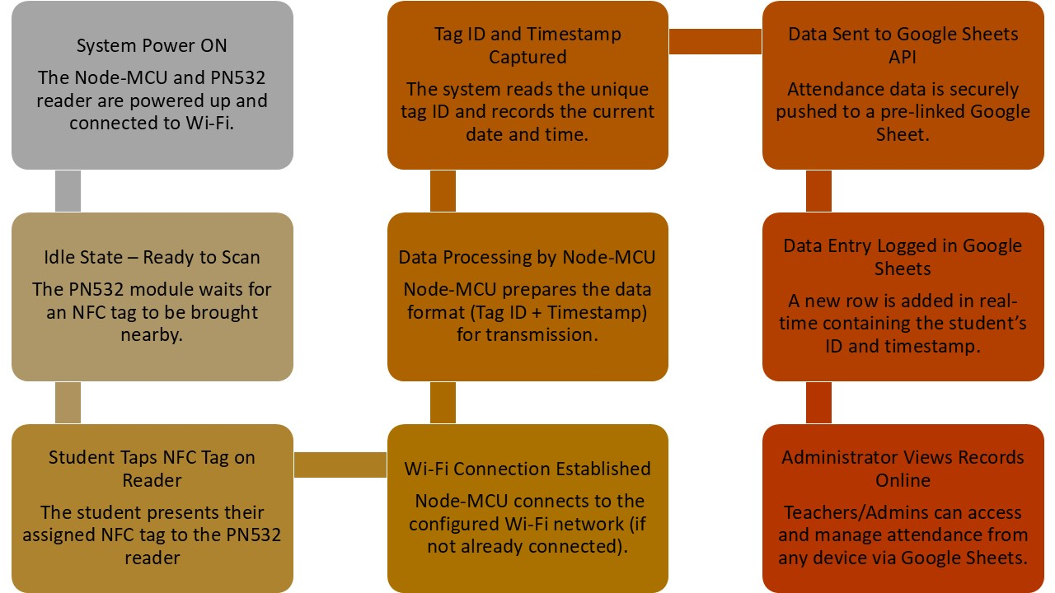
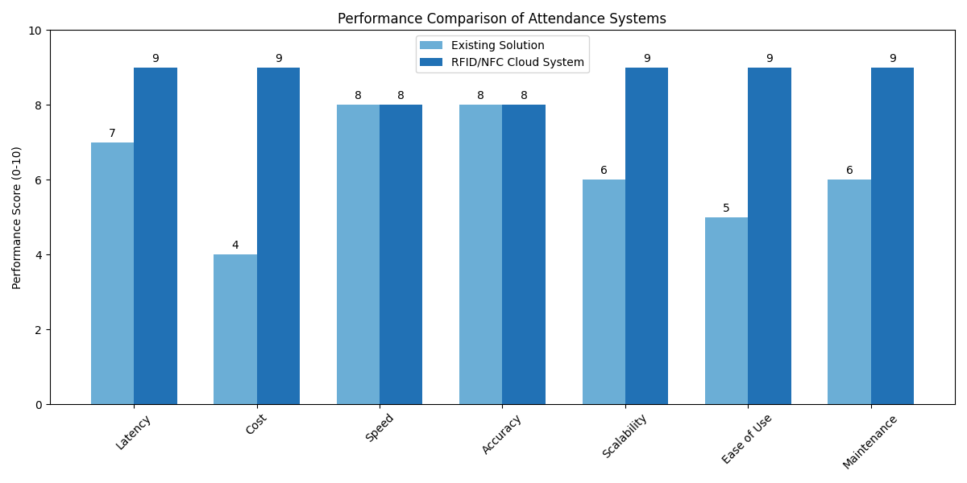
Register No: 192124033
Students Name: Bharathwaj K S
Guided By Dr.S.Kalaiarasi
RFID/NFC Based Attendance System with Cloud Integration: A Scalable and Cost-Effective Approach for Educational Institutions.
INTRODUCTION
Problem:
  Many government schools still use paper registers or expensive fingerprint scanners. These methods are slow, prone to mistakes, and often break down, leading to inaccurate records.
Why This Solution:
  There is a clear need for a system that is both affordable and reliable, reduces teacher workload, and delivers accurate attendance instantly.
Product Solution:
  The proposed cloud-connected RFID/NFC attendance system that employs a PN532 reader and a Node-MCU ESP8266. Students tap inexpensive NFC tags, and attendance is captured automatically.
Key Result:
  In tests, our system records each tap in under 2 seconds, pushes data to the cloud with almost zero delay, and cuts overall costs by around 30 % compared to fingerprint devices.
MATERIALS AND METHODS
Hardware Components:
  PN532 RFID/NFC Reader: Reads student tags quickly and reliably.
  Nodemcu ESP8266: Processes tag IDs and handles Wi-Fi communication.
  NFC Tags: Low-cost cards assigned to each student.
Software & Cloud Setup:
  Arduino IDE: Code for NFC reading and Wi-Fi routines
  Google Sheets API: Secure endpoint for real-time data storage.
RESULTS
Parameter | Manual Register | Biometric System | RFID/NFC Cloud System
Cost | Low hardware cost but high labour expenses | Very high setup and maintenance costs | Very low hardware + free cloud storage
Speed (per student) | 10–20 s (manual entry) | 2–5 s (scanning) | 1–2 s (tap & cloud update)
Accuracy | Error-prone (missing entries) | Generally accurate but sensor glitches can occur | Automated read, near-zero error rate
Latency | Minutes to hours (data entry delays) | 5–10 s (processing overhead) | 1-2 s (real-time cloud sync)
Scalability | Not suitable for storage efficient | Increased hardware cost per location | Easily add readers and tags, no extra infrastructure
DISCUSSION AND CONCLUSION
Discussion:
  Efficiency: Teachers save valuable class time—no manual roll-calls or waiting for scanners.
  Reliability: NFC tags and cloud integration eliminate human error and data loss.
  Affordability: Low-cost tags and open-source hardware cut initial and ongoing expenses.
  Ease of Management: A single Google Sheet replaces bulky paperwork and complex databases.
Conclusion:
  The proposed cloud-connected RFID/NFC attendance system offers a practical, scalable, and budget-friendly solution for schools. It streamlines attendance tracking, delivers real-time data to administrators, and significantly reduces both administrative workload and costs. This makes it an ideal choice for government and resource-constrained educational environments.
BIBLIOGRAPHY
J. K. Doe and A. L. Smith, “Design and Implementation of an RFID-Based Attendance System for Educational Institutions,” in Proc. IEEE Int. Conf. on Smart Education, 2018, pp. 123–127.
M. Zhang and P. R. Gupta, “NFC Technology in Attendance Management: A Case Study in Government Schools,” IEEE Trans. Ind. Informant., vol. 15, no. 4, pp. 2164–2171, Aug. 2019.
A. Patel and R. Singh, “Low-Cost IoT Solutions for Attendance Management in Resource-Constrained Environments,” in Proc. IEEE Int. Conf. on Emerging Technologies, 2020, pp. 234–238.
F. Hernandez and G. Martinez, “Google Sheets as a Cloud Platform for Real-Time Data Logging in IoT Systems,” IEEE Internet Things J., vol. 8, no. 5, pp. 3323–3330, Oct. 2021.
H. W. Choi, “Integrating Cloud Services with RFID/NFC Technologies: Challenges and Solutions,” IEEE Trans. Cloud Compute., vol. 9, no. 1, pp. 75–83, Jan. 2021.

