Slide 1
Welcome

Slide 2
18MAB101T
CALCULUS AND LINEAR ALGEBRA

Slide 3
SYLLABUS

Slide 4
UNIT- I
MATRICES

Slide 5
Eigen Values & Eigen Vectors
Cayley Hamilton Theorem
Orthogonal reduction
Reduction of Quatratic Form to Canonical Form

Slide 6

Google's extraordinary success as a search engine was due to their clever use of eigenvalues and eigenvectors.
Their task was to find the "most important" page for a particular search query,

Slide 7
In structural mechanics eigenvalues may determine whether an automobile is too noisy or whether a building will collapse in an earth-quake.
In the analysis of financial data and are integral in extracting useful information from the raw data. They can be used for predicting stock prices and analyzing correlations between various stocks, corresponding to different companies.

Slide 8
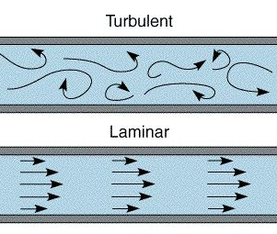
In aeronautical engineering - eigenvalues may determine whether the flow over a wing is laminar or turbulent.

Slide 9
UNIT- II
Functions of Several Variables

Slide 10
Funstions of two variables
Taylors expansion for two variables
Maxima & Minima
Constrained Maxima & Minima
Jacobians of Three variables

Slide 11
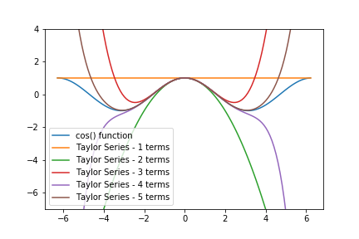
The Taylor series can be used to calculate the value of an entire function at every point, if the value of the function, and of all of its derivatives, are known at a single point.

Slide 12
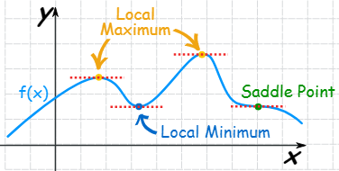
the maxima and minima (the respective plurals of maximum and minimum) of a function, known collectively as extrema (the plural of extremum), are the largest and smallest value of the function, either within a given range (the local or relative extrema), or on the entire domain (the global or absolute extrema).

Slide 13
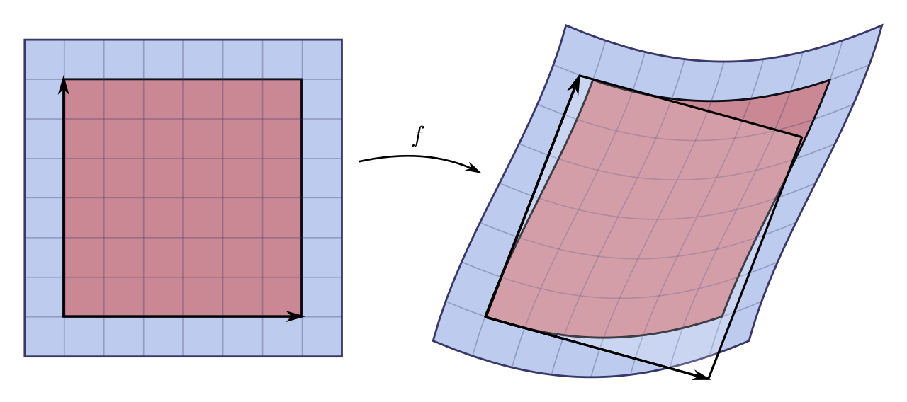
The Jacobian can also be used to solve systems of differential equations at an equilibrium point or approximate solutions near an equilibrium point.

Slide 14
UNIT- III
Ordinary Differential Equations
(ODE)

Slide 15
Euler & Legendre Type
Homogeneous Types
Variation of parameters
Simultaneous First order ODE

Slide 16
variation of parameters, also known as variation of constants, is a general method to solve inhomogeneous linear ordinary differential equations.

Slide 17
UNIT- IV
DIFFERENTIAL CALCULUS

Slide 18
Radius of Curvature
Circle of Curvature
Centre of Curvature
Evolutes
Envelopes

Slide 19
When engineers design train tracks, they need to ensure the curvature of the track will be safe and provide a comfortable ride for the given speed of the trains f or this The radius of curvature of the curve at a particular point is defined as the radius of the approximating circle

Slide 20
An evolute of may also be thought of as the curve determined by the centers of curvature of alpha.
Involutes are used in gear tooth design to eliminate vibration as much as possible, while the involute and evolute of a very special curve can be used to design a clock

Slide 21
UNIT- V
Sequences and Series

Slide 22
Comparison Test
D’Alembert ratio Test
Raabe’s Test
Cauchy’s root test
Leibnitz Test
Absolute convergence
Conditional Convergence

Slide 23
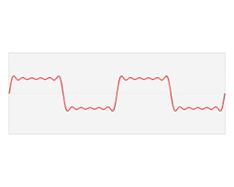
Engineers use Series to predict the life of machine components subject to a random sequence of repeated loading, known as fatigue loading..

Slide 24
J. Vilma Roseline
Assistant Professor
Department of Mathematics
SRM Institute of Science & Technology

