Slide 1
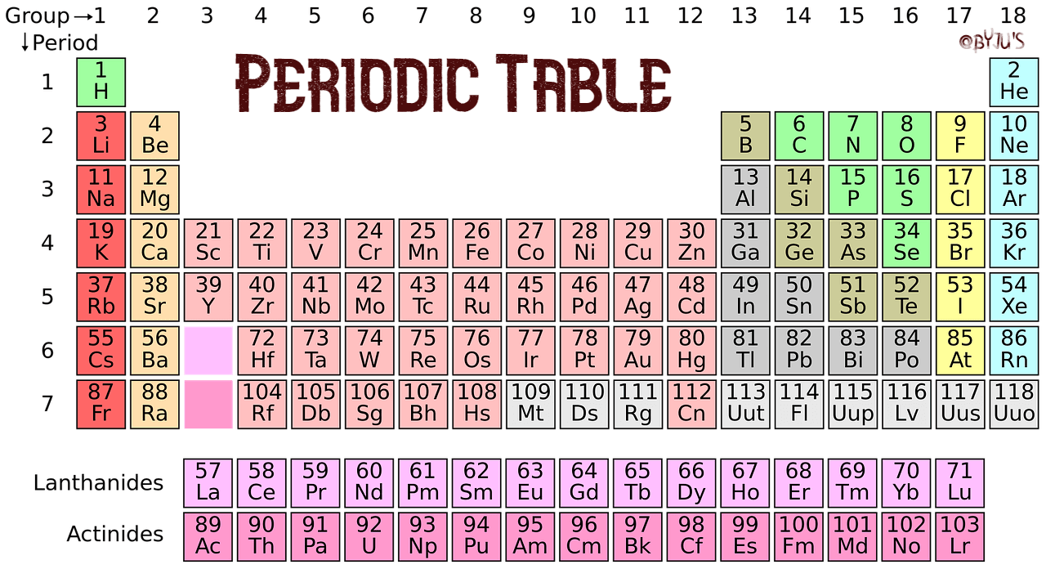
PERIODIC CLASSIFICATION OF ELEMENTS

Slide 2
Classification of elements
The arranging of elements into different groups on the basis of the similarities in their properties is called classification of elements.
The classification of similar elements into groups makes the study of elements easier.
There are about 118 different elements known so far.

Slide 3
Early attempts at classification of elements
a) The earliest attempt to classify elements was grouping the known elements (about 30 elements) into two groups called metals and non metals.
The defect in this classification was that it had no place for metalloids (elements which have properties of both metals and non metals) which were discovered later.

Slide 4
b) Dobereiner’s Triads :-
Dobereiner classified elements in the increasing order of their atomic masses into groups of three elements called triads. In each triad the atomic mass of the middle element was approximately equal to the average atomic mass of the other two elements.
The defect in this classification was that all the known elements could not be correctly arranged into triads.

Slide 5
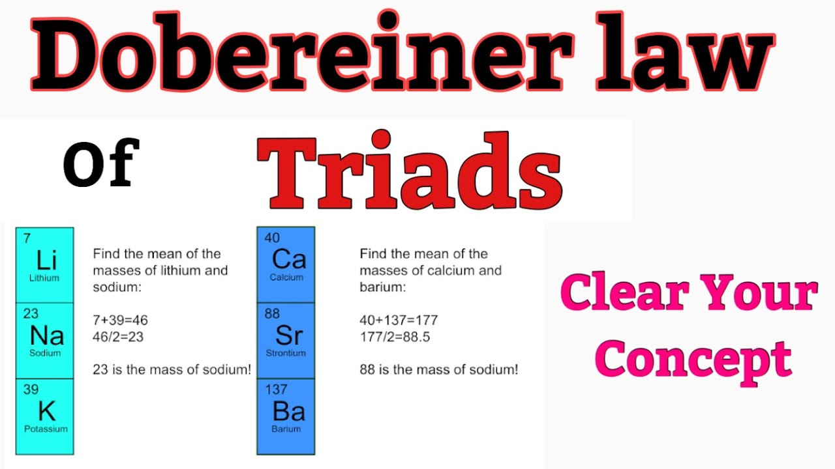

Slide 6
Triad | Atomic mass | Average atomic mass of Ist and 3rd element
Lithium Li Sodium Na Potassium K | 6.9 23.0 39.0 | ​ 22.95
Calcium Ca Strontium Sr Barium Ba | 40.1 87.6 137.3 | ​ 88.7
Chlorine CI Bromine Br Iodine I | 35.5 79.9 126.9 | ​ 81.2

Slide 7
c) Newland’s octaves
Newland classified the elements in the increasing order of their atomic masses into groups of eight elements called octaves like the notes of music. He found that when the elements were arranged in the increasing order of their atomic masses into octaves then there was similarity of properties in every eighth element.

Slide 8
sa | re | ga | ma | pa | da | ni
H | LI | Be | B | C | N | O
F | Na | Mg | Al | Si | P | S
Cl | K | Ca | Cr | Tl | Mn | Fe
Co and Ni | Cu | Zn | Y | In | As | Se
Br | Rb | Sr | Ce and La | Zr | - | -

Slide 9
The defect in this classification was:-
i) All the known elements and elements discovered later could not be correctly arranged into octaves.
ii) Some elements having different properties were placed in the same rows like cobalt and nickel having different properties are placed along with Fluorine, Chlorine and Bromine. Iron having properties similar to Cobalt and Nickel are placed in different rows.

Slide 10
3a) Mendeleev’s periodic law :-
Mendeleev’s periodic law states that, ‘ The properties of elements are periodic functions of their atomic masses’.

Slide 11
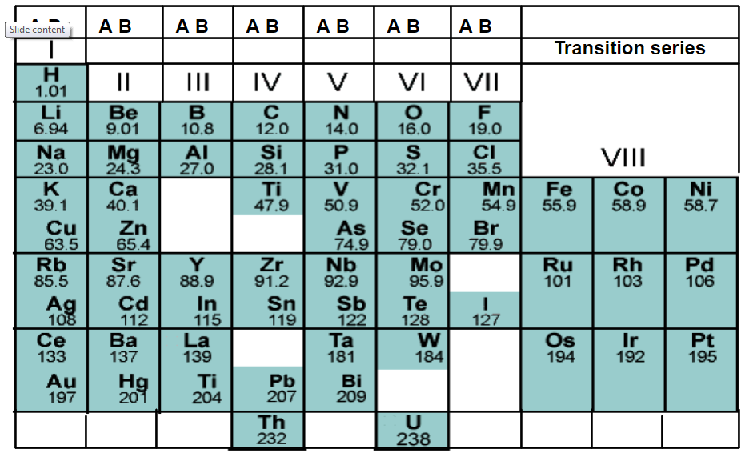

Slide 12
b) Mendeleev’s periodic table
Mendeleev classified elements in the increasing order of their atomic masses and similarities in their properties.
The formulae of the oxides and hydrides formed by the elements was also the basis for the classification of the elements.
Mendeleev’s periodic table has 6 horizontal rows called periods and 8 vertical rows called groups. The groups 1 to 7 had two sub groups called A sub group and B sub group. Group 8 had 3 rows of elements. Elements having similar properties were placed in the same groups. There are some spaces left vacant in the table to accommodate the elements to be discovered in future.

Slide 13
Merits of Mendeleev’s periodic table
i) Elements were classified on a more fundamental basis of their atomic masses and properties.
ii) Spaces were left vacant to accommodate the elements to be discovered in future.
iii) It could predict the properties of the elements which helped in the discovery of new elements.
iv) The inert gas elements discovered later could be placed in a separate group without disturbing the table.

Slide 14
Defects of Mendeleev’s periodic table
i) Some elements are not arranged in the increasing order of their atomic masses. Co is placed before Ni, Te is placed before I etc.
ii) Position of hydrogen is not clear because it shows properties similar to metals as well as non metals.
iii) The position of isotopes of elements is not clear.

Slide 15
Modern periodic law
Modern periodic law states that, ‘ The properties of elements are periodic functions of their atomic numbers’.

Slide 16
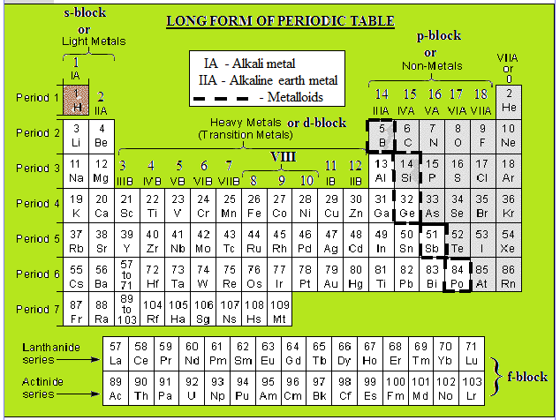

Slide 17
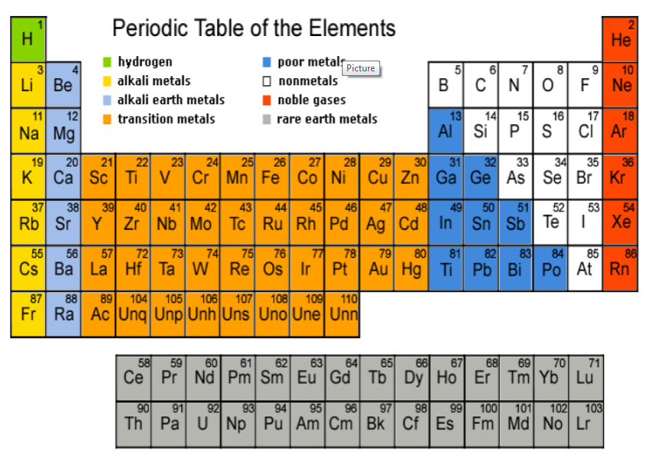

Slide 18
Modern periodic table
In the modern periodic table elements are arranged in the increasing order of their atomic numbers in the form of a table having 7 horizontal rows of elements called periods and 18 vertical rows of elements called groups.

Slide 19
i) Periods
There are 7 periods of elements as follows :-
First period has 2 elements H and He called very short period.
Second period has 8 elements Li to Ne called short period.
Third period has 8 elements Na to Ar called short period.
Fourth period has 18 elements K to Kr called long period.
Fifth period has 18 elements Rb to Xe called long period.
Sixth period has 32 elements Cs to Rn called very long period.
Seventh period has 28 elements from Fr to atomic number 114
called incomplete period.
14 elements each of he sixth and seventh periods are placed
separately at the bottom of the table.
The 14 elements of the sixth period from La to Lu are called
Lanthanides. and the 14 elements of the seventh period from Ac to Lr are called Actinides.

Slide 20
ii) Groups
There are 18 groups of elements divided into 9 main groups. They are
I, II, III, IV, V, VI, VII, VIII and 0 groups. The groups I to VII has two sub
groups each called A – sub group and B – sub group. Group VIII has 3
rows of elements and 0 group has one row of elements.
The A sub group elements are called normal elements.
The B sub group elements are called transition elements.
Lanthanides and Actinides are called inner transition elements.
Group 1 (I A ) elements are called alkali metals
Group 2 (II A) elements are called alkaline earth metals.
Group 17 (VII A) elements are called halogens.
Group 18 (0 group) are called noble gases.
In a group all the elements have the same number of valence
electrons. Group I elements have 1 valence electron, Group II elements
have 2 valence electron, Group III elements have 3 valence electrons
etc.
In a period all the elements contain the same number of shells.

Slide 21
Properties of elements in periods and groups
i) Valence electrons :-
In a period the number of valence electrons increases from 1 to 8 from the left to the right and the number of shells is the same.
Eg :- 2nd Period
Elements - Li, Be, B, C, N, O, F, Ne
AN - 3 4 5 6 7 8 9 10
EC - 2,1 2,2 2,3 2,4 2,5 2,6 2,7 2,8
Valence electrons - 1 2 3 4 5 6 7 8
Shells - 2 2 2 2 2 2 2 2
In a group the number of valence electrons is the same for all the elements but the number of shells increases from top to bottom.
Eg :- Group – I A
Elements AN EC VE Shells
H 1 1 1 1
Li 3 2,1 1 2
Na 11 2,8,1 1 3
K 19 2,8,8,1 1 4

Slide 22
ii) Valency
In a period the valency of the elements increases from 1 to 4 and then decreases from 4 to 0 from the left to the right.
Eg :- 2nd Period
Elements - Li, Be, B, C, N, O, F, Ne
AN - 3 4 5 6 7 8 9 10
EC - 2,1 2,2 2,3 2,4 2,5 2,6 2,7 2,8
Valence electrons - 1 2 3 4 5 6 7 8
Valency - 1 2 3 4 3 2 1 0
​
In a group the valency is the same for all elements of the group.
Eg :- Group – I A
Elements AN EC VE Valency
H 1 1 1 1
Li 3 2,1 1 1
Na 11 2,8,1 1 1
K 19 2,8,8,1 1 1

Slide 23
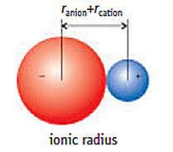
ATOMIC AND IONIC RADII
The term atomic or ionic radius is generally used for the distance between the nucleus and the outer most shell of electrons of the atomic or ionic particle. It is not possible to isolate an individual atoms or an ion. Therefore these quantities are derived indirectly.

Slide 24
Atomic size ( Radius of the atom)
In a period the atomic size of the elements decreases from the left to the right because the nuclear charge (number of protons) increases and so the electrons are pulled closer to the nucleus.
Eg :- 2nd Period
Elements - Li, Be, B, C, N, O, F, Ne
AN - 3 4 5 6 7 8 9 10
EC - 2,1 2,2 2,3 2,4 2,5 2,6 2,7 2,8
No. of protons - 3 4 5 6 7 8 9 10
Atomic size decreases

Slide 25
In a group the atomic size of the elements increases from top to bottom because the number of shells increases and the distance between the nucleus and shells also increases.
Eg :- Group – I A
Elements AN EC VE Shells
H 1 1 1 1 Atomic
Li 3 2,1 1 2 size
Na 11 2,8,1 1 3 increases
K 19 2,8,8,1 1 4

Slide 26
Period
Elements of 2nd period | : | Li | Be | B | C | N | O | F
Covalent radii (A*) | : | 1.23 | 0.90 | 0.82 | 0.77 | 0.75 | 0.73 | 0.72

Slide 27
Group
Elements of IIA Group | : | Be | Mg | Ca | Sr | Ba
Covalent radii ( Å) | : | 0.90 | 1.36 | 1.74 | 1.91 | 1.98
Ionic radii of M2+ cations (Å) | : | 0.31 | 0.65 | 0.99 | 1.13 | 1.35

Slide 28
IONISATION POTENTIAL OR IONISATION ENERGY
The amount of energy required to remove the most loosely bound electron (i.e., the outermost electron) from an isolated gaseous atom of an element in its lowest energy state (i.e., ground stale) to produce a cation is known as ionisation potential or ionisation energy of that element.
M(g) + Energy supplied (Ionisation energy, I) → M⁺(g) + e⁻
Isolated gaseous atom Cation

Slide 29
Successive ionisation potentials
I₁< I₂< I₃< I₄<…….

Slide 30
Successive ionisation potentials
Elements with atomic number | Electronic configuration | Successive Ionisation potentials( eV)
 |  | I₁ | I₂ | I₃ | I₄ | I₅ | I₆ | I₇ | I₈
H₁ | 1s¹ | 13.6
He₂ | 1s² | 24.6 | 54.4
Li₃ | 1s² ,2s¹ | 5.4 | 75.6 | 122.4
Be₄ | 1s² ,2s² | 9.3 | 18.2 | 153.9 | 217.7
B₅ | 1s²,2s² p¹ | 8.3 | 25.1 | 37.9 | 259.3 | 340.1
C₆ | 1s² ,2s² p² | 11.3 | 24.4 | 47.9 | 64.5 | 39.2 | 489.8
N₇ | 1s² ,2s² p³ | 14.5 | 29.6 | 47.4 | 77.5 | 97.9 | 551.9 | 666.8
O₈ | 1s²,2s² p⁴ | 13.6 | 35.1 | 54.9 | 77.4 | 113.9 | 138.1 | 739.1 | 871.1

Slide 31
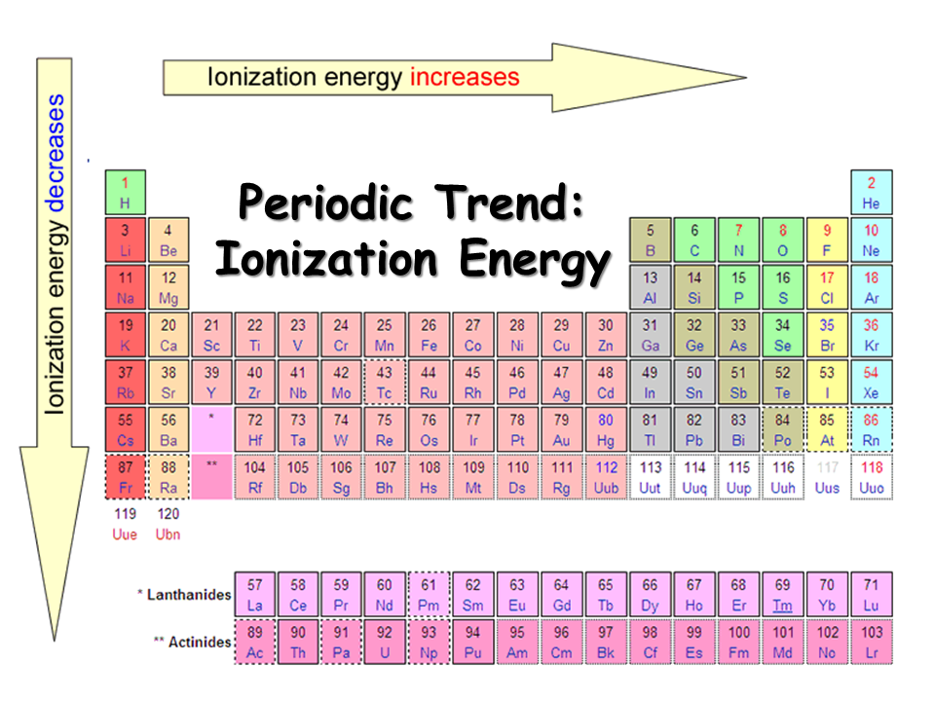

Slide 32
Factors affecting the magnitude of ionisation potential and its periodic variations
Charge on the nucleus (i.e., nuclear charge) and variation in a period
Elements of 2nd period | : | Li | Be | B | C | N | O | F | Ne
Nuclear charge: | : | +3 | +4 | +5 | +6 | +7 | +8 | +9 | +10
Ionisation potential (eV) | : | 5.4 | 9.3 | 8.3 | 11.3 | 14.5 | 13.6 | 17.4 | 21.7

Slide 33
Factors affecting the magnitude of ionisation potential and its periodic variations
The degree of penetration of electrons
s >p > d > f
The ionisation potential corresponding to the removal of 2p¹electron of boron (B→2s²p¹) is 8.3 eV while those corresponding to the removal of two 2s electrons are 25.1 and 37.9 eV.

Slide 34
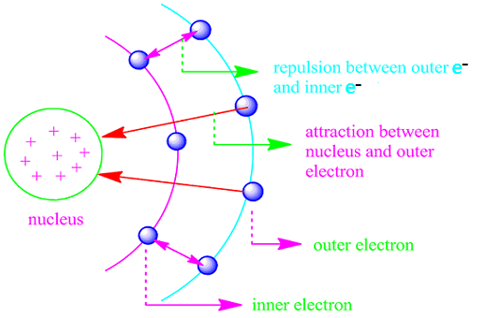
Factors affecting the magnitude of ionisation potential and its periodic variations
The shielding effect or screening effect of the inner electrons on the valence-electrons and variation in a group
As we move down a group, the number of inner-shells increases and hence the ionisation potential tends to decrease.

Slide 35
Factors affecting the magnitude of ionisation potential and its periodic variations
Elements of II A group | : | Be | Mg | Ca | Sr | Ba
No. of inner-shells: | : | 1 | 2 | 3 | 4 | 5
Ionisation potential (eV) | : | 9.3 | 7.6 | 6.1 | 5.7 | 5.2
 | ________ Decreasing ________

Slide 36
Factors affecting the magnitude of ionisation potential and its periodic variations
Completely-filled and half-filled orbitals
Be and N in the second period and Mg and P in the third period have slightly higher values of ionisation potentials than those normally expected. This is explained on the basis of extra stability of the completely-filled 2s-orbital in Be(Be → 2s2) and 3s-orbital in Mg(Mg → 3s2) and of half-filled 2p-orbital in N (N → 2s2p3) and 3p-orbital in P(P → 3s2p3).

Slide 37
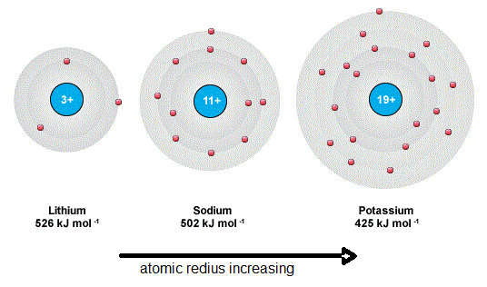
Factors affecting the magnitude of ionisation potential and its periodic variations
Atomic radius and variation in a group
The ionisation potential decreases with the increase in atomic radius. This is because of the fact that in case of larger atoms, the attraction between the nucleus and outer-most electron is less.Therfore it is easier to remove an electron from a larger atom than from a smaller one.

Slide 38
Factors affecting the magnitude of ionisation potential and its periodic variations
(vi) Principal quantum number (n) and variation in a group
Higher the value of n, the lower will be the amount of energy required to remove the electron i.e., its ionisation potential will be lower.
Thus on moving from top to bottom in a group, as the value of n for the valence-electron increases, ionisation potential decreases.

Slide 39
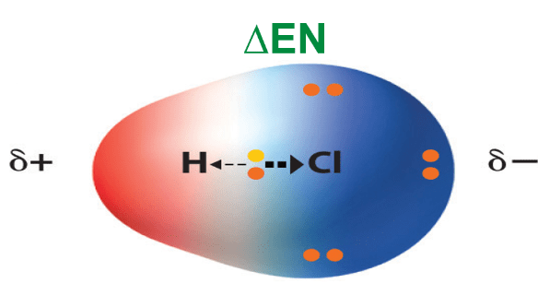
ELECTRONEGATIVITY
The electronegativity of a bonded atom is defined as its relative tendency (or ability) to attract the shared electron pair towards itself.
Electronegativity of an atom A is generally represented as x_{A}.

Slide 40
PERIODIC VARIATIONS
(a) In a period
Electronegativity increases on moving in a period of the periodic table from left to right. This is due to the increase in nuclear charge as a result of which the added electrons can be held more tightly. Thus the C—N bond should be shown as C+ - N- or CN, the arrow head being towards the more electronegative element N.
Elements of 2nd period | : | Li | Be | B | C | N | O | F
Valence-shell configuration | : | 1s¹ | 2s² | 2s²p¹ | 2s²p² | 2s²p³ | 2s²p⁴ | 2s²p⁵
No. of valence-shell electrons | : | 1 | 2 | 3 | 4 | 5 | 6 | 7
Electronegativity values | : | 1.0 | 1.5 | 2.0 | 2.5 | 3.0 | 3.5 | 4.0
 | _____ Increasing _____

Slide 41
PERIODIC VARIATIONS
(b) In a group
In moving down through a group of the periodic table since the nuclear charge again increases, the electronegativity of a lower element should be more than that of upper element. Actually it is not so because of the electron shielding effects. Therefore a lower element of a group is less electronegative than the upper element of the same group. In general, It can be stated that, small atoms attract electrons more strongly than large ones and are, there¬fore, more electronegative.

Slide 42
ELECTRON AFFINITY
The amount of energy released when an electron is added to an isolated neutral gaseous atom in its lowest energy state (i.e. ground state) to produce an anion is called its electron affinity or affinity energy.
It is represented as EA or E and is measured in electron volts (eV) or Kilocalories (Kcalories) per gm atom.
Thus electron affinity can be expressed by the following equation:

Slide 43
PERIODIC VARIATIONS
(a) In a period
Electron affinity values generally increase on moving from left to right in aperiod in the periodic table.
I A | IIA | III A | IV A | V A | VI A | VII A | Zero
H 0.75 |  |  |  |  |  |  | He 0.0
Li -0.61 | Be 0.0 | B -0.30 | C -1.25 | N -1.20 | O-1.48 (+7.3) | F -3.6 | Ne 0.0
Na -0.82 | Mg 0.0 | Al -0.52 | Si -1.39 | P -0.80 | S -2.0 (+3.4) | Cl -3.8 | Ar 0.0
K -0.69 |  |  |  |  |  | Br -3.5 I -3.2 | Kr 0.0 Xe 0.0

Slide 44
PERIODIC VARIATIONS
(a) In a period
In moving down a group, electron affinity values generally decrease.
For example E_{Cl}>E_{Br}>E_{I} This is because of the steady increase in the atomic radius of the elements.

Slide 45
Polarization or Ion Deformation
When a cation approaches an anion closely, the net positive charge on the cation tends to attract the electron cloud of the anion towards itself due to the electrostatic force of attraction existing between them.
The electron tends to repel the positively charged nucleus of the anion.
The combined effect of the two forces causes the electron cloud of the anion remains no longer symmetrical, but bulged or elongated towards the cation.

Slide 46
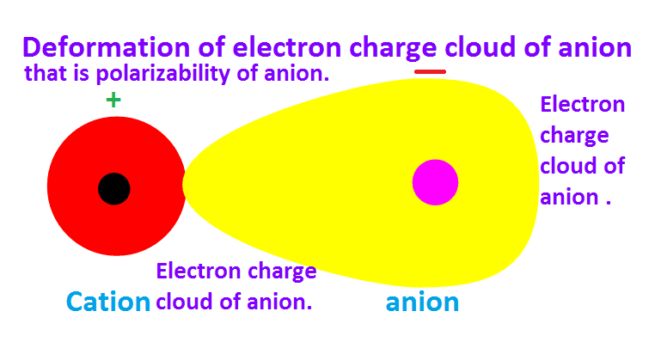
POLARIZABILITY

Slide 47
Polarisation abilty or Polarisation power.
The ability of the cation to polarize anion is called as the polarizing ability or Polarization power.
The anion is said to be Polarized.

Slide 48
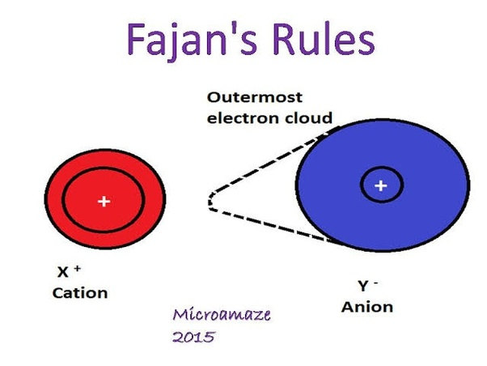

Slide 49
Factors Affecting Polarization (Fajans Rule)
1.Charge of the cation or anion
2.Size of the cation or anion
3.Electronic configuration of the cation

Slide 50
Charge of the cation or anion
The polarizing power of the cation to polarize the anion increase with the increase in the positive charge.
Eg NaCl ,MgCl_{2 ,}AlCl₃
The polarizing power of the cations:
_{Na < Mg2+ < Al 3+}
The covalent character increase from NaCl to AlCl3
NaCl(800ºC) ,MgCl₂(712ºC),AlCl₃(575ºC)

Slide 51
Size of the anion or cation
The polarizing power of the cation to polarize the anion increases with the decrease of its size.
Be2+ > Mg2+ > Ca2+ > Sr2+ > Ba2+ > Ra2+
(0.31) (0.65) (0.99) (1.13) (1.35) (1.40)
The greatest magnitude of the polarizing power of the Be2+ cation makes its salts to show maximum covalent character which is evidence by the melting points.

Slide 52
BeCl2 MgCl2 CaCl2 SrCl2 BaCl2
405⁰C 712⁰C 772⁰C 872⁰C 960⁰C
The polarizability of the anion increases with the increase in size.
F⁻ Cl⁻ Br⁻ I⁻
CaF₂ shows minimum covalent character(M. pt 1392⁰C) and CaI₂ shows maximun covalent character(575⁰C).

Slide 53
Electronic Configuration of the Cation
A cation with 18 electron configuration (ns2p6d10) has greater polarizing power than a cation with 8 electron configuration(ns2p6)even if both the cations are having same charge and size.

Slide 54
Eg Cu+ cation (18 electron configuration 3s2p6d10) has greater polarizing power to polarize Cl- anion than Na+ cation with 8 electron configuration though both the cations Cu+ and Na+ have the same charge and size (Cu+ =0.96 A⁰, Na+ =0.95 A⁰⁾
^{CuCl (442} ⁰C) NaCl(800 0C) AgCl (455 0C ) KCl(776 0C) AuCl (170 0C)

Slide 55
Polarizability, which is represented by the Greek letter alpha, α, is experimentally measured as the ratio of induced dipole moment p to the electric field E that induces it:
α = p/E
The units of α are Cm² V⁻¹.

Slide 56
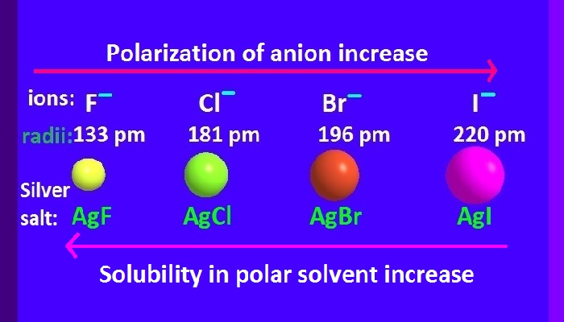
Polarizability Examples
Large, negatively charged ions, such as I⁻ and Br⁻, are highly polarizable.
Small ions with high positive charge, such as Mg²⁺ and Al³⁺ have low polarizability, but they have a high ability to polarize polarizable species, such as I⁻ and Br⁻.

Slide 57
Mean polarizability-the average over the x,y,z axes of the molecule. Polarizabilities in different directions-longitudinal polarizability The direction perpendicular to the bond- Transverse polarizability

Slide 58
The polarizing power and polarizability that enhances the formation of covalent bonds is favoured by the following factors:
Small cation: the high polarizing power stems from the greater concentration of positive charge on a small area. This explains why LiBr is more covalent than KBr (Li+ 90 pm cf. K + 152 pm).

Slide 59
The polarizing power and polarizability that enhances the formation of covalent bonds is favoured by the following factors:
Large anion: the high polarizability stems from the larger size where the outer electrons are more loosely held and can be more easily distorted by the cation. This explains why for the common halides, iodides, are the most covalent in nature (I206 pm).

Slide 60
The polarizing power and polarizability that enhances the formation of covalent bonds is favoured by the following factors:
Large charges: as the charge on an ion increases, the electrostatic attractions of the cation for the outer electrons of the anion increases, resulting in the degree of covalent bond formation increasing.

Slide 61
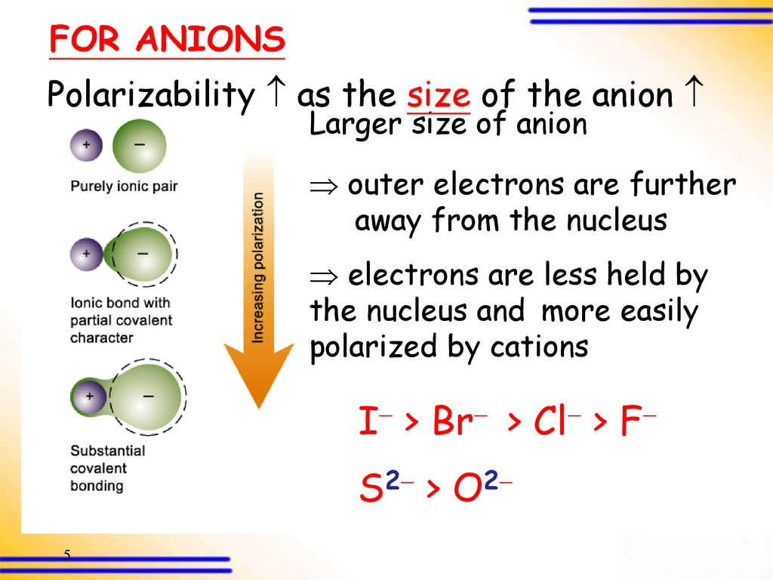

Slide 62
Electronic configuration of the cation: for two cations of the same size and charge, the one with a pseudo noble-gas configuration (with 18 electrons in the outer-most shell) will be more polarizing than that with a noble gas configuration (with 8 electrons in the outermost shell). Thus zinc (II) chloride ( Zn(II) 1s2 2s2 2p6 3s2 3p6 3d10 and Cl1s2 2s2 2p6 3s2 3p6 ) is more covalent than magnesium chloride ( Mg(II) 1s2 2s2 2p6 ) despite the Zn2+ ion (74 pm) and Mg2+ ion (72 pm) having similar sizes and charges.

