Slide 1
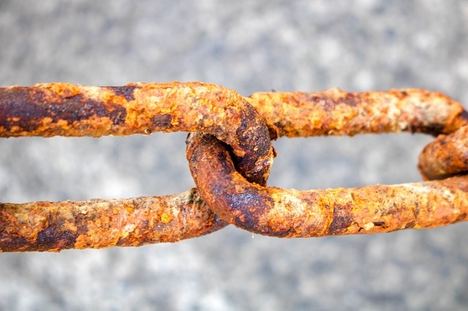
CORROSION

Slide 2
Definition
Corrosion is defined as the spontaneous process of degradation and deterioration of metallic construction in the course of their chemical, biochemical and electrochemical interaction with the environment.
Formation of rust
Fe₂O₃ ·xH₂O
Formation of green film on the Copper surface
[CuCO₃+Cu(OH)₂]

Slide 3
There are 2 types of corrosion
Dry or chemical corrosion.
Galvanic or Electrochemical or Wet corrosion.

Slide 4
Dry or Chemical corrosion
Corrosion on the surface of a metal is due to direct reaction of atmospheric gases like oxygen, halogens, oxides of sulphur, oxides of nitrogen, hydrogen sulphide and fumes of chemicals, with metal. Oxygen is mainly responsible for the corrosion of most metals when compared to other gases and chemicals.

Slide 5
There are three main types of dry corrosion.
1. Oxidation corrosion (Reaction with oxygen)
2. Corrosion by other gases such as H₂, Cl₂ , SO₂ , H₂S, Nox
3. Liquid metal corrosion

Slide 6
Oxidation corrosion (Reaction with oxygen):
Some of the metals directly react with oxygen in the absence of moisture. Alkali and alkaline earth metals react with oxygen at room temperature and form corresponding oxides.
During oxidation of a metal, metal oxide is formed as a thin film on the metallic surface which protects the metal from further corrosion. If diffusion of either oxygen or metal is across this layer, further corrosion is possible. Thus, the layer of metal oxide plays an important role in the process of corrosion.

Slide 7
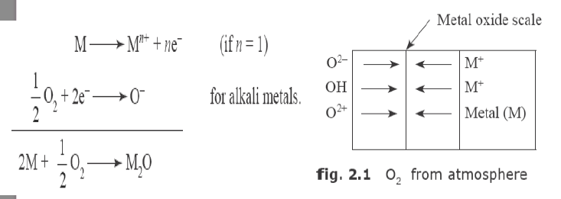

Slide 8
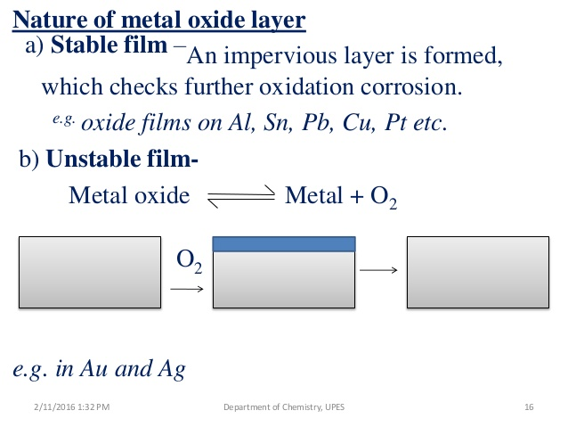

Slide 9
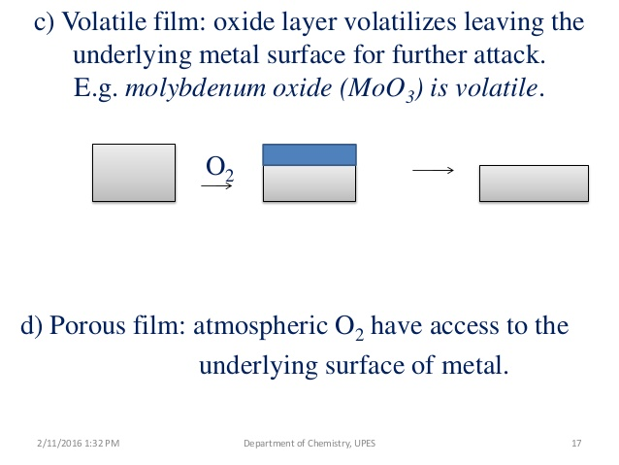
E. g: Oxides of alkali and alkaline earth metals

Slide 10
2:Corrosion by other gases such as Cl₂, SO₂, H₂S, Nox
In dry atmosphere, these gases react with metal and form corrosion products which may be protective or non-protective.
Dry Cl₂ reacts with Ag and forms AgCl which is a protective layer, while SnCl₄ is volatile.

Slide 11
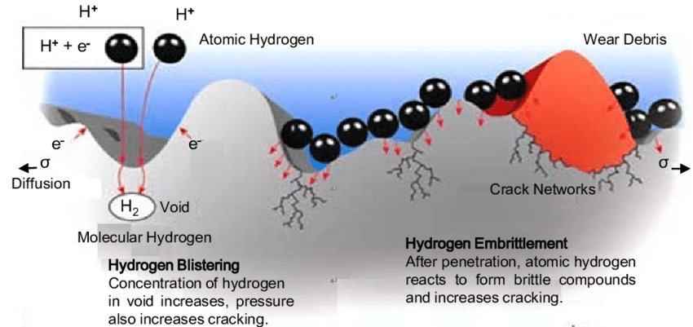
Hydrogen embrittlement

Slide 12
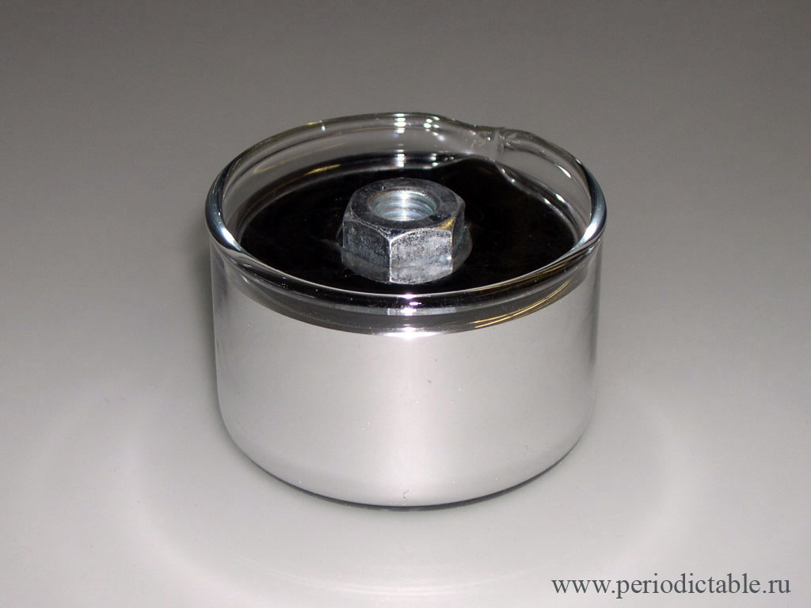
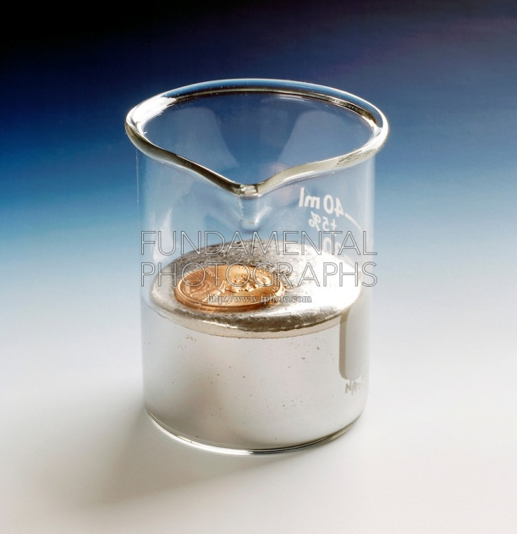
3: Liquid metal corrosion:
In several industries, molten metal passes through metallic pipes and causes corrosion due to dissolution or due to internal penetration. For example, liquid metal mercury dissolves most metals by forming amalgams, thereby corroding them.

Slide 13
Wet or electrochemical corrosion
This type of corrosion occurs when the metal comes in contact with a conducting liquid or when two dissimilar metals are immersed or dipped partly in a solution.
There is the formation of a galvanic cell on the surface of metals. Parts of the metal surface act as anode and rest act as cathode.
The chemical in the environment and humidity acts as an electrolyte. Oxidation of anodic part takes place and it results in corrosion at anode, while reduction takes place at cathode. The corrosion product is formed on the surface of the metal between anode and cathode.

Slide 14
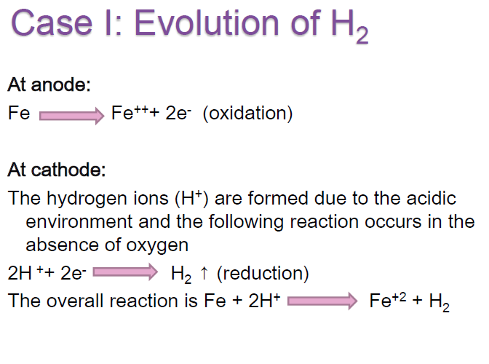

Slide 16
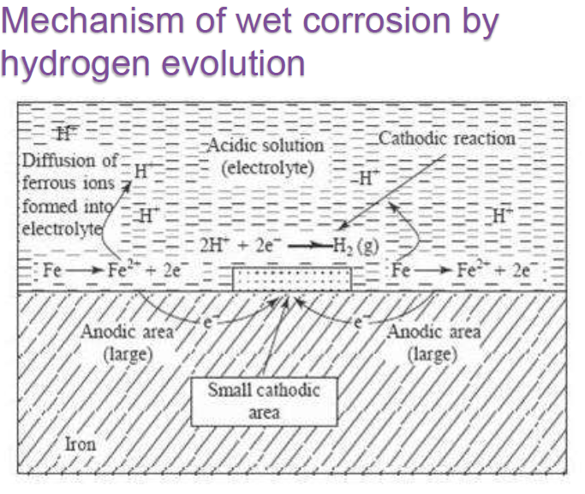

Slide 17
Case II: Absorption of O2
This type of corrosion takes place in neutral or basic medium in the presence of oxygen. The oxide of iron covers the surface of the iron. The small scratch on the surface creates small anodic area and rest of the surface acts as cathodic area

Slide 18
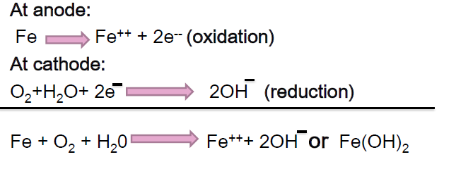

Slide 19
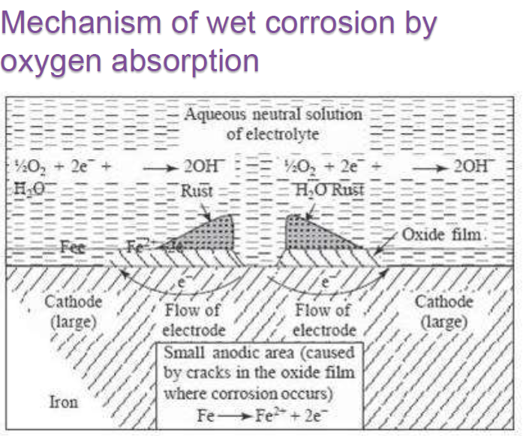

Slide 20
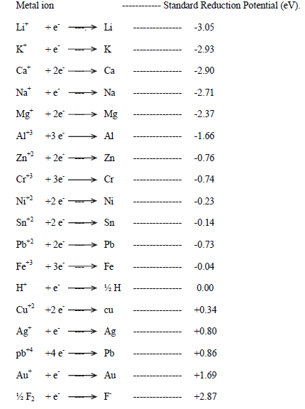
Galvanic series

Slide 21
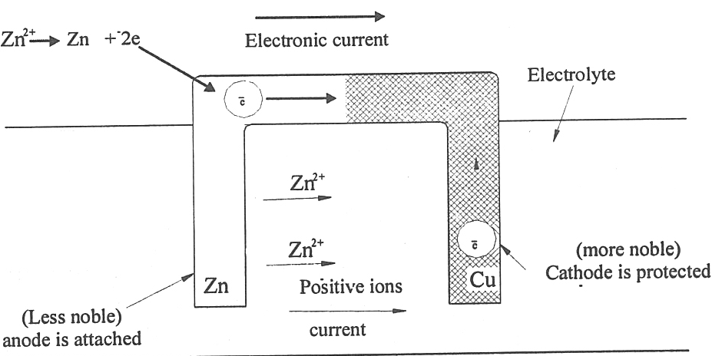
Galvanic corrosion

Slide 22
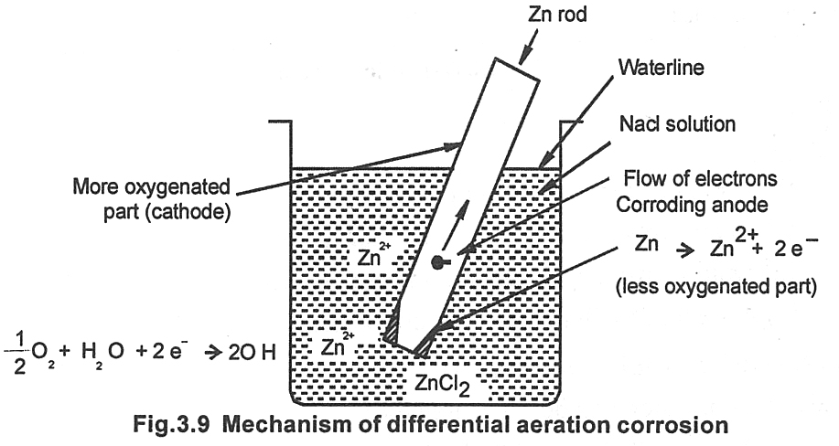
Differential aeration corrrosion

Slide 23
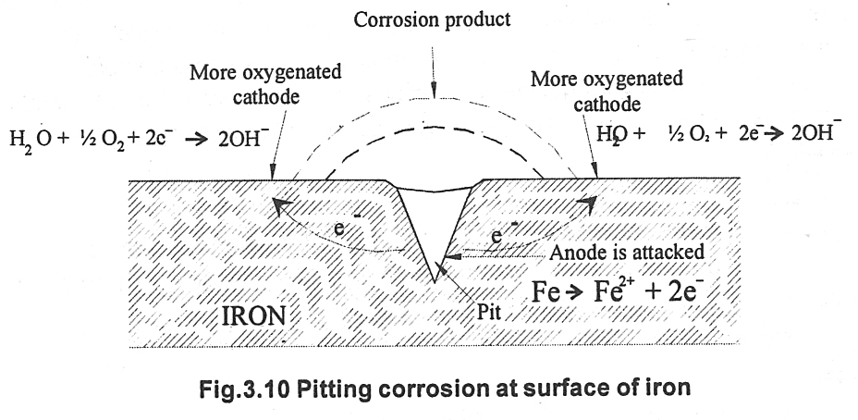
Pitting Corrosion

Slide 24
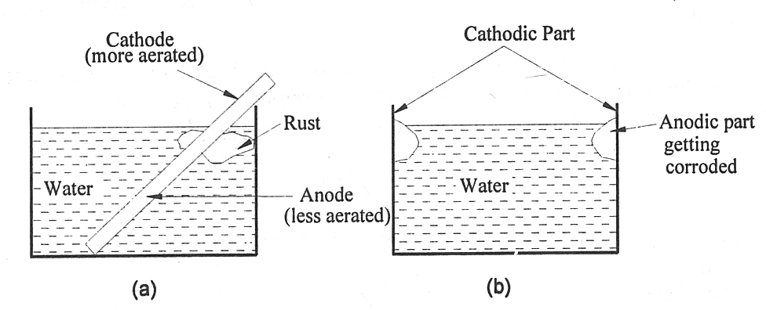
Water line corrosion

Slide 25
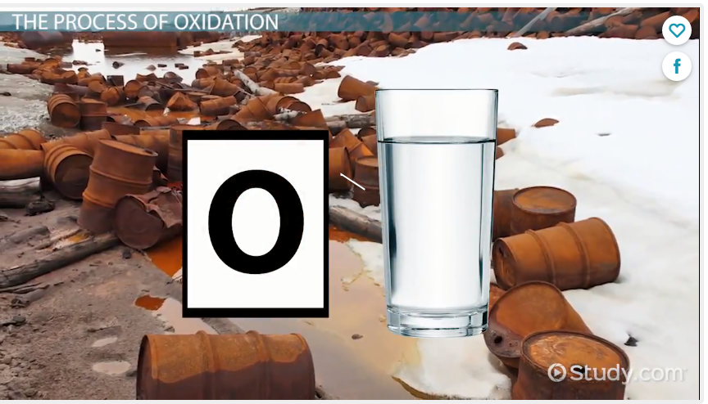

Slide 26
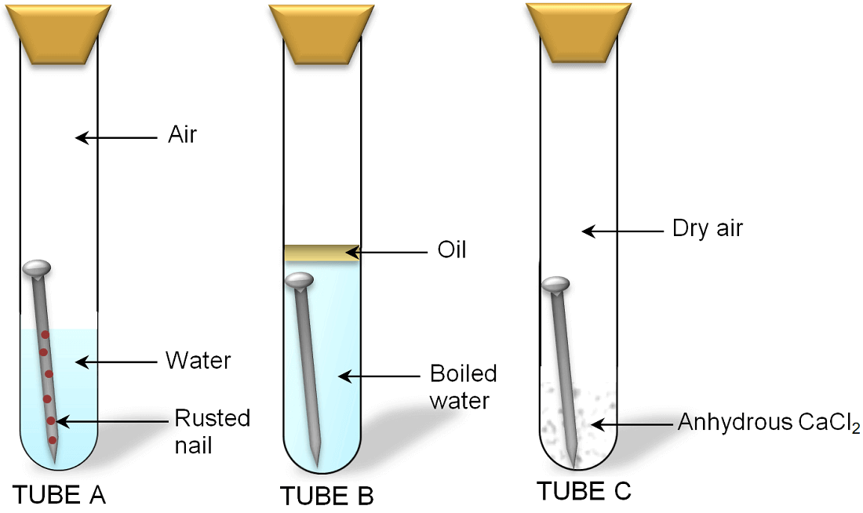

Slide 27
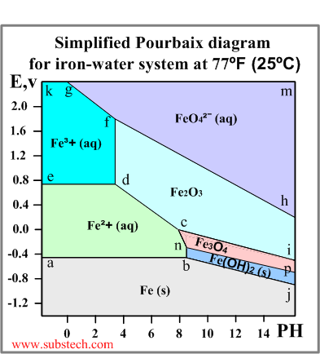
Pourbaix diagrams
Pourbaix diagram (Electrode potential / PH diagram) is a graphical presentation of the thermodynamic equilibrium states of a metal-electrolyte system.
below the line a-b-j: Solid iron (immunity zone). The electrochemical reactions in this zone proceed in the direction of reduction of iron ions. No corrosion occurs in this zone.
a-b-n-c-d-e: Aqueous solution of ion Fe²⁺ (corrosion zone). Metallic iron oxidizes in this zone.
e-d-f-g-k: Aqueous solution of ion Fe³⁺ (corrosion zone). Metallic iron oxidizes (corrodes) in this zone.

Slide 28
h-f-g-m: Aqueous solution of ion FeO₄²⁻ (corrosion zone).
c-d-f-h-i: Solid ferrous oxide Fe₂O₃ (passivation zone). Iron oxidizes (corrodes) in this zone however the resulted oxide film depresses the oxidation process causing passivation (corrosion protection of the metal due to formation of a film of a solid product of the oxidation reaction).
n-c-i-p: Solid oxide Fe₃O₄ (Fe₂O₃*FeO) (passivation zone). The oxide film causes passivation.
b-n-p-j: Solid hydroxide (II) Fe(OH)₂ / FeO*nH2O / green rust (passivation zone).

Slide 29
Application of Pourbaix Diagram for Corrosion Mitigation (or Prevention)
(i) Cathodic Protection
(ii) Anodic Protection
(iii) Environment Modification

