Slide 1

UNIT-4 Prepared by, S.Sridhar, AP/CSE, SRMIST-VDP Campus
18CSC204J / DESIGN AND ANALYSIS OF ALGORITHMS

Slide 2
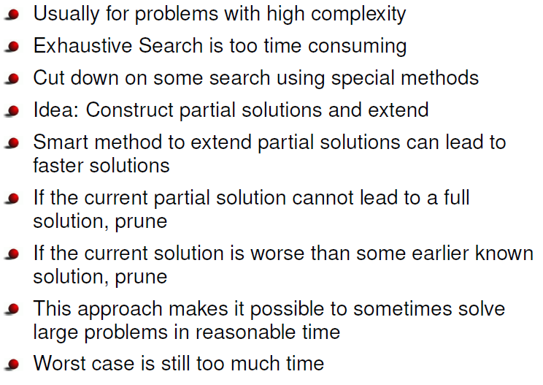
Backtracking and Branch- and- Bound

Slide 3
Difference between backtracking & Branch and Bound
Backtracking
[1] It is used to find all possible solutions available to the problem. [2] It traverse tree by DFS(Depth First Search). [3] It realizes that it has made a bad choice & undoes the last choice by backing up. [4] It search the state space tree until it found a solution. [5] It involves feasibility function.
. Branch-and-Bound (BB)
[1] It is used to solve optimization problem. [2] It may traverse the tree in any manner, DFS or BFS. [3] It realizes that it already has a better optimal solution that the pre-solution leads to so it abandons that pre-solution. [4] It completely searches the state space tree to get optimal solution. [5] It involves bounding function

Slide 4
Backtracking Method
A given problem has a set of constraints and possibly an objective function
The solution optimizes an objective function, and/or is feasible.
We can represent the solution space for the problem using a state space tree
The root of the tree represents 0 choices,
Nodes at depth 1 represent first choice
Nodes at depth 2 represent the second choice, etc.
In this tree a path from a root to a leaf represents a candidate solution
Note:
The backtracking algorithm has the ability to yield the same answer as brute force algorithm with far fewer than m-trials.

Slide 5
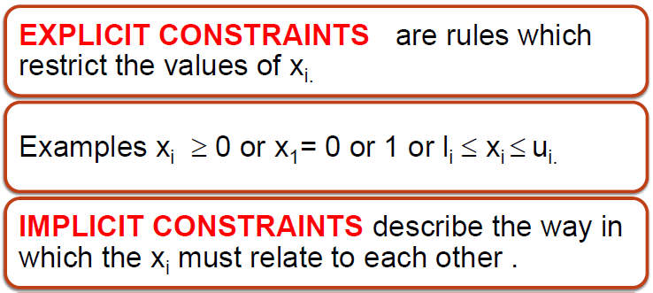
Backtracking Terminology
For E.g In 0/1 Knapsack Problem the explicit constraints refer to the placement of item in sack and should be either 0 or 1 (i.e) X_{i} =0 or 1 where i represents the Item number
Implicit constraints represents that placement of items should not exceed the sack capacity

Slide 6
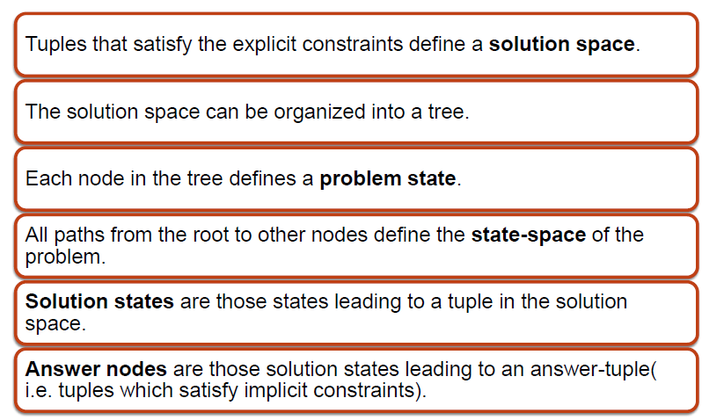
Backtracking Terminology

Slide 7
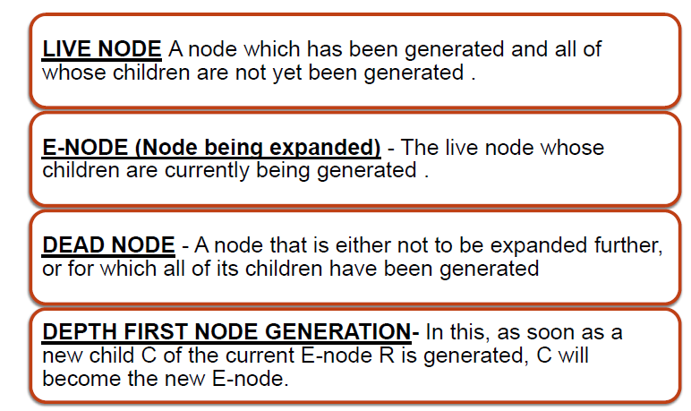
Backtracking Terminology

Slide 8
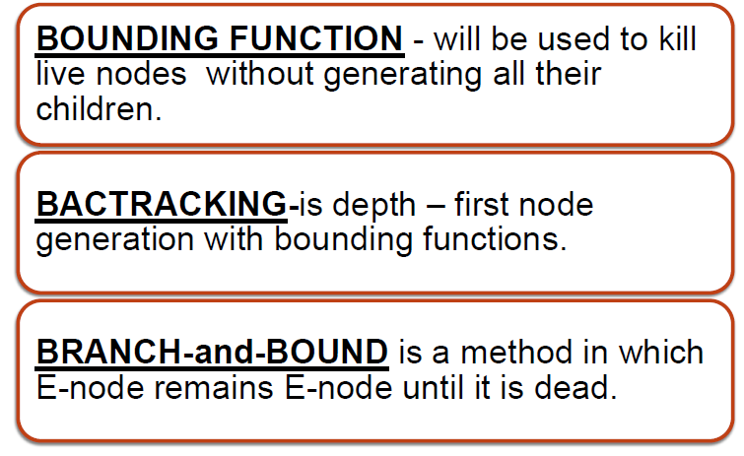
Backtracking Terminology

Slide 9
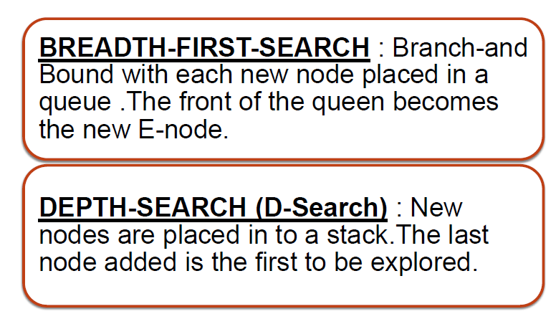
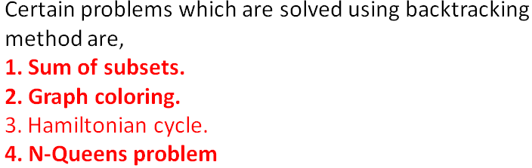
Backtracking Terminology
For Video Lecture : https://tinyurl.com/yb5deykj

Slide 10
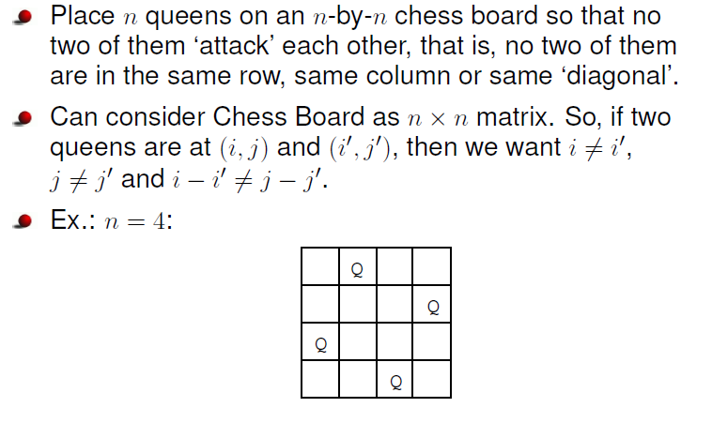
N-Queens problem

Slide 11
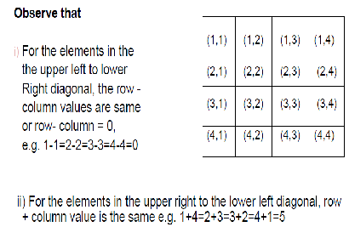
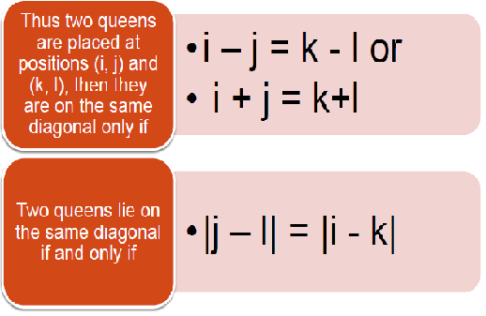
The conditions to test whether two queens are on the same diagonal

Slide 12
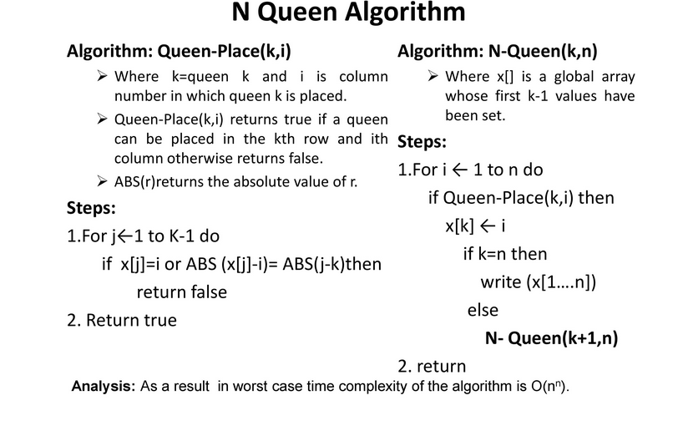
For Video Lecture : https://tinyurl.com/tarrx2v

Slide 13
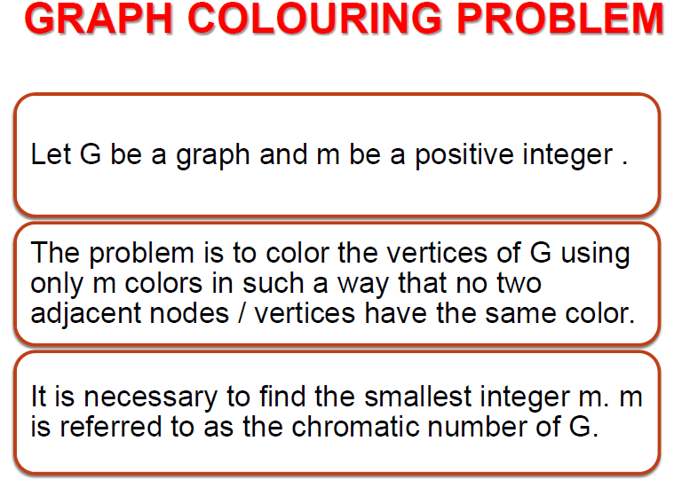

Slide 14
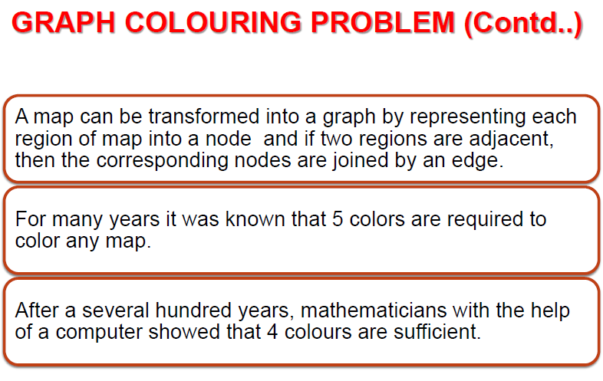

Slide 15
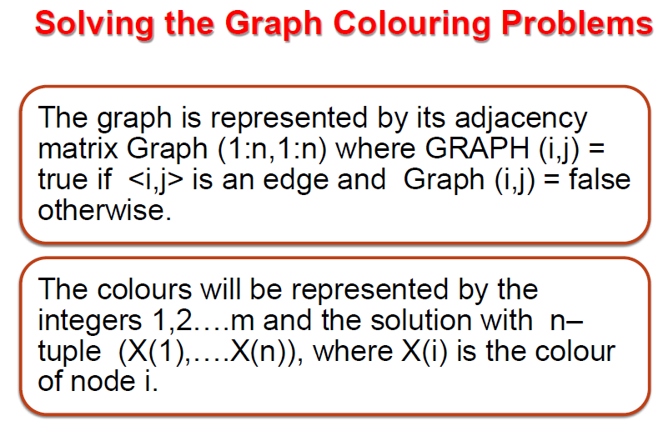

Slide 16
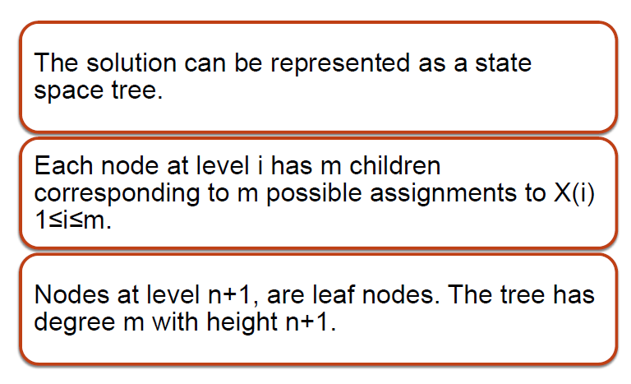

Slide 17
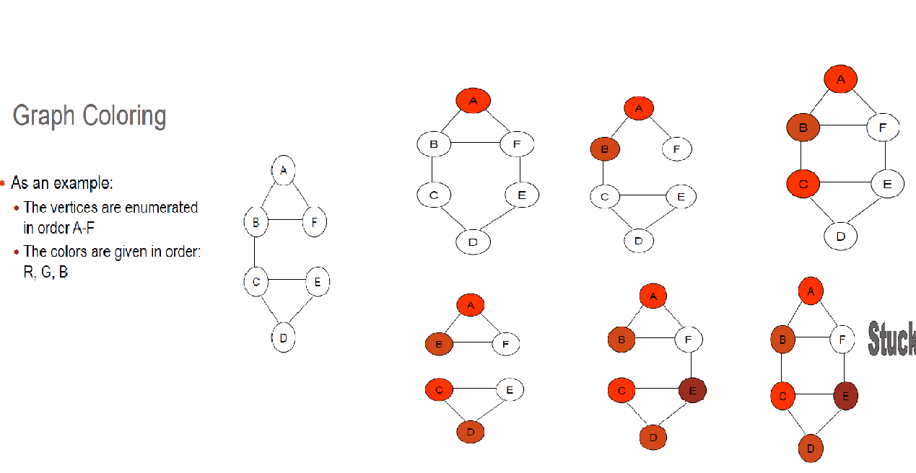

Slide 18
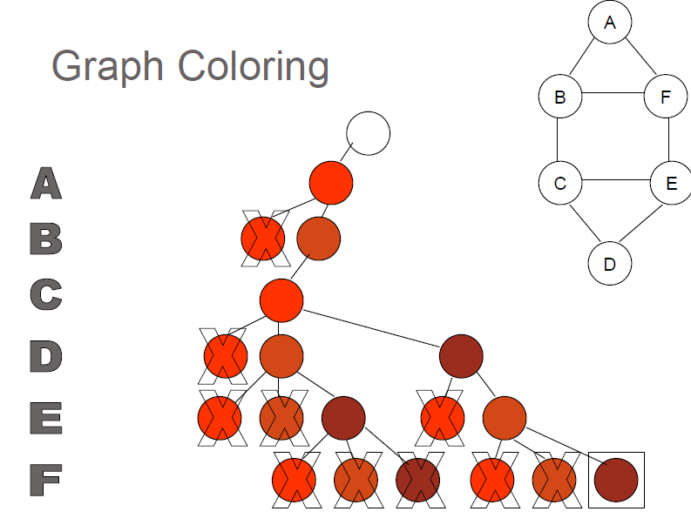
STATE SPACE TREE
X1 =1
X2 =2
X3 =1
X4 =3
X5=2
X6 =3
X1,x2,x3,….x6 are nodes in Graph and 1,2,3 represents color

Slide 19
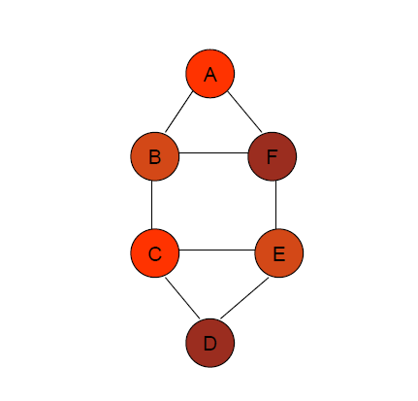
Solution
Time Complexity = O(nm^{n} ) //where n=no. of vertex, m=no. of color used
For Video Lecture : https://tinyurl.com/twwt3je

Slide 20
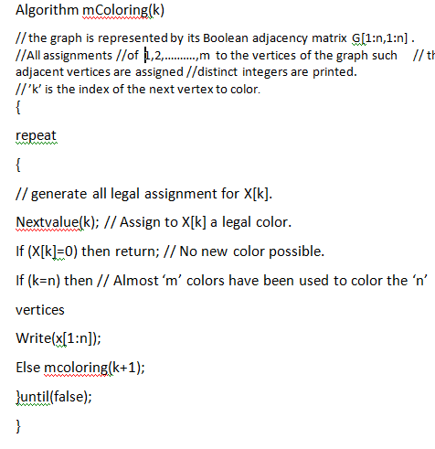

Slide 21
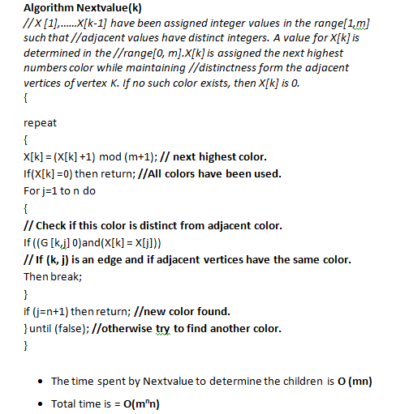

Slide 22
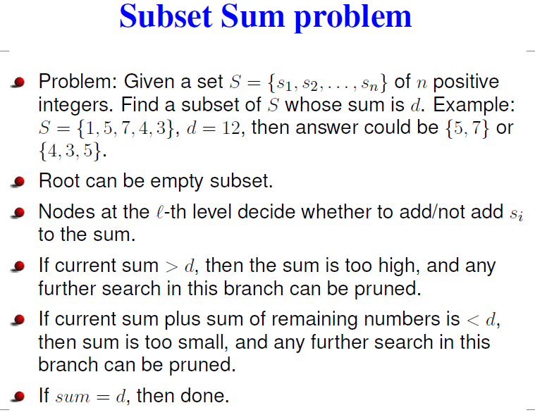
For Video Lecture : https://tinyurl.com/wx2gplu

Slide 23
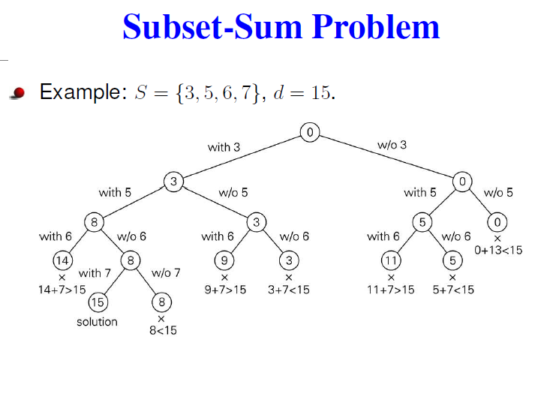

Slide 24
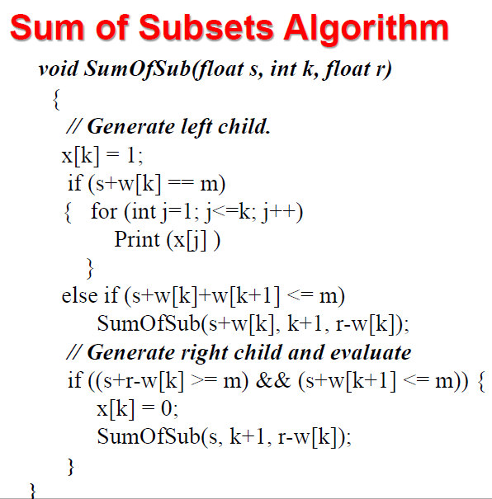
Time Complexity = O (2^{n})

Slide 25
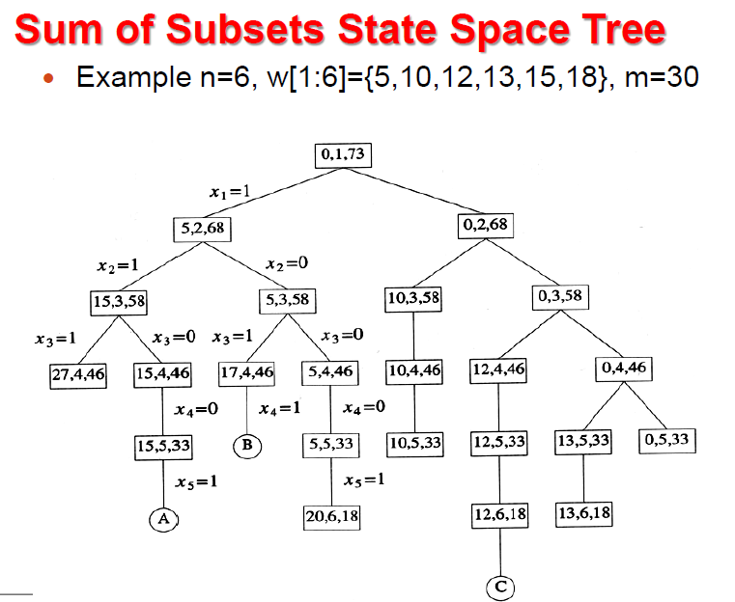

Slide 26
Hamiltonian Cycle
A Hamiltonian graph is the directed or undirected graph containing a Hamiltonian cycle.
The Hamiltonian cycle is the cycle that traverses all the vertices of the given graph G exactly once and then ends at the starting vertex.
The input for the Hamiltonian graph problem can be the directed or undirected graph. The Hamiltonian problem involves checking if the Hamiltonian cycle is present in a graph G or not

Slide 27
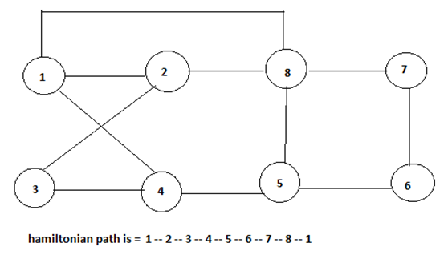
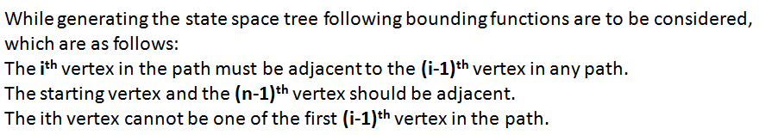
The following graph illustrates the presence of the Hamiltonian cycle in a graph G.
It will take (n-1)! Steps to find the solution roughly equals n! and we can say n!= O (n^{n})
So, Time Complexity = O (n^{n})

Slide 28
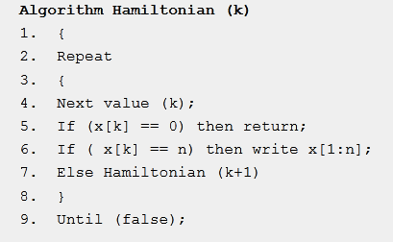
For Video Lecture : https://tinyurl.com/u3xttbo

Slide 29
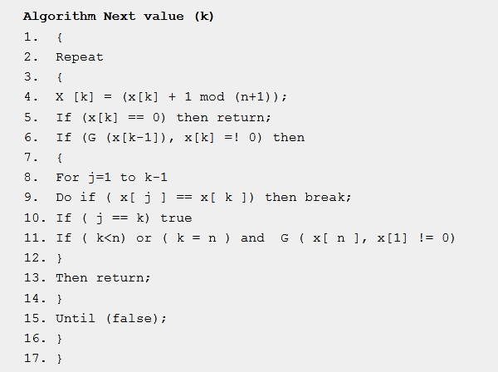

Slide 30
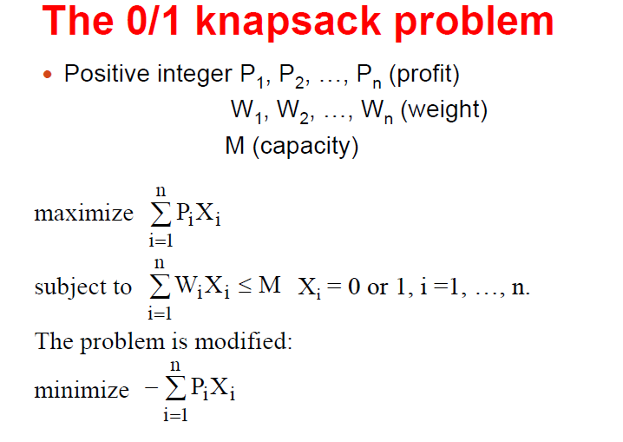
0/1 knapsack problem using Branch and Bound

Slide 31
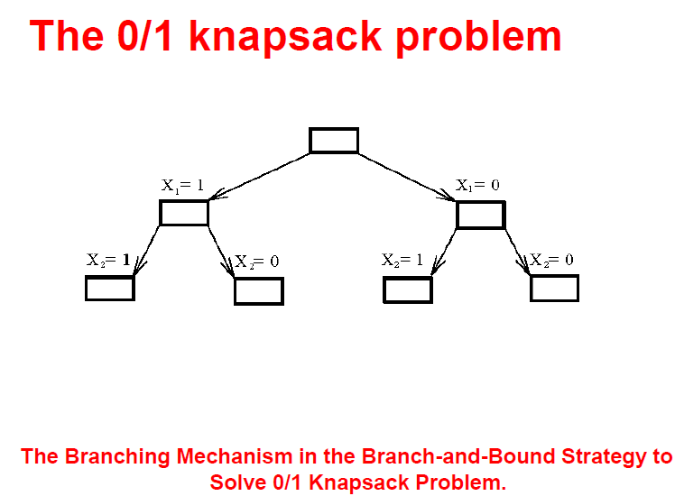

Slide 32
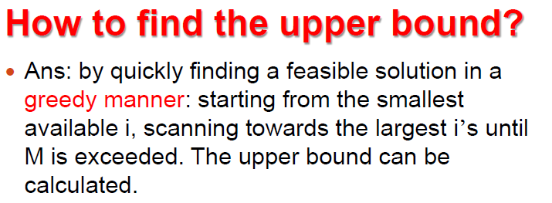
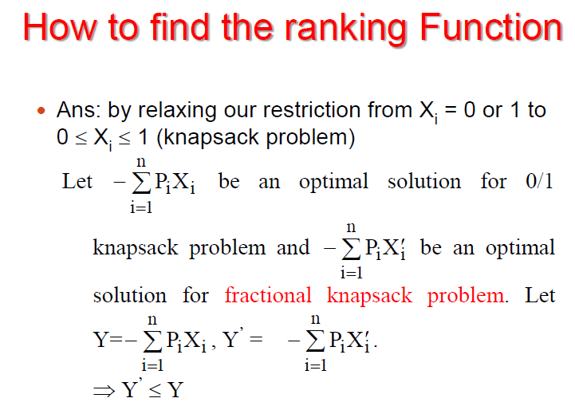

Slide 33
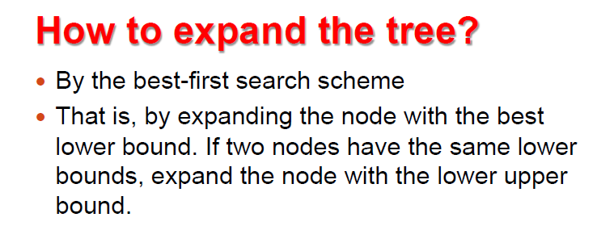
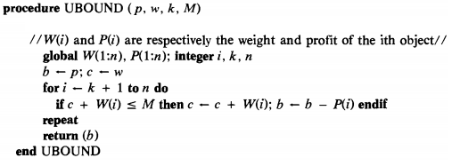

Slide 34
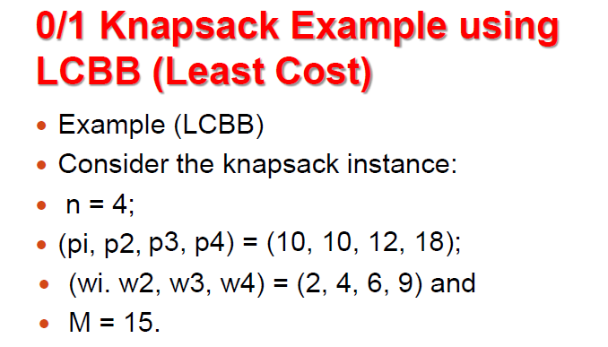
For Video Lecture : https://tinyurl.com/qmbmcfz

Slide 35
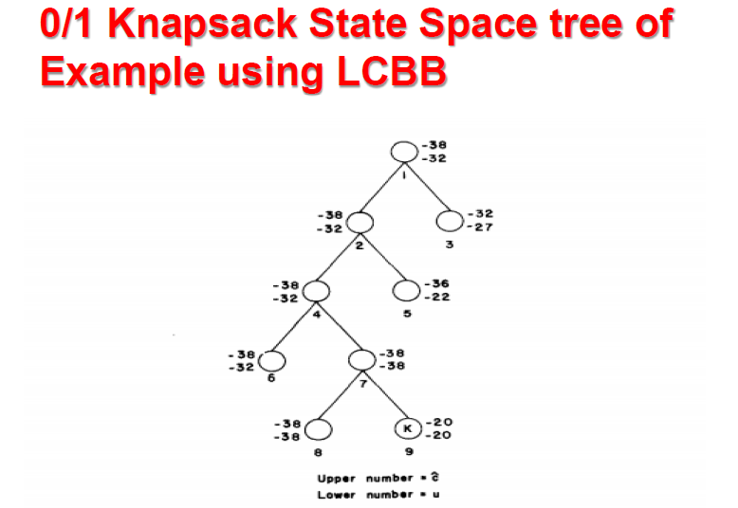
Time Complexity = O (2^{n})

Slide 36
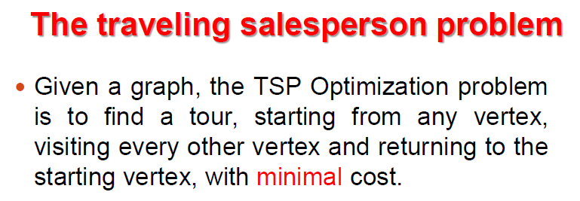
Traveling Salesman problem (TSP) using Branch and Bound
Time Complexity = O(n²2^{n}) using Dynamic Programming algorithms.
The worst case of branch and bound algorithms will not be better than O(n²2^{n}) .
But use of good bound functions enables branch and bound
algorithms to solve same problem in much less time than required by Dynamic Programming algorithms.

Slide 37
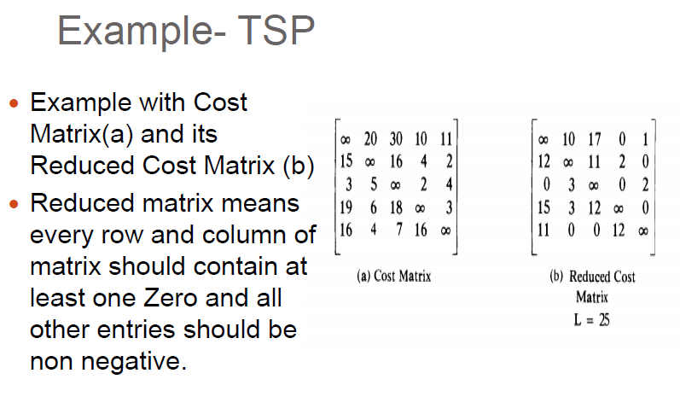
For Video Lecture : https://tinyurl.com/u4yteyf

Slide 38
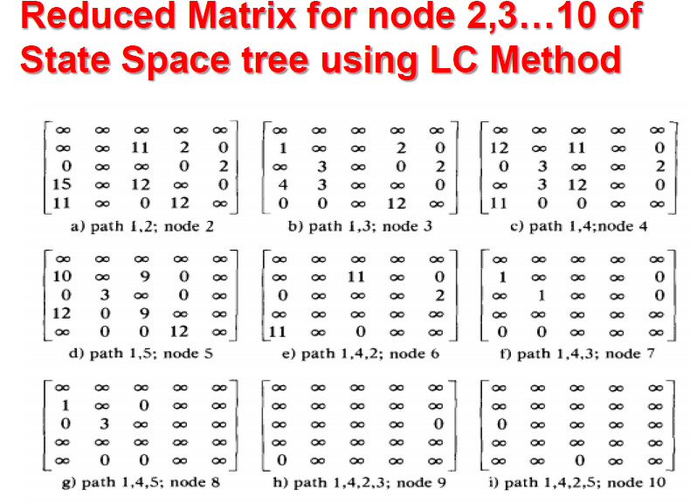

Slide 39
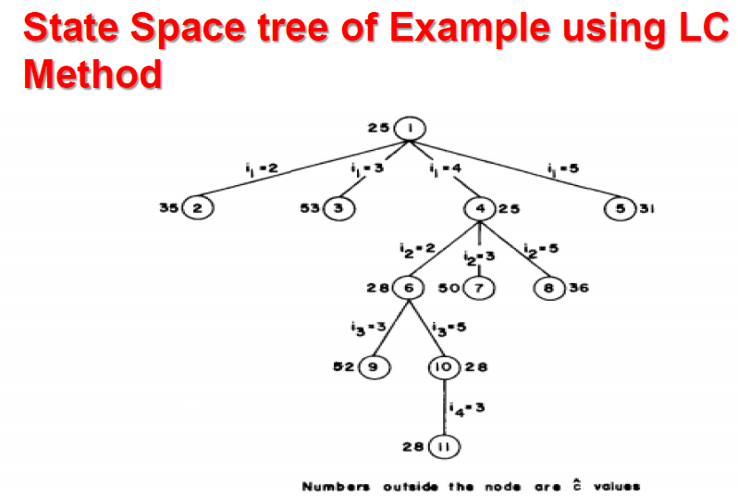

Slide 40
A COMPARISON
A Greedy approach is to pick the items in decreasing order of value per unit weight. The Greedy approach works only for fractional knapsack problem and may not produce correct result for 0/1 knapsack.
We can use Dynamic Programming (DP) for 0/1 Knapsack problem. In DP, we use a 2D table of size n x W. The DP Solution doesn’t work if item weights are not integers.
Since DP solution doesn’t alway work, a solution is to use Brute Force. With n items, there are 2^{n} solutions to be generated, check each to see if they satisfy the constraint, save maximum solution that satisfies constraint. This solution can be expressed as tree.
We can use Backtracking to optimize the Brute Force solution. In the tree representation, we can do DFS of tree. If we reach a point where a solution no longer is feasible, there is no need to continue exploring.

Slide 41
Shortest Path Algorithm
The shortest path problem is about finding a path between 2 vertices in a graph such that the total sum of the edges weights is minimum.
This problem could be solved easily using (BFS) if all edge weights were 1), but in practical applications weights can take any value.

Slide 42
Floyd–Warshall's Algorithm
Floyd–Warshall's Algorithm is used to find the shortest paths between all pairs of vertices in a graph, where each edge in the graph has a weight which is positive or negative. The biggest advantage of using this algorithm is that all the shortest distances between any 2 vertices could be calculated in O(V ^ 3) , where V is the number of vertices in a graph.

Slide 43
The Algorithm Steps:
For a graph with N vertices:
Initialize the shortest paths between any 2 vertices with Infinity.
Find all pair shortest paths that use 0 intermediate vertices, then find the shortest paths that use 1 intermediate vertex and so on.. until using all N vertices as intermediate nodes.
Minimize the shortest paths between any 2 pairs in the previous operation.
For any 2 vertices (i , j) , one should actually minimize the distances between this pair using the first K nodes, so the shortest path will be:
min (dist[i][k] + dist[k][j] , dist[i][j]) .

Slide 44
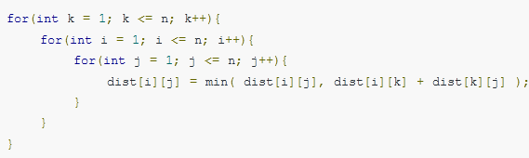
dist[i][k] represents the shortest path that only uses the first K vertices, dist[k][j] represents the shortest path between the pair k, j . As the shortest path will be a concatenation of the shortest path from i to k , then from k to j .
Time Complexity of Floyd–Warshall's Algorithm is O(V ^ 3) , where V is the number of vertices in a graph.

Slide 45
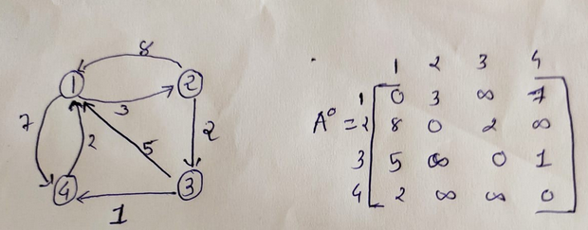
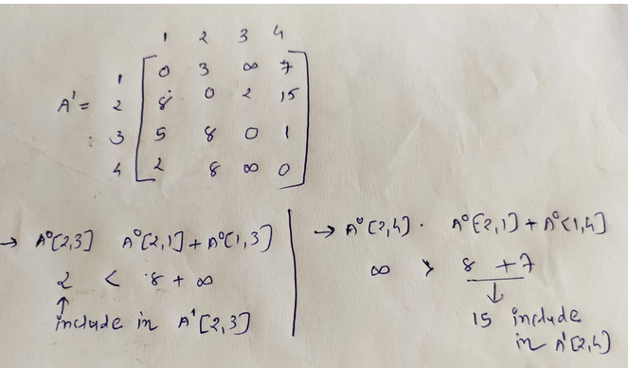

Slide 46
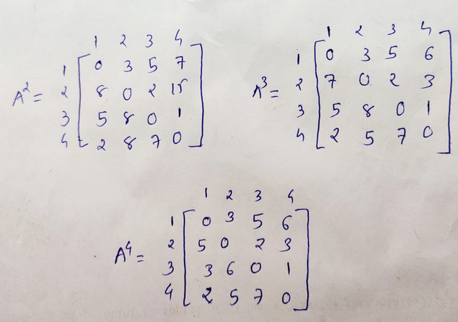
For Video Lecture : https://tinyurl.com/vsp4ulb
After including Second, Third and Four node one by one we get final matrix A⁴ which show possible minimum distance between any two nodes.

Slide 47
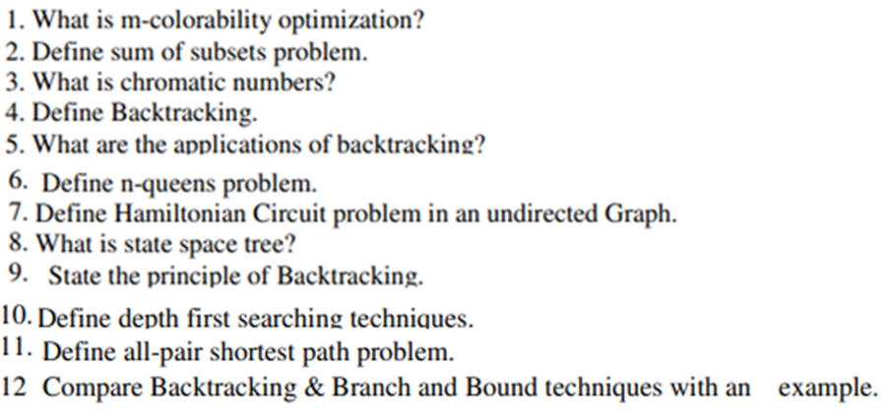
Question Bank

Slide 48
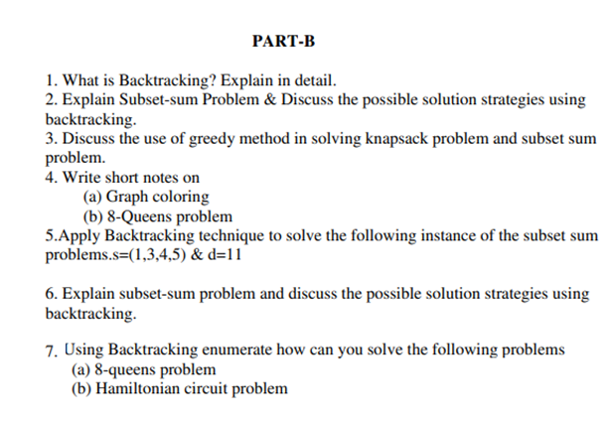

Slide 49
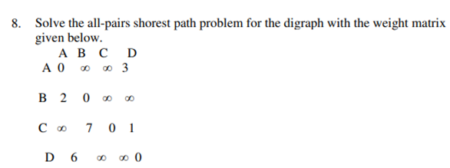
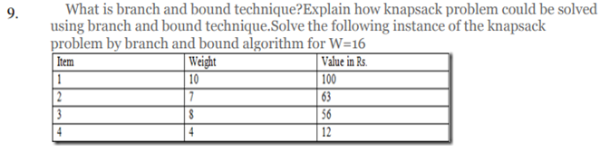

Slide 50
