Slide 1




SRM
INSTITUTE OF SCIENCE AND TECHNOLOGY,
CHENNAI.
18CSC205J-Operating Systems
Unit- V

Slide 2

SRM
INSTITUTE OF SCIENCE AND TECHNOLOGY,
CHENNAI.
UNIT V SYLLABUS
Mass storage structure-Overview of Mass storage structure-Magnetic Disks
Disk Scheduling-File System Interface-File Sharing and Protection-File System Implementation-File Structure

Slide 3
SRM
INSTITUTE OF SCIENCE AND TECHNOLOGY,
CHENNAI.
Contents:
1.Mass storage
-Overview of Mass storage structure
-Magnetic Disks
2. Disk Scheduling

Slide 4
SRM
INSTITUTE OF SCIENCE AND TECHNOLOGY,
CHENNAI.
OVERVIEW OF MASS STORAGE STRUCTURE
Magnetic disks provide bulk of secondary storage of modern computers Drives rotate at 60 to 250 times per second
Transfer rate is rate at which data flow between drive and computer
Positioning time (random-access time) is time to move disk arm to desired cylinder (seek time) and time for desired sector to rotate under the disk head (rotational latency)
Head crash results from disk head making contact with the disk surface -- That’s bad
Disks can be removable
Drive attached to computer via I/O bus
Busses vary, including EIDE, ATA, SATA, USB, Fibre Channel, SCSI, SAS, Firewire
Host controller in computer uses bus to talk to disk controller built into drive or storage array

Slide 5
Moving-head Disk Mechanism
SRM INSTITUTE OF SCIENCE AND TECHNOLOGY,
CHENNAI.

Slide 6
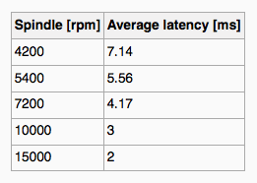
Hard Disks
SRM INSTITUTE OF SCIENCE AND TECHNOLOGY,
CHENNAI.
Platters range from .85” to 14” (historically)
Commonly 3.5”, 2.5”, and 1.8”
Range from 30GB to 3TB per drive
Performance
Transfer Rate – theoretical – 6 Gb/sec
Effective Transfer Rate – real – 1Gb/sec
Seek time from 3ms to 12ms – 9ms common for desktop drives
Average seek time measured or calculated based on 1/3 of tracks
Latency based on spindle speed
1 / (RPM / 60) = 60 / RPM
Average latency = ½ latency
(From Wikipedia)

Slide 7
Hard Disk Performance
SRM INSTITUTE OF SCIENCE AND TECHNOLOGY,
CHENNAI.
Access Latency = Average access time = average seek time + average latency
For fastest disk 3ms + 2ms = 5ms
For slow disk 9ms + 5.56ms = 14.56ms
Average I/O time = average access time + (amount to transfer / transfer rate) + controller overhead
For example to transfer a 4KB block on a 7200 RPM disk with a 5ms average seek time, 1Gb/sec transfer rate with a .1ms controller overhead =
5ms + 4.17ms + 0.1ms + transfer time =
Transfer time = 4KB / 1Gb/s * 8Gb / GB * 1GB / 1024²KB = 32 / (1024²) = 0.031 ms
Average I/O time for 4KB block = 9.27ms + .031ms = 9.301ms

Slide 8
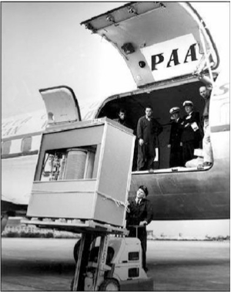
The First Commercial Disk Drive
SRM INSTITUTE OF SCIENCE AND TECHNOLOGY,
CHENNAI.
1956
IBM RAMDAC computer included the IBM Model 350 disk storage system
5M (7 bit) characters
50 x 24” platters
Access time = < 1 second

Slide 9
Solid-State Disks
SRM INSTITUTE OF SCIENCE AND TECHNOLOGY,
CHENNAI.
Nonvolatile memory used like a hard drive
Many technology variations
Can be more reliable than HDDs
More expensive per MB
Maybe have shorter life span
Less capacity
But much faster
Busses can be too slow -> connect directly to PCI for example
No moving parts, so no seek time or rotational latency

Slide 10
Magnetic Tape
SRM INSTITUTE OF SCIENCE AND TECHNOLOGY,
CHENNAI.
Was early secondary-storage medium
Evolved from open spools to cartridges
Relatively permanent and holds large quantities of data
Access time slow
Random access ~1000 times slower than disk
Mainly used for backup, storage of infrequently-used data, transfer medium between systems
Kept in spool and wound or rewound past read-write head
Once data under head, transfer rates comparable to disk
140MB/sec and greater
200GB to 1.5TB typical storage
Common technologies are LTO-{3,4,5} and T10000

Slide 11
Disk Structure
SRM INSTITUTE OF SCIENCE AND TECHNOLOGY,
CHENNAI.
Disk drives are addressed as large 1-dimensional arrays of logical blocks, where the logical block is the smallest unit of transfer
Low-level formatting creates logical blocks on physical media
The 1-dimensional array of logical blocks is mapped into the sectors of the disk sequentially
Sector 0 is the first sector of the first track on the outermost cylinder
Mapping proceeds in order through that track, then the rest of the tracks in that cylinder, and then through the rest of the cylinders from outermost to innermost
Logical to physical address should be easy
Except for bad sectors
Non-constant # of sectors per track via constant angular velocity

Slide 12
Disk Attachment
SRM INSTITUTE OF SCIENCE AND TECHNOLOGY,
CHENNAI.
Host-attached storage accessed through I/O ports talking to I/O busses
SCSI itself is a bus, up to 16 devices on one cable, SCSI initiator requests operation and SCSI targets perform tasks
Each target can have up to 8 logical units (disks attached to device controller)
FC is high-speed serial architecture
Can be switched fabric with 24-bit address space – the basis of storage area networks (SANs) in which many hosts attach to many storage units
I/O directed to bus ID, device ID, logical unit (LUN)

Slide 13
Storage Array
SRM INSTITUTE OF SCIENCE AND TECHNOLOGY,
CHENNAI.
Can just attach disks, or arrays of disks
Storage Array has controller(s), provides features to attached host(s)
Ports to connect hosts to array
Memory, controlling software (sometimes NVRAM, etc)
A few to thousands of disks
RAID, hot spares, hot swap (discussed later)
Shared storage -> more efficiency
Features found in some file systems
Snaphots, clones, thin provisioning, replication, deduplication, etc

Slide 14
Storage Area Network
SRM INSTITUTE OF SCIENCE AND TECHNOLOGY,
CHENNAI.
Common in large storage environments
Multiple hosts attached to multiple storage arrays - flexible

Slide 15
Storage Area Network (Cont.)
SRM INSTITUTE OF SCIENCE AND TECHNOLOGY,
CHENNAI.
SAN is one or more storage arrays
Connected to one or more Fibre Channel switches
Hosts also attach to the switches
Storage made available via LUN Masking from specific arrays to specific servers
Easy to add or remove storage, add new host and allocate it storage
Over low-latency Fibre Channel fabric
Why have separate storage networks and communications networks?
Consider iSCSI, FCOE

Slide 16
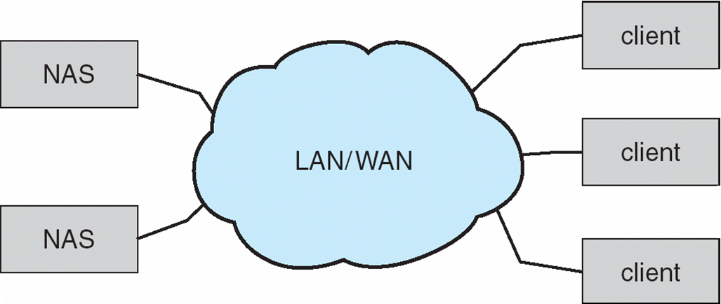
Network-Attached Storage
SRM INSTITUTE OF SCIENCE AND TECHNOLOGY,
CHENNAI.
Network-attached storage (NAS) is storage made available over a network rather than over a local connection (such as a bus)
Remotely attaching to file systems
NFS and CIFS are common protocols
Implemented via remote procedure calls (RPCs) between host and storage over typically TCP or UDP on IP network
iSCSI protocol uses IP network to carry the SCSI protocol
Remotely attaching to devices (blocks)

Slide 17
Disk Scheduling
SRM INSTITUTE OF SCIENCE AND TECHNOLOGY,
CHENNAI.
The operating system is responsible for using hardware efficiently — for the disk drives, this means having a fast access time and disk bandwidth
Minimize seek time
Seek time ≈ seek distance
Disk bandwidth is the total number of bytes transferred, divided by the total time between the first request for service and the completion of the last transfer

Slide 18
Disk Scheduling(Contd..)
SRM INSTITUTE OF SCIENCE AND TECHNOLOGY,
CHENNAI.
There are many sources of disk I/O request
OS
System processes
Users processes
I/O request includes input or output mode, disk address, memory address, number of sectors to transfer
OS maintains queue of requests, per disk or device
Idle disk can immediately work on I/O request, busy disk means work must queue
Optimization algorithms only make sense when a queue exists

Slide 19
Disk Scheduling(Contd..)
SRM INSTITUTE OF SCIENCE AND TECHNOLOGY,
CHENNAI.
Note that drive controllers have small buffers and can manage a queue of I/O requests (of varying “depth”)
Several algorithms exist to schedule the servicing of disk I/O requests
The analysis is true for one or many platters
We illustrate scheduling algorithms with a request queue (0-199)
98, 183, 37, 122, 14, 124, 65, 67
Head pointer 53

Slide 20
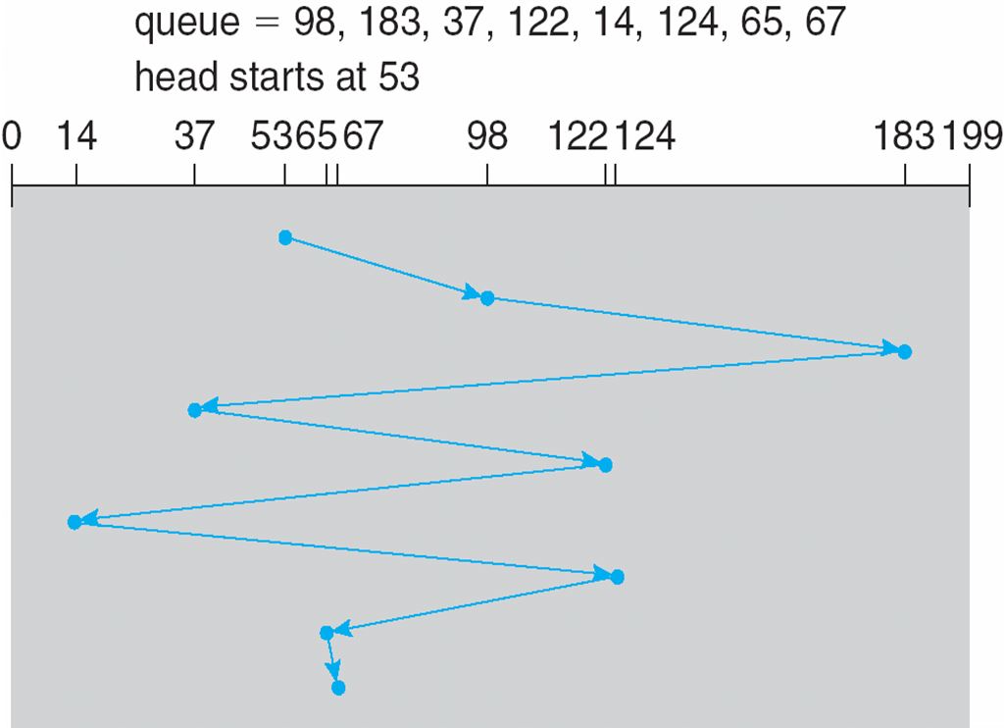
FCFS
SRM INSTITUTE OF SCIENCE AND TECHNOLOGY,
CHENNAI.
Illustration shows total head movement of 640 cylinders

Slide 21
C SCAN
SRM INSTITUTE OF SCIENCE AND TECHNOLOGY,
CHENNAI.
Provides a more uniform wait time than SCAN
The head moves from one end of the disk to the other, servicing requests as it goes
When it reaches the other end, however, it immediately returns to the beginning of the disk, without servicing any requests on the return trip
Treats the cylinders as a circular list that wraps around from the last cylinder to the first one
Total number of cylinders?

Slide 22
C LOOK
SRM INSTITUTE OF SCIENCE AND TECHNOLOGY,
CHENNAI.
LOOK a version of SCAN, C-LOOK a version of C-SCAN
Arm only goes as far as the last request in each direction, then reverses direction immediately, without first going all the way to the end of the disk
Total number of cylinders?

Slide 23
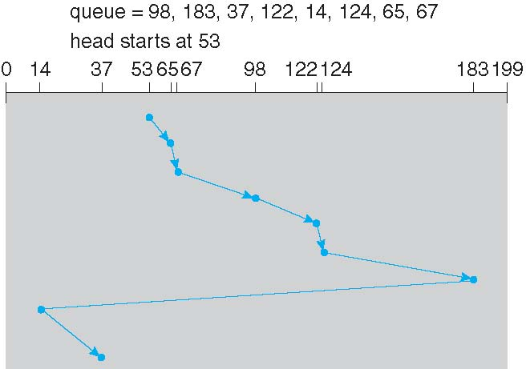
C LOOK(Contd..)
SRM INSTITUTE OF SCIENCE AND TECHNOLOGY,
CHENNAI.

Slide 24
Selecting a Disk-Scheduling Algorithm
SRM INSTITUTE OF SCIENCE AND TECHNOLOGY,
CHENNAI.
SSTF is common and has a natural appeal
SCAN and C-SCAN perform better for systems that place a heavy load on the disk
Less starvation
Performance depends on the number and types of requests
Requests for disk service can be influenced by the file-allocation method
And metadata layout
The disk-scheduling algorithm should be written as a separate module of the operating system, allowing it to be replaced with a different algorithm if necessary
Either SSTF or LOOK is a reasonable choice for the default algorithm
What about rotational latency?
Difficult for OS to calculate
How does disk-based queueing effect OS queue ordering efforts?

Slide 25
Contents:
File Concept
Access Methods
Disk and Directory Structure
File-System Mounting
File Sharing
Protection

Slide 26
FILE CONCEPT:
Contiguous logical address space
Types:
Data
numeric
character
binary
Program
Contents defined by file’s creator
Many types
Consider text file, source file, executable file

Slide 27
File Structure:
None -sequence of words, bytes
Simple record structure
Lines
Fixed length
Variable length
Complex Structures
Formatted document
Relocatable load file
Can simulate last two with first method by inserting appropriate control characters
Who decides:
Operating system
Program

Slide 28
File Attributes:
Name–only information kept in human-readable form
Identifier–unique tag (number) identifies file within file system
Type–needed for systems that support different types
Location–pointer to file location on device
Size–current file size
Protection–controls who can do reading, writing, executing
Time, date, and user identification–data for protection, security, and usage monitoring
Information about files are kept in the directory structure, which is maintained on the disk
Many variations, including extended file attributes such as file checksum
Information kept in the directory structure

Slide 29
File Operations:
File is an abstract data type
Create
Write –atwrite pointer location
Read –atread pointer location
Reposition within file -seek
Delete
Truncate
Open(Fi)–search the directory structure on disk for entry Fi, and move the content of entry to memory
Close (Fi)–move the content of entry Fi in memory to directory structure on disk

Slide 30
Open Files:
Several pieces of data are needed to manage open files:
Open-file table: tracks open files
File pointer: pointer to last read/write location, per process that has the file open
File-open count: counter of number of times a file is open –to allow removal of data from open-file table when last processes closes it
Disk location of the file: cache of data access information
Access rights: per-process access mode information

Slide 31
Open File Locking:
Provided by some operating systems and file systems
Similar to reader-writer locks
Sharedlocksimilar to reader lock –several processes can acquire concurrently
Exclusive lock similar to writer lock
Mediates access to a file
Mandatory or advisory:
Mandatory–access is denied depending on locks held and requested
Advisory–processes can find status of locks and decide what to do

Slide 32
File Locking Example –Java API:
import java.io.*;
import java.nio.channels.*;
public class LockingExample {
public static final boolean EXCLUSIVE = false;
public static final boolean SHARED = true;
public static void main(String arsg[]) throws IOException {
FileLock sharedLock = null;
FileLock exclusiveLock = null;
try {
RandomAccessFile raf = new RandomAccessFile("file.txt", "rw");
// get the channel for the file
FileChannel ch = raf.getChannel();
// this locks the first half of the file -exclusive
exclusiveLock = ch.lock(0, raf.length()/2, EXCLUSIVE);
/** Now modify the data . . . */
// release the lock
exclusiveLock.release();

Slide 33
continue
this locks the second half of the file -shared
sharedLock = ch.lock(raf.length()/2+1, raf.length(), SHARED);
/** Now read the data . . . */
// release the lock
sharedLock.release();
}catch (java.io.IOException ioe) {
System.err.println(ioe);
}finally {
if (exclusiveLock != null)
exclusiveLock.release();
if (sharedLock != null)
sharedLock.release();
}
}
}

Slide 34
File Types –Name, Extension:

Slide 35
File Structure:
None -sequence of words, bytes
Simple record structure
Lines
Fixed length
Variable length
Complex Structures
Formatted document
Relocatable load file
Can simulate last two with first method by inserting appropriate control characters
Who decides:
Operating system
Program

Slide 36
File Access Methods:
Sequential Access
read next
write next
reset
no read after last write
(rewrite)
Direct Access –file is fixed length logical records
read n
write n
position to n
read next
write next
rewrite n
n= relative block number
Relative block numbers allow OS to decide where file should be placed

Slide 37
Simulation of Sequential Access on Direct-access File:

Slide 38
Other Access Methods
Can be built on top of base methods
General involve creation of an indexfor the file
Keep index in memory for fast determination of location of data to be operated on (consider UPC code plus record of data about that item)
If too large, index (in memory) of the index (on disk)
IBM indexed sequential-access method (ISAM)
Small master index, points to disk blocks of secondary index
File kept sorted on a defined key
All done by the OS
VMS operating system provides index and relative files as another example

Slide 39
File Sharing
Sharing of files on multi-user systems is desirable
Sharing may be done through a protectionscheme
On distributed systems, files may be shared across a network
Network File System (NFS) is a common distributed file-sharing method
If multi-user system
User IDs identify users, allowing permissions and protections to be per-userGroup IDs allow users to be in groups, permitting group access rights
Owner of a file / directory
Group of a file / directory

Slide 40
File Sharing –Remote File Systems:
Uses networking to allow file system access between systems
Manually via programs like FTP
Automatically, seamlessly using distributed file systems
Semi automatically via theworld wide web
Client-server model allows clients to mount remote file systems from servers
Server can serve multiple clients
Client and user-on-client identification is insecure or complicated
NFSis standard UNIX client-server file sharing protocol
CIFSis standard Windows protocol
Standard operating system file calls are translated into remote calls
Distributed Information Systems (distributed naming services)such as LDAP, DNS, NIS, Active Directory implement unified access to information needed for remote computing

Slide 41
File Sharing-Failure Modes:
All file systems have failure modes
For example corruption of directory structures or other non-user data, called metadata
Remote file systems add new failure modes, due to network failure, server failure
Recovery from failure can involve state information about status of each remote request
Statelessprotocols such as NFS v3 include all information in each request, allowing easy recovery but less security

Slide 42
File Sharing –Consistency Semantics:
Specify how multiple users are to access a shared file simultaneously
Similar to Ch 6 process synchronization algorithms
Tend to be less complex due to disk I/O and network latency (for remote file systems
Andrew File System (AFS) implemented complex remote file sharing semantics
Unix file system (UFS) implements:
Writes to an open file visible immediately to other users of the same open file
Sharing file pointer to allow multiple users to read and write concurrently
AFS has session semantics
Writes only visible to sessions starting after the file is closed

Slide 43
Protection:
File owner/creator should be able to control:
what can be done
by whom
Types of access
Read
Write
Execute
Append
Delete
List

Slide 44
Access Lists and Groups:
Mode of access: read, write, execute
Three classes of users on Unix / Linux
RWX
a) owner access7→1 1 1RWX
b) group access6→1 1 0 RWX
c) public access1→0 0 1
Ask manager to create a group (unique name), say G, and add some users to the group.
For a particular file (say game) or subdirectory, define an appropriate access.
Owner group public
Chmod 761 game
Attach a group to a file
chgrp G game

Slide 45
File-system structure:
Disks offer the massive amount of secondary storage where a file system can be maintained. They have two characteristics which make them a suitable medium for storing various files -

Slide 46
System continue
A disk can be used to rewrite in place; it is possible to read a chunk from the disk, modify the chunk and write it back there in the same place.
A disk can access directly any given block of data it contains. Hence, it is easy to access any file either in sequence or at random and switching from one single file to another need only to move the read-write heads and wait for the disk to rotate to that specific location.

Slide 47
Basic file system structure:
The basic file system requires only issuing generic commands for the appropriate device driver mainly for reading and writing physical blocks on the disk. Each physical block can be recognized by its numeric disk address (like this: drive 1, cylinder 62, track 2, sector 14).

Slide 48
File system implementation:
Numerous on-disk and in-memory configurations and structures are being used for implementing a file system. These structures differ based on the operating system and the file system but applying some general principles.

Slide 49
Continue
A boot control block usually contains the information required by the system for booting an operating system from that volume. When the disks do not contain any operating system, this block can be treated as empty. This is typically the first chunk of a volume. In UFS, this is termed as the boot block; in NTFS, it is the partition boot sector.
A volume control block holds volume or the partition details, such as the number of blocks in the partition, size of the blocks or chunks, free-block count along with free-block pointers. In UFS, it is termed as superblock; in NTFS, it is stored in the master file table.

Slide 50
continue
A directory structure per file system is required for organizing the files. In UFS, it held the file names and associated 'inode' numbers. In NTFS, it gets stored in the master file table.
The FCB contains many details regarding any file which includes file permissions, ownership; the size of file and location of data blocks. In UFS, it is called the inode. In NTFS, this information gets stored within the master file table that uses a relational database (RDBM) structure, using a row per file.

