Slide 1




SRM INSTITUTE OF SCIENCE AND TECHNOLOGY,
CHENNAI.
18CSC205J-Operating Systems
Unit- V

Slide 2
FILE SYSTEM IMPLEMENTATION :
File system structure
Directory Implementation
Allocation methods
Free space Management
Swap space Management

Slide 3
File-System Structure
File structure
Logical storage unit
Collection of related information
File system resides on secondary storage (disks)
Provided user interface to storage, mapping logical to physical
Provides efficient and convenient access to disk by allowing data to be stored, located retrieved easily
Disk provides in-place rewrite and random access
I/O transfers performed in blocks of sectors (usually 512 bytes)
File control block – storage structure consisting of information about a file
Device driver controls the physical device
File system organized into layers

Slide 4
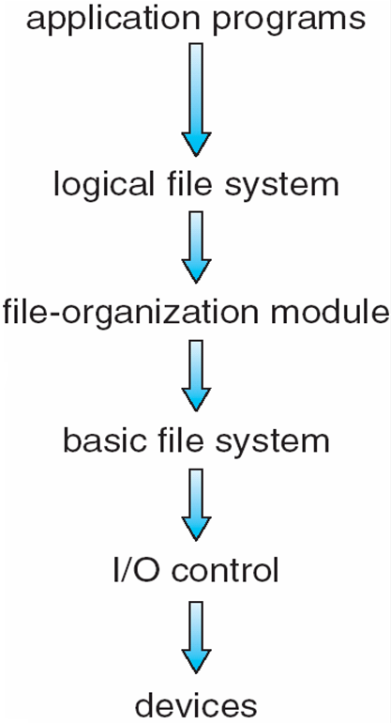
Layered File System
application program asks for a file, the first request is directed to the logical file system.
The logical file system contains the Meta data information of the file and directory structure and provides protection also. It translates file name into file number, file handle, location by maintaining file control blocks (inodes in UNIX)
The logical blocks of files need to be mapped to physical blocks in harddisk. This mapping is done by File organization module
The basic file system - issues the commands to I/O control in order to fetch those blocks. Basic file system given command like “retrieve block 123” translates to device driver.
I/O controls contain the codes by using which it can access hard disk.
These codes are known as device driversGiven commands like “read drive1, cylinder 72, track 2, sector 10, into memory location 1060” outputs low-level hardware specific commands to hardware controller
Logical layers can be implemented by any coding method according to OS designer eg. UFS, extended file system in Linux

Slide 5
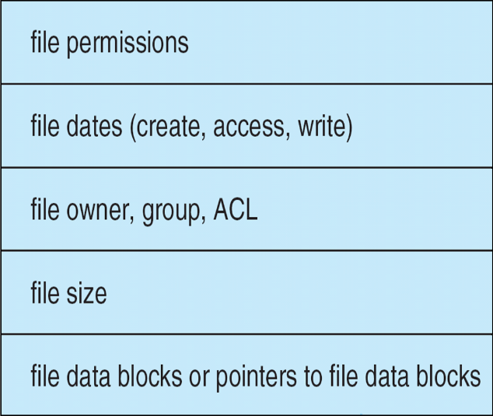
File System Implementation
on-disk and in-memory structures
On Disk Data Structures
Boot Control Block - Boot Control Block contains all the information which is needed to boot an operating system from that volume. It is called boot block in UNIX file system. In NTFS, it is called the partition boot sector.
Volume Control Block - Volume control block all the information regarding that volume such as number of blocks, size of each block, partition table, pointers to free blocks and free FCB blocks. In UNIX file system, it is known as super block. In NTFS, this information is stored inside master file table.
Directory Structure (per file system) -A directory structure (per file system) contains file names and pointers to corresponding FCBs.
File Control Block - File Control block contains all the details about the file such as ownership details, permission details, file size,etc. In UFS, this detail is stored in inode.
File control Block

Slide 6
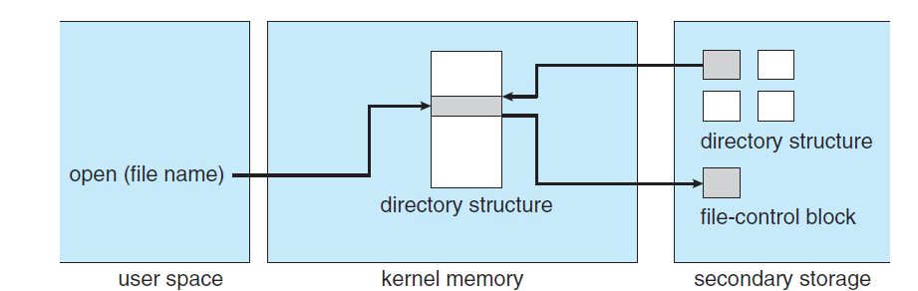
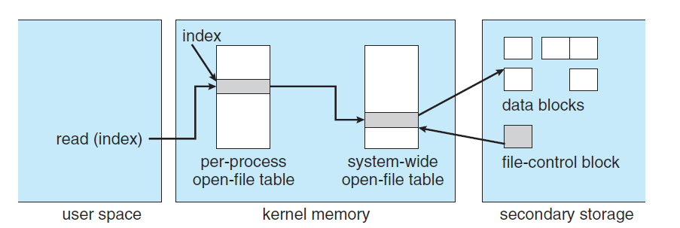
In-Memory File System Structures
The in-memory data structures are used for file system management as well as performance improvement via caching. This information is loaded on the mount time and discarded on ejection.

Slide 7
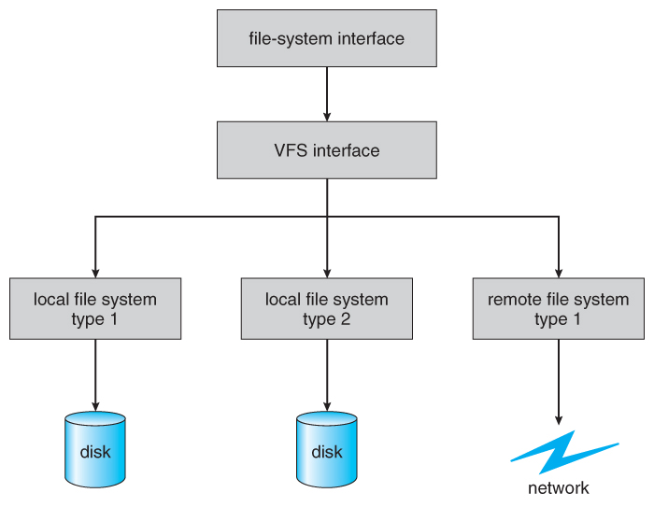
Virtual File Systems
Virtual File Systems, VFS, provide a common interface to multiple different filesystem types. In addition, it provides for a unique identifier ( vnode ) for files across the entire space, including across all filesystems of different types. ( UNIX inodes are unique only across a single filesystem, and certainly do not carry across networked file systems. )
The VFS in Linux is based upon four key object types:
The inode object, representing an individual file
The file object, representing an open file.
The superblock object, representing a filesystem.
The dentry object, representing a directory entry.

Slide 8
Directory Implementation
Directories need to be fast to search, insert, and delete, with a minimum of wasted disk space.
Linear List
A linear list is the simplest and easiest directory structure to set up, but it does have some drawbacks.
Finding a file ( or verifying one does not already exist upon creation ) requires a linear search.
Deletions can be done by moving all entries, flagging an entry as deleted, or by moving the last entry into the newly vacant position.
Sorting the list makes searches faster, at the expense of more complex insertions and deletions.
A linked list makes insertions and deletions into a sorted list easier, with overhead for the links.
More complex data structures, such as B-trees, could also be considered.
Hash Table
A hash table can also be used to speed up searches.
Hash tables are generally implemented in addition to a linear or other structure

Slide 9
Allocation Methods
An allocation method refers to how disk blocks are allocated for files.There are three major methods of storing files on disks:
contiguous
linked
indexed.

Slide 10
Allocation Methods - Contiguous
Contiguous allocation – each file occupies set of contiguous blocks
Best performance in most cases
Simple – only starting location (block #) and length (number of blocks) are required
Problems include finding space for file, knowing file size, external fragmentation, need for compaction off-line (downtime) or on-line

Slide 11
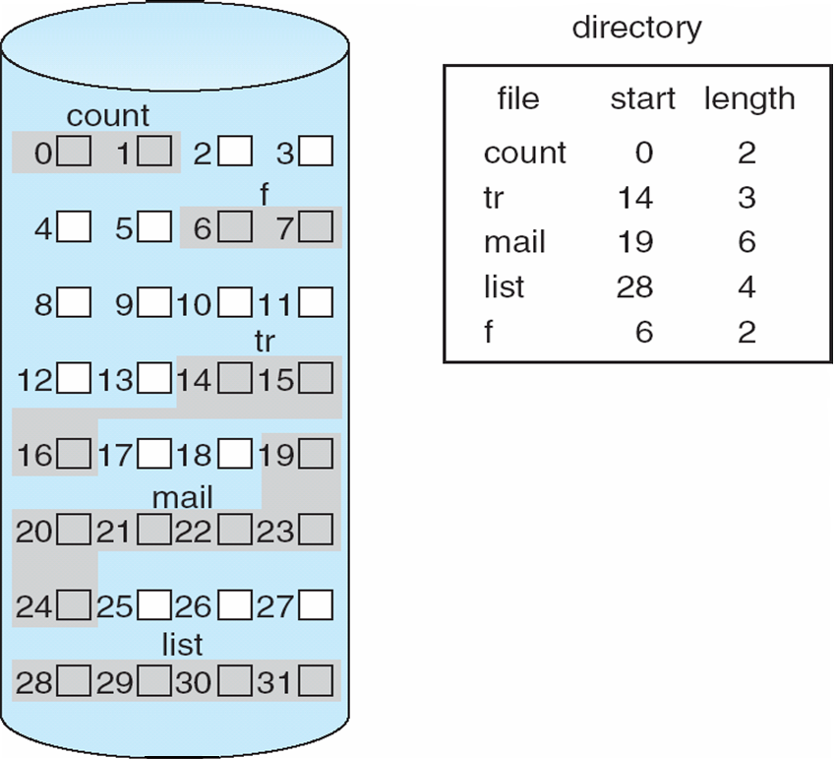
Contiguous Allocation
Mapping from logical to physical
Q
LA/512
R
Block to be accessed = Q + starting address
Displacement into block = R

Slide 12
Extent-Based Systems
Many newer file systems (i.e., Veritas File System) use a modified contiguous allocation scheme
Extent-based file systems allocate disk blocks in extents
An extent is a contiguous block of disks
Extents are allocated for file allocation
A file consists of one or more extents

Slide 13
Allocation Methods - Linked
Linked allocation – each file a linked list of blocks
File ends at nil pointer
No external fragmentation
Each block contains pointer to next block
No compaction, external fragmentation
Free space management system called when new block needed
Improve efficiency by clustering blocks into groups but increases internal fragmentation
Reliability can be a problem
Locating a block can take many I/Os and disk seeks
FAT (File Allocation Table) variation
Beginning of volume has table, indexed by block number
Much like a linked list, but faster on disk and cacheable
New block allocation simple

Slide 14
Linked Allocation
Each file is a linked list of disk blocks: blocks may be scattered anywhere on the disk
block =
pointer
Mapping
Q
Block to be accessed is the Qth block in the linked chain of blocks representing the file.
Displacement into block = R + 1
LA/511
R

Slide 15
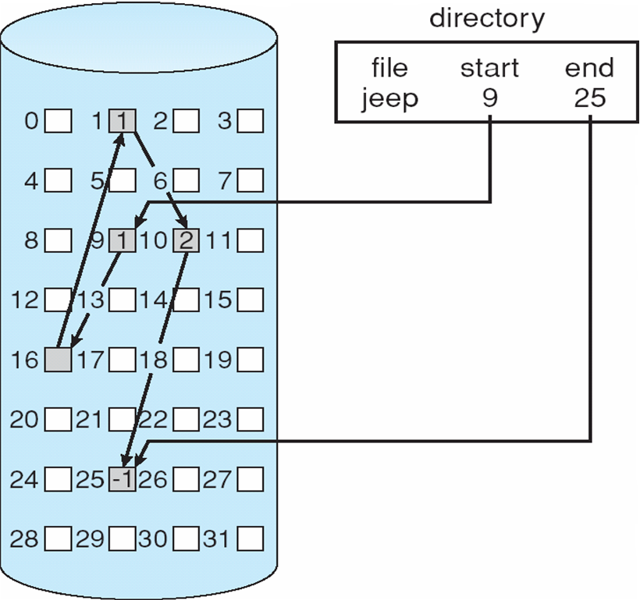
Allocation Methods - Linked

Slide 16
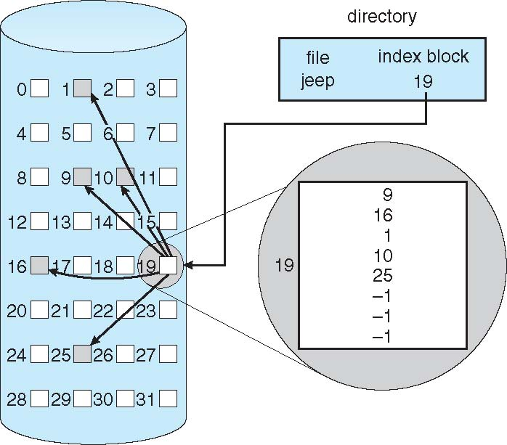
Allocation Methods - Indexed
Indexed allocation
Each file has its own index block(s) of pointers to its data blocks
Logical view

Slide 17
Allocation Methods - Indexed
Need index table
Random access
Dynamic access without external fragmentation, but have overhead of index block
Mapping from logical to physical in a file of maximum size of 256K bytes and block size of 512 bytes. We need only 1 block for index table
Q
Q = displacement into index table
R = displacement into block
LA/512
R

Slide 18
Indexed Allocation
Some disk space is wasted (relative to linked lists or FAT tables) because an entire index block must be allocated for each file, regardless of how many data blocks the file contains. This leads to questions of how big the index block should be, and how it should be implemented. There are several approaches:
Linked Scheme - An index block is one disk block, which can be read and written in a single disk operation. The first index block contains some header information, the first N block addresses, and if necessary, a pointer to additional linked index blocks.
Multi-Level Index - The first index block contains a set of pointers to secondary index blocks, which in turn contain pointers to the actual data blocks.
Combined Scheme - This is the scheme used in UNIX inodes, in which the first 12 or so data block pointers are stored directly in the inode, and then singly, doubly, and triply indirect pointers provide access to more data blocks as needed. (See below.) The advantage of this scheme is that for small files ( which many are ), the data blocks are readily accessible ( up to 48K with 4K block sizes ); files up to about 4144K ( using 4K blocks ) are accessible with only a single indirect block ( which can be cached ), and huge files are still accessible using a relatively small number of disk accesses ( larger in theory than can be addressed by a 32-bit address, which is why some systems have moved to 64-bit file pointers. )

Slide 19
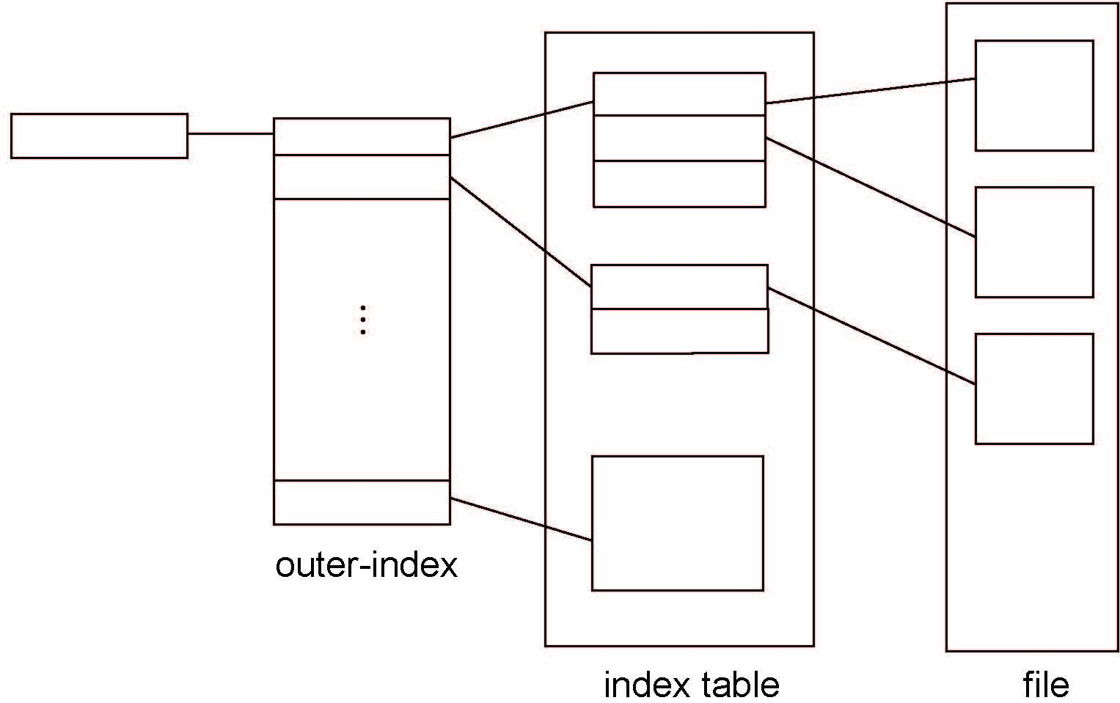
Allocation Methods - Indexed
Two level index

Slide 20
Free-Space Management
File system maintains free-space list to track available blocks/clusters
1. Bit Vector
One simple approach is to use a bit vector, in which each bit represents a disk block, set to 1 if free or 0 if allocated.
Fast algorithms exist for quickly finding contiguous blocks of a given size
Block number calculation:
number of bits per word) *
(number of 0-value words) +
offset of first 1 bit
The down side needs extra space . For example 40GB disk requires over 5MB just to store the bitmap.
(

Slide 21
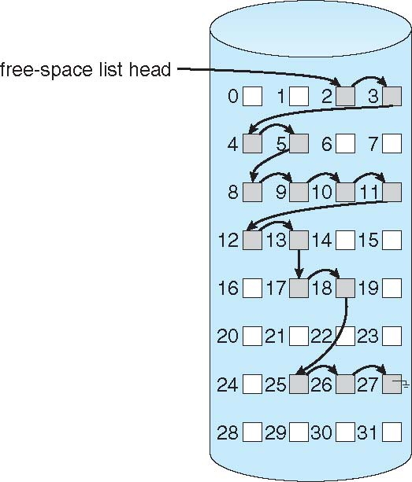
2. Linked Free Space List on Disk
Cannot get contiguous space easily
No waste of space
No need to traverse the entire list (if # free blocks recorded)

Slide 22
Free space management
3. Grouping
Modify linked list to store address of next n-1 free blocks in first free block, plus a pointer to next block that contains free-block-pointers (like this one)
4. Counting
Because space is frequently contiguously used and freed, with contiguous-allocation allocation, extents, or clustering
Keep address of first free block and count of following free blocks
Free space list then has entries containing addresses and counts

Slide 23
Space maps
Sun's ZFS file system was designed for HUGE numbers and sizes of files, directories, and even file systems.
The resulting data structures could be VERY inefficient if not implemented carefully. For example, freeing up a 1 GB file on a 1 TB file system could involve updating thousands of blocks of free list bit maps if the file was spread across the disk.
ZFS uses a combination of techniques, starting with dividing the disk up into ( hundreds of ) metaslabs of a manageable size, each having their own space map.
Free blocks are managed using the counting technique, but rather than write the information to a table, it is recorded in a log-structured transaction record. Adjacent free blocks are also coalesced into a larger single free block.

Slide 24
Efficiency and Performance
Efficiency dependent on:
Disk allocation and directory algorithms
Types of data kept in file’s directory entry
Pre-allocation or as-needed allocation of metadata structures
Fixed-size or varying-size data structures

Slide 25
Efficiency and Performance
Performance
Keeping data and metadata close together
Buffer cache – separate section of main memory for frequently used blocks
Synchronous writes sometimes requested by apps or needed by OS
No buffering / caching – writes must hit disk before acknowledgement
Asynchronous writes more common, buffer-able, faster
Free-behind and read-ahead – techniques to optimize sequential access
Reads frequently slower than writes

Slide 26
Swap Space management
Modern systems typically swap out pages as needed, rather than swapping out entire processes. Hence the swapping system is part of the virtual memory management system.
Managing swap space is obviously an important task for modern Oses
Swap space usage – depends on os . sometimes to in with RAM size, or bigger size
Swap space location – as a part of regular file system. Or

Slide 27
Swap-space management
Swap-space management
4.3BSD allocates swap space when process starts; holds text segment (the program) and data segment
Kernel uses swap maps to track swap-space use
Solaris 2 allocates swap space only when a dirty page is forced out of physical memory, not when the virtual memory page is first created
File data written to swap space until write to file system requested
Other dirty pages go to swap space due to no other home
Text segment pages thrown out and reread from the file system as needed
What if a system runs out of swap space?
Some systems allow multiple swap spaces

Slide 28
Swap-space management
In the mapping system shown below for Linux systems, a map of swap space is kept in memory, where each entry corresponds to a 4K block in the swap space. Zeros indicate free slots and non-zeros refer to how many processes have a mapping

