Slide 1
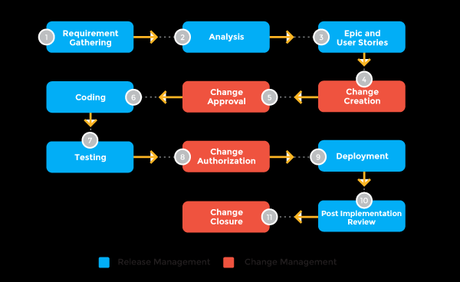
UNIT-5
Product Release and Maintenance

Slide 2
Outline
Product Release Management
Product Implementation
User Training
Maintenance
Maintenance Types
Maintenance Cost
Maintenance Process
Maintenance Life Cycle
Maintenance Techniques
Software Release
Software Maintenance

Slide 3
Product Release
The software product which you have been building for so long is now complete.
You need to take it to the customer’s site and get it implemented so that the end users can start using it.
However, do not run fast in anticipation of wrapping things as early as possible. After all this is your magnum opus and you need to be careful.
You need to make sure that all your tasks are completed

Slide 4
In software engineering, a release is a new or modified software and the process of its creation.
A release constitutes a fully functional version of the software, and it is the climax of the software development and engineering processes.
Alpha and beta versions of the software typically precede its release.
Releases may also referred to as launches or increments.

Slide 5
A product release is the process of launching a new product or feature set into the market.
Releases can happen frequently (daily or weekly) or just occasionally (quarterly or annually).
Your release rhythm will depend on a few factors, including where your product business is in its market lifecycle and your available resources.

Slide 6
There are many reasons for releasing product. Here’s just a few:
You’re releasing an existing product onto a new platform (such as Android)
You’re releasing a new idea into market for the first time
You’re releasing an existing product onto a new platform (such as Android)
You’re introducing new features to current customers
You’re introducing new features to new or different customer segments
You’re re-releasing your current product using different technology (often called “re-platforming”)

Slide 7
Release Planning
A release planning session is a descendent of the product roadmap. That means that the company should first decide what initiatives it wants to deliver on (and when) and then set aside time to plan each (major) product release.
Start your release planning session by revisiting or discussing why the release matters.
What do you hope will happen for the business once the product has been released?
By when?

Slide 8
How will you measure that success?
Take care to assess team alignment at this stage. Is everybody in agreement about why we’re doing this?
The release planning session is an opportunity to get buy-in from your team. This is especially important given that most of the attendees will lead the efforts of actually building the product.

Slide 9
Product Release Management
A release management process may likely mean different things to a product management team and a development team.
Both perspectives are strongly incorporated into a dependable release management process.
A release management process incorporates all of the following:

Slide 10
1)Planning
An initial release plan takes into account the team's velocity on the previous release (or general capacity to deliver) and the feature prioritization to create a general scope, sequencing, and timeline for the release.
During release planning, a general expectation on the number of sprints or iterations to deliver the scope is achieved.
The accuracy of this expectation and plan depends on whether the team's capacity is well-known as well as the level of detail (or grooming) the scope has been through during estimation.
This general plan will also provide expectations of major product changes (or dependencies) for products that may depend on your roadmap or platform.
Plans will be revisited after each iteration. For this reason, a tracking of an external release target (with quarterly, monthly, or other precision) can be helpful.
It will still set the expectation and trust with your customers, but can be refined by you as the plan progresses.

Slide 11
2) Phased communication and supporting team engagement
Product managers know best how to deliver their product successfully — and that includes a series of non-development tasks of engagement with supporting teams to complete items like documentation, sales training, or marketing campaigns.
As a product manager, establishing a launch or release template will enable you to create a "gold standard" for major delivery.
Use this template to engage your greater team, who may be supporting multiple products in the portfolio only when needed.
A standard for launch also sets expectation for when these teams will be needed internally.

Slide 12
3) Repeatable stages to readiness
Establish standardized status at both the release and feature level to indicate overall health of the plan.
Status provides an "Are we good?" pulse point that can be key to seeing around corners and proactive risk mitigation.
A release status will enable communication to your internal stakeholders, while feature status workflows enable granular visibility into the readiness of the feature and its current status with respect to development, staging, or QA environments.

Slide 13
4)Forward adjustment on plan
Regardless of whether your release plan is executed in sprints or via more waterfall methodologies, regular check-ins and adjustments to plan are necessary.
Use your sprint closure to adjust plans as needed, or schedule regular reviews to ensure plans are on track.

Slide 14
Product Release Management
Project teams working for software product vendors struggle to keep pace with release of the software product.
There is pressure from the market to launch new versions by certain dates.
New features are to be added, porting the product to new platforms, old features are to be enhanced, existing bugs are to be removed, and yet it has to meet the deadline.
It is a constant struggle that calls for good product release strategies.
Depending on the situation, the project manager may need to convince the management to cut short some of the product features to meet the deadline as well as meet quality standards.
A half-baked product will never have any takers; instead the project manager may be blamed for its poor quality issues.
Bargaining also has to be done for other requirements of bug fixes, feature enhancements, etc. If quality concerns are paramount, then moving some of the tasks of new features to a future release may be the best solution for meeting quality standards.
If the software vendor is not too sure about product quality, then he may opt for an alpha or beta release of the product.
In that case, the product will be released only among a few selected groups and not in the market as a whole. The controlled product release is the best option in these conditions

Slide 15
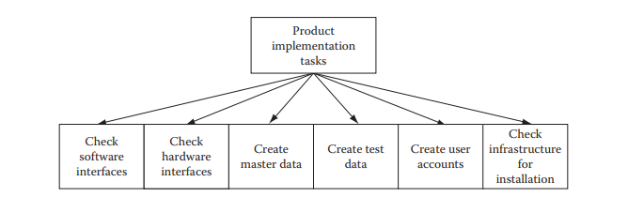
Product Release Management(Contd…)
Product release management is such a dynamic environment that if proper planning is not done at a minute level and constant vigilance is not applied over project activities, then a huge mess can be created and there will be no time to clear it.
So the project manager must be vigilant all the time
Walk around for known issues, estimated number of critical bugs still remaining in the product, training for the support staff, etc., should be done.
The cost of support, depending on the number of estimated users, walk around, and remaining bugs should be figured out.
These measures will ensure that the product is transitioned into market without facing major difficulties.

Slide 16
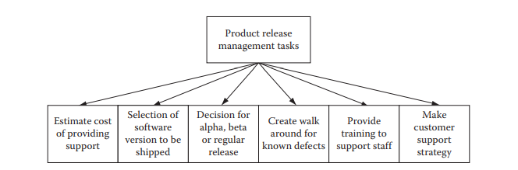
Product Release Management(Contd…)

Slide 17
Product Implementation
The product that has been developed and thoroughly tested now needs to be implemented at a customer site.
You need to prepare all master data and test transaction data for testing the implemented product.
You need to get all required hardware and software that need to be there for installing your software product.
You need to make sure that you have developed and tested all the hardware and software interfaces for integrating your product, with existing legacy systems and infrastructure.
You also need to make sure that your product will run smoothly on customer premises without any interference with their existing applications.
Often project teams run into problems during implementation, due to unforeseen circumstances or negligence on part of the production team or customer’s team.
Therefore, prepare a list of your own requirements and hand it over to your customer’s support team so that they are prepared when you arrive for implementation.

Slide 18
A product software implementation method is a blueprint to get users and/or organizations running with a specific software product.
The method is a set of rules and views to cope with the most common issues that occur when implementing a software product: business alignment from the organizational view and acceptance from human view.
The implementation of product software, as the final link in the deployment chain of software production, is in a financial perspective of a major issue.
It is stated that the implementation of (product) software consumes up to 1/3 of the budget of a software purchase (more than hardware and software requirements together).

Slide 19
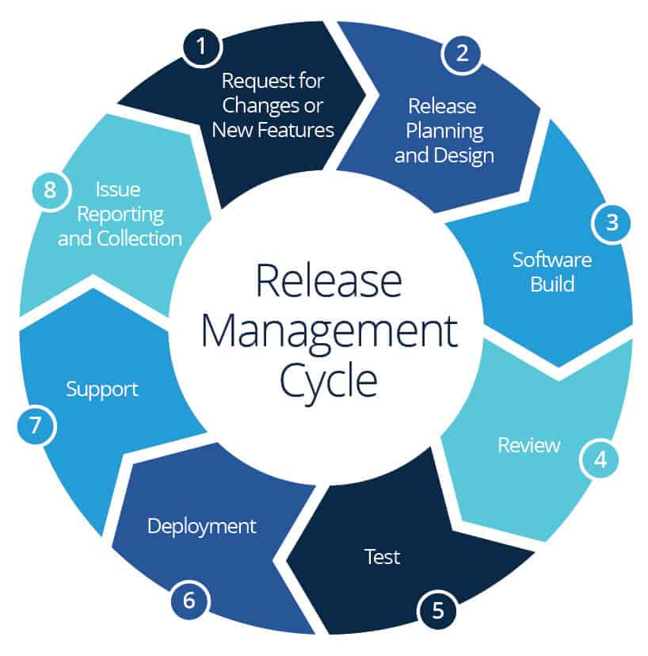
Release management cycle

Slide 20
SIMPLE RELEASE MANAGEMENT TEMPLATE
template.docx

Slide 21
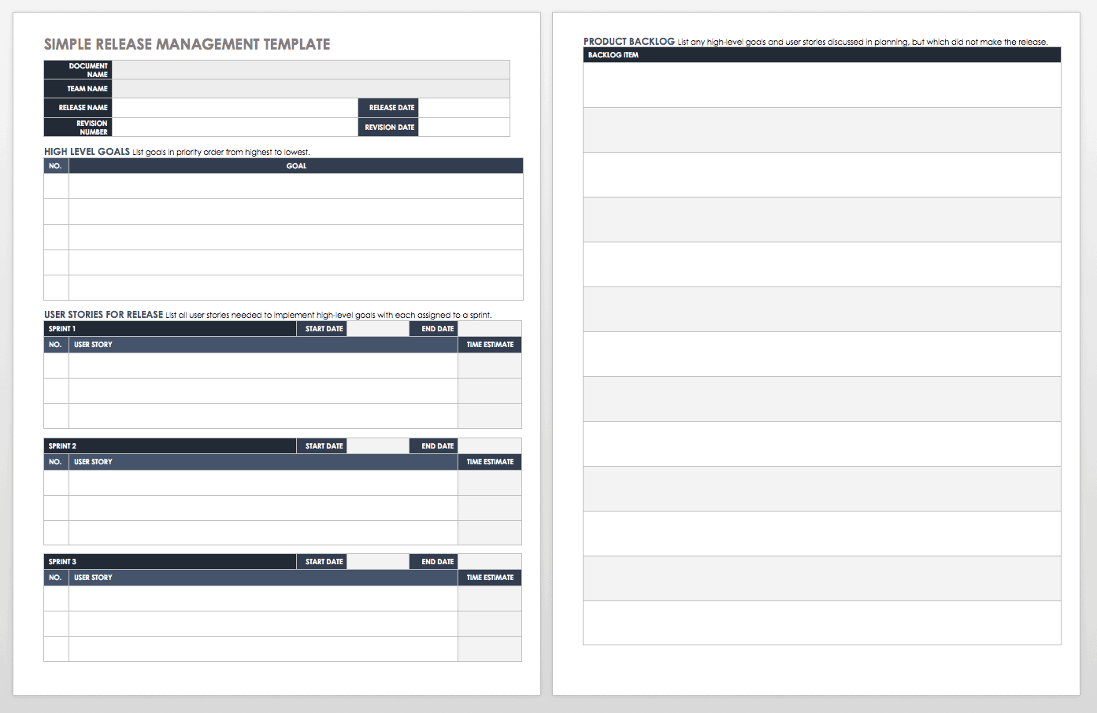

SIMPLE RELEASE MANAGEMENT TEMPLATE

Slide 22
User Training
Make sure that the user manual prepared by your team is up to date and in synch with the version of your software product, which you will implement at the customer site.
It is not possible to provide training to all users. So prepare a list of roles that are needed to operate the product.
Give this list to the end users and ask them to select one user per role who will receive the training.
Apart from the user manual, you also need to prepare a tutorial to include probable scenarios that may arise during operation of the product.
The tutorial will provide a step-by-step guide for using the product under those scenarios.
This will be a very important step in training, because if users do not learn it during training, then they will contact you later after implementation and ask you to provide information as to how to use the product in those circumstances.
This will lead to a waste of your support team’s time.
It is lot better to train them now, during user training, rather than face user requests later

Slide 23
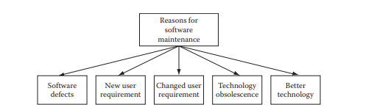
User Training(Contd..)

Slide 24
Maintenance
Software products do not age or wear out like physical products Well. There are some factors which make it absolutely necessary. Here are some of the reasons:
1. Technology obsolescence The software platform (operating system, medium of user, interface) or the hardware platform on which the software product runs gets obsolete.
2. Software defects: There are major software defects in the product and it is difficult to operate. For this reason, a software patch may be needed to be applied so that these defects are removed.
3. Change in user requirements: The business organization that was using the software product has seen a change in business transactions or business workflows that are not supported by the software product
It is estimated that more than 70% of all costs associated with software product development, implementation, and support and maintenance is consumed in the activities of supporting and maintaining software products.
These kinds of queries have always puzzled the business community.
This recognition has resulted in an awareness of the importance of finding ways to build such a software product.
This situation has led to including maintainability characteristics during the entire product development cycle.
A lot of work remains to be done during the maintenance phase of any software product. How to manage these activities so that costs can be minimized is an area of concern yet to be resolved.

Slide 25
Maintenance Types
Software maintenance is of four types:
corrective
adaptive,
preventive
perfective maintenance
If the software has some defects, then it will take a corrective maintenance to rectify it.
If there are some changes in the operating environment of the software product, then the product can be made useful by doing adaptive maintenance.
If there is an insecurity that although the product is running fine in future we may have difficulty in using it, then preventive maintenance is employed.
If there are some deficiencies in the product that must be rectified, then perfective maintenance will fit the bill

Slide 26
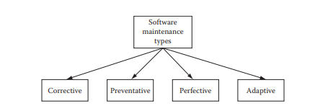
Maintenance Types

Slide 27
Corrective Maintenance
Even after thorough reviews and testing, the software product contains many defects when it goes into production.
These defects are uncovered as users start using the application.
They are logged with the support staff and after a sizable number of errors are detected, the software vendor instructs his maintenance team to create a patch to rectify them.
The maintenance team then makes a plan and fixes those defects.
After application of the patch containing the fixes, the software starts running without these defects
Adaptive Maintenance
The operating environment in which a software product runs in operation includes the hardware and software platform as well as the interfaces for human and other machine interactions.
If any of these change over time, it becomes difficult to run the software product. In such cases, it becomes necessary to do adaptive maintenance so that the software product becomes reusable.
This kind of maintenance may involve changing the interface or porting the application to another hardware/ software platform

Slide 28
Perfective Maintenance
This kind of maintenance is needed when there is a change in the business environment, and thereby users need additional/modified functionality in the software product to do their tasks.
A business workflow may have changed, a business transaction may have changed, or an altogether new business transaction was represented in the software product.
For all these kinds of requirements, a perfective maintenance may be needed
Preventive Maintenance
Generally after a lapse of time, there are likely changes in business or operative environment, or there may be changes in hardware/software environment.
These changes are bound to occur and they affect the way the software product operates.
Many of these changes can be perceived in advance.
In such cases, preventive maintenance on the software product can make sure that the product will be useful even after these environmental changes occur

Slide 29
Maintenance Cost
A software product is generally very valuable to an organization if it is used for doing a large portion of their daily business. If for some reason the software product has become unusable, then the organization in fact will be making losses on their revenue.
Moreover, large enterprise software products are that much crucial.
When the organization faces such a case, it is left with no alternative but to either get an entirely different software product that will replace the existing one or do maintenance of an existing product to make it usable.
Following are some financial reasons for which a maintenance may be needed:
1. Loss in business revenue: It may happen that business transactions are faulty and thus the business may lose revenue.
2. Opportunity loss: Sometimes there could be some business opportunity in the marketplace, but due to some software problems it could not be availed.
3. Productivity loss: If the software product becomes difficult to operate due to many walk around or lengthy processing then productivity will become lower for business personnel Maintenance of an existing software product has its own share of problems. The maintenance will incur costs. A profit/loss analysis can be done, to see if it is more profitable to conduct a maintenance program on the software or keep using it as it is.
The losses due to problems with the software can be compared to probable cost of maintenance and an ROI (return on investment) can be done.
If we get a desirable ROI then it is better to go for maintenance.
Notes:
A software product is generally very valuable to an organization if it is used for doing a large portion of their daily business. If for some reason the software product has become unusable, then the organization in fact will be making losses on their revenue. Moreover, large enterprise softwareproducts are that much crucial! When the organization faces such a case, it is left with no alternative but to either get an entirely different software product that will replace the existing one or do maintenance of an existing product to make it usable. Following

Slide 30
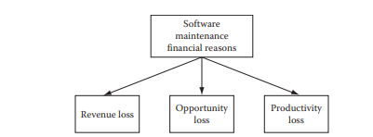
Maintenance Cost(Contd..)

Slide 31
Maintenance Process
For any work, it is always better to have a process model instead of doing things on an ad hoc basis.
When it comes to software maintenance, some process models have been defined. Some of the popular ones include the quick fix model, Boehm’s model, Osborne’s model, iterative enhancement model, and reuse oriented model
Quick fix model: This is the simplest of maintenance models; whenever any defects with the software products are found they are immediately fixed. There is no planning involved in the whole process and it is mostly an ad hoc approach.
Boehm’s model: Boehm’s model is based on economic models and often involves calculating ROI, for any planned maintenance. If ROI turns out to be good, then it is carried out or else it is dropped.
Osborne’s model: Osborne realized that difficulties in carrying out maintenance work are due to gaps in communication. He proposed four steps to prevent this situation. He stated that a maintenance plan should include all change requests in the form of maintenance requirements. A quality assurance plan should accompany the maintenance plan. Metrics should be developed to measure and assess quality of work carried out during maintenance. Finally, reviews should be held after maintenance work to assess quality of work done.
Iterative enhancement model: This model is based on the similar concept of iterative software development. All software defects and change requests are logged and then a small set from this list is taken for making fixes. This set is prepared based on the priority of changes required. High priority fixes are done before low priority fixes.
Reuse oriented model: This type of process is adopted for component-based software products. For fixing any defects, existing components are analyzed and then the appropriate changes are made.

Slide 32
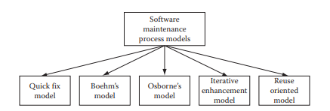
Maintenance Process

Slide 33
Maintenance Life Cycle
Like the software development, software maintenance also has a life cycle.
Requirements for software maintenance come from the list of defects that have been logged.
Either the list of defects can be taken as a whole or a subset of defects from this list can be taken for a fixing plan.
It makes a lot of sense to go for an iterative approach.
This approach is similar to the concept of iterative software development.
This way it can be ensured that highly visible, important, and priority defects are fixed first and other defects which do not make much impact on operations of the product are tackled later .In the software maintenance life cycle, testing is a crucial phase.
This phase also consumes a lot of time and effort.
But the value addition in all this effort and time spent helps in reducing defects, which in the long run is a much cheaper alternative compared to no testing/cursory testing and later spending money in providing support.

Slide 34
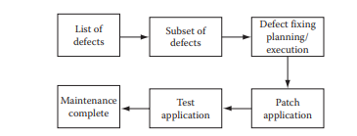
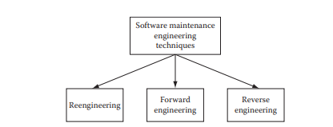
Maintenance Life Cycle

Slide 35
Maintenance Techniques
Maintenance of software products sometimes becomes a tough proposition.
There is no proper documentation that can be used for understanding how the product is designed and constructed.
Sometimes there is no documentation at all.
Even if documentation is there, it is not up to date.
This out-of-date documentation is not of much use for any maintenance work.
Sometimes even if the documentation is up to date, the maintenance work is difficult due to dirty design or construction work.
All these situations call for some specific techniques for maintenance work depending on the situation.
Some of the common maintenance techniques include reengineering, reverse engineering, and forward engineering.

Slide 36
Reengineering
Reengineering is also known as reuse engineering.
This technique is a standard method for maintenance work for component-based software products.
Details about all components in the software products are well known.
When any maintenance work is needed, from the list of defects, each defect is specifically analyzed to find out the root cause of the defect.
Once this analysis is successful, then fixing that defect becomes easy.
Reverse Engineering
Reverse engineering technique is most useful when nonexistent or sketchy documentation is available for the software product.
Due to unavailability of documentation, there is no information as to what the design is and how the product is constructed.
In such a situation, it is almost impossible to do any modification in the source code for any maintenance work.
In such cases, the reverse engineering technique is adopted.
Using this technique, similar components or product parts are constructed as compared to existing product components/parts.
This way the software product functionality is changed as the new constructed parts will have the desired functionality.

Slide 37
Forward Engineering
Forward engineering is just the opposite of reverse engineering.
In this situation, we have ample documentation about the existing product.
Due to new customer needs, the existing product needs to be extended so that the new needs can be fulfilled.
All new extended development is based on the existing design and construction methods and will be made for the same hardware/software platform.

Slide 38
Software Release
Our SaaS vendor releases minor versions of its product on a quarterly basis and major versions on a yearly basis. For each minor release, new features to be added are carefully planned.
The product manager makes sure that the release plan for a minor release will be on time by assigning priority to each new feature.
The high priority features will be definitely added and the low priority features for that iteration will be added if any time remains in the iteration.
Our SaaS vendor does not release alpha or beta releases of its product as they do not serve mass markets.
Their product is an enterprise computing product and is used by large retailers, government offices, logistics providers, manufacturers, and distributors.
They always release new versions of their product to their existing customers.
Since they do not do alpha or beta releases, they make sure that their new version is tested thoroughly by their testing team, and no major defects are passed in the production instances.
Since there are no immediate customers who will be available for doing user acceptance testing, the internal testing team does the user acceptance testing as well.

Slide 39
Software Maintenance
The software vendor keeps all of the production instances of its software product at its data center .
All previous versions of the software as well as the current working version of the software product run at this center as production instances of different versions of their software product.
The maintenance team makes sure that all versions of the product are available for users.
They run sanity test scripts daily on all instances.
If any problems are found, they is immediately resolved.
These scripts are run at night.
If any problems are found then, it is made sure that they are rectified before office hours start and people start using the application.
In packaged software or custom built software that are not used in an SaaS environment, this kind of quick fix is not possible.
So in those cases, a maintenance plan is made to fix all or most defects found by users during a time span of 3 months or more.
But with SaaS environments, this kind of maintenance is not needed at all.
All defects are quickly and easily fixed, without hampering work of end users.

Slide 40
THANK YOU……….

