Slide 1
UNIT -5
Product Release and Software
Maintenance

Slide 2
Product Release Management
Product Implementation
User Training
Software Maintenance
Software Maintenance Types
Software Maintenance Cost
Software Maintenance Process
Software Maintenance Life Cycle
Software Maintenance Techniques
Software Release

Slide 3
Product Release
The software product which you have been building for so long is now complete.
You need to take it to the customer’s site and get it implemented so that the end users can start using it.
However, do not run fast in anticipation of wrapping things as early as possible. After all this is your magnum opus and you need to be careful.
You need to make sure that all your tasks are completed
In software engineering, a release is a new or modified software and the process of its creation.
A release constitutes a fully functional version of the software, and it is the climax of the software development and engineering processes.
Alpha and beta versions of the software typically precede its release.
Releases may also referred to as launches or increments.

Slide 4
A product release is the process of launching a new product or feature set into the market.
Releases can happen frequently (daily or weekly) or just occasionally (quarterly or annually).
Your release rhythm will depend on a few factors, including where your product business is in its market lifecycle and your available resources.
There are many reasons for releasing product. Here’s just a few:
You’re releasing an existing product onto a new platform (such as Android)
You’re releasing a new idea into market for the first time
You’re releasing an existing product onto a new platform (such as Android)
You’re introducing new features to current customers
You’re introducing new features to new or different customer segments
You’re re-releasing your current product using different technology (often called “re-platforming”)

Slide 5
Release Planning
A release planning session is a descendent of the product roadmap. That means that the company should first decide what initiatives it wants to deliver on (and when) and then set aside time to plan each (major) product release.
Start your release planning session by revisiting or discussing why the release matters.
What do you hope will happen for the business once the product has been released?
By when?
How will you measure that success?
Take care to assess team alignment at this stage. Is everybody in agreement about why we’re doing this?
The release planning session is an opportunity to get buy-in from your team. This is especially important given that most of the attendees will lead the efforts of actually building the product.

Slide 6
Product Release Management
A Release management process may likely mean different things to a product management team and a development team.
Both perspectives are strongly incorporated into a dependable release management process.
A release management process incorporates all of the following:
1)Planning
An initial release plan takes into account the team's velocity on the previous release (or general capacity to deliver) and the feature prioritization to create a general scope, sequencing, and timeline for the release.
During release planning, a general expectation on the number of sprints or iterations to deliver the scope is achieved.
The accuracy of this expectation and plan depends on whether the team's capacity is well-known as well as the level of detail (or grooming) the scope has been through during estimation.
This general plan will also provide expectations of major product changes (or dependencies) for products that may depend on your roadmap or platform.
Plans will be revisited after each iteration. For this reason, a tracking of an external release target (with quarterly, monthly, or other precision) can be helpful.
It will still set the expectation and trust with your customers, but can be refined by you as the plan progresses.

Slide 7
2) Phased communication and supporting team engagement
Product managers know best how to deliver their product successfully — and that includes a series of non-development tasks of engagement with supporting teams to complete items like documentation, sales training, or marketing campaigns.
As a product manager, establishing a launch or release template will enable you to create a "gold standard" for major delivery.
Use this template to engage your greater team, who may be supporting multiple products in the portfolio only when needed.
A standard for launch also sets expectation for when these teams will be needed internally.
3) Repeatable stages to readiness
Establish standardized status at both the release and feature level to indicate overall health of the plan.
Status provides an "Are we good?" pulse point that can be key to seeing around corners and proactive risk mitigation.
A release status will enable communication to your internal stakeholders, while feature status workflows enable granular visibility into the readiness of the feature and its current status with respect to development, staging, or QA environments
4)Forward adjustment on plan
Regardless of whether your release plan is executed in sprints or via more waterfall methodologies, regular check-ins and adjustments to plan are necessary.
Use your sprint closure to adjust plans as needed, or schedule regular reviews to ensure plans are on track.

Slide 8
Product Release Management
Project teams working for software product vendors struggle to keep pace with release of the software product.
There is pressure from the market to launch new versions by certain dates.
New features are to be added, porting the product to new platforms, old features are to be enhanced, existing bugs are to be removed, and yet it has to meet the deadline.
It is a constant struggle that calls for good product release strategies.
Depending on the situation, the project manager may need to convince the management to cut short some of the product features to meet the deadline as well as meet quality standards.
A half-baked product will never have any takers; instead the project manager may be blamed for its poor quality issues.
Bargaining also has to be done for other requirements of bug fixes, feature enhancements, etc. If quality concerns are paramount, then moving some of the tasks of new features to a future release may be the best solution for meeting quality standards.
If the software vendor is not too sure about product quality, then he may opt for an alpha or beta release of the product.
In that case, the product will be released only among a few selected groups and not in the market as a whole. The controlled product release is the best option in these conditions

Slide 9
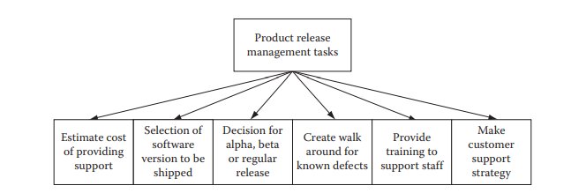
Product release management is such a dynamic environment that if proper planning is not done at a minute level and constant vigilance is not applied over project activities, then a huge mess can be created and there will be no time to clear it.
So the project manager must be vigilant all the time
Walk around for known issues, estimated number of critical bugs still remaining in the product, training for the support staff, etc., should be done.
The cost of support, depending on the number of estimated users, walk around, and remaining bugs should be figured out.
These measures will ensure that the product is transitioned into market without facing major difficulties.

Slide 10
Product Implementation
The product that has been developed and thoroughly tested now needs to be implemented at a customer site.
You need to prepare all master data and test transaction data for testing the implemented product.
You need to get all required hardware and software that need to be there for installing your software product.
You need to make sure that you have developed and tested all the hardware and software interfaces for integrating your product, with existing legacy systems and infrastructure.
You also need to make sure that your product will run smoothly on customer premises without any interference with their existing applications.
Often project teams run into problems during implementation, due to unforeseen circumstances or negligence on part of the production team or customer’s team.
Therefore, prepare a list of your own requirements and hand it over to your customer’s support team so that they are prepared when you arrive for implementation.

Slide 11
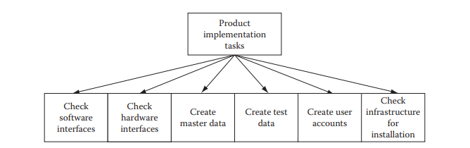
A product software implementation method is a blueprint to get users and/or organizations running with a specific software product.
The method is a set of rules and views to cope with the most common issues that occur when implementing a software product: business alignment from the organizational view and acceptance from human view.
The implementation of product software, as the final link in the deployment chain of software production, is in a financial perspective of a major issue.
It is stated that the implementation of (product) software consumes up to 1/3 of the budget of a software purchase (more than hardware and software requirements together).

Slide 12
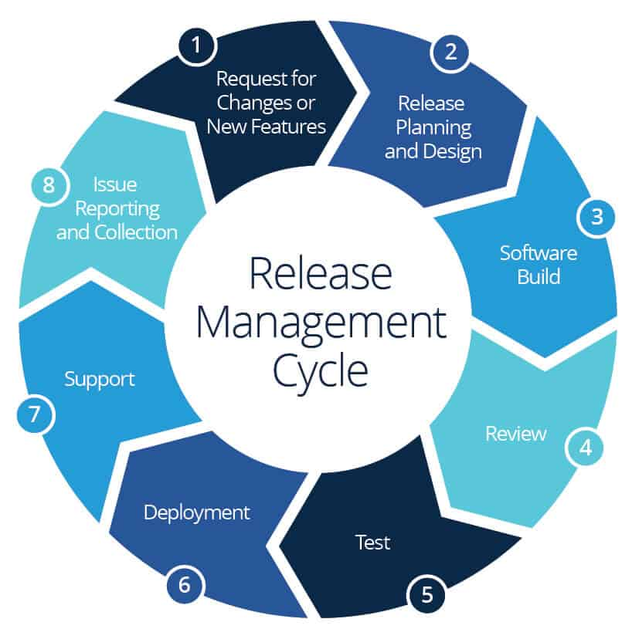
Release Management cycle

Slide 13
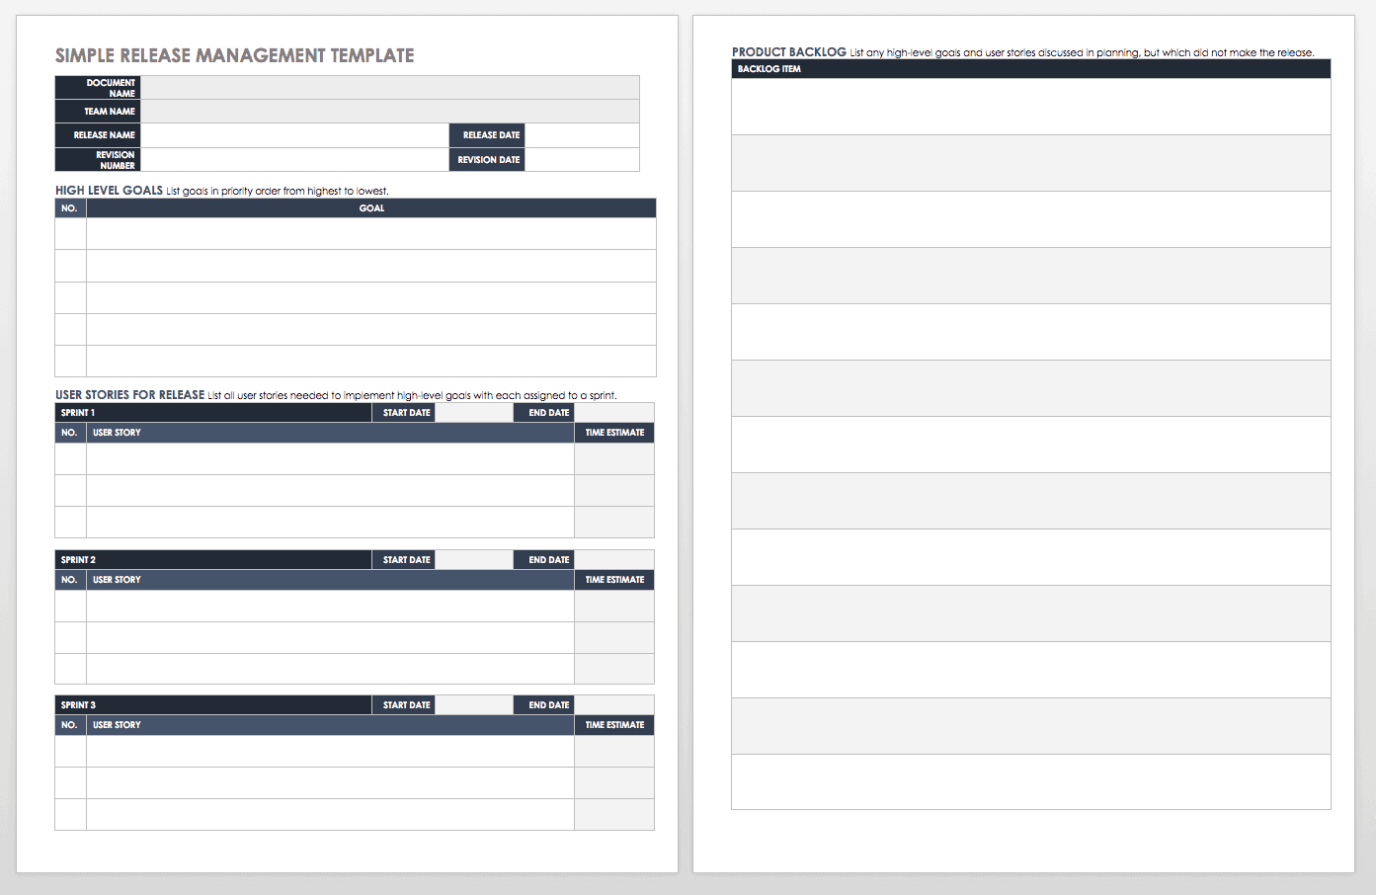
Simple Release Management Template

Slide 14
User Training
Make sure that the user manual prepared by your team is up to date and in synch with the version of your software product, which you will implement at the customer site.
It is not possible to provide training to all users. So prepare a list of roles that are needed to operate the product.
Give this list to the end users and ask them to select one user per role who will receive the training.
Apart from the user manual, you also need to prepare a tutorial to include probable scenarios that may arise during operation of the product.
The tutorial will provide a step-by-step guide for using the product under those scenarios.
This will be a very important step in training, because if users do not learn it during training, then they will contact you later after implementation and ask you to provide information as to how to use the product in those circumstances.

Slide 15
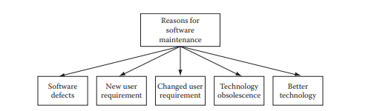
User Training
This will lead to a waste of your support team’s time.
It is lot better to train them now, during user training, rather than face user requests later

Slide 16
OBJECTIVES
To appreciate need of Software maintenance performed.
To understand reasons for change taking place in a software system.
To appreciate the concept of legacy system.
To know Software maintenance prediction.
To list various factors which adversely affect software maintenance.
To know types of software maintenance, viz. corrective, adaptive, perfective, and preventive maintenance.
To understand the Software maintenance life cycle.

Slide 17
OBJECTIVES
To know various software maintenance models, viz. quick-fix, iterative enhancement and reuse model.
To understand various techniques for maintenance, such as configuration management, impact analysis and software rejuvenation.
To list various tools that assist in maintaining the software.
To appreciate need for technology change management, which is a process of identifying, selecting and evaluating new technologies.
To understand software maintenance documentation.

Slide 18
CONTENTS
Basics of software maintenance
Types of software maintenance
Software maintenance life cycle
Software maintenance Models
Techniques for maintenance
Tools for Software maintenance
Technology change management(TCM)
Software maintenance documentation.

Slide 19
BASICS OF SOFTWARE MAINTENANCE
IEEE defines maintenance as :
‘A process of modifying a software system or component after delivery to correct faults, to improve performance or other attributes, or to adapt the product to a changed environment’.
In software engineering a software needs to be ‘serviced’ so that it is able to meet the changing
environment (such as business and user needs) where it functions this servicing of software.

Slide 20
Providing Continuity of Service
Fixing errors, recovering from failures, such as hardware failures or incompatibility of hardware with software, and accommodating changes in the operating system and the hardware.
Supporting Mandatory Upgrades
Due to changes in government regulations or students to maintain competition with other software that exist in the same category.
Improving the Software to Support User Requirements
To enhance functionality in a software, to improve performance .

Slide 21
Facilitating Future Maintenance Work
Include restructuring of the software code and database used in the software.
Improving the Software to Support User Requirements
To enhance functionality in a software, to improve performance .
Facilitating Future Maintenance Work
Include restructuring of the software code and database used in the software.

Slide 22
Changing a Software System
Software maintenance and evolution of system was first introduced by Lehman.
One of the key observations of the studies was that large system are never complete and continue to evolve and as these system evolve, they become more complex unless some actions are taken to reduce the complexity.
Lehman stated five laws for software maintenance and evolution of large systems.

Slide 23
Lehman Laws for software maintenance and evolution of large systems
Law | Description
Law of continuing change | A program that is used in a real-world environment necessarily must change or become progressively less useful in that environment.
Law of increasing complexity | As an evolving program changes, its structure tends to become more complex. Extra resources must be devoted to preserving and simplifying the structure.
Law of conservation of familiarity | For E-Systems to efficiently continue to evolve a deep understanding of how the system functions, and why it has been developed to function in that manner, must be preserved at all costs. The incremental change in each release over the life time of the system is approximately constant.
Law of conservation of organizational stability | Over a program’s lifetime, its rate of development is approximately constant and independent of the resources devoted to system development.

Slide 24
Lehman Laws for software maintenance and evolution of large systems
Law | Description
Law of self regulation | Global E-type system evolution processes are self-regulating, and distribution of product and process measures close to normal.
Law of continuing growth | E-type system’s functional capability must be continually enhanced to maintain user satisfaction over system lifetime, BUT expansion of the system size can have negative affects to the ability to be comprehended along with its ability to evolve.
Law of declining quality | Poorly modified systems lead to introduction of defects; & The quality of E-type systems will appear to be declining as newer products emerge.
Law of feedback system | To sustain continuous change or evolution, & to minimize threats of software decay & loss of familiarity, feedback to monitor the performance is must. Feedback helps to collect metrics on the systems and maintenance efforts performance.

Slide 25
Legacy Systems
Were developed before the introduction of structured programming .
Process models and basic principles such as modularity coupling, cohesion, good programming practice emerged too late for them.
Legacy system are generally associated with high maintenance costs.
The root cause of this expense is the degraded structure that results from prolonged maintenance.

Slide 26
Legacy System Characteristics
Characteristics | Description
High maintenance cost | Results due to combination of other system factors, such as complexity, poor documentation and lack of inexperienced personnel.
Complex software | Results due to structural degradation, which must have occurred over a legacy system’s lifetime of change.
Obsolete support software | Support software may not be available for a particular platform, or no longer be supported by its original vendor or any other organization.
Obsolete hardware | Legacy system’s hardware may have been discontinued.

Slide 27
Legacy System Characteristics
Characteristics | Description
Lack of technical expertise | Original developers of a legacy system are unlikely to involved with its maintenance today.
Business critical | Many legacy system are essential for the proper working of the organizations which operate them.
Poorly documented | Documentation is often missing or inconsistent.
Poorly understood | As a consequence of system complexity and poor documentation, software maintainers often understand the legacy system poorly.

Slide 28
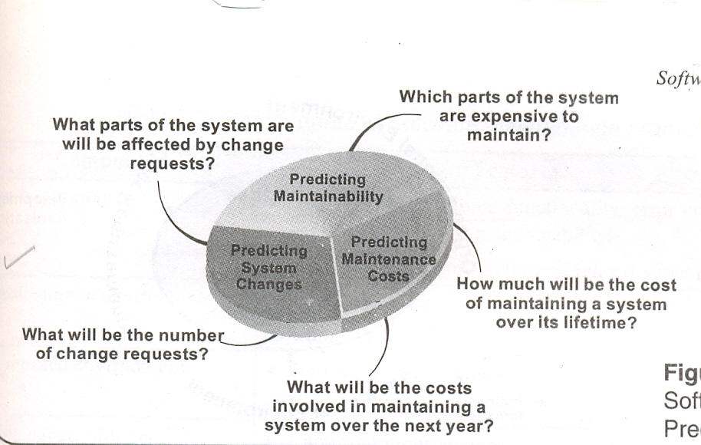
Software Maintenance Prediction

Slide 29
Software Maintenance Prediction
The various predictions shown in the figure are closely related and specify the following:
The decision to accept a system change depends on the maintainability of the system components affected by that change up to a certain extent.
Implementing change degrades the system structure and hence reduces its maintainability.
Costs involved in implementing change depend on the maintainability of system components.

Slide 30
Components of Software Maintenance Framework
Components | Features
User requirements | Request for additional functionality, error correction, capability and improvement in maintainability. Request for non-programming related support.
Organizational Environment | Change in business policies. Competition in market.
Operational Environment | Hardware platform. Software specifications.

Slide 31
Components of Software Maintenance Framework
Components | Features
Maintenance Process | Capturing requirements Variation in programming and working practices. Paradigm shift. Error detection and correction.
Software Product | Quality of documentation. Complexity of programs. Program Structure.
Software Maintenance team | Staff turnover. Domain expertise.

Slide 32
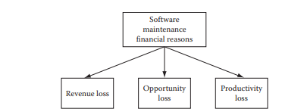
Maintenance Cost
A software product is generally very valuable to an organization if it is used for doing a large portion of their daily business. If for some reason the software product has become unusable, then the organization in fact will be making losses on their revenue. Moreover, large enterprise software products are that much crucial. When the organization faces such a case, it is left with no alternative but to either get an entirely different software product that will replace the existing one or do maintenance of an existing product to make it usable.
Software Maintenance team

Slide 33
Maintenance Cost
Following are some financial reasons for which a maintenance may be needed:
1. Loss in business revenue: It may happen that business transactions are faulty and thus the business may lose revenue.
2. Opportunity loss: Sometimes there could be some business opportunity in the marketplace, but due to some software problems it could not be availed.
3. Productivity loss: If the software product becomes difficult to operate due to many walk around or lengthy processing then productivity will become lower for business personnel Maintenance of an existing software product has its own share of problems. The maintenance will incur costs. A profit/loss analysis can be done, to see if it is more profitable to conduct a maintenance program on the software or keep using it as it is.
The losses due to problems with the software can be compared to probable cost of maintenance and an ROI (return on investment) can be done.
If we get a desirable ROI then it is better to go for maintenance.
Software Maintenance team

Slide 34
Factors Affecting Software Maintenance
Relationship of Software product and Environment
Relationship of Software product and User
Relationship of Software product and Software Maintenance team
Software Maintenance team

Slide 35
Software Maintenance Team:
Various functions performed by the Software Maintenance team are:
Locating information in system documentation
Keeping system documentation up-to-date
Extending existing functions to accommodate new or changing requirements
Adding new functions to the system
Finding the source of system failures or problems
Managing change to the system as they are made.
The aspects of a maintenance team that lead to high maintenance costs are:
Staff turnover
Domain expertise

Slide 36
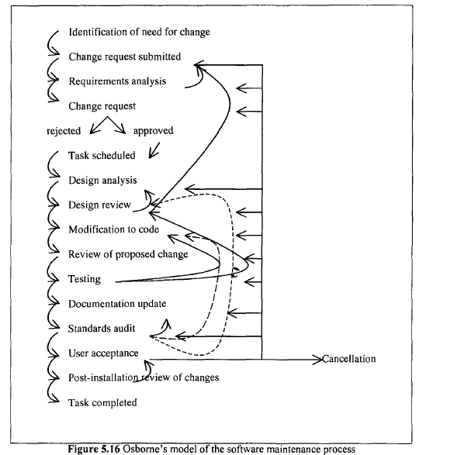

Slide 37
Osborne hypothesizes that many technical problems which arise during maintenance are due to inadequate management communications and control, and recommends a strategy that includes:
1.the inclusion of maintenance requirements in the change specification;
2.a software quality assurance program which establishes quality assurance requirements;
3.a means of verifying that maintenance goals have been met; performance review to provide feedback to managers

Slide 38
Iterative Enhancement Model
This model requires complete documentation as starting point of each iteration
Analyze Existing System
Characterize Proposed Modifications
Redesign Current Version & Implement
It is similar to evolutionary development paradigm
It is a three stage cycle
Existing documentation for each stage is:
- Requirement documentation, Design Documentation, Source code documentation, & Test documentation

Slide 39
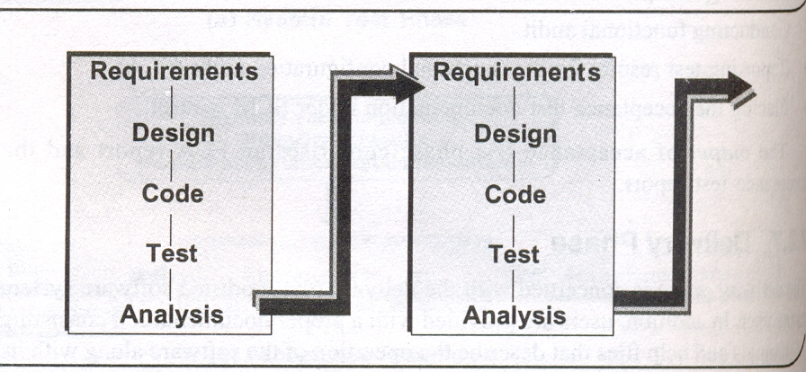
Iterative Enhancement Model

Slide 40
The Reuse-Oriented Model
Maintenance is viewed as the activity involving the reuse of existing program components.
It builds a component library for reusing requirements, design, source code, and test-data.
A detailed framework is required for classification of components for reuse.

Slide 41
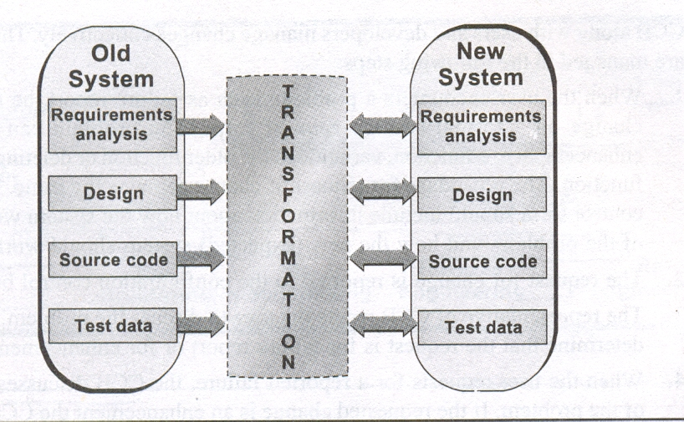
Reuse-oriented Model
Component Library

Slide 42
The Reuse-oriented Model has 4 main steps:
Identifying the parts of the old system which have the potential for reuse,
Fully understanding the system parts,
Modifying the old system parts according to the new requirements, and
Integrating the modified parts into the new system.

Slide 43
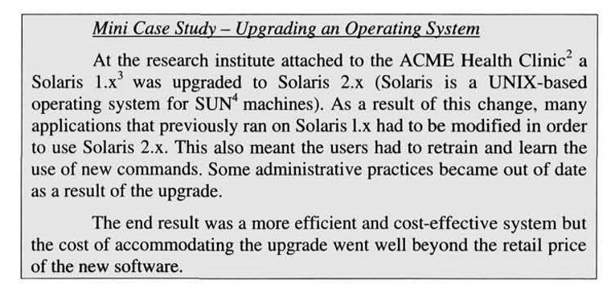
Case study

Slide 44
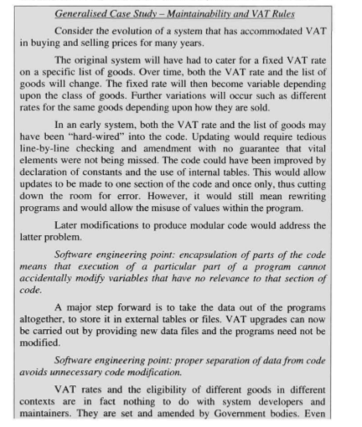
Case study2

Slide 45
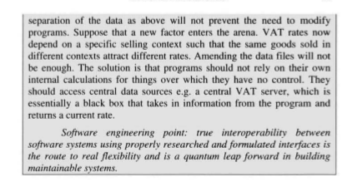
Case study 2 continuation

Slide 46
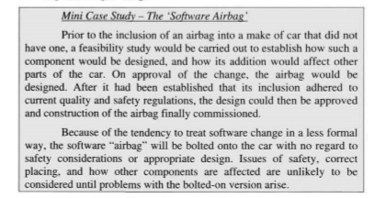
Casestudy 3

Slide 47
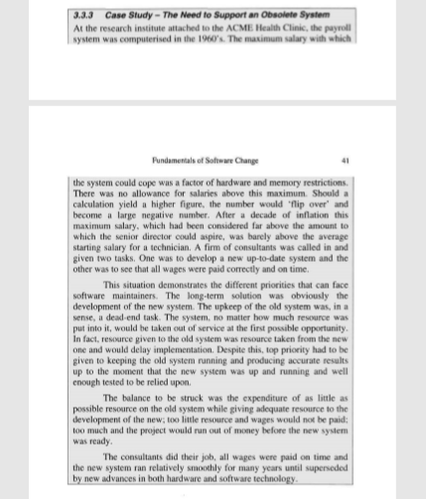
Casestudy 4

Slide 48
THANK YOU

