Slide 1
HDLC HIGH-LEVEL DATA LINK CONTROL PROTOCOL
BY
JOTHIMANI.A
AP/CSE

Slide 2
HDLC-DEFINITION
High-level Data Link Control (HDLC) is a bit- oriented protocol i.e use bits to stuff flags occurring in data.
HDLC was defined by ISO for use on both point-to-point and multipoint data links.
It supports full-duplex communication i.e receive and transmit at the same time.
ITU modified HDLC for use in X.25 network interface and called it Balanced Link Access Protocol (LAPB)
Other similar protocols are
Synchronous Data Link Control (SDLC) by IBM
Advanced Data Communication Control Procedure
(ADCCP) by ANSI

Slide 3
HDLC-FEATURES
Reliable protocol
selective repeat or go-back-N
Full-duplex communication
receive and transmit at the same time
Bit-oriented protocol
use bits to stuff flags occurring in data . i.e, it does NOT recognize or interpret byte value
Flow control
adjust window size based on receiver capability
Uses physical layer clocking and synchronization to send and receive frames

Slide 4
HDLC-OVERVIEW
Defines three types of stations
Primary
Secondary
Combined
Defines three types of data transfer mode
Normal Response mode
Asynchronous Response mode
Asynchronous Balanced mode
Three types of frames
Unnumbered
information
Supervisory

Slide 5
HDLC STATIONS
The three stations are :
Primary station
Has the responsibility of controlling the operation of data flow .
Handles error recovery
Frames issued by the primary station are called commands.
Secondary station,
Operates under the control of the primary station.
Frames issued by a secondary station are called responses.
The primary station maintains a separate logical link with each secondary station.
Combined station,
Acts as both as primary and secondary station

Slide 6
THREE TRANSFER MODES
1. NORMAL RESPONSE MODE(NRM)
2. ASYNCHRONOUS RESPONSE MODE(ARM)
3. ASYNCHRONOUS BALANCE MODE (ABM)
The three modes of data transfer operations are
Normal Response Mode (NRM)
Secondary station can send ONLY when the primary station instruct it to do so
Two common configurations
Point-to-Point link (one primary station and one secondary station)
Multipoint link (the primary station maintain different sessions with different secondary stations)
Asynchronous Response Mode (ARM)
More independent secondary station
Can send data or control information without explicit permission to do so (note that it is still can not send commands)
Asynchronous Balanced Mode (ABM)
Mainly used in point-to-point links, for communication between combined stations
Either stations can send data, control information and commands

Slide 7
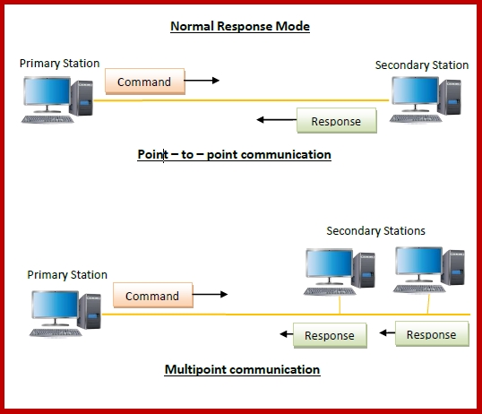
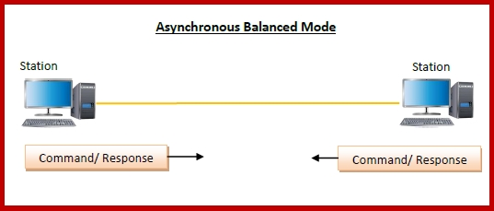
CONTD..

Slide 8
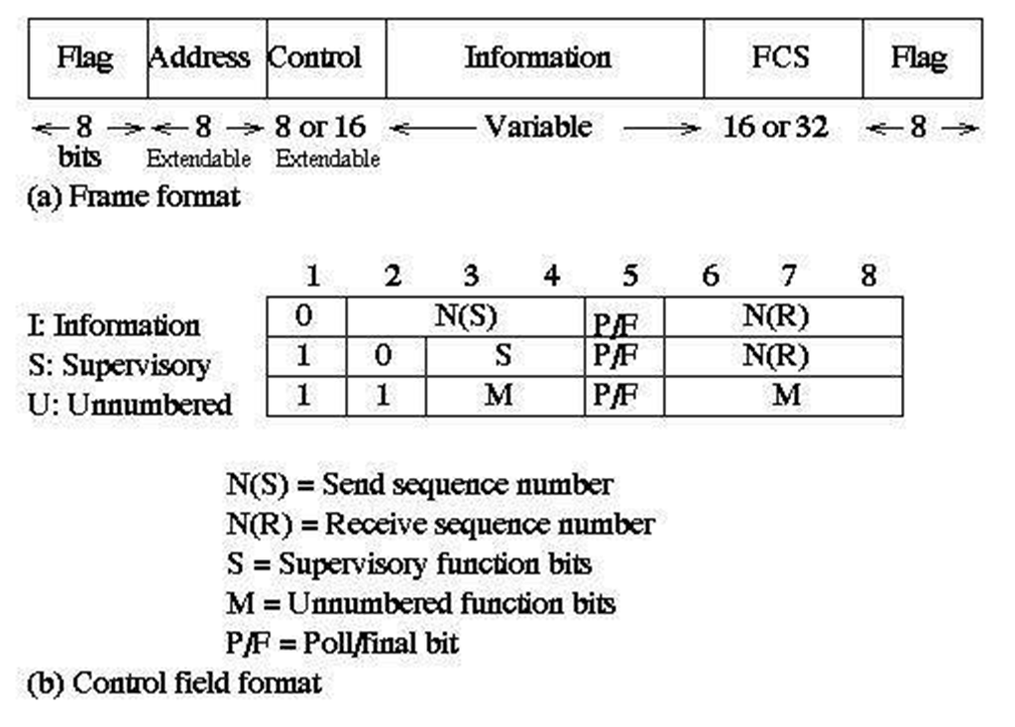
HDLC FRAME & CONTROL FIELD FORMAT

Slide 9
HDLC THREE FRAMES
Unnumbered frames (U-frames) :- These frames are used in link set-up and disconnection.
Information frames (I-frames) :-
These frames carry the actual information.
Supervisory frames (S-frames) :-
S-frames are used only to transport control information
Flag: 01111110- indicates start and ending of frames
FCS: 16-bit CRC using generating polynomial
G(x) = x¹⁶ + x¹² + x⁵ + 1
Address field:
When a primary station is sending a frame, the address field contains the receiver identity
If a secondary station is sending the frame, the address field
contains the sender identity

Slide 10
CONTD.
In some cases, it contains a group or broadcast address
In I-frames, N(s) is the sequence number of the frame being sent, and N(r) is the sequence number of the frame being expected.
The P/F bit, known as the poll/final bit, is used with different meaning in different contexts.
It is used to indicate polling, to indicate the final I-frame, etc
There are four different supervisory frames
SS=00, Receiver Ready (RR), and N(R) ACKs all frames received up to and including the one with sequence number N(R) - 1
SS=10, Receiver Not Ready (RNR), and N(R) has the same meaning as above
SS=01, Reject; all frames with sequence number N(R) or higher are rejected, which in turns ACKs frames with sequence number N(R) -1 or lower.
SS=11, Selective Reject; the receive rejects the frame with
sequence number N(R)

Slide 11
The unnumbered frames can be grouped into the following categories:
Mode-setting commands and responses
Recovery commends and responses
Miscellaneous commands and responses

