Slide 1
15CS201J-DATA STRUCTURES
UNIT-I
INTRODUCTION
TO
DATA STRUCTURES

Slide 2
Assignment Method:
Cycle Test I - 10%
Cycle Test II - 15%
Cycle Test III - 15%
Surprise Test - 5%
Assignment - 5%
---------------------------------
Total - 50%

Slide 3
Text Books
Seymour Lipschutz, “ Data Structures with C”,McGraw Hill Education, Special Indian Edition, 2014.
Mark Allen Weiss, “Data Structures and Algorithm Analysis in C”, 2nd Edition, Pearson Education, 2011.

Slide 4
Outline
Introduction
Basic terminology
Data structures–operations
ADT– Algorithms:
Complexity, Time – Space trade off
Mathematical notations and functions
Asymptotic notations
Linear and Binary search
Bubble sort -Insertion sort

Slide 5
Elementary Data Organization
Data are simply values or sets of values.
Collection of data are frequently organized into a hierarchy of fields, records and files.
This organization of data may not complex enough to maintain and efficiently process certain collections of data.
For this reason, data are organized into more complex type of structures called Data Structures.

Slide 6
DATA vs INFORMATION
DATA
INFORMATION
Raw Fact – about anything
Computers need data
Data doesn’t depend on Information
Input to any system may be treated as Data
Data – Raw Material
Data may not be in the order.
Processed data
Human needs information
Information depends on data.
Output after processing the data given to the system is Information.
Information – Product
Information should be in the order.

Slide 7

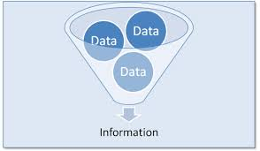

Information
Data + Meaning
Processed data (Making data meaningful and useful)
Subset of Data
Manipulated raw data

Slide 8
Example
Data
Information
Ingredients
01/01, or 01012015, or 20150101 – Date as data
Each student's test score is one piece of data.
Recipe
New Year’s Day, First day in a year
Performance of a student, Average score of a class, Performance of a school - information, derived from the given data.

Slide 9

Processing of data
Collection of Data
Organizing in a structure
Manipulation of data for need

Slide 10
Data Structure
Organizing Data in computer memory - To use efficiently (Algorithm Efficiency)
Way of collecting and organising data in such a way that we can perform operations on these data in an effective way
Anything that can store data
Rendering data elements in terms of some relationship, for better organization and storage
Store ordered data

Slide 11
Data Structure
Primitive Data Structure
Non – Primitive/User Defined Data Structure
Integer
Float
Character
Boolean
Linear Data Structure
Non - Linear Data Structure
Arrays
Stack
Queues
Linked List
Trees
Graphs

Slide 12
Linear Data Structure
If the elements organized in the data structure form a sequence
Data element relationship/Arrangement in linear fashion
Representation of linear data structures in memory – (Two Ways)
1. Elements in Consecutive/sequential
memory locations - Arrays
2. Elements with link to other element – Linked List
Other Linear Data Structures
Stacks, Queues

Slide 13
Non – Linear Data Structure
Data's are not arranged in sequence
Example:
Trees and Graphs

Slide 14
Static Data Structure
Memory size is fixed
Size of the Data Structure – Predefined
Memory Allocated at compile time
Advantage:
No need to check/Keep track of size of the data
structure
Disadvantage:
Memory can’t be utilized efficiently as it is assigned even after deletion of values

Slide 15
Dynamic Data Structure
Memory is allocated to the data structure as the program executes – Dynamically (at run time)
Used when size of the data structure is not known in advance
Memory size – not fixed used as need
Advantage:
Memory is used efficiently, assigned only as
much is needed.
Disadvantage:
Should keep track of memory utilized

Slide 16
Data Structure Operations
Traversing: Accessing each record exactly once so that certain items in the
record may be processed.
2. Searching: Finding the location of the record with a given key value.
3. Inserting: Adding a new record to the structure.
4. Deleting: Removing a record from the structure.
5. Sorting: Arranging the records in some logical order.
Merging: Combing the records in two different sorted files into a single
sorted file.

Slide 17
Algorithm
Problem
Algorithm
“Computer”
Input
Output

Slide 18
Algorithm
An Algorithm is a sequence of unambiguous instructions for solving a problem,
i.e., for obtaining a required output for any legitimate input in a finite amount of time.

Slide 19
Properties of Algorithm
Finiteness
Terminates after a finite number of steps
Definiteness
Clear, rigorously (Exact and Accurate) and unambiguously specified
Input
valid inputs are clearly specified
Clearly specified/expected output
can be proved to produce the correct output given a valid input
Effectiveness
Steps are sufficiently simple and basic

Slide 20
Types of Algorithm
1) Iterative
A()
{
for i=1 to n
max(a,b)
}
Recursive
A(n)
{
if( )
A(n/2)
}

Slide 21
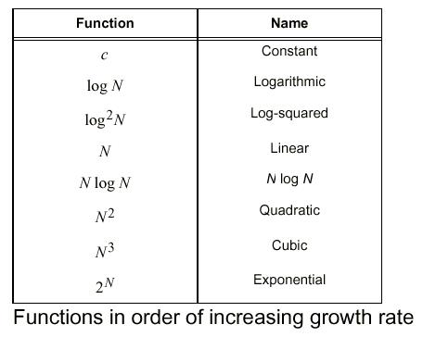
Algorithmic Efficiency Function

Slide 22
Basic Efficiency Classes
Class | Name | Comments
1 | constant | May be in best cases
lgn | logarithmic | Halving problem size at each iteration
n | linear | Scan a list of size n
n×lgn | linearithmic | Divide and conquer algorithms, e.g., mergesort
n² | quadratic | Two embedded loops, e.g., selection sort
n³ | cubic | Three embedded loops, e.g., matrix multiplication
2^{n} | exponential | All subsets of n-elements set
n! | factorial | All permutations of an n-elements set

Slide 23
Measure running time in terms of # of basic operations
Basic operation: the operation that contributes the most to the total running time of an algorithm
Usually the most time consuming operation in the algorithm’s innermost loop

Slide 24
Input size and basic operation examples
Problem | Measure of input size | Basic operation
Search for a key in a list of n items | # of items in the list | Key comparison
Add two n×n matrices | Dimensions of the matrices, n | Addition
Polynomial evaluation | Order of the polynomial | Multiplication

Slide 25
Asymptotic Notations
3 notations used to compare orders of growth of an algorithm’s basic operation count
O(g(n)): Set of functions that grow no faster than g(n)-Worst Case
Ω(g(n)): Set of functions that grow at least as fast as g(n)-Best Case
Θ(g(n)): Set of functions that grow at the same rate as g(n)-Average Case

Slide 26
O-Notation (contd.)
Definition: A function t(n) is said to be in O(g(n)), denoted t(n) є O(g(n)), if t(n) is bounded above by some positive constant multiple of g(n) for sufficiently large n.
If we can find +ve constants c and n₀ such that:
t(n) ≤ c × g(n) for all n ≥ n₀

Slide 27
O(big oh)-Notation
c × g(n)
t(n)
Doesn’t
matter
n
n₀
t(n) є O(g(n))

Slide 28
Ω-Notation (contd.)
Definition: A function t(n) is said to be in Ω(g(n)) denoted t(n) є Ω(g(n)), if t(n) is bounded below by some positive constant multiple of g(n) for all sufficiently large n.
If we can find +ve constants c and n₀ such that
t(n) ≥ c × g(n) for all n ≥ n₀

Slide 29
Ω(big omega)-Notation
t(n)
c × g(n)
Doesn’t
matter
n
n₀
t(n) є Ω(g(n))

Slide 30
Θ-Notation (contd.)
Definition: A function t(n) is said to be in Θ(g(n)) denoted t(n) є Θ(g(n)), if t(n) is bounded both above and below by some positive constant multiples of g(n) for all sufficiently large n.
If we can find +ve constants c₁, c_{2,} and n₀ such that
c₂×g(n) ≤ t(n) ≤ c₁×g(n) for all n ≥ n₀

Slide 31
Θ(big theta)-Notation
c₁ × g(n)
t(n)
c₂ × g(n)
Doesn’t
matter
n
n₀
t(n) є Θ(g(n))

Slide 32
Complexity of Algorithms
The complexity of an algorithm M is the function f(n) which gives the running time and/or storage space requirement of the algorithm in terms of the size n of the input data.
Two types of complexity
1. Time Complexity
2. Space Complexity

Slide 33
Performance Analysis of Algorithm
An investigation of an algorithm’s efficiency with respect to two resources:
Space Complexity
Amount of memory an algorithm needs to perform the computation
Time Complexity
Amount of CPU time an algorithm needs to run to completion.

Slide 34
Space Complexity
S(P) = c + S_{p}(instance)
Memory space S(P) needed by a program P, consists of two components:
A fixed part: needed for instruction space (Space for the code), simple variable space, constants space etc. → c (Ignore c during calculation)
A variable part: dependent on a particular instance of input and output data. → S_{p}(instance)
For constant no of variables (constant space complexity) –O(1)
For an array of n elements ( linear space complexity) – O(n)

Slide 35
Example-1
Algorithm abc (a, b, c)
{
return a+b+b*c+(a+b-c)/(a+b)+4.0;
}
Space required to store variables: a, b, and c. S_{p}()= 3. S(P) = 3.

Slide 36
Example 2
Algorithm Sum(a[], n)
{
s:= 0.0;
for i = 1 to n do
s := s + a[i];
return s;
}
n = 1
a[ ] = n (for n elements)
i = 1
s = 1
S_{p}(n) = (n + 3).
Hence S(P) = (n + 3).

Slide 37
Time Complexity
T(P) = c + t_{p}(instance)
Time required T(P) to run a program P also consists of two components:
A fixed part: compile time which is independent of the problem instance → c. (Ignore c during calculation)
A variable part: run time which depends on the problem instance → t_{p}(instance)

Slide 38
Theoretical Analysis of Time Efficiency
Count the number of times the algorithm’s basic operation is executed on inputs of size n: C(n)
T(n) ≈ c_{op} + C(n)
Input size
Ignore c_{op},
Focus on
orders of growth
# of times basic op.
is executed
Running time
Execution time for
basic operation

Slide 39
Example-1
Algorithm Sum(a[],n)
{
S = 0.0; 1
for i=1 to n do n
s = s+a[i]; n
return s; 1
}
2n + 2=O(n)

Slide 40
Example-2
Algorithm Sum(a[],n,m)
{
for i=1 to n do; n
for j=1 to m do nm
s = s+a[i][j]; nm
return s; 1
}
2nm + n + 1
=O(nm)

Slide 41
Iterative - Example
A()
{
int i;
for(i=1 to n)
printf (“abc”);
}
Soln: O(n)

Slide 42
Iterative - Example
A()
{
int I;
for(i=1 to n)
for(j=1 to n)
printf(“abc”);
}
Soln:
nxn= n²

Slide 43
Iterative - Example
A()
{
for(i=1;i^2<=n;i++)
print(“ “);
}
Soln:
n= i²
^{i=√n}

Slide 44
Iterative - Example
A()
{
int i,j,k,n; Soln:
for (i=1;i<=n;i++) =n
{
for (j=1;j<=i^2;j++) =nx n²
{ = n³
for(k=1;k<=n/2;k++) = n/2 x n³
{ = O(n⁴⁾
printf(“ “);
}
}
}

Slide 45
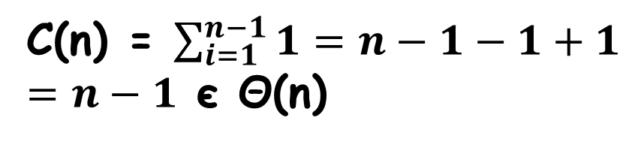
Example
ALGORITHM MaxElement(A[0..n-1])
//Determines largest element
maxval <- A[0]
for i <- 1 to n-1 do
if A[i] > maxval
maxval <- A[i]
return maxval
Input size: n
Basic operation: > or <-
C(n) = $\sum_{i=1}^{n−1}{1}=n−1−1+1$
$=n−1$єΘ(n)

Slide 46
Example
ALGORITHM UniqueElements(A[0..n-1])
//Determines whether all elements are //distinct
for i <- 0 to n-2 do
for j <- i+1 to n-1 do
if A[i] = A[j]
return false
return true
Input size: n
Basic operation: A[i] = A[j]
Does C(n) depend on type of input?

Slide 47

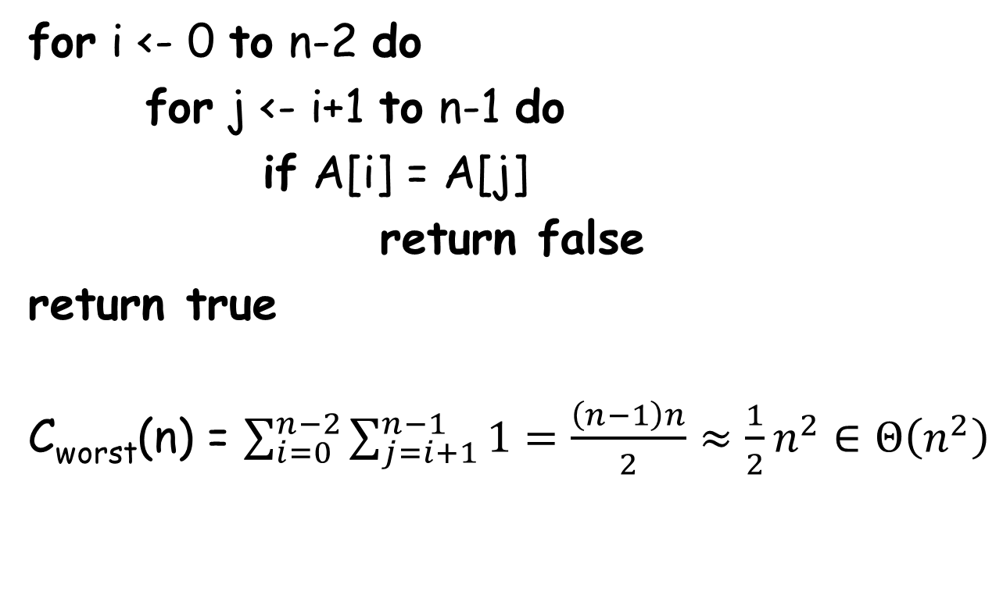
UniqueElements (contd.)
fori<- 0 to n-2 do
for j <- i+1 to n-1 do
if A[i] = A[j]
return false
return true
C_{worst}(n) = $\sum_{i=0}^{n−2}{\sum_{j=i+1}^{n−1}{1}}=\frac{\left(n−1\right)n}{2}≈\frac{1}{2}n^{2}∈Θ\left(n^{2}\right)$
Why C_{worst}(n) $∈Θ\left(n^{2}\right)$ is better than
saying C_{worst}(n) $∈O\left(n^{2}\right) ?$

Slide 48
General Plan for Recursive Algorithms
Decide on input size parameter
Identify the basic operation
Does C(n) depends also on input type?
Set up a recurrence relation
Solve the recurrence or, at least establish the order of growth of its solution

Slide 49
Solving Recurrence Relations
To solve a recurrence relation T(n) we need to derive a form of T(n) that is not a recurrence relation. Such a form is called a closed form of the recurrence relation.
There are five methods to solve recurrence relations that represent the running time of recursive methods:
Iteration method (unrolling and summing)
Substitution method (Guess the solution and verify by induction)
Recursion tree method
Master theorem (Master method)
Using Generating functions or Characteristic equations
In this course, we will use the Iteration method

Slide 50

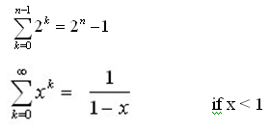


Iteration method
Steps:
Expand the recurrence
Express the expansion as a summation by plugging the recurrence back into itself until you see a pattern.
Evaluate the summation
In evaluating the summation one or more of the following summation formulae may be used:
Arithmetic series:
Geometric Series:
Special Cases of Geometric Series:

Slide 51

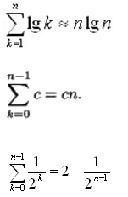
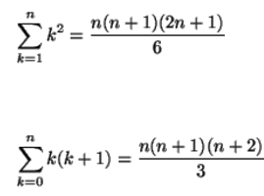
Solving Recurrence Relations - Iteration method (Cont’d)
Harmonic Series:
Others:

Slide 52
Example-1 Factorial
ALGORITHM F(n)
// Output: n!
if n = 0
return 1
else
return F(n-1)xn
Input size: n
Basic operation: ×
M(n) = M(n-1) + 1 for n > 0
to compute
F(n-1)
to multiply
n and F(n-1)

Slide 53
Analysis Of Recursive Factorial method
Example1: Form and solve the recurrence relation for the running time of factorial method and hence determine its big-O complexity:
T(0) = c (1)
T(n) = b + T(n - 1) (2)
= b + b + T(n - 2) by subtituting T(n – 1) in (2)
= b +b +b + T(n - 3) by substituting T(n – 2) in (2)
…
= kb + T(n - k)
The base case is reached when n – k = 0 → k = n, we then have:
T(n) = nb + T(n - n)
= bn + T(0)
= bn + c
Therefore the method factorial is O(n)
long factorial (int n) {
if (n == 0)
return 1;
else
return n * factorial (n – 1);
}

Slide 54
Analysis Of Recursive Binary Search
public int binarySearch (int target, int[] array,
int low, int high) {
if (low > high)
return -1;
else {
int middle = (low + high)/2;
if (array[middle] == target)
return middle;
else if(array[middle] < target)
return binarySearch(target, array, middle + 1, high);
else
return binarySearch(target, array, low, middle - 1);
}
}
The recurrence relation for the running time of the method is:
T(1) = a if n = 1 (one element array)
T(n) = T(n / 2) + b if n > 1

Slide 55
Analysis Of Recursive Binary Search (Cont’d)
Without loss of generality, assume n, the problem size, is a multiple of 2, i.e., n = 2^{k}
Expanding:
T(1) = a (1)
T(n) = T(n / 2) + b (2)
= [T(n / 2²) + b] + b = T (n / 2²) + 2b by substituting T(n/2) in (2)
= [T(n / 2³) + b] + 2b = T(n / 2³) + 3b by substituting T(n/2²) in (2)
= ……..
= T( n / 2^{k}) + kb
The base case is reached when n / 2^{k} = 1 ➔ n = 2^{k} ➔ k = log₂ n, we then
have:
T(n) = T(1) + b log₂ n
= a + b log₂ n
Therefore, Recursive Binary Search is O(log n)

Slide 56
Analysis Of Recursive Fibonacci
long fibonacci (int n) { // Recursively calculates Fibonacci number
if( n == 1 || n == 2)
return 1;
else
return fibonacci(n – 1) + fibonacci(n – 2);
}
T(n) = c if n = 1 or n = 2 (1)
T(n) = T(n – 1) + T(n – 2) + b if n > 2 (2)
We determine a lower bound on T(n):
Expanding: T(n) = T(n - 1) + T(n - 2) + b
≥ T(n - 2) + T(n-2) + b
= 2T(n - 2) + b
= 2[T(n - 3) + T(n - 4) + b] + b by substituting T(n - 2) in (2)
≥ 2[T(n - 4) + T(n - 4) + b] + b
= 2²T(n - 4) + 2b + b
= 2²[T(n - 5) + T(n - 6) + b] + 2b + b by substituting T(n - 4) in (2)
≥ 2³T(n – 6) + (2² + 2¹ + 2⁰)b
. . .
≥ 2^{k}T(n – 2k) + (2^{k-1} + 2^{k-2} + . . . + 2¹ + 2⁰)b
= 2^{k}T(n – 2k) + (2^{k} – 1)b
The base case is reached when n – 2k = 2 → k = (n - 2) / 2
Hence T(n) ≥ 2 ^{(n – 2) / 2} T(2) + [2 ^{(n - 2) / 2} – 1]b
= (b + c)2 ^{(n – 2) / 2} – b
= [(b + c) / 2]*(2)^{n/2} – b → Recursive Fibonacci is exponential

Slide 57
Algorithmic Notation
Example:
Write an algorithm for finding the location of the largest element of an array Data.
Largest-Item (Data, N, Loc)
1. [Initialize] Set k:=1, Loc:=1 and Max:=Data[1]
2. [Increment Counter] Set k:=k+1
3. [Test Counter] If k > N , then :
Write: Loc, Max and Exit
4. [Compare and Update] If Max < Data[k] ,then :
Set Loc:=k and Max:=Data[k]
5. [Repeat loop] Go to Step 2.

Slide 58
Analysis of Algorithm Properties
Measuring an input’s size
Measuring Running Time
Orders of Growth (of algorithm’s efficiency function)-based on the variation of inputs
Best-case – first found
Average-case – mid find
Worst-case – last found or not found

Slide 59
Worst, Best, Average Cases
Efficiency depends on input size n
For some algorithms, efficiency depends on the type of input
Example: Linear Search
Given a list of n elements and a search key k, find if k is in the list
Scan list, compare elements with k until either found a match (success), or list is exhausted (failure)

Slide 60
Linear Search Algorithm
ALGORITHM LinearSearch(A[0..n-1], k)
//Input: A[0..n-1] and k
//Output: Index of first match or -1 if no match is //found
i <- 0
while i < n and A[i] ≠ k do
i <- i+1
if i < n
return i //A[i] = k
else
return -1

Slide 61
Worst Case Time for Linear Search
For an array of n elements, the worst case time for serial search requires n array accesses: O(n).
Consider cases where we must loop over all n records:
desired record appears in the last position of the array
desired record does not appear in the array at all

Slide 62
Worst Case for Linear Search
Assumptions:
All keys are equally likely in a search
We always search for a key that is in the array
Example:
We have an array of 10 records.
If search for the first record, then it requires 1 array access; if the second, then 2 array accesses. etc.
The average of all these searches is:
(1+2+3+4+5+6+7+8+9+10)/10 = 5.5

Slide 63
Worst Case Time for Linear Search
Generalize for array size n.
Expression for average-case running time:
=(1+2+…+n)/n
= n(n+1)/2n
= (n+1)/2
Therefore, average case time complexity for serial search is O(n).

Slide 64
Binary Search
Requires a sorted array or a binary search tree.
Cuts the “search space” in half each time.
Keeps cutting the search space in half until the target is found or has exhausted the all possible locations.

Slide 65
Binary Search Algorithm
look at “middle” element
if no match then
look left (if need smaller))
or right (if greater)

Slide 66
The Binary Search Algorithm
Return found or not found (true or false), so it should be a function.
When move left or right, change the array boundaries
We’ll need a first and last

Slide 67
The Binary Search Algorithm
calculate middle position
if (first and last have “crossed”) then
“Item not found”
elseif (element at middle = to_find) then
“Item Found”
elseif to_find < element at middle then
Look to the left
else
Look to the right

Slide 68
Looking Left
Use indices “first” and “last” to keep track of where we are looking
Move left by setting last = middle – 1
7 12 42 59 71 86 104 212
F
L
M
L

Slide 69
Looking Right
Use indices “first” and “last” to keep track of where we are looking
Move right by setting first = middle + 1
7 12 42 59 71 86 104 212
F
M
F
L

Slide 70
Binary Search Example – Found
7 12 42 59 71 86 104 212
F
M
L
Looking for 42

Slide 71
Binary Search Example – Found
7 12 42 59 71 86 104 212
F
M
L
Looking for 42

Slide 72
Binary Search Example – Found
7 12 42 59 71 86 104 212
F
M
L
42 found – in 3 comparisons

Slide 73
Binary Search Example – Not Found
7 12 42 59 71 86 104 212
F
M
L
Looking for 89

Slide 74
Binary Search Example – Not Found
7 12 42 59 71 86 104 212
F
M
L
Looking for 89

Slide 75
Binary Search Example – Not Found
7 12 42 59 71 86 104 212
F
L
M
Looking for 89

Slide 76
Binary Search Example – Not Found
7 12 42 59 71 86 104 212
L
F
89 not found – 3 comparisons

Slide 77
Binary Search Function
Function Find return boolean (A Array, first, last, to_find)
middle <- (first + last) div 2
if (first > last) then
return false
elseif (A[middle] = to_find) then
return true
elseif (to_find < A[middle]) then
return Find(A, first, middle–1, to_find)
else
return Find(A, middle+1, last, to_find)
endfunction

Slide 78
Binary Search Analysis: Best Case
Best Case:
1 comparison
Best Case: match from the firs comparison
1 7 9 12 33 42 59 76 81 84 91 92 93 99
Target: 59

Slide 79

Binary Search Analysis: Worst Case
How many comparisons??
Worst Case: divide until reach one item, or no match.

Slide 80
Binary Search Analysis: Worst Case
With each comparison we throw away ½ of the list
N
…………
1 comparison
N/2
…………
1 comparison
Number of steps is at
most ➔Log₂N
N/4
…………
1 comparison
N/8
…………
1 comparison
.
.
.
1
…………
1 comparison

Slide 81
Analysis of Linear and Binary Search
Binary search reduces the work by half at each comparison
If array is not sorted ➔ Linear Search
Best Case O(1)
Worst Case O(N)
If array is sorted ➔ Binary search
Best Case O(1)
Worst Case O(Log₂N)

Slide 82
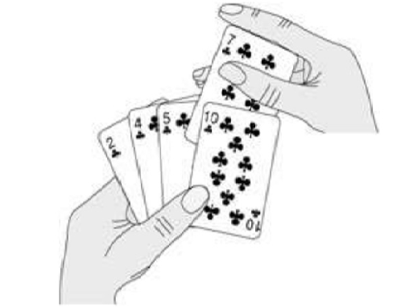
Insertion Sort

Slide 83
Definition
Insertion sort is a simple sorting algorithm that builds the final sorted array (or list) one item at a time. It is much less efficient on large lists than more advanced algorithms such as quick sort, heap sort, or merge sort.
More efficient than selection sort and bubble sort

Slide 84
Two Steps
Selection
Compare – Shift - Insert

Slide 85
Example of insertion sort
8
2
4
9
3
6

Slide 86
Example of insertion sort
8
2
4
9
3
6

Slide 87
Example of insertion sort
8
2
4
9
3
6
2
8
4
9
3
6

Slide 88
Example of insertion sort
8
2
4
9
3
6
2
8
4
9
3
6

Slide 89
Example of insertion sort
8
2
4
9
3
6
2
8
4
9
3
6
2
4
8
9
3
6

Slide 90
Example of insertion sort
8
2
4
9
3
6
2
8
4
9
3
6
2
4
8
9
3
6

Slide 91
Example of insertion sort
8
2
4
9
3
6
2
8
4
9
3
6
2
4
8
9
3
6
2
4
8
9
3
6

Slide 92
Example of insertion sort
8
2
4
9
3
6
2
8
4
9
3
6
2
4
8
9
3
6
2
4
8
9
3
6

Slide 93
Example of insertion sort
8
2
4
9
3
6
2
8
4
9
3
6
2
4
8
9
3
6
2
4
8
9
3
6

Slide 94
2
4
8
9
3
6
2
4
8
3
9
6
2
4
3
8
9
6
2
3
4
8
9
6

Slide 95
Example of insertion sort
2
3
4
8
9
6
2
3
4
8
6
6
2
3
4
6
8
6

Slide 96
Example of insertion sort
8
2
4
9
3
6
2
8
4
9
3
6
2
4
8
9
3
6
2
4
8
9
3
6
2
3
4
8
9
6
2
3
4
6
8
9
done

Slide 97
An array of Elements - Unordered
Left – Sorted
Right – Unsorted
Steps
Key selection – Always the first key element is the second element in the array
Compare with previous element
If Key smaller than previous – Swap with previous element until key get inserted in correct position (While loop)
Else Change the key element as the next element to the previous key
Repeat step 1 to 4 until the n-1th element becomes the key and get inserted in correct position (For loop)

Slide 98
Algorithm
InsertionSort(A[0…n-1])
//Sorts a given array by Insertion Sort
//Input: An array A[0…n-1] of n elements
//Output: Array A[0…n-1] sorted in nondecreasing order
for j ← 1 to n-1
do key ← A[ j ]
i ← j - 1
while i ≥ 0 and A[i] > key
do A[i + 1] ← A[i]
i ← i – 1
A[i + 1] ← key
Selection
Comparison
Shift
Insert

Slide 99
Complexity
Space/Memory
Time
Count a particular operation
Count number of steps
Asymptotic complexity

Slide 100
Best Case Analysis
Elements 1 2 3 4 5 6
J=1, key=a[1]=2
i=0, while 0>=0 and a[0]>key
1>2,false ,hence go to for loop
j=2,key=a[2]=3
i=1,while 1>=0 and a[1]>key
2>3,false, hence go to for loop
Hence the comparisons are
j=1, i=0 1>2
j=2, i=1 2>3
j=3, i=2 3>4
j=4, i=3 4>5
j=5 ,i=4 5>6
While loop runs for (n-1) times and the cond is false.
Hence (n-1) times execution is done.
So the order is O(n-1)=O(n)

Slide 101
Worst-Case Analysis
Elements 6 5 4 3 2 1
In Ist pass= 1 comparison,1 swap
In 2nd pass= 2 comparison,2 swap
In 3rd pass= 3 comparison,3 swap
……
We have (n-1) passes=5 passes (i.e) 1 + 2 + 3 + 4 + 5
(n-5)+(n-4)+(n-3)+(n-2)+(n-1)
total compares = 1 + 2 + 3 + … + (n-1)
= (n-1)n/2
=n²-n/2
=O(n² )

Slide 102
Advantages and disadvantages of Insertion sort
Advantages:
They are efficient for small sets of data
They are simply implemented
Insertion sorts pass through the array only once
They are adaptive; efficient for data sets that are already sorted.
Disadvantages:
It’s less efficient on larger list and arrays.

Slide 103
The Bubble Sort
Bubble sort, sometimes referred to as sinking sort, is a simple sorting algorithm that repeatedly steps through the list to be sorted, compares each pair of adjacent items and swaps them if they are in the wrong order.

Slide 104
The Bubble Sort
Each scan will push the maximum element to the top
3 5 6 2 8 9 1
3 5 6 2 8 9 1
3 5 2 6 8 9 1
3 5 2 6 8 9 1
3 5 2 6 8 9 1
3 5 2 6 8 1 9

Slide 105
The Bubble Sort
Starts at one end of the array and make repeated scans through the list comparing successive pairs of elements
5 3 6 2 8 9 1
If the first element is larger than the second, called an inversion, then the values are swapped
3 5 6 2 8 9 1

Slide 106
The Bubble Sort
This is the “bubbling” effect that gives the bubble sort its name
This process is continued until the list is sorted
The more inversions in the list, the longer it takes to sort

Slide 107
"Bubbling Up" the Largest Element
Traverse a collection of elements
Move from the front to the end
“Bubble” the largest value to the end using pair-wise comparisons and swapping
1 2 3 4 5 6
77
42
35
12
101
5

Slide 108
"Bubbling Up" the Largest Element
Traverse a collection of elements
Move from the front to the end
“Bubble” the largest value to the end using pair-wise comparisons and swapping
1 2 3 4 5 6
Swap
42
77
77
42
35
12
101
5

Slide 109
"Bubbling Up" the Largest Element
Traverse a collection of elements
Move from the front to the end
“Bubble” the largest value to the end using pair-wise comparisons and swapping
1 2 3 4 5 6
Swap
35
77
42
77
35
12
101
5

Slide 110
"Bubbling Up" the Largest Element
Traverse a collection of elements
Move from the front to the end
“Bubble” the largest value to the end using pair-wise comparisons and swapping
1 2 3 4 5 6
Swap
12
77
42
35
77
12
101
5

Slide 111
"Bubbling Up" the Largest Element
Traverse a collection of elements
Move from the front to the end
“Bubble” the largest value to the end using pair-wise comparisons and swapping
1 2 3 4 5 6
42
35
12
77
101
5
No need to swap

Slide 112
"Bubbling Up" the Largest Element
Traverse a collection of elements
Move from the front to the end
“Bubble” the largest value to the end using pair-wise comparisons and swapping
1 2 3 4 5 6
Swap
5
101
42
35
12
77
101
5

Slide 113
"Bubbling Up" the Largest Element
Traverse a collection of elements
Move from the front to the end
“Bubble” the largest value to the end using pair-wise comparisons and swapping
1 2 3 4 5 6
101
42
35
12
77
5
Largest value correctly placed

Slide 114
The “Bubble Up” Algorithm
index <- 1
last_compare_at <- n – 1
loop
exitif(index > last_compare_at)
if(A[index] > A[index + 1]) then
Swap(A[index], A[index + 1])
endif
index <- index + 1
endloop

Slide 115
Items of Interest
Notice that only the largest value is correctly placed
All other values are still out of order
So we need to repeat this process
1 2 3 4 5 6
101
42
35
12
77
5
Largest value correctly placed

Slide 116
Repeat “Bubble Up” How Many Times?
If we have N elements…
And if each time we bubble an element, we place it in its correct location…
Then we repeat the “bubble up” process N – 1 times.
This guarantees we’ll correctly place all N elements.

Slide 117
“Bubbling” All the Elements
1 2 3 4 5 6
42
35
12
77
5
101
1 2 3 4 5 6
35
12
42
5
77
101
1 2 3 4 5 6
N - 1
12
35
5
42
77
101
1 2 3 4 5 6
12
5
35
42
77
101
1 2 3 4 5 6
5
12
35
42
77
101

Slide 118
Reducing the Number of Comparisons
1 2 3 4 5 6
77
42
35
12
101
5
1 2 3 4 5 6
42
35
12
77
5
101
1 2 3 4 5 6
35
12
42
5
77
101
1 2 3 4 5 6
12
35
5
42
77
101
1 2 3 4 5 6
12
5
35
42
77
101

Slide 119
Reducing the Number of Comparisons
On the N^{th} “bubble up”, we only need to do MAX-N comparisons.
For example:
This is the 4th “bubble up”
MAX is 6
Thus we have 2 comparisons to do
1 2 3 4 5 6
12
35
5
42
77
101

Slide 120
procedure Bubblesort(A isoftype in/out Arr_Type)
to_do, index isoftype Num
to_do <- N – 1
loop
exitif(to_do = 0)
index <- 1
loop
exitif(index > to_do)
if(A[index] > A[index + 1]) then
Swap(A[index], A[index + 1])
endif
index <- index + 1
endloop
to_do <- to_do - 1
endloop
endprocedure // Bubblesort
Inner loop
Outer loop

Slide 121
Best Case of the Bubble Sort
Let X: number of interchanges (discrete).
Consider list of n elements already sorted x₁ < x₂ < x₃ < … < x_{n}

Slide 122
Best Case (cont.)
Only have to run through the list once since it is already in order, thus giving you n-1 comparisons and X = 0.
Therefore, the time complexity of the best case scenario is O(n).

Slide 123
Worst Case of the Bubble Sort
Let X: number of interchanges (discrete).
Consider list of n elements in descending order x₁ > x₂ > x₃ > … > x_{n}.

Slide 124
Worst Case (cont.)
# of comparisons = # of interchanges for each pass.
X = (n-1) + (n-2) + (n-3) + … + 2 + 1
This is an arithmetic series.

Slide 125
Worst Case (cont.)
(n-1) + (n-2) + … + 2 + 1 = n(n-1)/2
So X = n(n-1)/2.
Therefore, the time complexity of the worst case scenario is O(n²).

Slide 126
Advantages and disadvantages of Bubble sort
Advantages:
Popular and easy to implement
Elements are swapped in place without using additional temporary storage, so the space requirements is at minimum
Disadvantages:
Does not deal well with a list containing a huge number of items

Slide 127
Mock Questions
Compute the analysis of the algorithm to find the largest element in an array.
Compute the analysis of the algorithm to find the unique element in an array.
Compute the analysis of factorial of n nos.
Compute the analysis of selection sort.
Compute the analysis of merge sort.
Compute the analysis of quick sort.
Compute the analysis of shell sort

