Slide 1
15CS201J-DATA STRUCTURES
UNIT IV: TREES

Slide 2
Syllabus
General trees – Terminology – Representation of trees – Tree traversal
Binary tree – Representation – Expression tree – Binary tree traversal
Threaded Binary Tree
Binary Search Tree – Construction - Searching
Binary Search Tree- Insertion - Deletion
AVL trees - Rotation
AVL trees – Insertion - Deletion
B-Trees
B-Trees
Splay trees
Red-Black Trees

Slide 3
General trees
Terminology
Representation of trees
Tree traversal

Slide 4

General trees
Nature View of a Tree
leaves
branches
root

Slide 5

Computer Scientist’s View
root
leaves
branches
nodes

Slide 6
A tree is a collection of nodes.
It consist of distinguished node r, called root, and non empty sub trees.
It is an abstract model of a hierarchical structure.
It consists of nodes with a parent-child relation.
Applications:
Organization charts
File systems
Programming environments

Slide 7
Computers”R”Us
Sales
Manufacturing
R&D
US
International
Laptops
Desktops
Europe
Asia
Canada

Slide 8
Tree Terminology
Root: node without parent (A)
Siblings: nodes share the same parent
Internal node: node with at least one child (A, B, C, F)
External node (leaf ): node without children (E, I, J, K, G, H, D)
Ancestors of a node: parent, grandparent, grand-grandparent, etc.
Descendant of a node: child, grandchild, grand-grandchild, etc.
Depth of a node: number of ancestors
Height of a tree: maximum depth of any node (3)
Degree of a node: the number of its children
Degree of a tree: the maximum number of its node.
Subtree: tree consisting of a node and its descendants

Slide 9
A
B
C
D
E
F
G
H
I
J
K

Slide 10
Level
Example
A is the root node
B is the parent of D and E
C is the sibling of B
D and E are the children of B
D, E, F, G, I are external nodes,
or leaves
A, B, C, H are internal nodes
The level of E is 2
The height of the tree is 3
The degree of node B is 2
The degree of the tree is 3
The ancestors of node I is A, C, H
The descendants of node C is F, G, H, I
A
0
B
C
1
H
2
D
E
F
G
I
3

Slide 11
Tree Terminology
Length of a path = number of edges
Depth of a node x = length of path from root to x
Height of node x = length of longest path from x to a leaf
Depth and height of tree = height of root
The label of a node: A, B, C, …
depth=0, height = 2
A
B
C
D
depth = 2, height=0
F
E

Slide 12
Binary tree
Representation
Expression tree
Binary tree traversal

Slide 13
Introduction
Binary Tree is a special data structure used for data storage purposes.
A binary tree has a special condition that each node can have two children at maximum.
A binary tree have benefits of both an ordered array and a linked list as search is as quick as in sorted array and insertion or deletion operation are as fast as in linked list.

Slide 14
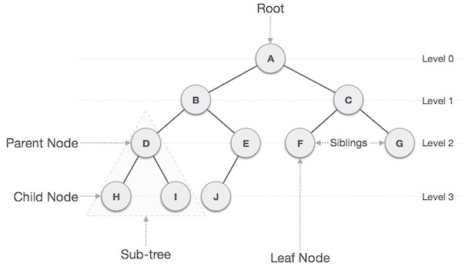

Slide 15
Terms
Path − Path refers to sequence of nodes along the edges of a tree.
Root − Node at the top of the tree is called root. There is only one root per tree and one path from root node to any node.
Parent − Any node except root node has one edge upward to a node called parent.
Child − Node below a given node connected by its edge downward is called its child node.
Leaf − Node which does not have any child node is called leaf node.
Subtree − Subtree represents descendents of a node.

Slide 16
Visiting − Visiting refers to checking value of a node when control is on the node.
Traversing − Traversing means passing through nodes in a specific order.
Levels − Level of a node represents the generation of a node. If root node is at level 0, then its next child node is at level 1, its grandchild is at level 2 and so on.
keys − Key represents a value of a node based on which a search operation is to be carried out for a node.

Slide 17
BinaryTree ADT
The BinaryTree ADT extends the Tree ADT, i.e., it inherits all the methods of the Tree ADT
Additional methods:
position leftChild(p)
position rightChild(p)
position sibling(p)
Update methods may be defined by data structures implementing the BinaryTree ADT

Slide 18
Examples of the Binary Tree
.
Skewed Binary Tree
Complete Binary Tree
A
1
A
A
B
B
2
B
C
C
3
D
E
F
G
D
4
H
I
E
5

Slide 19
Data Structure for Binary Trees
A node is represented by an object storing
Element
Parent node
Left child node
Right child node
∅
B
∅
∅
B
A
D
A
D
∅
∅
∅
∅
C
E
C
E

Slide 20
Binary Tree
A tree is said to be binary tree when, 1. A binary tree has a root node. It may not have any child nodes(0 child nodes, NULL tree). 2. A root node may have one or two child nodes. Each node forms a binary tree itself. 3. The number of child nodes cannot be more than two. 4. It has a unique path from the root to every other node.

Slide 21
Types
There are four types of binary tree: 1. Full Binary Tree 2. Complete Binary Tree 3. Skewed Binary Tree 4. Extended Binary Tree

Slide 22
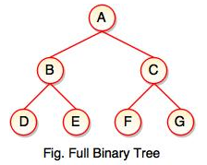
Full Binary Tree
If each node of binary tree has either two children or no child at all, is said to be a Full Binary Tree.
Full binary tree is also called as Strictly Binary Tree.
Every node in the tree has either 0 or 2 children.
Full binary tree is used to represent mathematical expressions.

Slide 23
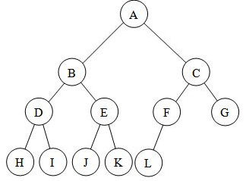
Complete Binary Tree
If all levels of tree are completely filled except the last level and the last level has all keys as left as possible, is said to be a Complete Binary Tree.
Complete binary tree is also called as Perfect Binary Tree.
In a complete binary tree, every internal node has exactly two children and all leaf nodes are at same level.
For example, at Level 2, there must be 2² = 4 nodes and at Level 3 there must be 2³ = 8 nodes.

Slide 24
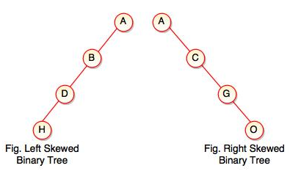
Skewed Binary Tree
If a tree which is dominated by left child node or right child node, is said to be a Skewed Binary Tree.
In a skewed binary tree, all nodes except one have only one child node. The remaining node has no child.
In a left skewed tree, most of the nodes have the left child without corresponding right child.
In a right skewed tree, most of the nodes have the right child without corresponding left child.

Slide 25
Tree traversals
A binary tree is defined recursively: it consists of a root, a left subtree, and a right subtree.
To traverse (or walk) the binary tree is to visit each node in the binary tree exactly once.
Tree traversals are naturally recursive.
Since a binary tree has three “parts,” there are six possible ways to traverse the binary tree:
root, left, right
left, root, right
left, right, root
root, right, left
right, root, left
right, left, root
25

Slide 26
Binary Tree Traversal Methods
Preorder
Inorder
Postorder
Level order

Slide 27
Preorder traversal(Rlr)
Steps
1. Visit the root.(R) 2. Traverse the left subtree.(l) 3. Traverse the right subtree.(r)
void printPreorder(struct node* node)
{
if (node == NULL)
return;
printf("%d ", node->data);
printPreorder(node->left);
printPreorder(node->right);
}
27

Slide 28
Preorder Example (Visit = print)
a
b
c
a
b
c

Slide 29
Preorder Example (Visit = print)
a
b
c
f
d
e
g
j
h
i
a
b
d
g
h
e
i
c
f
j
Notes:
During the traversal, t starts at the root, moves to the left child b of the root, then to the left child d of b. When the traversal of the left subtree of b is complete, t, once again, points to the node b. The t moves into the right subtree of b. When the traversal of this right subtree is complete, t again points to b. Following this, t points to a. We see that t points to every node in the binary tree three times – once when you get to the node from its parent (or in the case of the root, t is initially at the root), once when you return from the left subtree of the node, and once when you return from the node’s right subtree. Of these three times that t points to a node, the node is visited the first time.

Slide 30
Preorder Of Expression Tree
/
*
+
e
f
+
-
a
b
c
d
/
*
+
a
b
-
c
d
+
e
f
Gives prefix form of expression!

Slide 31
Inorder traversal(lRr)
Steps
1. Traverse the left subtree. (l) 2. Visit the root. (R ) 3. Traverse the right subtree. (r )
void printInorder(struct node* node)
{
if (node == NULL)
return;
printInorder(node->left);
printf("%d ", node->data);
printInorder(node->right);
}
31

Slide 32
Inorder Example (Visit = print)
a
b
c
b
a
c

Slide 33
Inorder Example (Visit = print)
a
b
c
f
d
e
g
j
h
i
g
d
h
b
e
i
a
f
j
c

Slide 34
Inorder By Projection (Squishing)
a
b
c
f
d
e
g
j
h
i
g
d
h
b
e
i
a
f
j
c

Slide 35
Inorder Of Expression Tree
/
*
+
e
f
+
-
a
b
c
d
a
+
b
*
c
-
d
/
e
+
f
Gives infix form of expression (sans parentheses)!

Slide 36
Postorder traversal(lrR)
Steps
1. Traverse the left subtree. (l) 2. Traverse the right subtree. (r ) 3. Visit the root. ( R)
void printPostorder(struct node* node)
{
if (node == NULL)
return;
printPostorder(node->left);
printPostorder(node->right);
printf("%d ", node->data);
}
36

Slide 37
Postorder Example (Visit = print)
a
b
c
b
c
a

Slide 38
Postorder Example (Visit = print)
a
b
c
f
d
e
g
j
h
i
g
h
d
i
e
b
j
f
c
a

Slide 39
Postorder Of Expression Tree
/
*
+
e
f
+
-
a
b
c
d
a
b
+
c
d
-
*
e
f
+
/
Gives postfix form of expression!

Slide 40
Traversal Applications
a
b
c
f
d
e
g
j
h
i
Make a clone.
Determine height.
Determine number of nodes.
Notes:
Make a clone using postorder traversal … clone the left subtree, clone the right subtree, clone the root in the visit step.
Determine height using postorder traversal … determine the height of the left subtree, determine the height of the right subtree, in the visit step add 1 to the max of the already determined heights of the left and right subtrees.
Determine number of nodes using preorder, inorder, or postorder traversal … initialize a counter to 0, add 1 to the counter in the visit step.

Slide 41
Level Order
Let ptr be a pointer to the tree root.
while (ptr != NULL)
{
visit node pointed at by ptr and put its children on a FIFO queue;
if FIFO queue is empty, set ptr = NULL;
otherwise, delete a node from the FIFO queue and call it ptr;
}

Slide 42
Level-Order Example (Visit = print)
a
b
c
f
d
e
g
j
h
i
a
b
c
d
e
f
g
h
i
j

Slide 43
Tree traversals
The order in which the nodes are visited during a tree traversal can be easily determined by imagining there is a “flag” attached to each node, as follows:
preorder
inorder
postorder
To traverse the tree, collect the flags:
A
A
A
B
C
B
C
B
C
D
E
F
G
D
E
F
G
D
E
F
G
A B D E C F G
D B E A F C G
D E B F G C A
43

Slide 44
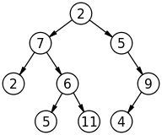
Exercise
Find In-order, Pre-order, Post-order traversal

Slide 45
Uses of trees
1. Manipulate hierarchical data.
2. Make information easy to search.
3. Manipulate sorted lists of data.
4. Router algorithms.
45

Slide 46
Applications of trees
Represent organization
The library database in a library, a student database in a school or college, an employee database in a company, a patient database in a hospital or any database for that matter would be implemented using trees.
Represent computer file systems
The file system in your computer i.e. folders and all files, would be stored as a tree.
When you search for a word in a file or misspell a word and you get a list of possible correct words, you are using a tree
Networks to find best path in the Internet
When you watch a YouTube video or surf anything on the internet, the data which would be present in a computer somewhere in the world would travel to your computer passing through many intermediate computers called routers. The routers heavily use trees for routing.
Google maps uses trees for all the locations in it.
46

Slide 47
Constructing Expression Tree

Slide 48
Arithmetic Expression Tree
Binary tree associated with an arithmetic expression
internal nodes: operators
external nodes: operands
Example: arithmetic expression tree for the expression
(2 × (a - 1) + (3 × b))
+
×
×
2
−
3
b
a
1

Slide 49
Building an Expression Tree
Let us start with a postfix expression.
The question is how to link up operands as (sub)trees.
As in the case of evaluating a postfix expression, have to remember operators seen so far.
need to see the correct operands.
A stack helps again.
But instead of evaluating subexpression, we have to grow them as trees.
Details follow.

Slide 50
Building an Expression Tree
Procedure ExpressionTree(E)‏
//E is an expression in postfix notation.
begin
for i=1 to |E| do
if E[i] is an operand then
create a tree with the operand as the only node;
add it to the stack
else if E[i] is an operator then
pop two trees from the stack
create a new tree with E[i] as the root and the two trees popped as its children;
push the tree to the stack
end-for
end

Slide 51
Example
Consider the expression
The postfix of the expression is a b + f − c d × e + /
Let us follow the above algorithm.

Slide 52
Example
Stack
b
a
+ f − c d × e + /

Slide 53
Example
Stack
b
+
a
f − c d × e + /

Slide 54
Example
Stack
f
b
+
a
− c d × e + /

Slide 55
Example
Stack
c d × e + /
f
-
b
+
a

Slide 56
Example
Stack
× e + /
d
c
f
-
b
+
a

Slide 57
Example
Stack
e + /
d
+
c
f
-
b
+
a

Slide 58
Example
Stack
+ /
e
d
+
c
f
-
b
+
a

Slide 59
Example
Stack
/
e
+
d
+
f
c
-
b
+
a

Slide 60
Example
Stack
e
+
d
+
/
c
f
-
b
+
a

Slide 61
Exercise
Construct Expression tree for the following
x x * 2 + x 1 + /

Slide 62
Binary Search Tree (BST)
Search tree property
all keys in left subtree smaller than root’s key
all keys in right subtree larger than root’s key
result:
easy to find any given key
inserts/deletes by changing links
8
5
11
2
6
10
12
4
7
9
14
13
Notes:
A binary search tree is a binary tree in which all nodes in the left subtree of a node have lower values than the node. All nodes in the right subtree of a node have higher value than the node.
It’s like making that recursion into the data structure!
I’m storing integers at each node. Does everybody think that’s what I’m _really_ going to store?
What do I need to know about what I store?
(comparison, equality testing)

Slide 63
Insertion in BST - Pseudocode
if tree is empty
create a root node with the new key
else
compare key with the top node
if key = node key
replace the node with the new value
else if key > node key
compare key with the right subtree:
if subtree is empty create a leaf node
else add key in right subtree
else key < node key
compare key with the left subtree:
if the subtree is empty create a leaf node
else add key to the left subtree

Slide 64
Insert a Key
TreeNode insert(int x, TreeNode T)
{ if ( T == NULL ) return new TreeNode(x,null,null);
if (x == T.Element) return T;
if (x < T.Element)
T.Left = insert(x, T.Left);
else
T.Right = insert(x, T.Right);
return T;
}
10
5
15
2
9
20
3
7
17
30
Notes:
The running time is again O(height(T)). Even more important to keep height(T) small

Slide 65
Creation in BST
#include<stdio.h>
#include<stdlib.h>
struct node
{
int key;
struct node *left, *right;
};
// create a new BST node
struct node *newNode(int item)
{
struct node *temp = (struct node *)malloc(sizeof(struct node));
temp->key = item;
temp->left = temp->right = NULL;
return temp;
}

Slide 66
Insertion in BST
// Insert a new node with given key in BST
struct node* insert(struct node* node, int key)
{
if (node == NULL) return newNode(key);
if (key < node->key)
node->left = insert(node->left, key);
else if (key > node->key)
node->right = insert(node->right, key);
return node;
}
int main()
{
struct node *root = NULL;
root = insert(root, 50);
insert(root, 30);
insert(root, 20);
insert(root, 40);
insert(root, 70);
insert(root, 60);
insert(root, 80);
return 0;
}

Slide 67
Searching in BST
struct node* search(struct node* root, int key)
{
// Base Cases: root is null or key is present at root
if (root == NULL || root->key == key)
return root;
// Key is greater than root's key
if (root->key < key)
return search(root->right, key);
// Key is smaller than root's key
return search(root->left, key);
}

Slide 68
FindMin and FindMax
10
TreeNode min(Node T) {
if (T.Left == NULL)
return T;
else
return min(T.Left); }
TreeNode max(Node T) {
if (T.Right== NULL)
return T;
else
return max(T.Right); }
5
15
2
9
20
7
17
30
Notes:
Every now and then everyone succumbs to the temptation to really overuse color.

Slide 69
Delete a Key
How do you delete:
17 ?
9 ?
20 ?????
10
5
15
2
9
20
7
17
30
Notes:
And now for something completely different.
Let’s say I want to delete a node. Why might it be harder than insertion?
Might happen in the middle of the tree instead of at leaf.
Then, I have to fix the BST.

Slide 70
Deletion - Leaf Case
Delete(17)
10
5
15
2
9
20
7
17
30
If the node to be deleted is leaf node just delete it.
Notes:
Alright, we did it the easy way, but what about real deletions?
Leaves are easy; we just prune them.

Slide 71
Deletion - One Child Case
Delete(15)
10
5
15
2
9
20
7
30
If the node to be deleted is having one child then replace by its successor node.
Notes:
Single child nodes we remove and…
Do what?
We can just pull up their children.
Is the search tree property intact?
Yes.

Slide 72
Deletion - Two Children Case
Delete(5)
10
5
20
2
9
30
7
If the node to be deleted is having two children then replace the node with the smallest node in the right subtree
Notes:
Ah, now the hard case.
How do we delete a two child node?
We remove it and replace it with what?
It has all these left and right children that need to be greater and less than the new value (respectively).
Is there any value that is guaranteed to be between the two subtrees?
Two of them: the successor and predecessor!
So, let’s just replace the node’s value with it’s successor and then delete the succ.

Slide 73
Deletion - Two Children Case
Delete(5)
10
5
20
2
9
30
7
7 is replaced in place of 5
Notes:
Ah, now the hard case.
How do we delete a two child node?
We remove it and replace it with what?
It has all these left and right children that need to be greater and less than the new value (respectively).
Is there any value that is guaranteed to be between the two subtrees?
Two of them: the successor and predecessor!
So, let’s just replace the node’s value with it’s successor and then delete the succ.

Slide 74
Deletion - Two Child Case
Delete(5)
10
7
20
2
9
30
7
Notes:
Ah, now the hard case.
How do we delete a two child node?
We remove it and replace it with what?
It has all these left and right children that need to be greater and less than the new value (respectively).
Is there any value that is guaranteed to be between the two subtrees?
Two of them: the successor and predecessor!
So, let’s just replace the node’s value with it’s successor and then delete the succ.
Cost = O(height(T))

Slide 75
Deletion in BST with all the three cases
struct node* deleteNode(struct node* root, int key)
{
if (root == NULL) return root;
if (key < root->key)
root->left = deleteNode(root->left, key);
else if (key > root->key)
root->right = deleteNode(root->right, key);
else
{
// node with only one child or no child
if (root->left == NULL)
{
struct node *temp = root->right;
free(root);
return temp;
}
else if (root->right == NULL)
{
struct node *temp = root->left;
free(root);
return temp;
}

Slide 76
Deletion in BST with all the three cases (contd)
// node with two children: Get the inorder successor (smallest in the right subtree)
struct node* temp = minValueNode(root->right);
// Copy the inorder successor's content to this node
root->key = temp->key;
// Delete the inorder successor
root->right = deleteNode(root->right, temp->key);
}
return root;
}

Slide 77
Threaded Binary Tree
Threads
Do you find any drawback of the above tree?
Too many null pointers in current representation of binary trees
n: number of nodes
number of non-null links: n-1
total links: 2n
null links: 2n-(n-1) = n+1
Solution: replace these null pointers with some useful “threads”

Slide 78
Rules for constructing the threads
If ptr->left_child is null, replace it with a pointer to the node that would be visited before ptr in an inorder traversal
If ptr->right_child is null, replace it with a pointer to the node that would be visited after ptr in an inorder traversal

Slide 79
A Threaded Binary Tree
root
A
t: true ⇒ thread
f: false ⇒ child
dangling
f
B
f
C
D
t
E
t
F
G
dangling
inorder traversal:
H
I
H D I B E A F C G

Slide 80
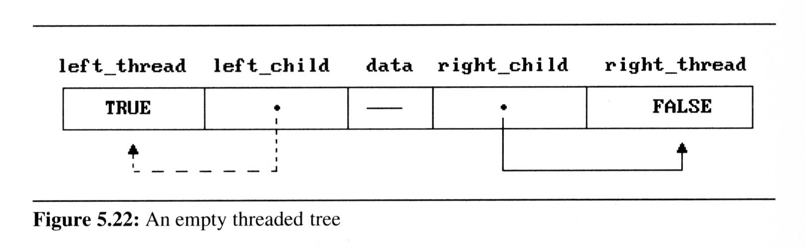
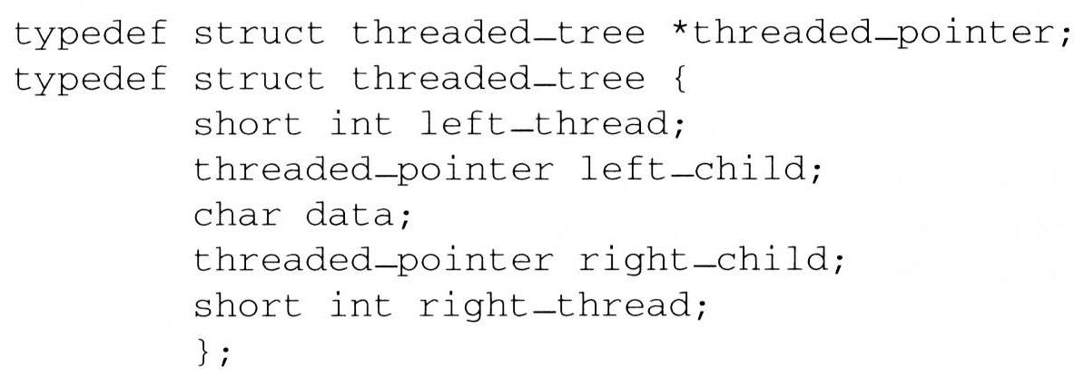
Two additional fields of the node structure, left-thread and right-thread
If ptr->left-thread=TRUE, then ptr->left-child contains a thread;
Otherwise it contains a pointer to the left child.
Similarly for the right-thread

Slide 81
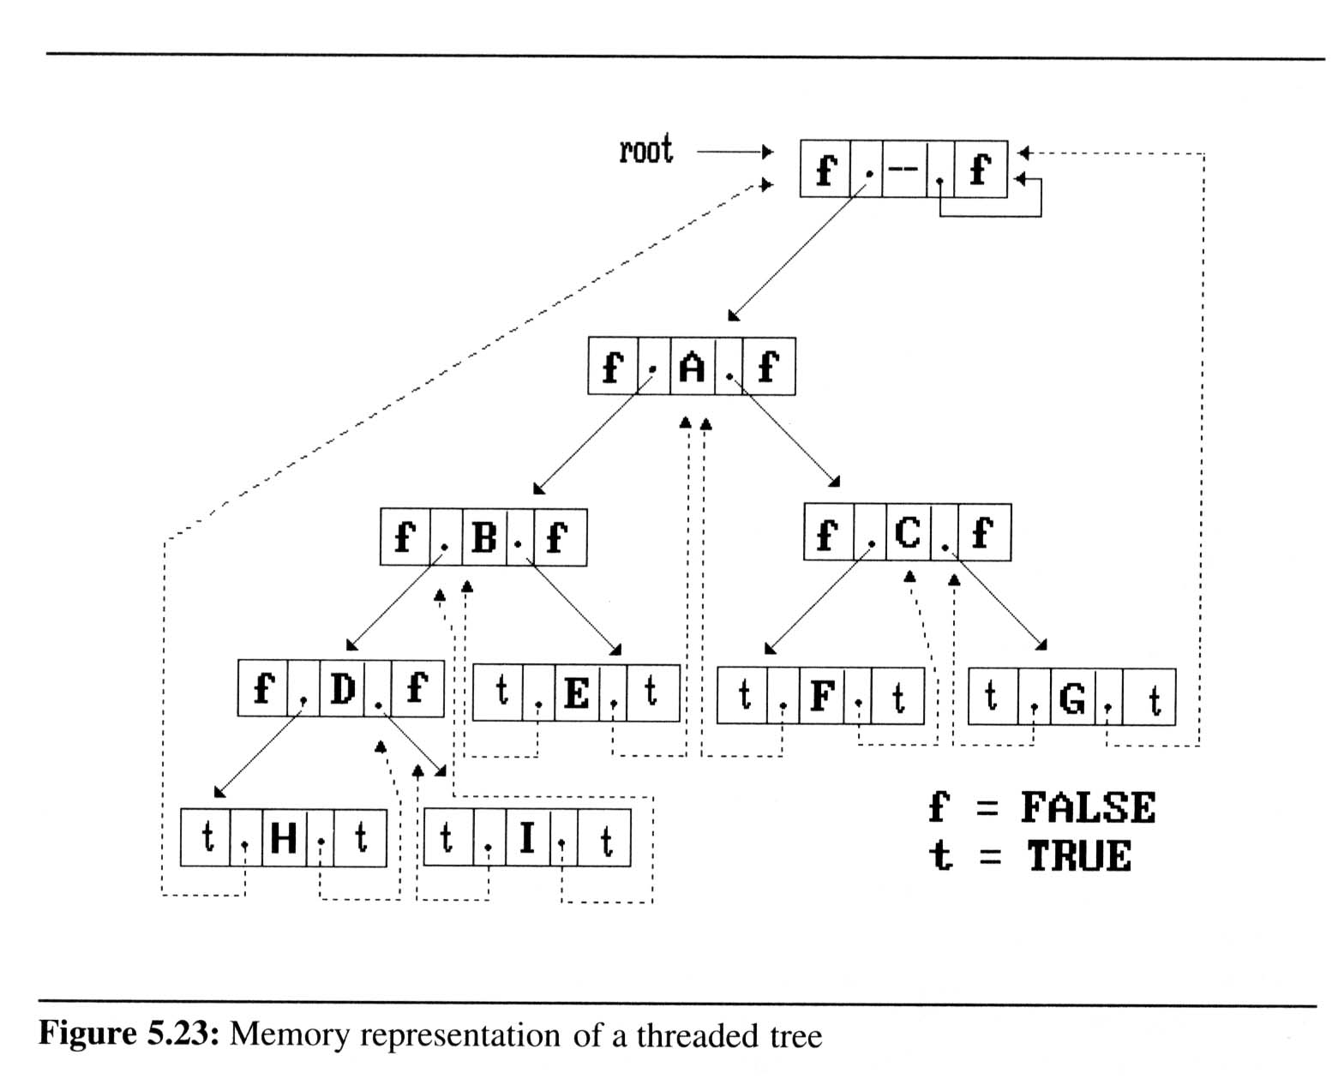
If we don’t want the left pointer of H and the right pointer of G to be dangling pointers, we may create root node and assign them pointing to the root node

Slide 82
Inorder traversal of a threaded binary tree
By using of threads we can perform an inorder traversal without making use of a stack (simplifying the task)
Now, we can follow the thread of any node, ptr, to the “next” node of inorder traversal
If ptr->right_thread = TRUE, the inorder successor of ptr is ptr->right_child by definition of the threads
Otherwise we obtain the inorder successor of ptr by following a path of left-child links from the right-child of ptr until we reach a node with left_thread = TRUE

Slide 83
Finding the inorder successor (next node) of a node
threaded_pointer insucc(threaded_pointer tree){
threaded_pointer temp;
temp = tree->right_child;
if (!tree->right_thread)
while (!temp->left_thread)
temp = temp->left_child;
return temp;
}
tree
temp
Inorder

Slide 84
Finding the inorder successor (next node) of a node
threaded_pointer insucc(threaded_pointer tree){
threaded_pointer temp;
temp = tree->right_child;
if (!tree->right_thread)
while (!temp->left_thread)
temp = temp->left_child;
return temp;
}
tree
temp
Inorder

Slide 85
Inorder traversal of a threaded binary tree
void tinorder(threaded_pointer tree){
/* traverse the threaded binary tree inorder */
threaded_pointer temp = tree;
for (;;) {
temp = insucc(temp);
if (temp==tree)
break;
printf(“%3c”,temp->data);
}
}
output:
H
D
I
B
E
A
F
C
G
tree
Time Complexity: O(n)

Slide 86
Inserting A Node Into A Threaded Binary Tree
1. Insert child as the right child of node parent
2. change parent->right_thread to FALSE
3. set child->left_thread and child->right_thread to TRUE
4. set child->left_child to point to parent
5. set child->right_child to parent->right_child
6. change parent->right_child to point to child

Slide 87
Right insertion in a threaded binary tree
void insert_right(thread_pointer parent, threaded_pointer child){
/* insert child as the right child of parent in a threaded binary tree */
threaded_pointer temp;
child->right_child = parent->right_child;
child->right_thread = parent->right_thread;
child->left_child = parent;
child->left_thread = TRUE;
parent->right_child = child;
parent->right_thread = FALSE;
If(!child->right_thread){
temp = insucc(child);
temp->left_child = child;
}
}
root
A
parent
B
C
X
child
parent
temp
A
B
child
X
C
D
E
F
successor

Slide 88
AVL Trees

Slide 89
Introduction
Named after their inventor Adelson, Velski & Landis (AVL)
AVL trees are height balancing binary search tree.
AVL tree checks the height of left and right sub-trees and assures that the difference is not more than 1. This difference is called Balance Factor.

Slide 90
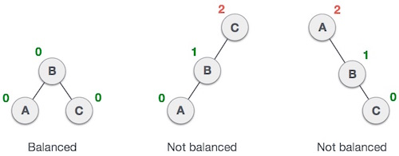
Balanced and unbalanced trees
First tree is balanced
In second tree, the left subtree of C has height 2 and right subtree has height 0, so the difference is 2.
In third tree, the right subtree of A has height 2 and left is missing, so it is 0, and the difference is 2 again.
AVL tree permits difference (balance factor) to be only 1.

Slide 91
Balance factor
Balance Factor = Height(Left-sub tree) - Height(Right-sub tree)) (i.e.) h_{L}-h_{R}
Balance factor of each node in an AVL tree must be –1, 0, or 1
-1: height of the right sub tree is one greater than the left sub tree.
0: height of the left and right sub trees is equal.
+1: height of the left sub tree is one greater than the right sub tree.

Slide 92


Example
-1
10
7
1
40
1
0
3
0
8
1
30
-1
45
0
0
-1
0
0
1
5
20
35
60
25

Slide 93
Properties of AVL Tree
The height of an AVL tree with n nodes is O(log n)
For every value of n, n ≥ 0, there exists an AVL tree
An n-node AVL search tree can be searched in O(height) = O(log n) time
A new node can be inserted into an n-node AVL search tree so that the result is an n+1 node AVL tree and insertion can be done in O(log n) time

Slide 94
A node can be deleted from an n-node AVL search tree, n>0, so that the result is an n-1 node AVL tree and deletion can be done in O(log n) time
After insertion and deletion of any node in an AVL tree if the balance factor of any node becomes other than -1, 0, +1 then it is said that AVL property is violated. Then we have to restore the destroyed balance condition.
The balancing should be such that the entire tree should satisfy AVL property.

Slide 95
Rotation
Any modification done on AVL tree in order to rebalance then it is called rotations of AVL trees.
Left rotation (case 1)
Right rotation (case 2)
Left-Right rotation (case 3)
Right-Left rotation (case 4)
-> case 1 and case 2 are single rotations.
-> case 3 and case 4 are double rotations.
Note:- To have an unbalanced tree we at least need a tree of height 2

Slide 96
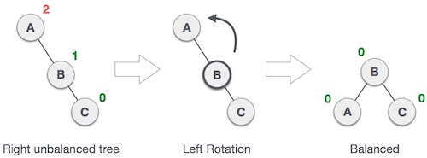
Left Rotation
If a tree become unbalanced, when a node is inserted into the right subtree of right subtree, then we perform single left rotation −
Node A has become unbalanced as a node is inserted in right subtree of A's right subtree.
We perform left rotation by making A left-subtree of B.

Slide 97
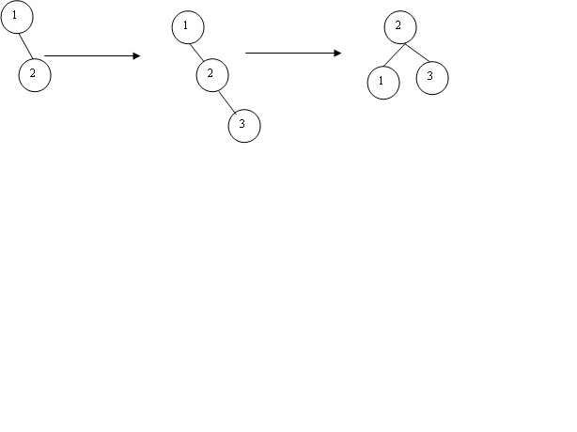
Example:
BF=-1
-2
0
Insert Node 3
left rotation
-1
BF=0
0
0
0
Unbalanced Tree
Balanced Tree
When node 3 is inserted to the right of 2, the tree becomes unbalanced hence rotate left to make the balanced tree

Slide 98
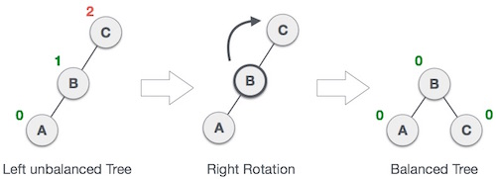
Right Rotation
AVL tree may become unbalanced if a node is inserted in the left subtree of left subtree. The tree then needs a right rotation.

Slide 99
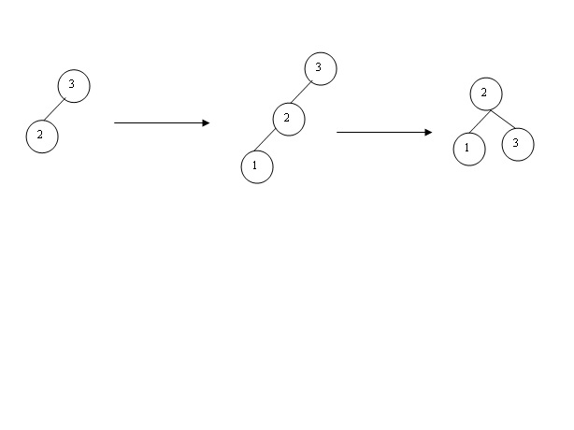
Example:
BF=1
2
0
Insert Node 1
1
Right rotation
0
0
0
BF=0
Balanced Tree
Unbalanced Tree

Slide 100

Left-Right Rotation
A left-right rotation is combination of left rotation followed by right rotation.
Step 1:
A node has been inserted into right subtree of left subtree. This makes C an unbalanced node. These scenarios cause AVL tree to perform left-right rotation.

Slide 101
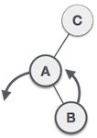
Contd…
STEP 2:
First perform left rotation on left subtree of C. This makes A, left subtree of B.

Slide 102
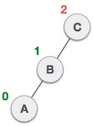
Contd…
STEP 3:
Node C is still unbalanced but now, it is because of left-subtree of left-subtree.

Slide 103
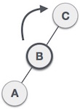
Contd…
STEP 4:
Now right-rotate the tree making B new root node of this subtree. C now becomes right subtree of its own left subtree.

Slide 104
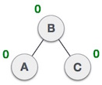
Contd…
STEP 5
The tree is now balanced.

Slide 105
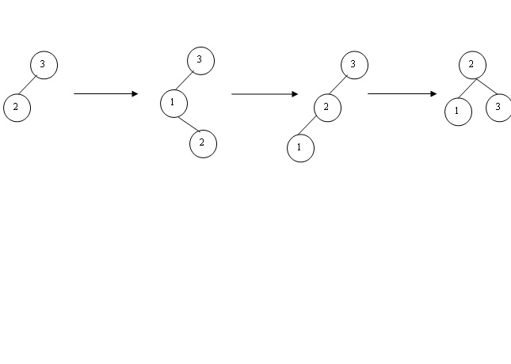
Example
BF=1
2
0
2
Insert Node 2
left rotation
Right rotation
-1
1
0
0
0
0
BF=0
Unbalanced Tree Unbalanced Tree Balanced Tree
When node 2 is inserted to the right of 1, the tree becomes unbalanced hence rotate left, still it is unbalanced hence rotate right to make a balanced tree

Slide 106

Right-Left Rotation
Second type of double rotation is Right-Left Rotation.
It is a combination of right rotation followed by left rotation.
STEP 1:
A node has been inserted into left subtree of right subtree. This makes A an unbalanced node, with balance factor 2.

Slide 107
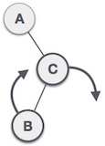
Contd…
STEP 2:
Perform right rotation along C node, making C the right subtree of its own left subtree B.
Now, B becomes right subtree of A.

Slide 108
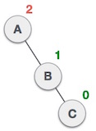
Contd…
STEP 3:
Node A is still unbalanced because of right subtree of its right subtree and requires a left rotation.

Slide 109
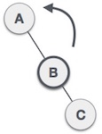
Contd…
STEP 4:
A left rotation is performed by making B the new root node of the subtree. A becomes left subtree of its right subtree B.

Slide 110
Contd…
STEP 5:
The tree is now balanced

Slide 111
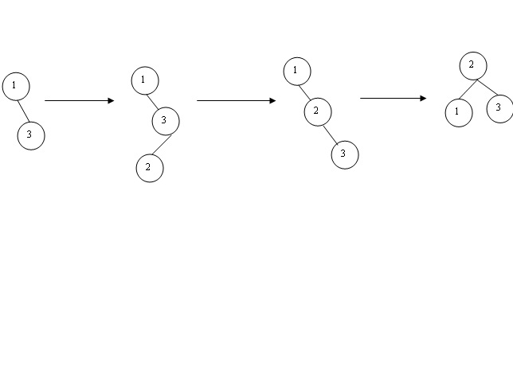
Example
0
BF=-1
-2
-2
Insert node 2
Left rotation
Right rotation
-1
1
0
0
BF=0
0
0
Unbalanced Tree Unbalanced Tree Balanced Tree
When node 2 is inserted to the left of 3, the tree becomes unbalanced hence rotate right , still it is unbalanced hence rotate left to make a balanced tree.

Slide 112
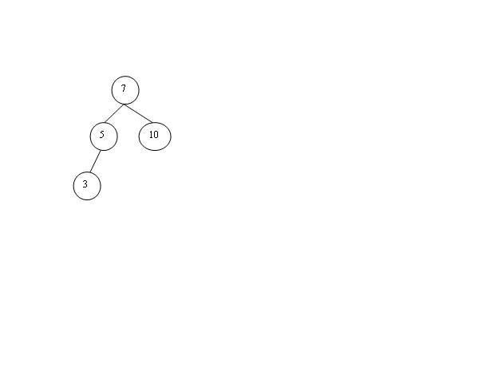
Problem
Insert 1,8,20,9,12 and apply the rotations for the following AVL tree

Slide 113
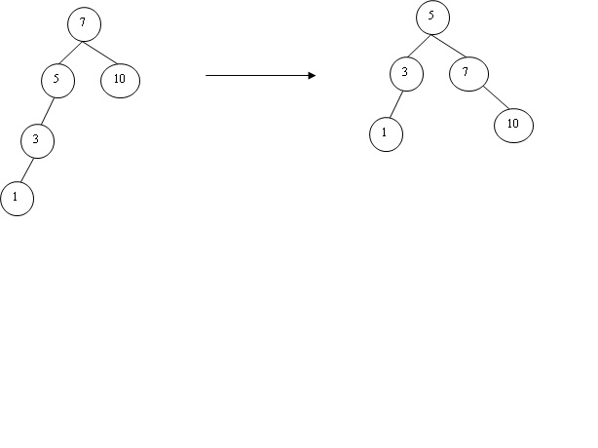
Insert 1
2
0
0
Right rotation
1
-1
2
1
0
0
0
Balanced
Unbalanced

Slide 114
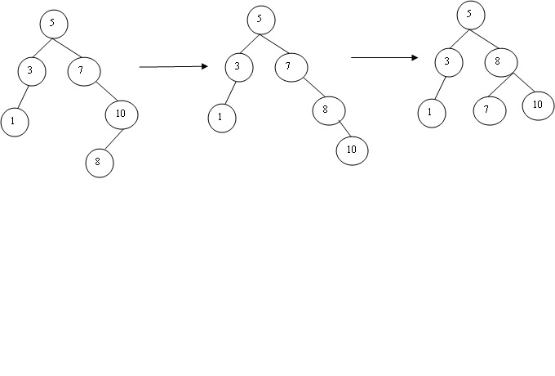
Insert 8 Double Rotation
-1
-1
0
1
-2
Left rotation
1
-2
Right rotation
0
1
-1
1
0
0
0
0
0
0
0
Unbalanced Unbalanced Balanced

Slide 115
Insert 20 Insert 9

Slide 116
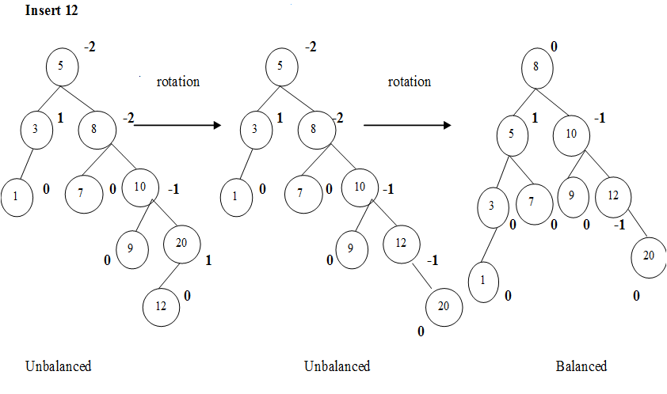

Slide 117
Function to compute height of an AVL tree
int height( AvlNode *t) const
{
return t==NULL ?-1:t→height;
}
Routine to perform single rotation
void rotateWithLeftChild ( AvlNode * & k2 )
{
AvlNode *k1 = k2→left;
k2 → left = k1 → right;
k1 → right = k2;
k2 → height = max( height( k2 → left ), height(k2 → right ) ) + 1;
k1 → height = max(height( k1 → left ), k2 → height ) + 1;
k2=k1;}

Slide 118
Routine to perform double rotation
void doubleWithLeftChild (AvlNode * & k3)
{
rotateWithRightChild ( K3 → Left );
rotateWithLeftChild ( K3 );
}
Insertion into an AVL tree
void insert( const Comparable & x , AvlNode * & t )
{
if ( t == NULL )
t = new AvlNode(x, NULL , NULL );
else if ( x < t → element )
{

Slide 119
insert(x, t → left)
if ( height( t → left ) - height( t → right ) == 2 )
if ( x < t → left → element )
rotateWithLeftChild ( t );
else
doubleWithLeftChild ( t );
}
else if ( t → element < x )
{
insert(x, t → right);
if( height( t → right ) - height( t → left ) == 2 )
if( t → right → element < x )
rotateWithRightChild ( t );

Slide 120
else
doubleWithRightChild ( t );
}
else
// Duplicate; do nothing
t → height = max( height( t → left ), height( t → right ) ) + 1;
}

Slide 121
node * insert(node *T,int x) { if(T==NULL) { T=(node*)malloc(sizeof(node)); T->data=x; T->left=NULL; T->right=NULL; } else if(x > T->data) // insert in right subtree { T->right=insert(T->right,x); if(BF(T)==-2) if(x>T->right->data) T=RR(T); else T=RL(T); }
else if(x<T->data) { T->left=insert(T->left,x); if(BF(T)==2) if(x < T->left->data) T=LL(T); else T=LR(T); } T->ht=height(T); return(T); }

Slide 122
Deletion in AVL Trees
The deletion algorithm is more complex than insertion algorithm.
Search the node which is to be deleted
If the node to be deleted is a leaf node then simply make it NULL to remove.
If the node to be deleted is not a leaf node then the node must be swapped with its inorder successor. After swap we can remove this node.

Slide 123
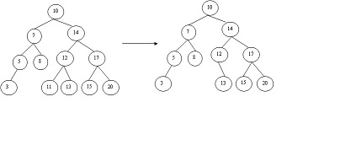
Example:
Case 1: Leaf Node
Delete 11

Slide 124
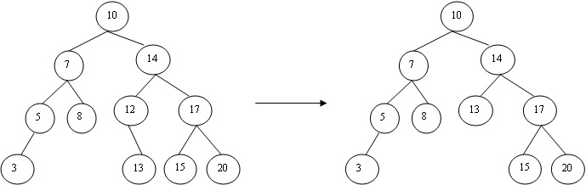
Case 2: One Child
Delete 12

Slide 125
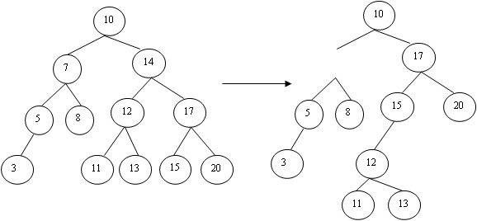
Case 3: Two Child
-1
1
2
Delete 14
7
1
0
2
0
0
0
0
0
Unbalanced (violates AVL property)
right rotation

Slide 126
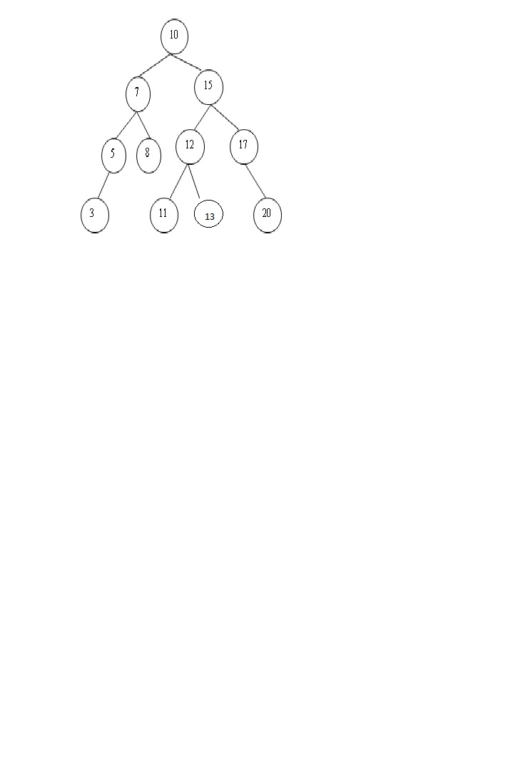
0
1
0
1
0
0
-1
0
0
0
0

Slide 127
Implementation
AvlTree Delete( ElementType X, AvlTree T ){
if( T == NULL )
Error("Item not Found);
else if( X < T->Element ){
T->Left = Delete( X, T->Left );
if( Height( T->Left ) - Height( T->Right ) == -2 )
if( Height(T->Right->Right) > Height(T->Right- >Left) )
T = SingleRotateWithRight( T ); /* RR */
else

Slide 128
T = DoubleRotateWithRight( T ); /* RL */
}
else if( X > T->Element ){
T->Right = Delete( X, T->Right );
if( Height( T->Right ) - Height( T->Left ) == -2 )
if( Height(T->Left->Left) > Height(T->Left->Right) )
T = SingleRotateWithLeft( T ); /* LL */
else
T = DoubleRotateWithLeft( T ); /* LR */
}
else if( T->Left && T->Right ){ /* Found with two children */

Slide 129
/* Replace with smallest in right subtree */
TmpCell = FindMin( T->Right );
T->Element = TmpCell->Element;
T->Right = Delete( T->Element, T->Right );
if( Height( T->Right ) - Height( T->Left ) == -2 )
if( Height(T->Left->Left) > Height(T->Left->Right) )/*LL*/
T = SingleRotateWithLeft( T );
else
T = DoubleRotateWithLeft( T ); /*LR*/
}

Slide 130
else { /* Found with one or zero child */
TmpCell = T;
T = T->Left ? T->Left : T->Right; /* Also handles 0 child */
free( TmpCell );
}
if( T!= NULL )
T->Height=Max(Height(T->Left), Height(T->Right))+1;
return T;
}

Slide 131
Exercise
Construct AVL tree using the following sequence of data 2, 7, 4, 9, 1, 5, 8, 3, 6.

Slide 132
SPLAY TREES
Splay trees are self branching binary search tree which has the property of re accessing the elements quickly that which is recently accessed.
The performance of the Splay trees depends on the self balancing and self optimizing.
The worst case with this splay tree algorithm is that this will sequentially access all the elements of the tree which makes tree unbalanced.

Slide 133
Advantages
It is easy to implement than other self branching binary search trees, such as Red black trees or AVL trees. Much simpler to code than AVL, Red Black trees.
It requires less space as no balance information is required.
Disadvantages
More local adjustments during Search operations.
Individual operations can be expensive, drawback for real-time applications.
The main disadvantage of Splay trees is the height. After accessing all 0n0 elements in the tree, the height of the tree corresponds to worst case access time.

Slide 134
Operations
Splay trees are self adjusting binary search trees which performs basic operations such as
Search
Insertion
Deletion

Slide 135
Search,Insert,Delete operations are like in Binary Search trees, except at the end of each operation, a special step called Splaying is done. Splaying the tree rearranges the tree so that element is placed at the root of the tree. It uses tree rotations to bring the element to the top.
The main basic operations of the Splay tree are
Search
Insert
Delete
Splaying

Slide 136
Search: Splay node where key was found.
Insert: When an item is inserted, a Splay is performed. As a result, the newly inserted node becomes the root of the tree.
Delete: Splay parent of removed node which is either the node with the deleted key or its successor.
To perform a splay operation, there is need to carry out sequence of Splay steps, which moves the node closer to the root. The recently accessed nodes are kept closer to the root so that tree remains balanced

Slide 137
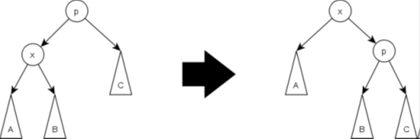
Each Splay step depends on three factors
X is left or right child of its parent node P.
Check P is root node or not, if not.
P is left or right child of its parent G.
The three types of Splay steps are:
1.Zig Step

Slide 138
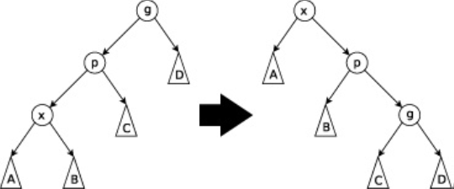
2.Zig-zig step
Here X and P are either both left children and both right children.
The Zig-Zig splay rotates between P and G and X and P.

Slide 139
3.Zig-Zag step
In this case, X and both a parent P and a grandparent G. X is a right child and P is a left child or vice versa.
This is same as the double rotation.

Slide 140
Result of splaying at node 1

Slide 141
Example:

Slide 142
Deletion
Access the node to be deleted bringing it to the root.
Delete the root leaving two subtrees L left and R right.
Find the largest element in L, thus the root of L will have no right child.
Make R the right child of L’s root.

Slide 143
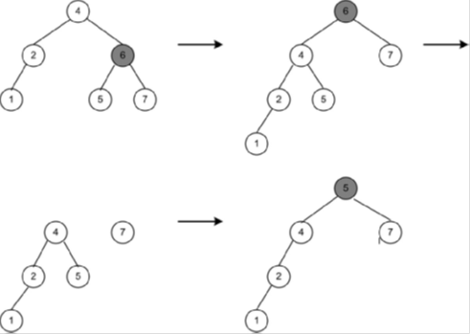
Delete element 6

Slide 144
Time Complexity:
On an average the time complexity of each operation on the splay tree is
Search: Searching for a node in the tree would take O(logn).
Insert: Inserting a node in to the tree takes O(logn).
Delete: Deleting a node from the tree takes O(logn).

Slide 145
B-TREES
A good example of a data structure for external memory is a B-tree.
Proposed by R. Bayer and E. M. McCreigh in 1972.
A B-tree of order m is an m-way tree (i.e., a tree where each node may have up to m children) in which:
the number of keys in each non-leaf node is one less than the number of its children and these keys partition the keys in the children in the fashion of a search tree
all leaves are on the same level
all non-leaf nodes except the root have at least ⎡m / 2⎤ children
the root is either a leaf node, or it has from two to m children
a leaf node contains no more than m – 1 keys

Slide 146
The number m should always be odd
Example of B-Tree of order 5:

Slide 147
Insertion on B-Tree
The steps in insertion are
Find the node where the item is to be inserted by following the search procedure.
If the node is not full, insert the item into the node in order.
If the node is full, it has to be split.

Slide 148
Example Case 1: Insert 12 - After Insertion
When the node x of the B-tree of order m can accommodate the key k, then it is inverted in that node and the number of child pointer fields are appropriately upgraded. To insert 12, it is less than the root node 25 hence it has to be placed at the left side of the root 25. Compared to 3, 9 and 15 the node 12 is placed between 10 and 13.

Slide 149
Case 2: Insert 53
To insert 53, it is greater than the root 25 hence it has to be placed on the right side of the root. Compared to 37 and 50, the node 53 has to be placed as the child node of 50, but already it has 4 child nodes. Trying to insert 53 the node becomes full which is not allowed

Slide 150
Hence we have to split the node as follows
Find middle value (of old keys in the node and the new key).
Keep records with keys smaller than middle in the old node.
Put records with keys greater than middle in the new node.
Push middle record up into parent node.
If this makes the parent full, split it as well and push its middle item upwards.
Continue doing this until either some space is found in an ancestor node, or a new root node is created.
From the above diagram the middle value is 55, hence it becomes the parent node. The nodes less than 55 are placed as old nodes and greater than 55 are placed as new nodes as follows

Slide 151
After Insertion

Slide 152
Deletion on B-Tree
The Key 12 is a leaf node and it does not result in the node having less than its minimum no of elements, so it is deleted immediately

Slide 153
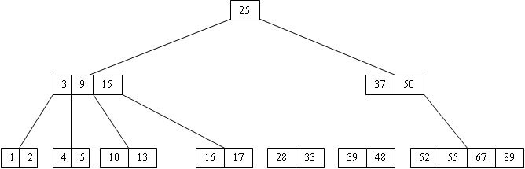
After Deletion

Slide 155
If the key K belongs to a non-leaf node then replace k with the largest key KLmax in the left sub tree of K or the smallest key KRmin from the right sub tree of K and then delete KRmin or KLmax from the node
To delete 9, is a non-leaf node hence replace KRmin (i.e) 10 from the right sub tree and delete 10 from its original position.

Slide 157
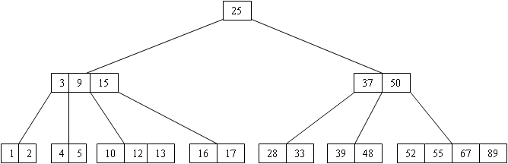
Case 3: Delete 16

Slide 158
If the key K to be deleted from a node leaves it with less than its minimum number of elements then the elements may be borrowed either from left or right sibling. If the left sibling has a node to spare, then move the largest key KLmax in the left sibling node to the parent node and the element p in the parent node is moved down to set the vacancy created by the deletion of K in node X.If left sibling node has no elements to spare then move to case 4.
Deleting the key 16, leaves the node less than its minimum number of elements. Hence the largest key 13 from the left sibling is moved to the parent node and the element 15 in the parent node is moved down to set the vacancy created by deleting 16.

Slide 161
If the key K to be deleted from a node X leaves it with less than its minimum no of elements and the left sibling is unable to spare an element then the node X is merged with one of the sibling nodes along with intervening element p in the parent node.
Deleting the key 5 leaves the node less than its minimum no of elements and the left sibling is unable to spare, so the node containing key 5 is merged with the left sibling and the intervening parent element 3

Slide 163
Exercise
Show the B-tree that results when inserting R,Y,F,X,A,M,C,D,E,T,H,V,L,W,G (in that order)
branching factor of t=3 (m=(s*t)-1). You need only draw the trees just before and after each split.

Slide 164
RED-BLACK TREES
A red-black tree is a balanced binary search tree with the following properties.
Red-Black Tree Rules (Properties)
1. Every node is colored red or black.
2. The root is black.
3. Every leaf is a NIL node, and is colored black.
4. If a node is red, then both its children are black.
5. Every simple path from a node to a descendant leaf contains the same number of black nodes=black-height(x).

Slide 165
Example:
26
17
41
NIL
NIL
30
47
38
NIL
50
NIL
NIL
NIL
NIL
NIL

Slide 166
Black-Height of a node:
h = 4
bh = 2
26
h = 1
bh = 1
h = 3
bh = 2
17
41
NIL
NIL
h = 2
bh = 1
h = 2
bh = 1
30
47
h = 1
bh = 1
38
50
h = 1
bh = 1
NIL
NIL
NIL
NIL
NIL
NIL

Slide 167
Height of a node : the number of edges in the longest path to a leaf.
Black-height of a node x: bh(x) is the number of black nodes (including NIL) on the path from x to a leaf, not counting x
A red-black tree with n internal nodes has height at most 2lg(n + 1).
Insertion in red-black tree
There are 4 cases:
Case 1: y is red and z is a left child
Case 2: y is red and z is a right child
Case 3: y is black and z is a left child
Case 4: y is black and z is a right child

Slide 168
RED-Black Tree Insertion Rules
If empty tree create black root node.
Insert new leaf node as red
If its parent is black then done
If parent is red
If black or absent sibling then
rotate, recolor (Red-black tree property)& done
If Red sibling then
Recolor and check (Red-black tree property)again

Slide 169
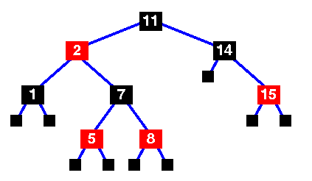
Example
The tree insert routine has just been called to insert node "4" into the tree.
This is no longer a red-black tree - there are two successive red nodes on the path
11 - 2 - 7 - 5 - 4
Mark the new node, x, and it's uncle, y.
y is red, so we have case 1 ...

Slide 170
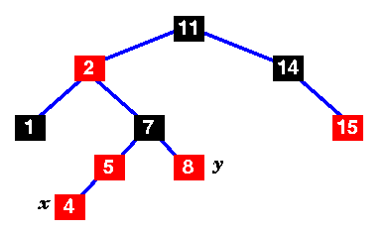
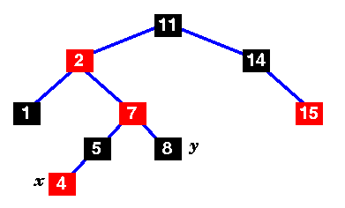
Change the colors of nodes 5, 7 and 8.

Slide 171

Move x up to its grandparent, 7.
x's parent (2) is still red, so this isn't a red-black tree yet.
Mark the uncle, y.
In this case, the uncle is black, so we have case 2 .

Slide 172
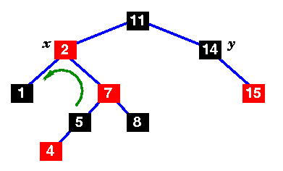
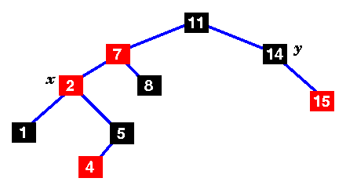
Move x up and rotate left.
Still not a red-black tree... the uncle is black, but x's parent is to the left .

Slide 173
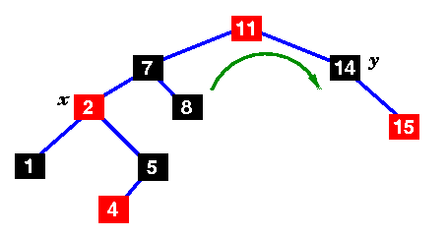
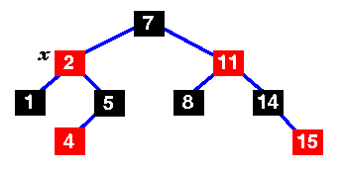
Change the colors of 7 and 11 and rotate right.
This is now a red-black tree,

Slide 174
Red-Black tree Insertion Algorithm
If (empty tree)
Create a black root node
else
{
create red leaf node
If (parent is black) then
{
insertion done
}
else if (parent sibling is RED) then
{
if (parent's parent is root) then
{
recolor
}
else
{
recolor & check Red-Black tree property
}
}
else
{
rotate;
if (LL) then rotate Right
if (RR) then rotate Left
if (Left subtree of Right child (LR)) then rotate Right -> Left
if (Right subtree of Left child (RL)) then rotate Left ->Right
}
}

Slide 175
Implementation:
Rotate method
RedBlackNode *rotate(const Comparable & item, RedBlackNode *theParent)
{
if ( item < theParent->element)
{
item < theParent->left->element ?
rotateWithLeftChild( theParent->left) : // LL
rotateWithRightChild( theParent->left) ; // LR
return theParent->left;
}

Slide 176
else
{
item < theParent->right->element ?
rotateWithLeftChild( theParent->right) : // RL
rotateWithRightChild( theParent->right) ; // RR
return theParent->right;
}
}

Slide 177
Insertion procedure
void handleReorient( const Comparable & item)
{
current->color=RED;
current->left->color=BLACK;
current->right->color=BLACK;
if(parent->color==RED)
{
grand->color=RED;
if(item < grand->element !=item < parent->element)
parent=rotate( item, grand);
current = rotate( item, great);
current->color = BLACK;

Slide 178
}
header->right->color=BLACK;
}
void insert( const Comparable & x)
{
current = parent=grand=header;
nullNode->element=x;
while( current->element !=x)
{
great = grand; grand=parent; parent=current;
current = x < current->element ? current->left : current->right;
if( current->left->color ==RED && current->right->color ==RED)
handleReorient (x );
}

Slide 179
if ( current!=nullNode)
return;
current = new RedBlackNode( x, nullNode,nullNode);
if( x < parent->element)
parent->left = current;
else
parent->right = current;
handleReorient( x);
}

Slide 180
Deletion in red-black tree
If the key to be deleted is stored at a node that has no external children, we move there the key of its inorder predecessor (or successor), and delete that node instead .
Example: to delete key 7, we move key 5 to node u, and delete node v

Slide 181
Deletion Algorithm
Remove v with a remove Above External operation
If v was red, color u black. Else, color u double black.

Slide 182
While a double black edge exists, perform one of the following actions
(a) Eliminate the Double Black Edge
The intuitive idea is to perform a “color compensation’’
i)Find a red edge nearby, and change the pair
( red , double black ) into ( black , black )
As for insertion, we have two cases:
• restructuring, and
• recoloring (demotion, inverse of promotion)
• Restructuring resolves the problem locally, while recoloring may propagate it two levels up.
• Slightly more complicated than insertion, since two restructurings may occur(instead of just one)

Slide 183
Case 1: black sibling with a red child

Slide 185
Case 2: black sibling with black children
If sibling and its children are black, perform a recoloring
If parent becomes double black, continue upward

Slide 187
Case 3: red sibling
If sibling is red, perform an adjustment
• Now the sibling is black and one the of previous cases applies.
• If the next case is recoloring, there is no propagation upward (parent is now red).

Slide 188
Example:
Remove 9

Slide 189
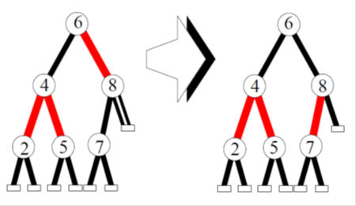
Sibling is black with black children hence Recoloring is necessary.
Delete 8
no double black

Slide 190
Delete 7
Restructuring

Slide 191
Exercise
Create a Red-Black tree by inserting following sequence of numbers with necessary steps 8, 18, 5, 15, 17, 25, 40, 80.

