Slide 1
UNIT-V GRAPHS AND HASHING

Slide 2
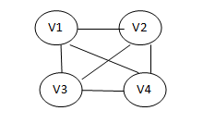
GRAPH DEFINITION
A graph G= (V, E) consists of a set of vertices V and set of edges E.
Vertices are often also called nodes.
Elements of E are called edges, or directed edges, or arcs.
Each edge is a pair (v,w) where v,w €V
Here v1,v2,v3,v4 are the vertices and (v1,v2), (v2,v3), (v3,v4), (v4,v1), (v2,v4),(v1,v3) are edges.

Slide 3
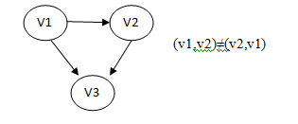
Basic Terminologies
Directed Graph
A directed graph, or digraph, is a graph which consists of directed edges where each edge in E is unidirectional.
If(v,w) is a directed edge then (v,w) ≠ (w,v)
For directed edge (v, w) in E, v is its tail and w its head;
(v, w) is represented in the diagrams as the arrow, v -> w.

Slide 4
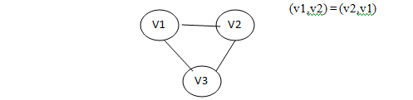
Undirected Graph
A undirected graph is a graph which consists of undirected edges. If (v,w) is an undirected edge then (v,w) = (w,v)

Slide 5
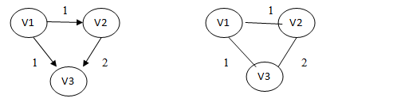
Weighted Graph
A graph is said to be weighted graph if every edge in a graph is assigned a weight or value. It can be a directed or undirected graph

Slide 6
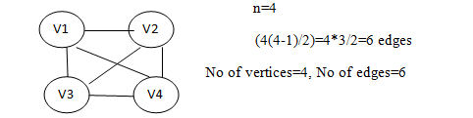
Complete Graph
A complete graph is a graph in which there is a edge between every pair of vertices. A complete graph with n vertices will have
n(n-1)/2 edges.

Slide 7
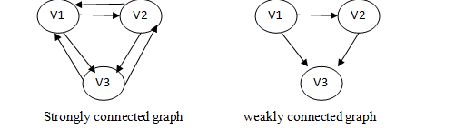
Strongly connected Graph
If there is a path from every vertex to other vertex in a directed graph then it is said to be strongly connected graph otherwise it is said to be weakly connected graph.

Slide 8
Path
A path in a graph is a sequence of vertices w1,w2,w3…..wn such that wi,wi+1 for 1≤i≤N. Refering the weakly connected graph the path from v1 to v3 is v1,v2,v3
Length
The length of the path is the number of edges on the path, which is equal to N-1 where N represents the number of vertices. The length of the above path v1 to v3 is 2. (i.e) (v1,v2), (v2,v3).
If there is a path from a vertex to itself with no edges then the path length is 0.
Loop
If the graph contains an edge (v,v) from a vertex to itself then the path is referred to as a loop.

Slide 9
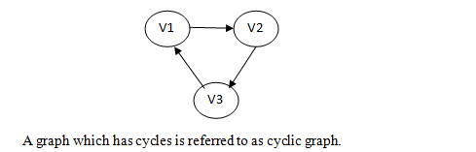
Simple path
A simple path is a path that all vertices on the path, except possibly the first and the last are distinct.
A simple cycle is the simple path of length atleast one that begins and ends at the same vertex.
Cycle
A cycle in a graph is a path in which first and last vertex are the same

Slide 10
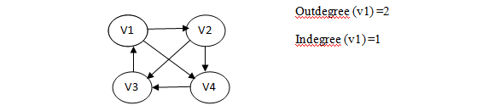
Degree
The number of edges incident on a vertex determines its degree. The degree of the vertex is written as degree (v). The in degree of the vertex V is the number of edges entering into vertex V. Similarly the out degree of the vertex V is the number of edges existing fro that vertex V.

Slide 11

Acyclic Graph
A directed graph which has no cycles is referred to as acyclic graph. It is abbreviated as DAG (Directed Acyclic Graph)

Slide 12
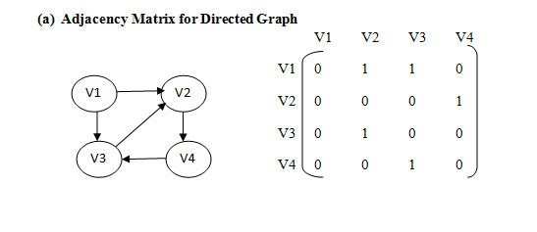
Representation of Graph
Graph can be represented by Adjacency Matrix and Adjacency List.
Adjacency Matrix Representation
The adjacency matrix A for a graph G=(V,E) with n vertices in an n x n matrix , such that
Aij = 1, if there is an edge Vi to Vj
Aij = 0, if there is no edge

Slide 13
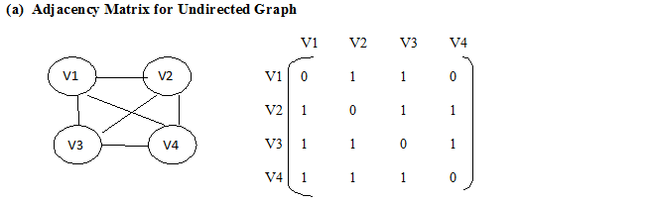

Slide 14
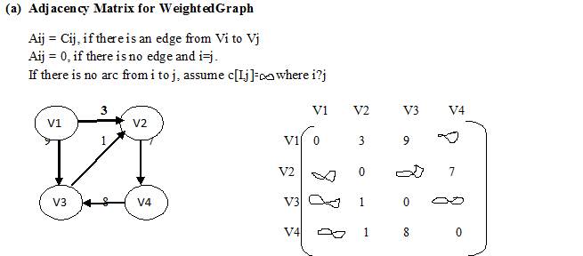

Slide 15
Pros:
Simple to implement
Easy and fast to tell if a pair (i,j) is an edge: simply check if A[i][j] is 1 or 0
Cons:
No matter how few edges the graph has, the matrix takes O(n2) in memory

Slide 16
Adjacency List Representation
In this representation we store a graph as a linked structure. We store all the vertices in a list for each vertex; we have a linked list of its adjacency vertices.
0
1
1
2
0
2

Slide 17
0
3
1
2
2
3
0
1
2
1
3
0
3
0
1
2

Slide 18
Pros:
Saves on space (memory): the representation takes as many memory words as there are nodes and edge.
Cons:
It can take up to O(n) time to determine if a pair of nodes (i,j) is an edge: one would have to search the linked list L[i], which takes time proportional to the length of L[i].

Slide 19
Topological sort

Slide 20
Introduction
Linear ordering of vertices in a directed acyclic graph such that if there is a path from V_{i} to V_{j} in the linear ordering.
Not possible if there is a cycle.

Slide 21
Steps
Find the indegree of every vertex
Place the vertices whose indegree is ‘0’ on the empty queue.
Dequeue the vertex v and decrement the indegree’s of all its adjacent vertices.
Enqueue the vertex in the queue if its indegree falls to zero.
Repeat from step3 until the queue becomes empty.
Topological ordering is the order in which the vertices dequeued.

Slide 22
Routine to perform topological sort
void topsort(Graph G)
{
Queue Q;
int counter=0;
Vertex v,w;
Q=CreateQueue(Num=Vertex);
Makeempty(Q);
For each vertex V
if (indegree[v]==0)
Enqueue (v,Q);
While (!IsEmpty (Q))
{
V=Dequeue(Q);
TopNum[v]=++counter;
For each w adjacent to v
If(--Indegree[w]==0))
Enqueue(w,Q);
}
If(counter!=NumVertex)
Error(“graph has a cycle”);
DisposeQueue(Q);
}

Slide 23
Example
 | 1 | 2 | 3 | 4
a | 0 | 0 | 0 | 0
b | 1 | 0 | 0 | 0
c | 2 | 1 | 0 | 0
d | 2 | 2 | 1 | 0
Enqueu | a | b | c | d
Dequeu | a | b | c | d
a
c
b
d

Slide 24
GRAPH TRAVERSAL
A graph traversal is a systematic way of visiting the nodes in a specific order .
There are two types of graph traversal namely
Breadth First Search
Depth First Search

Slide 25
Breadth First Search(BFS)
BFS of a graph G starts from an unvisited vertex u.
BFS uses a queue data structure to keep track of the order of nodes whose adjacent nodes are to be visited.
Steps
Choose any node in the graph, designate it as source node and mark it as visited.
Using the adjacency matrix of the graph find all the unvisited adjacent nodes to the search node and enqueue them into the queue Q
Then the node is dequeued from the queue. Mark that node as visited and designate it as the new search node.
Repeat step 2 and 3 using the new search node.
This process continues until the queue Q which keeps track of the adjacent nodes is empty.

Slide 26
Routine
BFS(node)
{
queue node
visited[node] = true
while queue not empty
v queue
print v
for each child c of v
if not visited[c]
queue c
visited[c]=true
}

Slide 27
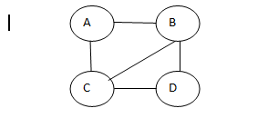

Example
Let A be the source vertex. Mark it as visited.
Find the adjacent unvisited vertices of A and enqueue it into the queue. Here B and C are adjacent nodes of A and B and C are enqueued

Slide 28


Then the vertex B is dequeued and its adjacency vertices C and D are taken from the adjacency matrix for enqueuing. Since vertex C is already in the queue, vertex D alone is enqueue
Here B is dequeued and D is enqueued
Then the vertex C is dequeued and its adjacent vertices A, B and D are found out. Since the vertices A and B are already visited and vertex D is also in the queue, no enqueue operation takes place.

Slide 29
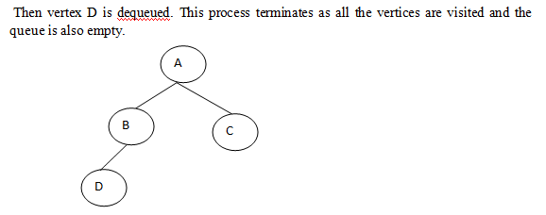

Slide 30
Application of BFS
GPS Navigation systems
Computer Networks
Face book

Slide 31
Depth First Search (DFS)
DFS works by selecting one vertex V of G as a start vertex; V is marked visited. Then each unvisited vertex adjacent to V is searched in turn using DFS recursively.
Steps
Choose any node in the graph. Designate it as the search node and mark it as
visited.
Using the adjacency matrix of the graph, find a node adjacent to the search node
that has not be visited yet. Designate this as the new search node and mark it as
visited.
Repeat step 2 using the new search node. If no nodes satisfying (2) can be found
return to the previous search node and continue from there.
When a return to the previous search node in (3) is impossible, the search from
the originally chosen search node is complete.
If the graph still contains unvisited nodes, choose any node that has not been visited and repeat step 1 through 4.

Slide 32
Routine
DFS(node)
{
stack node
visited[node] = true
while stack not empty
v stack
print v
for each child c of v
if not visited[c]
stack c
visited[c]=true
}

Slide 33
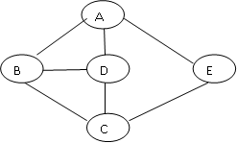
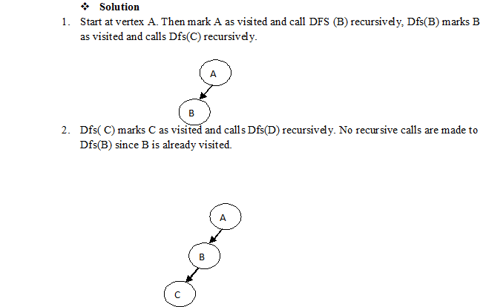
Example

Slide 34
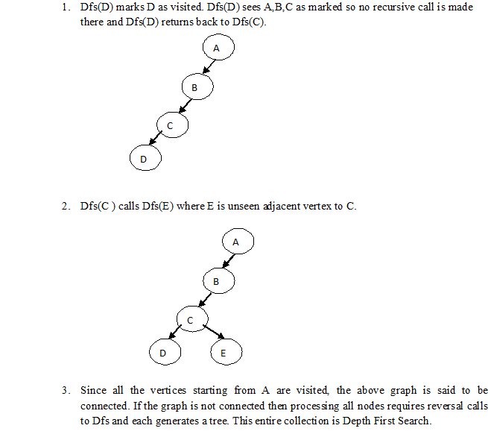

Slide 35
Applications of DFS
Detecting cycle in a graph
Path Finding
Solving puzzles with only one solution, such as mazes

Slide 36
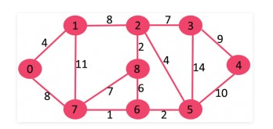
Exercise
Find BFS and DFS Traversal ordering of nodes for the following graph.

Slide 37
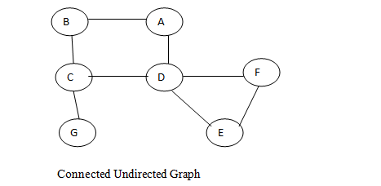
Biconnectivity
A connected undirected graph is biconnected if there are no vertices whose removal disconnects the rest of the graph.
Articulation Points
The vertices whose removal would disconnect the graph are known as articulation points

Slide 38
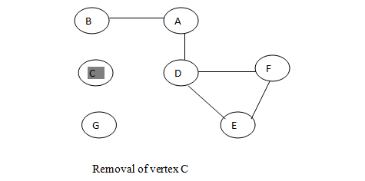
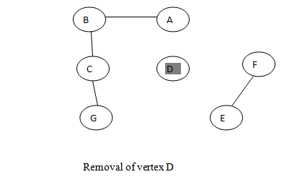
Hence the removal of C vertex will disconnect G from the graph. Similarly the removal of D vertex will disconnect E and F from the graph. Therefore C and D are articulation points.

Slide 39
MINIMUM SPANNING TREES
A spanning tree of a graph is just a subgraph that contains all the vertices and is a tree.
A graph may have many spanning trees
On a connected graph G=(V, E), a spanning tree:
is a connected subgraph
acyclic
is a tree (|E| = |V| - 1)
contains all vertices
A Minimum Spanning Tree (MST) is a subgraph of an undirected graph such that the subgraph spans (includes) all nodes, is connected, is acyclic, and has minimum total edge weight
For an edge-weighted , connected, undirected graph, G, the total cost of G is the sum of the weights on all its edges.
A minimum-cost spanning tree for G is a minimum spanning tree of G that has the least total cost.

Slide 40
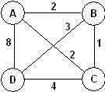
Has 16 spanning trees. Some are:

Slide 41
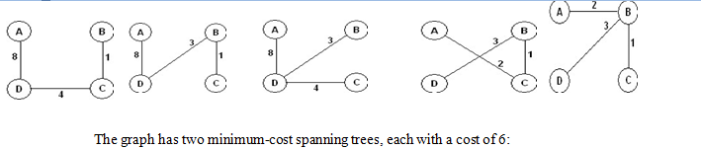
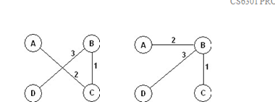

Slide 42
There are two algorithms to find the minimum spanning tree
Prim’s Algorithm
Kruskal’s Algorithm

Slide 43
Minimum Spanning Trees-Prim’s Algorithm
This is one of the ways to compute a minimum spanning tree which uses a greedy technique.
This algorithm begins with a set U initialized to {1}
It then grows a spanning tree one edge at a time.
At each step it finds a shortest edge(u,v) such that the cost of (u,v) is the smallest among all edges, where u is in minimum spanning tree.

Slide 44
Routine
Void Prims ( Table T)
{
Vertex v,w;
for (i=0; i< NumVertex; i++)
{
T[i].known = false;
T[i].Dist = INFINITY;
T[i].Path=0;
for(; ;)
{
// Let v be the start vertex with the smallest distance
T[v].Dist=0;
T[v].known=true;
for each w adjacent to v
if ( ! T[w].known)
{
T[w].Dist = Min( T[w].Dist, C_{v,w});
T[w].path=v;
}
}
}

Slide 45
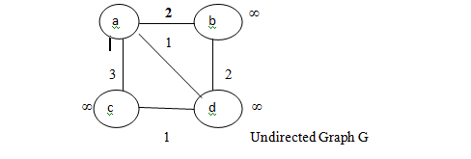
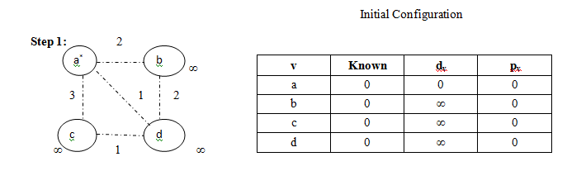
Example

Slide 46
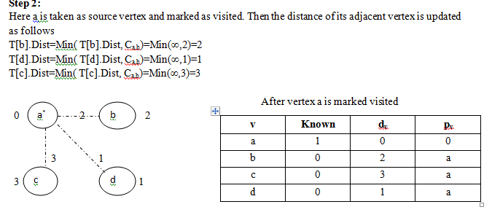

Slide 47
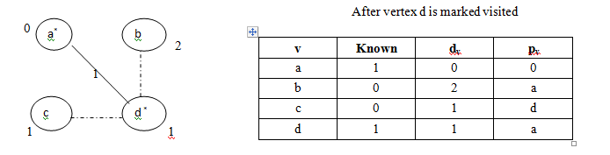
Step 3:
Next vertex d with minimum distance is marked as visited and the distance of its unknown adjacent vertex is updated.
T[b].Dist=Min( T[b].Dist, C_{d,b})=Min(2,2)=2
T[c].Dist=Min( T[c].Dist, C_{d,c})=Min(3,1)=1

Slide 48
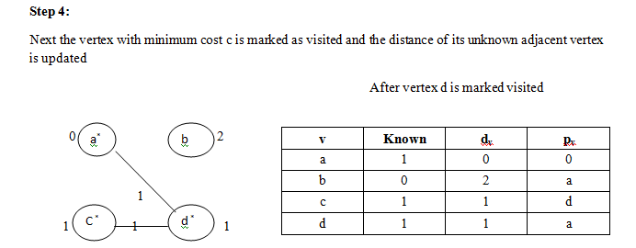

Slide 49
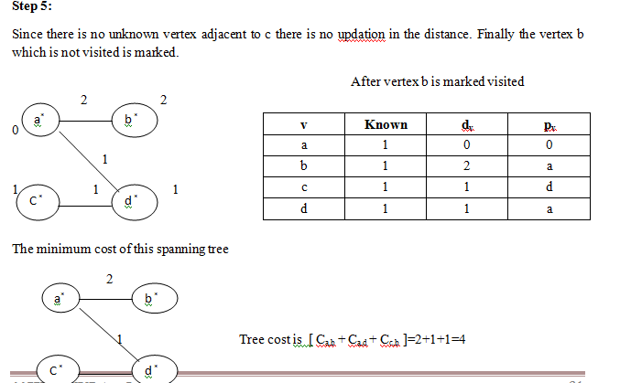

Slide 50
Minimum Spanning Tree-Kruskal’s Algorithm
This uses a greedy technique to compute a minimum spanning tree.
This algorithm selects the edges in the order of smallest weight and accept an edge if it does not cause a cycle.
The algorithm terminates if enough edges are accepted
Initially there are |v| single node trees.
Adding an edge merges two trees into one
When the algorithm terminates, there is only one tree, which is called as minimum spanning tree.
The algorithm uses two DS namely find and union
Find(u) returns the root of the tree that contains the vertex u
Union(u,v) merge the two trees by making the root pointer of one point the root of the other tree.

Slide 51
Routine
MST-KRUSKAL(G, w)
A ← Ø
for each vertex v V[G]
do MAKE-SET(v)
sort the edges of E into nondecreasing order by weight w
for each edge (u, v) E, taken in nondecreasing order by weight
do if FIND-SET(u) ≠ FIND-SET(v)
then A ← A {(u, v)}
UNION(u, v)
return A

Slide 52
// Routine for Find
SetType Find(Vertex U,DisjointSet S)
{
If(S[u]<=0)
return u;
else
return Find(S[u],S);
}
// Routine for Union
Void SetUnion (DisjointSet S, SetType Uset,SetType Vset)
{
S[Vset]=Uset;
}

Slide 53
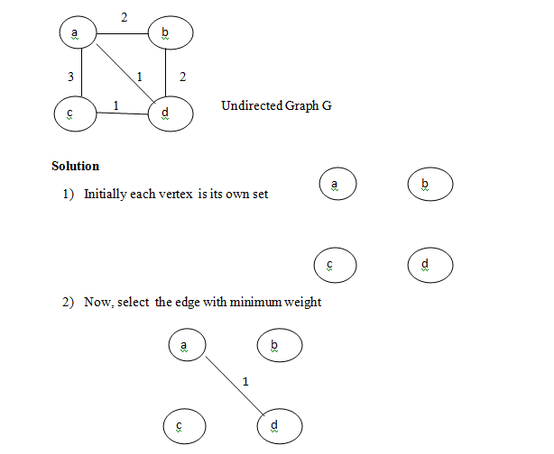
Example

Slide 54
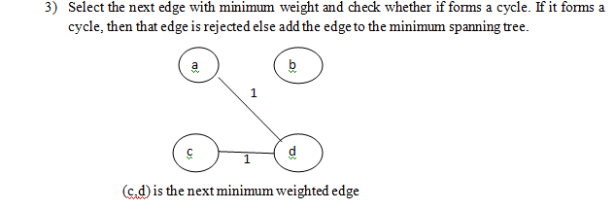
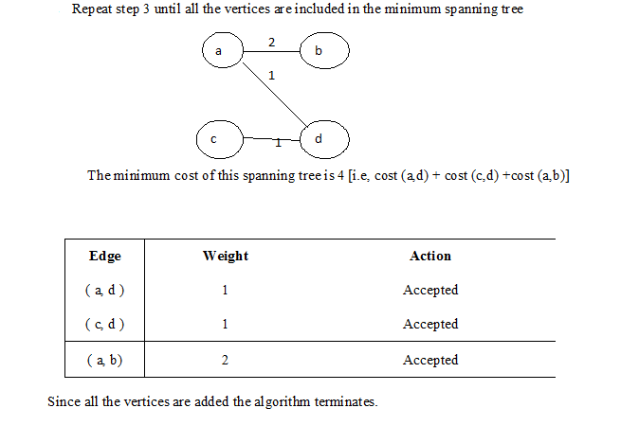

Slide 55
Exercise
Find minimum spanning tree for the following graph using Prim’s and Kruskal’s Algorithms

Slide 56
Shortest Path Algorithm Dijkstra’s Algorithm(Single Source Shortest Path)
The general method to solve the single source shortest path problem is known as Dijkstra’s algorithm. This is applied to the weighted graph G.
This is the prime example of Greedy technique which generally solve the problem in stages to be the best thing at each stage.
This algorithm proceeds in stages, just like the unweighted shortest path algorithm
At each stage it selects a vertex v which has the smallest d_{v} among all the unknown vertices and declares that as the shortest path from s to v and mark it to be known.
We should set d_{w}=d_{v} + C_{v,w}

Slide 57
Routine
void dijkstra( Graph G, Table T)
{
int i;
Vertex v,w;
ReadGraph (G,T);
for (i=0; i< NumVertex; i++)
{
T[i].known = false;
T[i].Dist = INFINITY;
T[i].Path=0;
}
T[Start].dist=0;
for(; ;)
{
v= smallest unknown distance vertex;
if ( v= = NOT_A_VERTEX)
break;
T[v].known=true;
for each W adjacent to v
if( ! T[w].known)
{
T[w].Dist = Min( T[w].Dist, T[v].Dist+C_{v,w});
T[w].path=v;
}}}

Slide 58
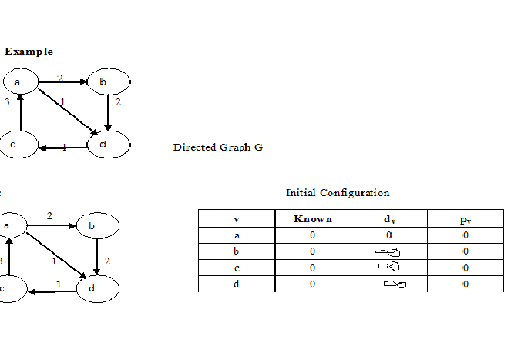
Example

Slide 59
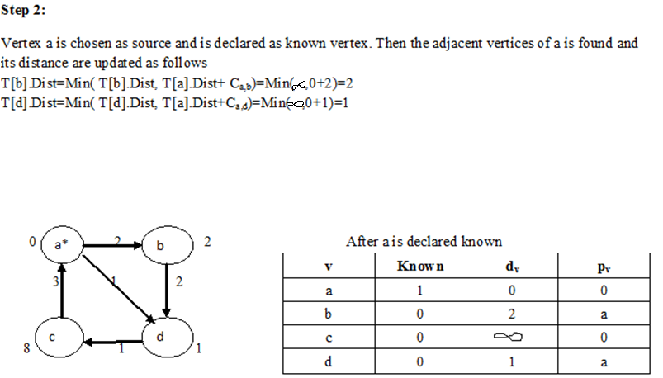

Slide 60
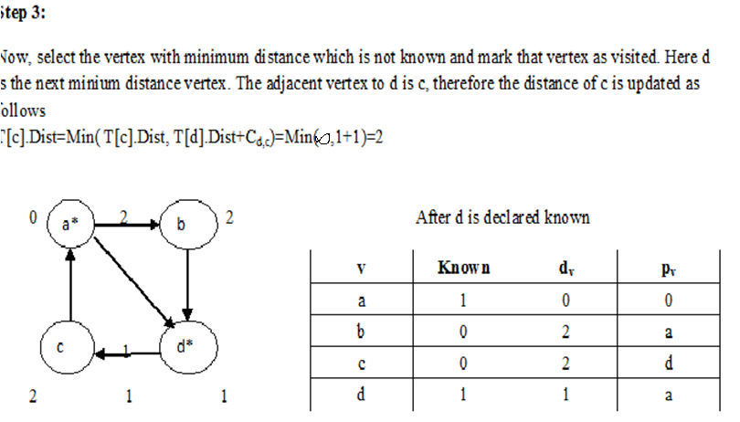

Slide 61
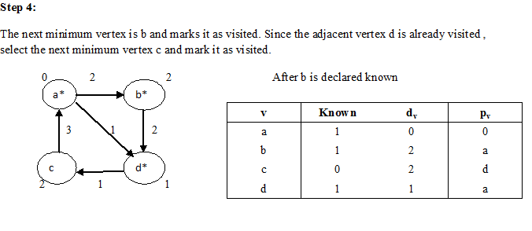

Slide 62
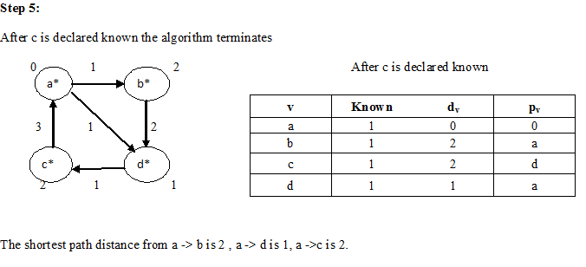

Slide 63
Hashing
A Procedure / Technique to insert and retrieve elements in a table (hash table)in almost constant time.
Hash Table is a data structure which store data in associative manner. In hash table, data is stored in array format where each data values has its own unique index value. Access of data becomes very fast if we know the index of desired data.
Thus, it becomes a data structure in which insertion and search operations are very fast irrespective of size of data. Hash Table uses array as a storage medium and uses hash technique to generate index where an element is to be inserted or to be located from
Implementation of hash tables
Key, Hash Function and Hash Table

Slide 64
Hashing
Hash
Table
0
1
Hash
Function
2
3
key
4
5
6
7
8
9

Slide 65
Hash Function
A hash function h transforms a key into an index in a hash table T[0…m-1]:
h : U → {0, 1, . . . , m - 1}
A hash function transforms a key into a table address

Slide 66
Collision
Different keys may map into same location
Hash function is not one-to-one => collision.
Hash function mapping two keys to the same
position in the hash table - Collision occurs.

Slide 67
Collision Avoidance Techniques
Separate Chaining(Open hashing)
Open Addressing(Closed hashing)
1. Linear Probing
2. Quadratic Probing
3. Double Hashing
Rehashing
Extendible hashing

Slide 68
Separate Chaining(Open Hashing)
Each table entry stores a list of items
A pointer field is added to each record, when overflow occurs this pointer is set to print overflow blocks making a linked list
Adv:
More no of elements can be inserted
Disadv:
Requires pointers which occupies more memory space
Takes more effort to perform a search

Slide 69
Example
Table Size: 10
Hash Function: H(k) = k mod Table Size
Insert the keys 83, 14, 29, 10, 74, 36, 96,67

Slide 70
14, 67,83,36,10,29, 74,96
H(k) = 14 % 10
= 4
0
10
H(k) = 67 % 10
= 7
1
H(k) = 83 % 10
= 3
2
83
H(k) = 36 % 10
= 3
3
14
74
H(k) = 10 % 10
= 0
4
5
H(k) = 29 % 10
= 9
36
96
6
H(k) = 74 % 10
= 4
67
7
H(k) = 96 % 10
= 4
8
29
9

Slide 71
Open Addressing(Closed hashing)
Alternate to resolve collision with linked lists.
Three techniques are
Linear Probing
Quadratic Probing
Double Hashing

Slide 72
Linear Probing
Hash Function: H(k)=(H(k)+i )mod Table Size
Probe 0:h(k) mod Tablesize
Probe 1:(h(k)+1) mod Tablesize
Probe 2:(h(k)+2) mod Tablesize
Probe 3:(h(k)+3) mod Tablesize
Probe i :(h(k)+i) mod Tablesize
Adv:
Time is not required for allocating new cells
Does not require pointers
Disadv:
Forms clusters which degrades the performance of the hash table for storing and retrieving data.

Slide 73
14,83,36,10, 29,74,96,66
H(k) = 14 % 10
= 4
Probe 0:
H(k) = 96 % 10
= 6 (already occupied)
Probe 1:
H(k)=(H(k)+1) % 10
= (6+1) % 10
= 7
0
10
1
H(k) = 83 % 10
= 3
2
H(k) = 36 % 10
= 6
3
83
H(k) = 10 % 10
= 0
Probe 0:
H(k) = 66 % 10
= 6 (already occupied)
Probe 1:
H(k)=(H(k)+1) % 10
= (6+1) % 10
= 7 (already occupied)
Probe 2:
H(k)=(H(k)+2) % 10
= (6+2) % 10
= 8
4
14
H(k) = 29 % 10
= 9
5
74
Probe 0:
H(k) = 74 % 10
= 4 (already occupied)
Probe 1:
H(k)=(H(k)+1) % 10
= (4+1) % 10
= 5
6
36
96
7
8
66
9
29

Slide 74
Quadratic Probing
Hash Function: H(k)=(H(k)+i² )mod Table Size
Probe Sequence:
Probe 0:h(k) mod Tablesize
Probe 1:(h(k)+1) mod Tablesize
Probe 2:(h(k)+4) mod Tablesize
Probe 3:(h(k)+9) mod Tablesize
Probe i:(h(k)+ i²) mod Tablesize

Slide 75
14,83,36,10, 29,96,66
Probe 0:
H(k) = 66 % 10
= 6 (already occupied)
Probe 1:
H(k)=(H(k)+1) % 10
= (6+1) % 10
= 7 (already occupied)
Probe 2:
H(k)=(H(k)+4) % 10
= (6+4) % 10
= 0 (already occupied)
Probe 3:
H(k)=(H(k)+9) % 10
= (6+9) % 10
= 5
H(k) = 14 % 10
= 4
0
10
1
H(k) = 83 % 10
= 3
2
H(k) = 36 % 10
= 6
3
83
H(k) = 10 % 10
= 0
4
14
H(k) = 29 % 10
= 9
5
66
36
Probe 0:
H(k) = 96 % 10
= 6 (already occupied)
Probe 1:
H(k)=(H(k)+1) % 10
= (6+1) % 10
= 7
6
96
7
8
9
29

Slide 76
Double Hashing
Hash Function: H(k)=(H(k)+i*g(k) )mod Table Size
g(k)=i*hash2(x) where g or hash2 is a second hash function
hash2(x)=R-(x mod R)
R-prime, smaller than tablesize
Probe Sequence:
Probe 0:h(k) mod Tablesize
Probe 1:(h(k)+1*g(k)) mod Tablesize
Probe 2:(h(k)+2*g(k)) mod Tablesize
Probe 3:(h(k)+3*g(k)) mod Tablesize
Probe i:(h(k)+i*g(k)) mod Tablesize

Slide 77
76,93,40,47,10,55
H(k) = 10 % 7
= 3
H(k) = 76 % 7
= 6
0
1
47
H(k) = 93 % 7
= 2
Probe 0:
H(k) = 55 % 7
= 6 (already occupied)
Probe 1:
H(k)=(h(k)+1*g(k)) % 7
=(6+5) mod 7
= 4
2
93
H(k) = 40 % 7
= 5
10
g(k)=R-(x-mod R)
=5-(55 mod 5)
=5-0
=5
3
4
55
5
40
Probe 0:
H(k) = 47 % 7
= 5 (already occupied)
Probe 1:
H(k)=(h(k)+1*g(k)) % 7
=(5+3) mod 7
= 1
6
76
g(k)=R-(x-mod R)
=5-(47 mod 5)
=5-2
=3

Slide 78
Re Hashing
Rehash as soon as the table is half full
Rehash only when an insertion fails
Rehashing- Builds new table that is about twice as big and scan down the entire original hash table.
Uses linear probing function
Adv:
Programmer does not worry about the tablesize
Simple to implement

Slide 79
6,15,23,24,13
H(k) = 6 % 7
= 6
0
1
15
H(k) = 15 % 7
= 1
2
23
H(k) = 23 % 7
= 2
3
24
H(k) = 24 % 7
= 3
4
5
6
6
When 13 is to be inserted the table will be too full hence rehash the tablesize.(i.e)
New tablesize=2*old tablesize
2*7=14,choose the next prime (i.e)
17

