Slide 1

18CSC301T Formal Language and Automata
UNIT-1
1

Slide 2
UNIT 1
Introduction to Automaton
Mathematical concepts
Formal Languages: Strings, Languages, Properties
Finite Representation : Regular Expressions
Problems related to regular expressions
Finite Automata :Deterministic Finite Automata
Nondeterministic Finite Automata
Finite Automaton with €- moves
Problems related to Deterministic and Nondeterministic Finite Automata
Problems related to Finite Automaton with €- moves
Minimization of DFA
Problems related to Minimization of DFA
Regular Languages : Equivalence of Finite Automata and Regular Languages
Equivalence of Finite Automata and Regular Grammars
Problems related to Equivalence of Finite Automata and Regular Languages and Regular Grammars
Variants of Finite Automata :Two-way Finite Automaton Mealy Machines
Properties of Regular Languages: Closure Properties
Set Theoretic Properties & Other Properties
Pumping Lemma

Slide 3
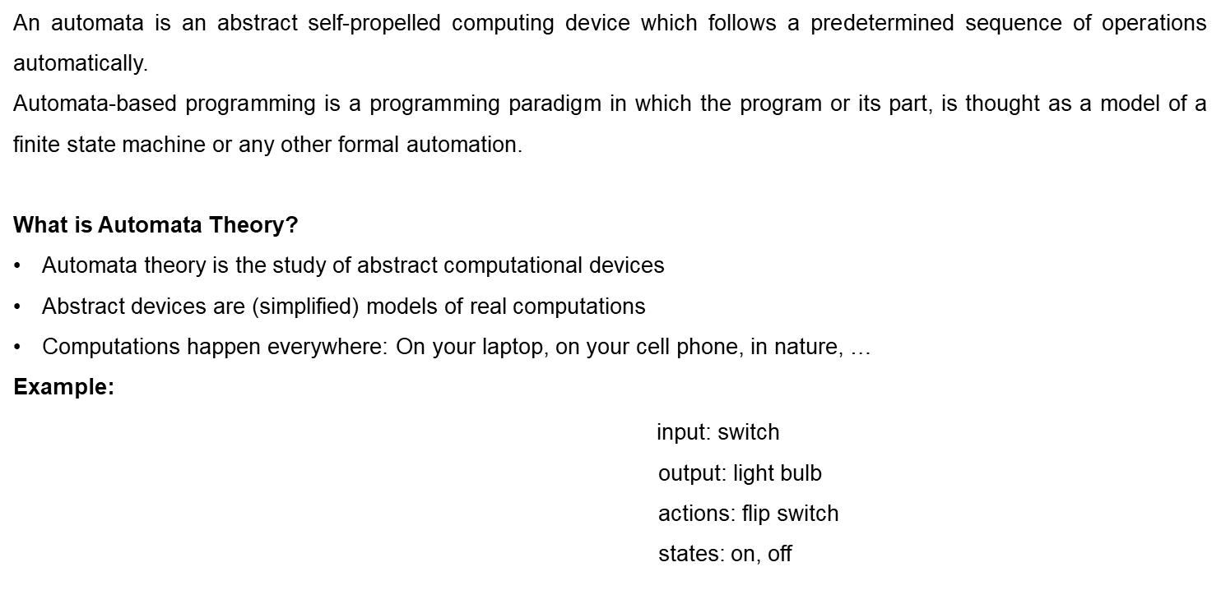
Introduction of Automaton
BATTERY

Slide 4
Electric Switch
Fan Regulator
Automatic door controller
Binary string with divisible by 4

Slide 5
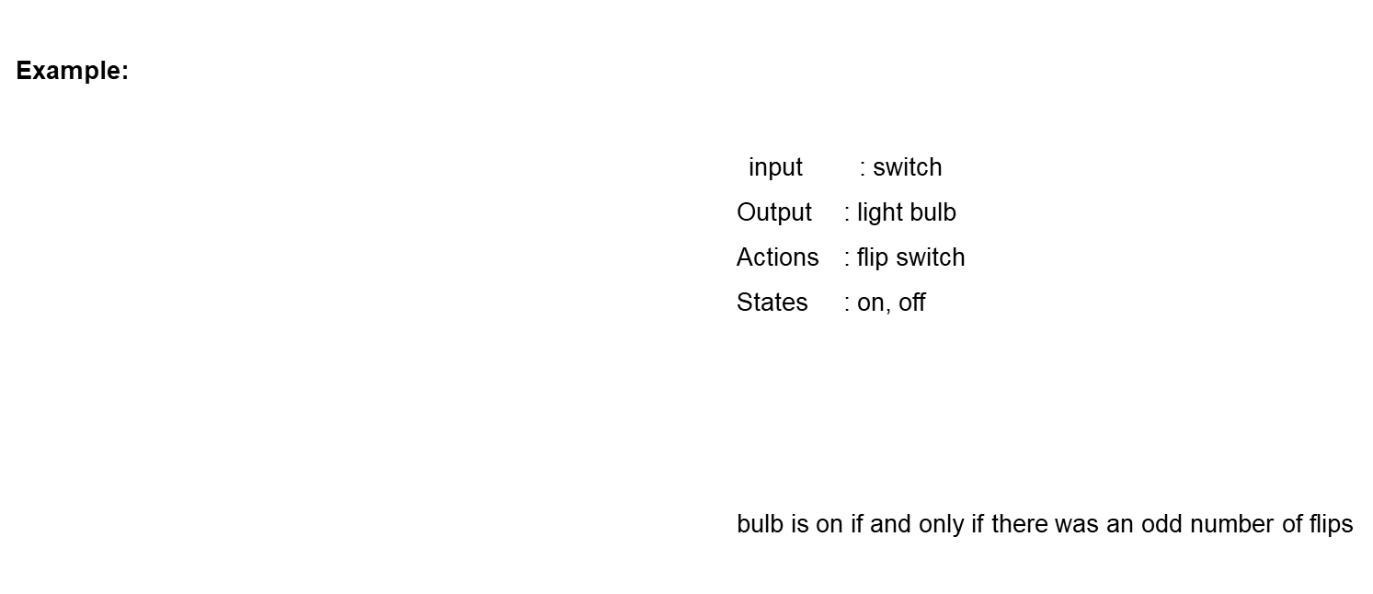
Simple Computer
OTHER EXAMPLES
Electric Switch
Fan Regulator
Automatic door controller
Binary string with divisible by 4
BATTERY
f
start
off
on
f

Slide 6
Types of Automata
finite automata | Devices with a finite amount of memory. Used to model “small” computers.
push-down automata | Devices with infinite memory that can be accessed in a restricted way. Used to model parsers, etc.
Turing Machines | Devices with infinite memory. Used to model any computer.

Slide 7
Introduction of Formal Proof - Basic Definitions
1. Alphabet - a finite set of symbols.
  Notation: Σ .
  Examples: Binary alphabet {0,1},
  English alphabet {a,...,z,!,?,...}
2. String over an alphabet Σ - a finite sequence of symbols from Σ.
  Notation: (a) Letters u, v, w, x, y, and z denote strings.
  (b) Convention: concatenate the symbols. No parentheses or commas used.
  Examples: 0000 is a string over the binary alphabet.
  a!? is a string over the English alphabet.

Slide 8
3. Empty string: e or ε denotes the empty sequence of symbols.
4. Language over alphabet Σ - a set of strings over Σ.
  Notation: L.
  Examples:
    {0, 00, 000, ...} is an "infinite" language over the binary alphabet.
    {a, b, c} is a "finite" language over the English alphabet.
5. Empty language - empty set of strings. Notation: Φ.
6. Binary operation on strings: Concatenation of two strings u.v - concatenate the symbols of u and v.
  Notation: uv
  Examples:
    00.11 = 0011.
    ε.u = u.ε = u for every u. (identity for concatenation)

Slide 9
Binary relations on strings
Prefix - u is a prefix of v if there is a w such that v = uw.
  Examples:
    ε is a prefix of 0 since 0 = ε0
    apple is a prefix of appleton since appleton = apple.ton
Suffix - u is a suffix of v if there is a w such that v = wu.
  Examples:
    0 is a suffix of 0 since 0 = ?
    ton is a suffix of appleton since ?

Slide 10
Substring - u is a substring of v if there are x and y such that v = xuy.
  Examples:
    let is a substring of appleton since appleton = app.let.on
    0 is a substring of 0 since 0 = epsilon.0.epsilon
Observe that prefix and suffix are special cases
of substring.

Slide 11
Applications of the Concepts AND New Developments
Applications include:
  Text processing (editors, etc.)
  Compiler design
  Verification through model checking
Development’s include :
DNA Computing
Quantum Turing Machines

Slide 12
Introduction to Mathematical concepts
Inductive Proof
Deductive Proof

Slide 13
INDUCTIVE PROOF
It is a special form of proof that deals about the objects in recursion.
Induction Principle:
If we prove S(i) and we prove that for all n>=I, S(n)=>S(n+1), then we may conclude that s(n) for all n>=1.
It has two parts.
1.Basis part.
2.Inductive part.

Slide 14
Basis step: We have to show S(i) for a particular integer value “i”, here “i “ may be zero or one.
Inductive step: We assume n>=i, where “i “ is the basis integer and we have to show that if S(n) then S(n+1) i.e., S(n) =>S(n+1).

Slide 15
Problems
Prove by an induction method on “n”
i=0 ∑ n i2 =((n(n+1)(2n+1))/6).
Solution:
i=0 ∑ n i2 =((n(n+1)(2n+1))/6). ----> Equ 1
Induction Principle:
If we prove S(i) and we prove that for all n>=I, S(n)=>S(n+1), then we may conclude that s(n) for all n>=1.

Slide 16
Basis:
Put n=0 in the equ 1
RHS= (0 (0+1) (2*0+1))/6 => 0
LHS = i=0 ∑ n (02) => 0
i.e., LHS = RHS.
Inductive step:
Put n =1 in the equ 1
S(n) = (n(n+1)(2n+1))/6.
= (2n3+2n2+n2+n)/6. ---> Equ 2

Slide 17
Put n=n+1 in the equ 1
S(n+1) => ((n+1)(n+2)(2n+3))/6.
=> ((n2+3n+2) (2n+3))/6.
=> (2n3+6n2+4n+3n2+9n+6)/6.->equ 3
From the induction principle:
= S(n+1) =S(n) + (n+1)2.
= ((2n3+3n2+n)/6) + (n+1)2

Slide 18
= ((2n³+3n²+n)/6) + (n²+2n+1)
Cross multiplying the ‘6’ on the numerator.
= ((2n³+3n²+n + 6n²+12n+6))/6.
= ((2n³+9n²+13n+6))/6. --→ equ 4
Equ 4 satisfies equ 3
Hence proved.

Slide 19


Regular Expressions

Slide 20

Regular Expressions
Regular expressions describe regular languages
Example:
describes the language

Slide 21


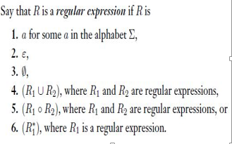

Recursive Definition
Given regular expressions and
Are regular
Expressions

Slide 22


Regular Expressions
A regular expression:
Not a regular expression:

Slide 23


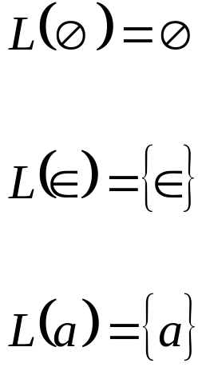
Regular Expressions
: language of regular expression
Example

Slide 24





Regular Expressions
For regular expressions and

Slide 25






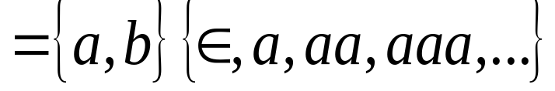
Regular Expressions
Regular expression:

Slide 26



Regular Expressions
Regular expression
Regular expression
= { all strings containing substring 00 }

Slide 27
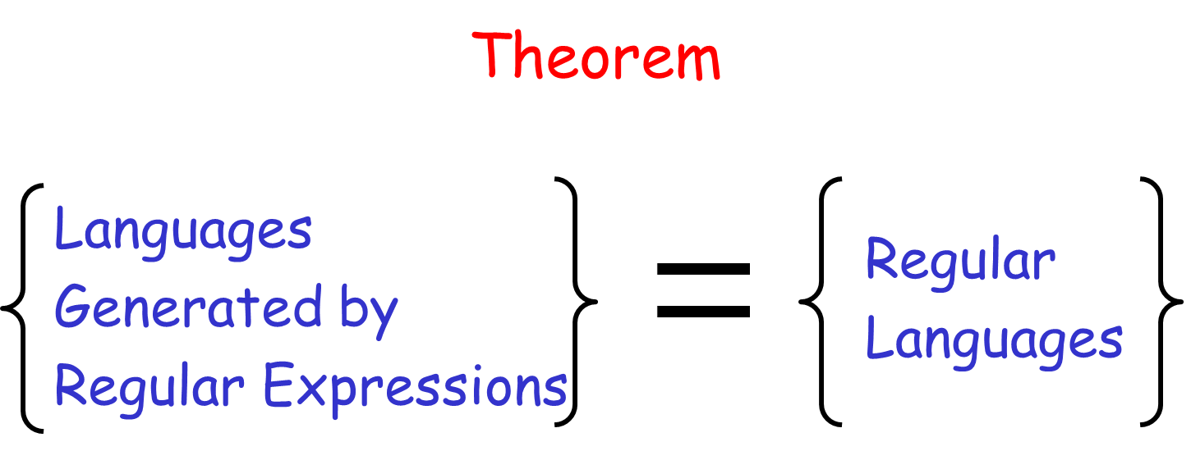

Slide 28
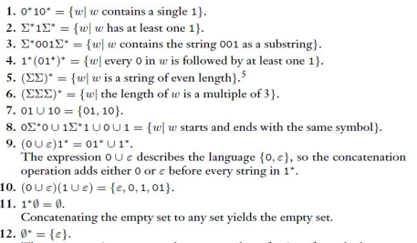
Example Problems in Regular Expressions

Slide 29
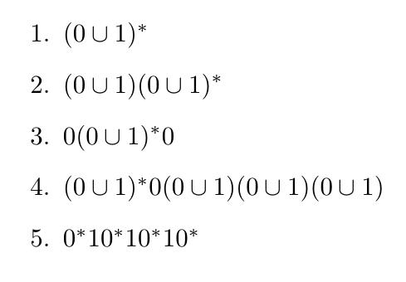
Solve Problems in Regular Expressions

Slide 30
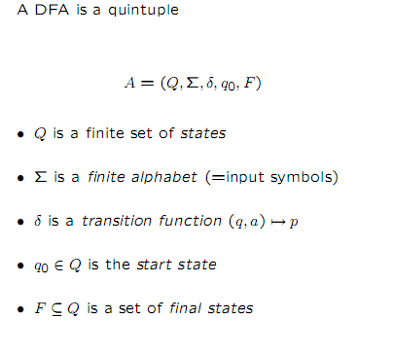
Deterministic Finite Automata (DFA)

Slide 31
Formal definition of DFA
DFA M = (Q, Σ, δ, s, F)
Where,
  Q is finite set of states
  Σ is input alphabet
  s ∈ Q is initial state
  F ⊆ Q is set of final states
  δ: Q X Σ -> Q

Slide 32
DFA
The DFA has:
  a finite set of states
  1 special state - initial state
  0 or more special states - final states
  input alphabet
  transition table containing
  (state, symbol) -> next state

Slide 33
How does a DFA work?
After reading input string,
  if DFA state final, input accepted
  if DFA state not final, input rejected
Language of DFA -- set of all strings accepted by DFA.

Slide 34
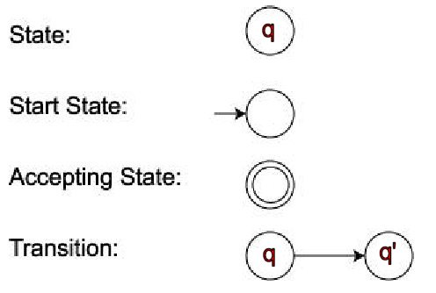
Pictorial representation of DFA
(q,σ) -> q'

Slide 35
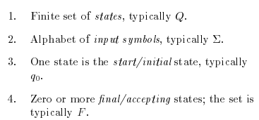
Formal definition of FA

Slide 36
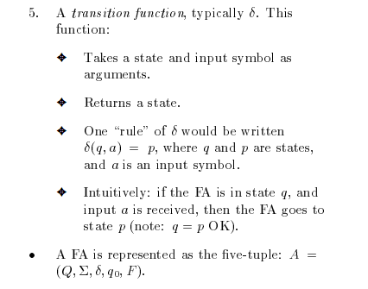

Slide 37
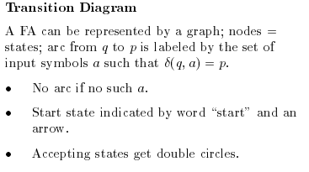
Transition Diagram

Slide 38
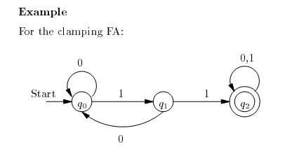
Example

Slide 39
Transition table
A transition table is a conventional tabular representation of functions like δ that takes the two argument and returns another state.
The row of the table corresponding to the states.
The column of the table corresponding to the inputs.

Slide 40
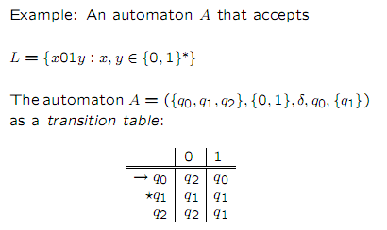
Example

Slide 41
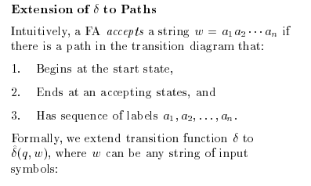
Extending the Transition functions to the strings

Slide 42
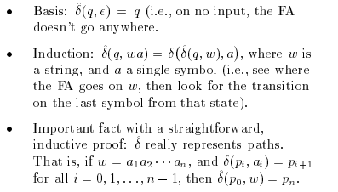

Slide 43
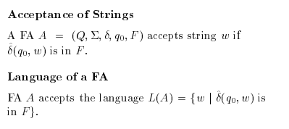
Language of DFA

Slide 44
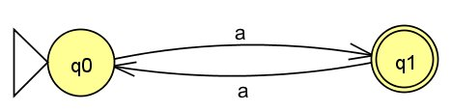
Example: Diagram of DFA
L = {a^{2n + 1} | n >= 0}
Answer:
L = {a, aaa, aaaaa, ...}

Slide 45
Formal definition of L(M)
L(M) - Language accepted by M
Define δ*:
  δ*(q, ε) = q
  δ*(q, wσ) = δ(δ*(q,w),σ)
Definition: L(M) = { w in Σ* | δ* (s,w) in F }.

Slide 46

Example: L(M) = {w in {a,b}* | w contains even no. of a's}
Problem 2

Slide 47
Regular Languages
Definition: A Language is regular iff there is a DFA that accepts it.
Examples:
  φ
  {ε}
  Σ*
  {w in {0,1}* | second symbol of w is a 1} Exercise
  {w in {0,1}* | second last symbol of w is a 1} Exercise
  {w in {0,1}* | w contains 010 as a substring} - (importance?)

Slide 48
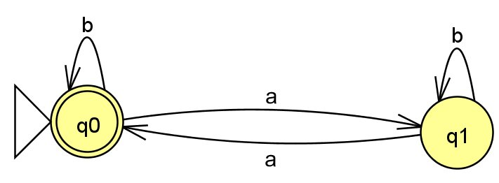
DFA of L₁ = {w in {a,b}* | w has even number of a's}.
Problem 3

Slide 49
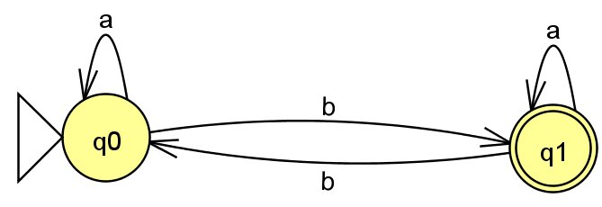
DFA of L₂ = { w in {a,b}* | w has odd number of b's}.
Problem 4

Slide 50
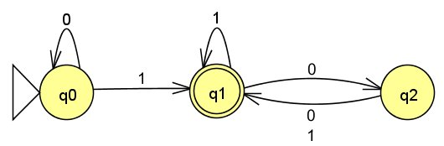
DFA of A = {w | w contains at least one 1 and an even number of 0s follow the last 1}
Problem 8

Slide 51
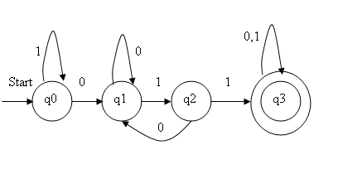
Problem 10
Given a DFA accepting the following language over the alphabet {0,1}
Set of all the strings with 3 consecutive 0’s (not necessarily at the end).

Slide 52
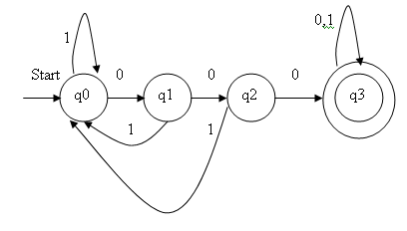
Problem 11:
Given a DFA accepting the following language over the alphabet {0,1}
Set of all the strings with a 011 as a substring.

Slide 53
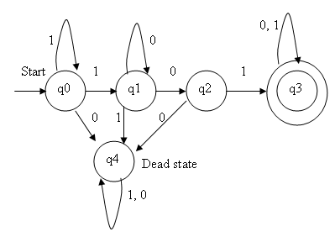
Given a DFA accepting the following language over the alphabet {0,1}
Set of all the strings beginning with a 101.
Problem 13

Slide 54
Given a DFA accepting the following language over the alphabet {0,1}
Set of all the strings with three consecutive zeros.
Problem 14

Slide 55
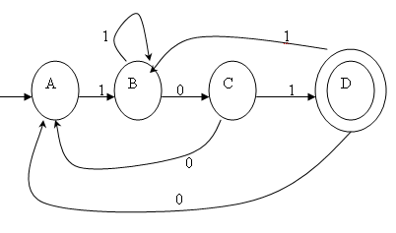
:
Consider the following transition diagram and to check the input string 110111,011101 is accepted or not.
Problem 14

Slide 56
Transition table:
Let A be a DFA which has A={Q,∑,δ,q0,F)
 | 0 | 1
→ A | A | B
B | C | B
C | A | D
* D | A | B

Slide 57
Input: 110111
δ( A,є) =A.
δ( A,1) =B.
δ( A,11) =δ( A,1),1) =δ( B,1) =B.
δ( A,110) =δ( A,11),0) =δ( B,0) = C.
δ( A,1101) =δ( A,110),1) =δ( C,1) = D.
δ( A,11010) =δ( A,1101),0) =δ( D,1) = B.
δ( A,110101) =δ( A,11010),0) =δ( B,1) = B.
It does not reach the final state.
The given string is not accepted by DFA.

Slide 58
Input: 011101
δ( A,є) =A.
δ( A,0) =A.
δ( A,01) =δ( A,0),1) =δ( A,1) =B.
δ( A,011) =δ( A,01),1) =δ( B,1) = B.
δ( A,0111) =δ( A,011),1) =δ( B,1) = B.
δ( A,01110) =δ( A,0111),0) =δ( B,0) = C.
δ( A,011101) =δ( A,011101),0) =δ( C,1) = D.
It reaches the final state.
The given string is accepted by DFA.

Slide 59
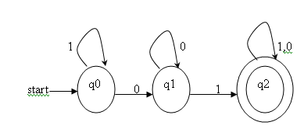
Give a DFA accepting the following language over the alphabet {0,1}.
All the strings with a substring 01 and to check the given input string 10010 is accepted or not by a DFA.
Problem 15
 | 0 | 1
q0 | q1 | q0
q1 | q1 | q2
*q2 | q2 | q2

Slide 60
Input 10010
δ( q0,є) =q0.
δ( q0,1) =q0.
δ( q0,10) =δ( q0,1),0) =δ( q0,0) =q1.
δ( q0,100) =δ( q0,10),0) =δ( q1,0) =q1.
δ( q0,1001) =δ( q0,100),1) =δ( q1,1) =q2.
δ( q0,10010) =δ( q0,1001),0) =δ( q2,0) =q2.
It reaches the final state
The given string is accepted by DFA.

Slide 61
Problem16 :
Design a DFA to accept the language
L ={w/w has an even number of 0’s and even number of 1’s}and to check the given input strings are 110101 and 10010 is accepted or not by an DFA.
It has the 4 states like q0,q1,q2,q3.
q0: Number of 1’s and number of 0’s are even.
q1: Number of 0’s is even and number of 1’s is odd.
q2: Number of 0’s is odd and number of 1’s is even.
q3: Number of 0’s and number of 1’s are odd.

Slide 62
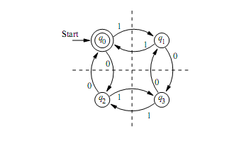
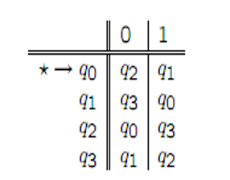
Let A be a DFA which has A={Q,∑,δ,q0,F)
Transition diagram:

Slide 63
Input: 110101
δ( q0,є) =q0.
δ( q0,1) =q1.
δ( q0,11) =δ( q0,1),1) =δ( q1,1) =q0.
δ( q0,110) =δ( q0,11),0) =δ( q0,0) =q2.
δ( q0,1101) =δ( q0,110),1) =δ( q2,1) =q3.
δ( q0,11010) =δ( q0,1101),0) =δ( q3,0) =q1.
δ( q0,110101) =δ( q0,11010),0) =δ( q1,1) =q0.
It reaches the final state. The given string is accepted by DFA.

Slide 64
Input: 10010
δ( q0,є) =q0.
δ( q0,1) =q1.
δ( q0,10) =δ( q0,1),0) =δ( q1,0) =q3.
δ( q0,100) =δ( q0,10),0) =δ( q3,0) =q1.
δ( q0,1001) =δ( q0,100),1) =δ( q1,1) =q0.
δ( q0,10010) =δ( q0,1001),0) =δ( q0,0) =q2.
The state q2 is not a accepting state.
The given string is not accepted by DFA.

Slide 65
Nondeterministic Finite Automaton (NFA)
Generalization of DFA. Allows:
  0 or more next states for the same (q, σ).
    Guessing
  Transitions labeled by the empty string.
    Changing state without reading input
Motivation: Flexibility.
  Easier to prove many closure properties.

Slide 66
How does an NFA work?
w is accepted by an NFA provided there is a sequence of guesses that leads to a final state.
Language accepted by NFA is the set of all strings accepted by it.

Slide 67
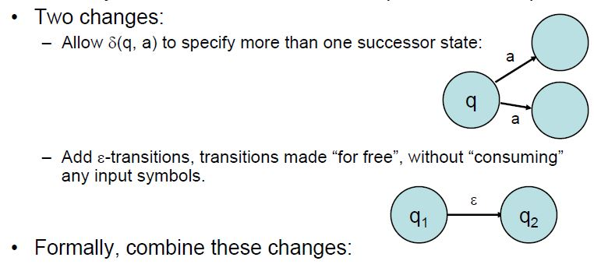
Nondeterministic Finite Automata:
Generalize FAs by adding nondeterminism,allowing several alternative computations on the same input string.
Ordinary deterministic FAs follow one path on each input.

Slide 68
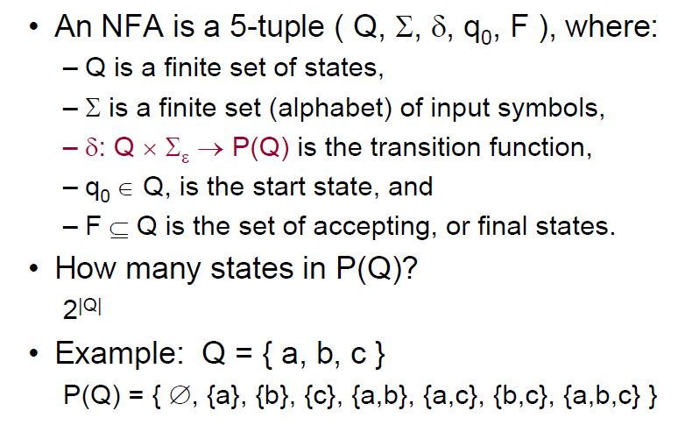
Nondeterministic Finite Automata:

Slide 69
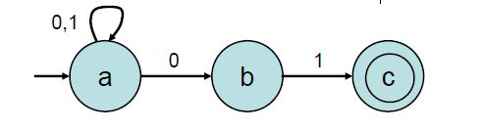
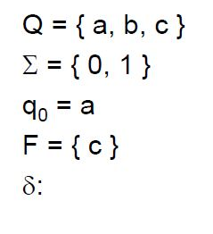
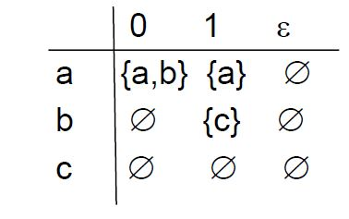
Nondeterministic Finite Automata:
NFA Example

Slide 70
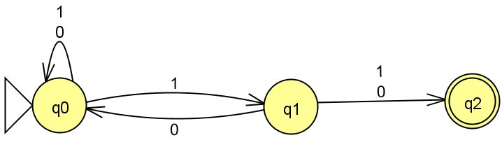
Example: {w in {0,1}* | the second last symbol of w is a 1}
Problem 1

Slide 71
Formal definition of NFA
Notation: Σ_{e} = Σ U {e}.
NFA M = (Q, Σ, Δ, s, F) where:
  Q - finite set of states
  Σ - input alphabet
  s - initial state
  F ⊆ Q - set of final states
  Δ is a subset of Q X Σ_{e} X Q.
If (p, u, q) in Δ, then NFA in state p can read u and go to q.

Slide 72
Formal definition of NFA acceptance
Define Δ*(q, w) as a set of states: p ε Δ*(q, w) if there is a directed path from q to p labeled w
  Example: consider NFA of Lecture 3
Δ*(q₀, 1) = ?
  Ans: {q₀, q₁}
Δ*(q₀, 11) = ?
  Ans: {q₀, q₁, q₂}

